Slide 1
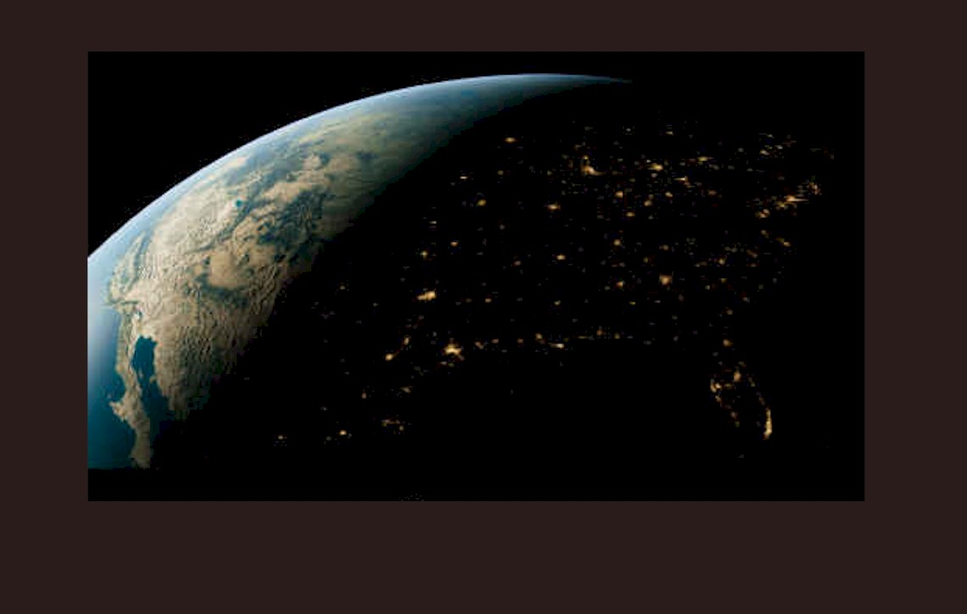
Synchrotron Computed Microtomography
Virtual Hands-On Tutorial
October 29 & 30, 2020
Mark Rivers
Yanbin Wang
Tim Officer
Man Xu
Charlie Smith
University of Chicago
Advanced Photon Source
Doug Schmitt (Purdue University)

Slide 2
Schedule
1:00 | Introduction to synchrotron computed microtomography
2:15 | Break
2:25 | Collect absorption and phase contrast tomography data on Doug Schmitt’s Chicxulub samples
3:25 | Break
3:30 | Overview of tomography data reconstruction
3:50 | Reconstruct the Chicxulub data
4:45 | Discussion
5:00 | End

Slide 3
Introduction to Synchrotron Computed Microtomography
Brief introduction to synchrotron sources for non-experts
Advantages of synchrotrons for imaging and tomography
Describe the beamline we use
Different types of computed tomography at our beamlines
Apparatus for computed tomography
Data collection techniques
End with actual data collection on real samples

Slide 4
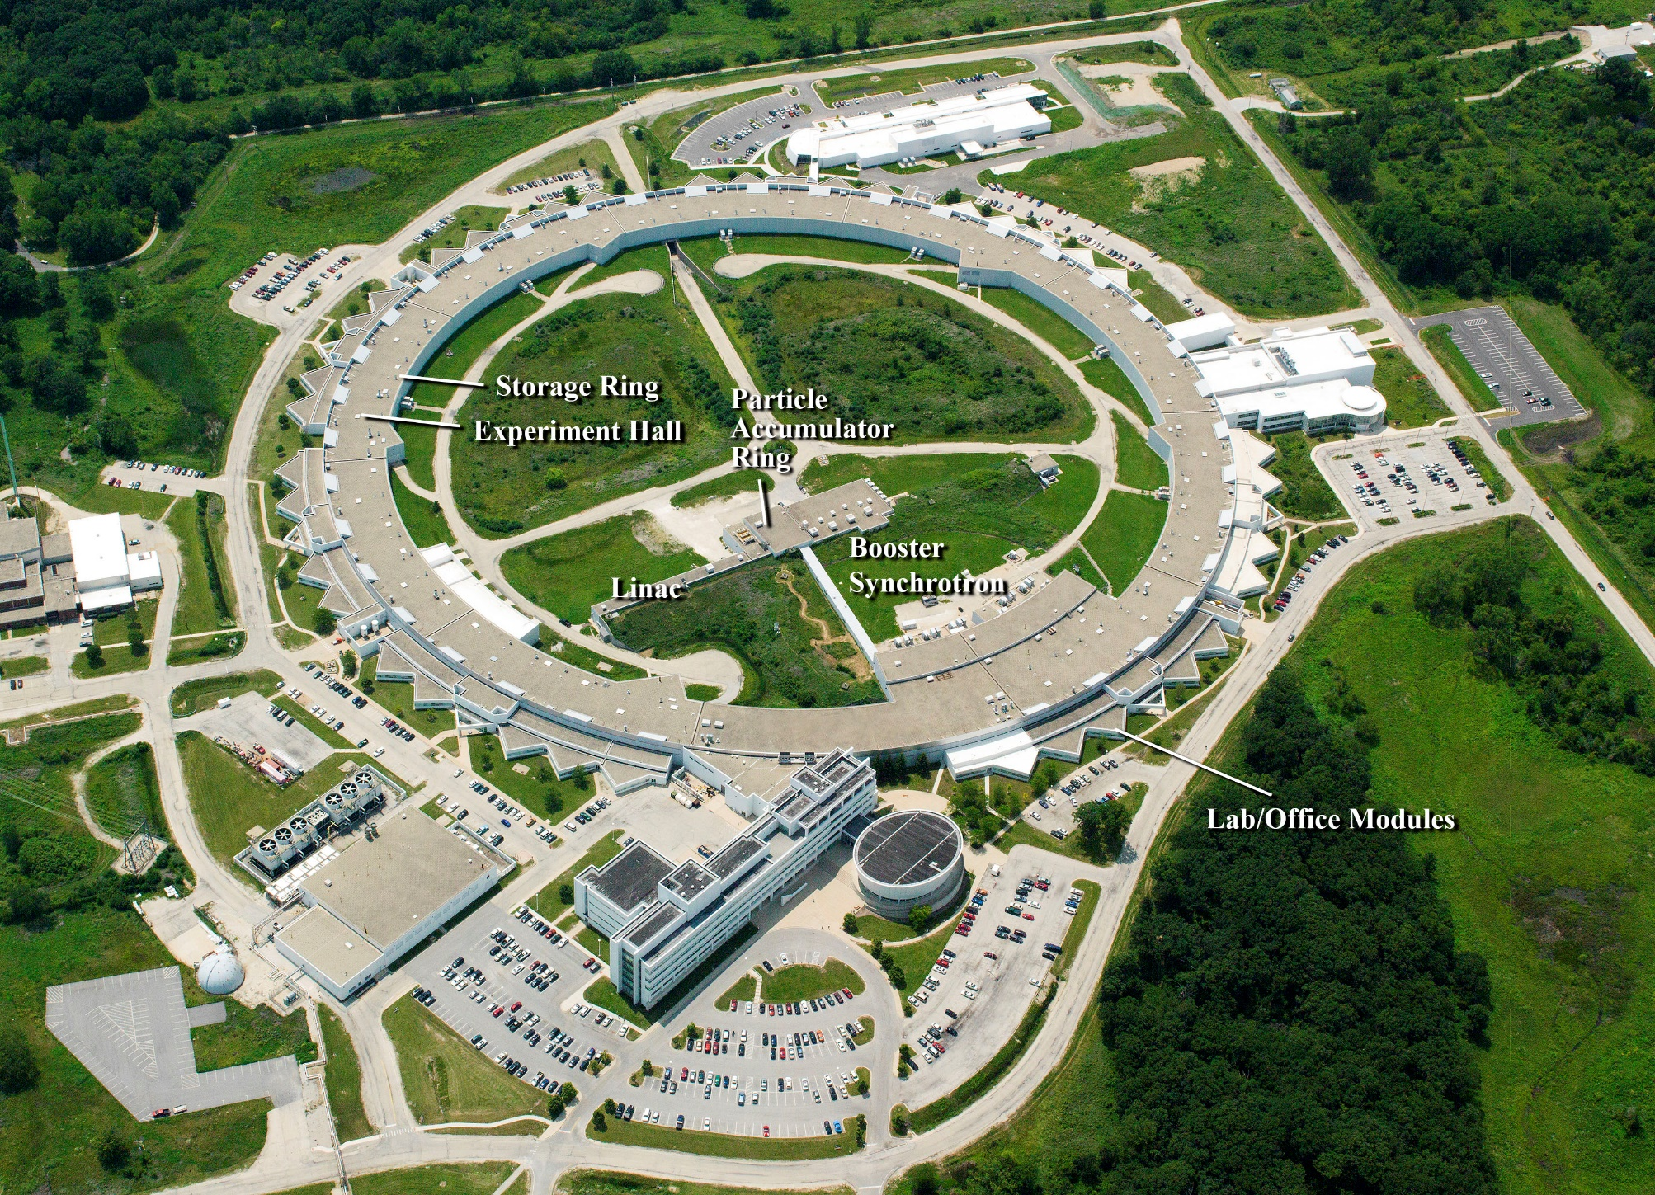
Advanced Photon Source: 7 GeV, high-brightness electron storage ring
GSECARS

Slide 5
Synchrotron Radiation Properties
Tunability (IR to hard x-rays)
Brightness (highly collimated, small source)
  High intensity, lots of photons in a small spot
  Can be focused well with x-ray optics
Polarization (linear, circular, tunable)
Time structure (short pulse)
Partial coherence (laser-like beam from insertion devices)

Slide 6
Relativistic electrons
γ = m/m₀, ratio of mass m of a relativistic electron to its rest mass m₀,
γ = 1957 E (GeV)
E = energy of the electron in GeV.
1/ γ ~= FWHM opening angle of the synchrotron radiation at the characteristic “critical energy”
E_{c} = 0.665 * E²(GeV) * B(T) Critical energy, half-power point
Facility | Energy | γ | 1/γ
Advanced Light Source (LBL) | 1.9 GeV | 3718 | 269 μrad
NSLS-II (BNL) | 3.0 GeV | 5871 | 170 μrad
Advanced Photon Source (ANL) | 7.0 GeV | 13699 | 73 μrad
APS bending magnet:
73 μrad at 60 meters ~4.4 mm vertical beam size
E_{c} bending magnet = ~20keV

Slide 7
Sources of Synchrotron Radiation
Bending magnets (dipole magnets)
Periodic magnetic field devices, called insertion devices
  Wiggler: high field and/or large period Electron beam angular deviation >> 1/γ
  Undulator: medium field with small period
    Electron beam angular deviation < ~1/γ

Slide 8
Undulator
How are X-rays Produced in a Synchrotron?
Bending Magnet
Relativistic
electrons
N
N
X-rays
S
S
S
Notes:
X-rays are a form of EM radiation.
QUESTION: Why does this bulb light?
Filament is conductor, outer shell electrons free to move. Random acceleration of these electrons by applied electric field causes collisions, collisions mean dramatic velocity changes, these accelerations produce light.
In general: accelerating electric charges. (eg. transmitting antennae make radio waves)
QUESTION: WHAT CONTROLS ON A CAR ALLOW YOU TO ACCELERATE?
(certainly, synchrotron speeds up charged particles in linac and booster, but these are not source of used radiation)
Synchrotron accelerates particles, (initially, speeds up) but also by forcing charges to follow a curved path (remember change in velocity is req’d for acceleration)
Undulator
Each oscillation produces a wavefront; If electron makes one complete wiggle in the time it takes wavefront to advance in same distance, then constructive addition of waves occurs
Advantage of undulator: Brilliance = More photons in small area (to sample)

Slide 9
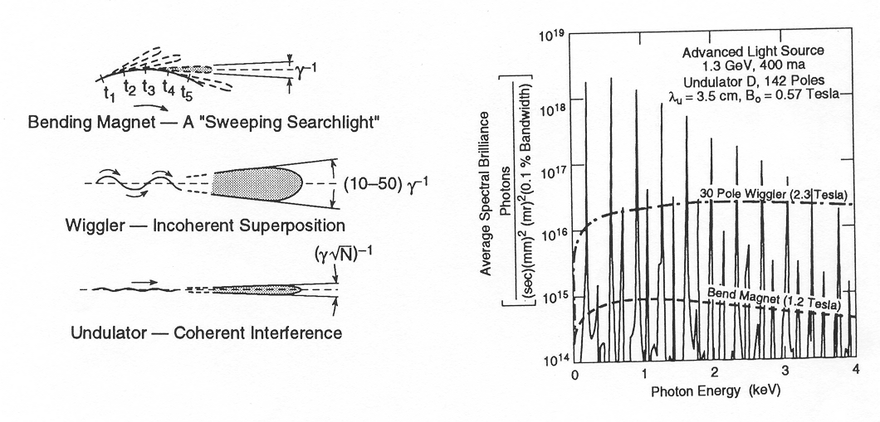
Spatial distribution
Spectral distribution

Slide 10
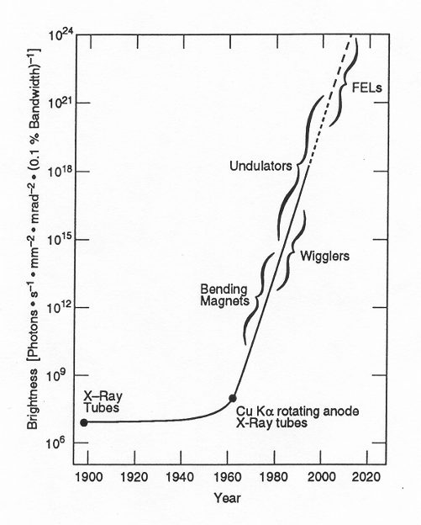
Discovery
of x-rays
We are here
H. Winnick, “Synchrotron Radiation Sources a Primer”, World Scientific,Singapore, 1994

Slide 11
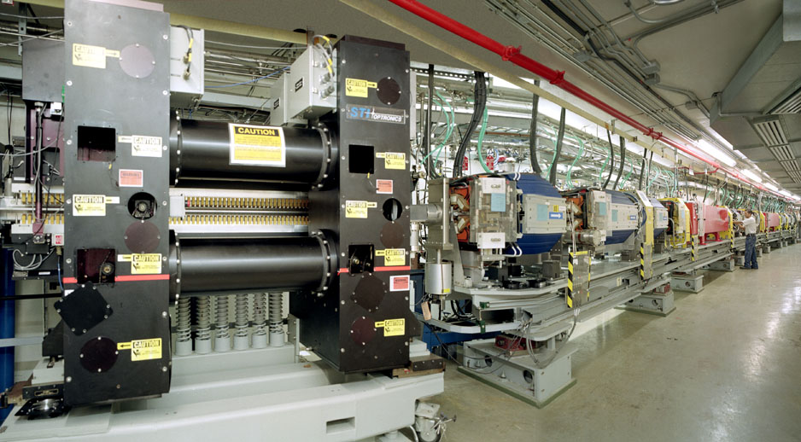
APS Storage Ring

Slide 12
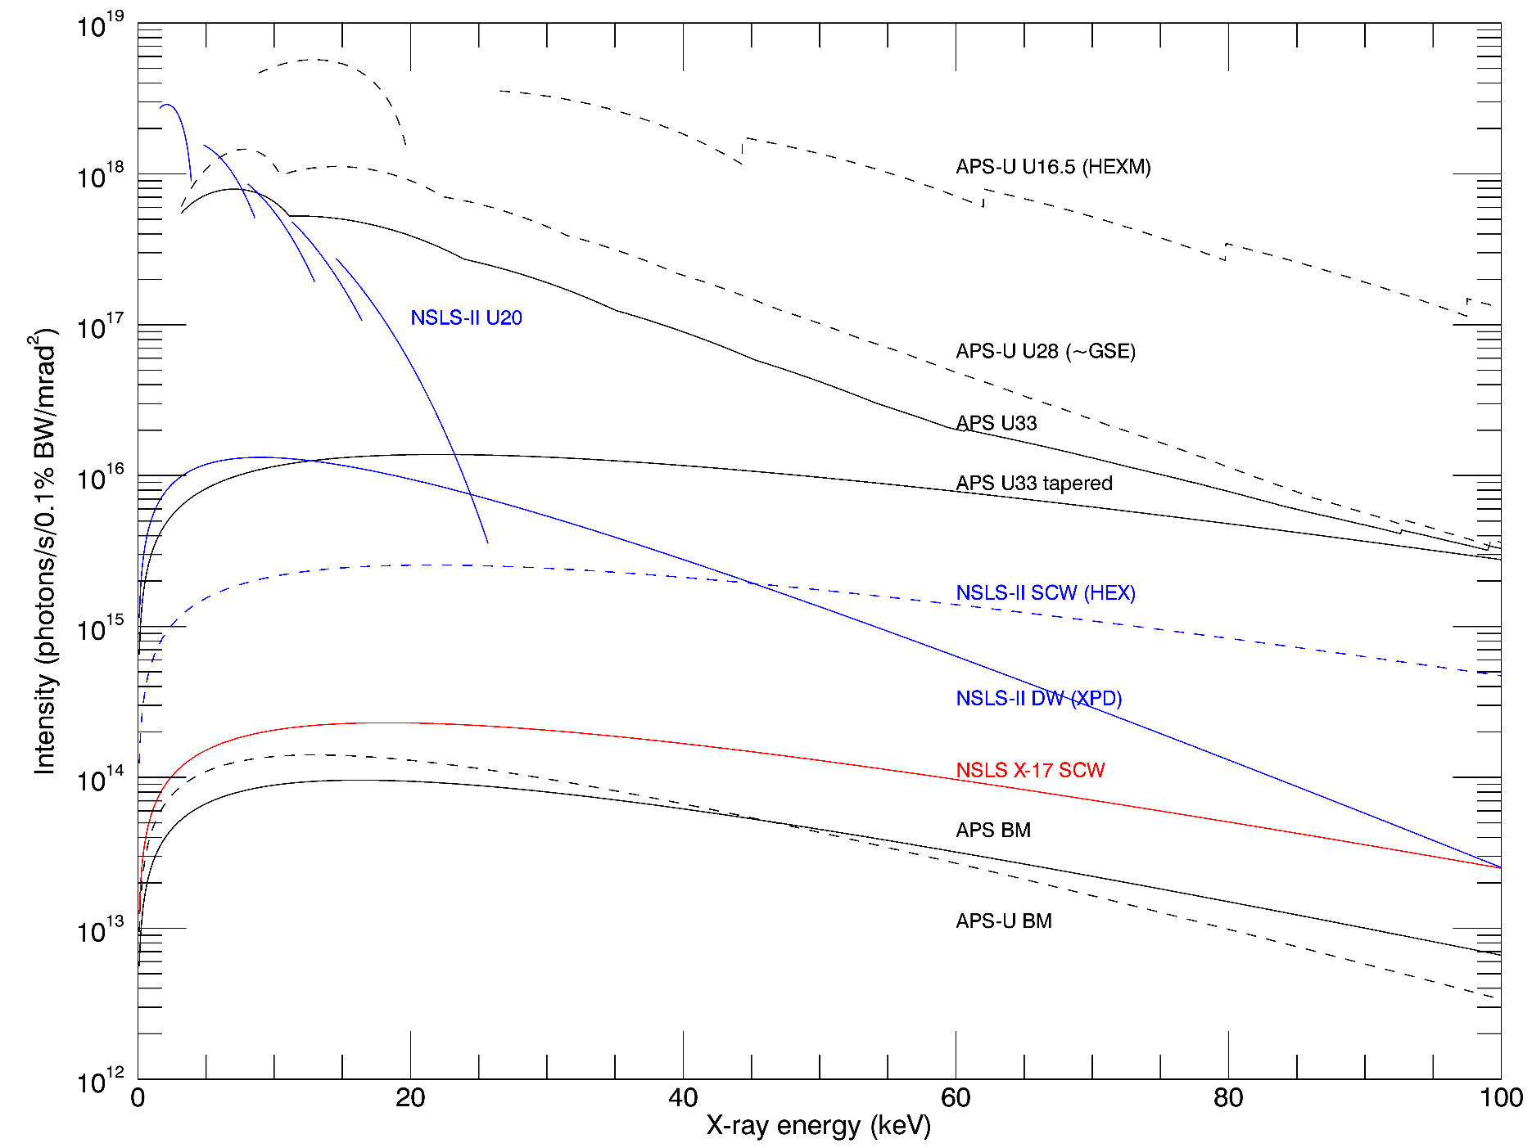
Intensity of some synchrotron sources
Figure of merit for beamline without focusing

Slide 13
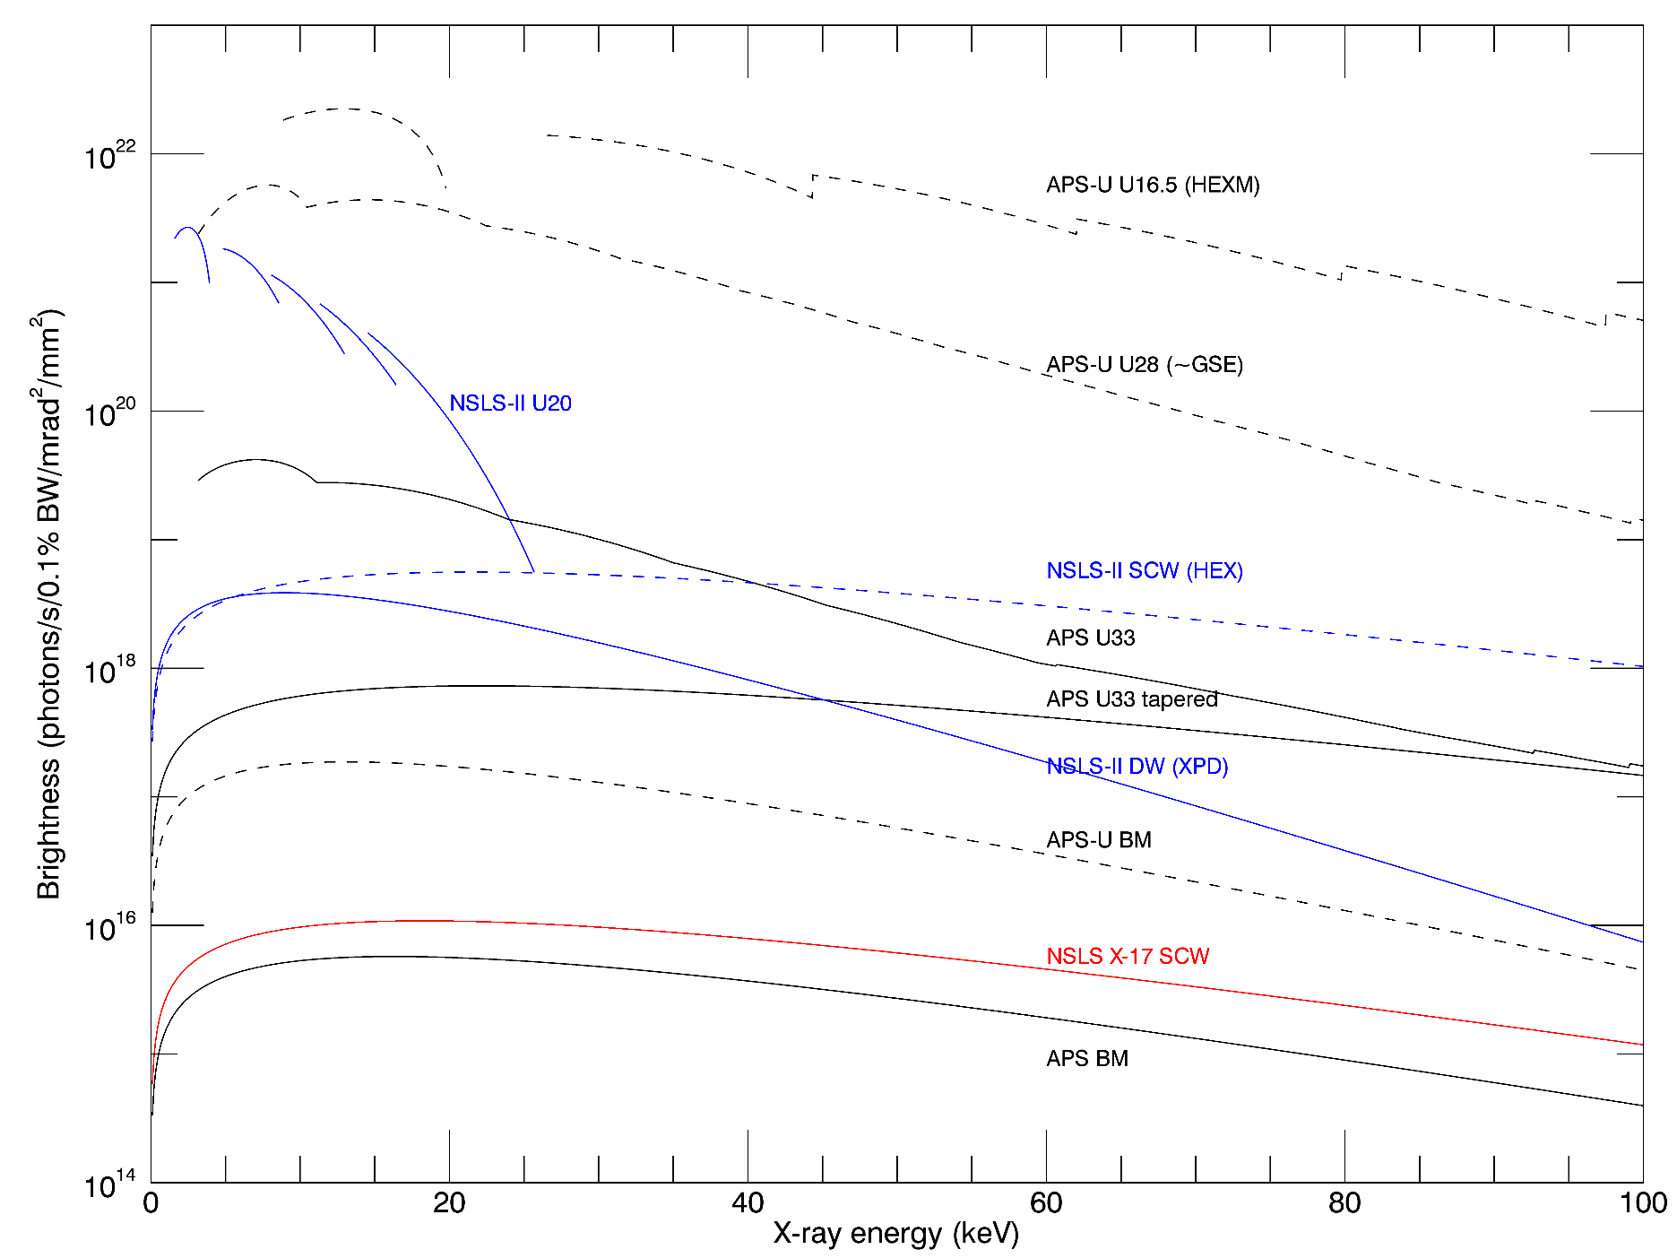
Brightness of some synchrotron sources
Figure of merit for beamline with focusing

Slide 14
APS Bending Magnets
Storage Ring | APS | APS | APS-U
Ring energy (GeV) | 7 | 7 | 6
Critical energy (keV) | 19.529 | 19.529 | 15.663
Beamline | 13-BM-D | 13-BM-D defocused | 13-BM-D
Distance from source (m) | 56 | 56 | 57.82
X-ray Energy (keV) | Photons/s/0.1% BW/mm²
20 | 29,990 | 29,990 | 38,733
40 | 19,710 | 15,695 | 19,929
60 | 10,226 | 6,453 | 8,052
80 | 4,793 | 2,560 | 2,933
100 | 2,123 | 1,006 | 1,008
X-ray Energy (keV) | Vertical FWHM (mm)
20 | 6.50 | >7 | 6.94
40 | 4.42 | >5 | 4.68
60 | 3.51 | >5 | 3.72
80 | 2.97 | >5 | 3.17
100 | 2.63 | >5 | 2.81

Slide 15
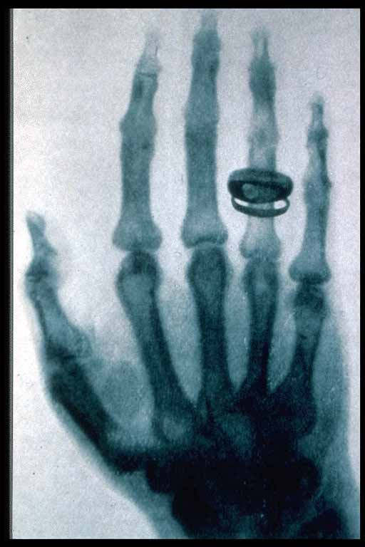
Synchrotrons for X-ray Imaging
Source is bright: intense, well-collimated, with a small source
  High flux in beam for full-field imaging
  Can focus to a small spot for fluorescence, diffraction, or projection imaging
X-ray spectrum is continuous:
  With monochromator
    Energy optimized for specific sample thickness and composition
    Energy optimized for exciting a specific element
    Energy scanned for X-ray absorption fine structure analyses
  No monochromator
    10⁴ more flux for high-speed imaging
    Efficient excitation of a large number of elements for fluorescence
Source is partially coherent – useful for phase contrast imaging
Parallel beam geometry – avoids artifacts of cone-beam geometry
High-energy x-rays – can be used to study thick samples or high Z samples
  Generally not as high as high-energy tube sources)
Discovery of X-rays W. C. Röntgen, 1895
Radiograph of his wife’s hand, 1896

Slide 16
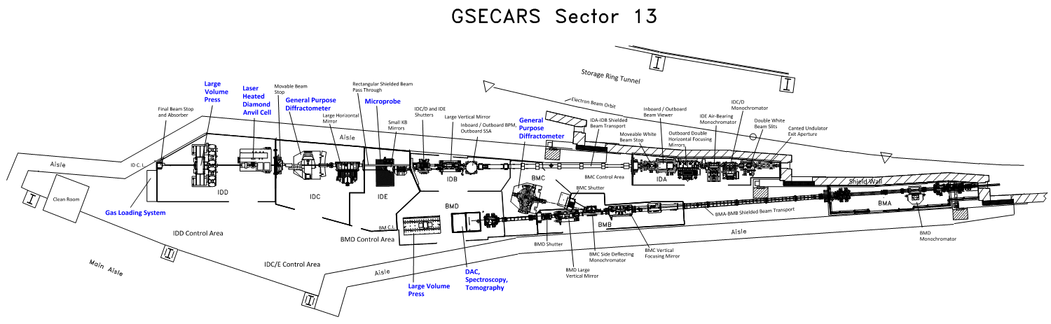
GSECARS – APS Sector 13
Undulator beamline with 3 experimental stations (13-ID-C, 13-ID-D, 13-ID-E)
Bending magnet beamline with 2 experimental stations (13-BM-C, 13-BM-D)
  Absorption tomography is done in 13-BM-D

Slide 17
Instruments and Techniques
Station | Instrument | Technique
13-ID-E | X-ray Microprobe | Trace element microanalysis
 |  | Fluorescence microtomography
 |  | MicroXAFS
 |  | Microdiffraction
13-ID-C | General Purpose Diffractometer | Interface scattering
 |  | Grazing incidence XAFS
 |  | Inelastic x-ray scattering
13-ID-D | Laser heated Diamond Anvil Cell | Monochromatic diffraction
 |  | Emission spectroscopy
 | Multi-anvil Press (1000-ton) | Monochromatic & energy dispersive diffraction
 |  | Radiography
13-BM-D | Multi-anvil Press (250-ton) | Monochromatic & energy-dispersive diffraction
 |  | Tomography & Radiography
 | Diamond Anvil Cell | Brillouin spectroscopy
 |  | Monochromatic diffraction
 | Tomography | Absorption and phase contrast tomography
13-BM-C | General Purpose Diffractometer | Diamond anvil cell diffraction (single crystal)
 |  | Interface diffaction
 |  | Powder diffraction

Slide 18
Beam modes in 13-BM-D
White beam
  No x-ray optics except slits and absorbers, direct beam from storage ring
Monochromatic beam
  High resolution Si 111 double crystal monochromator
  Very narrow energy bandwidth, ~10⁻⁴. 99.99% of x-rays are thrown away.
Pink beam
  White beam reflected from an x-ray mirror
  Beam reflected from mirror is called “pink beam” because it has lost high-energy (“blue”) photons
  Mirror optics are achromatic, all energies focus at the same place
    Can focus pink beam or monochromatic beam
  Mirrors allow defocusing the beam to increase the size for imaging
  Focusing with mirrors can greatly increase the flux on the sample

Slide 19
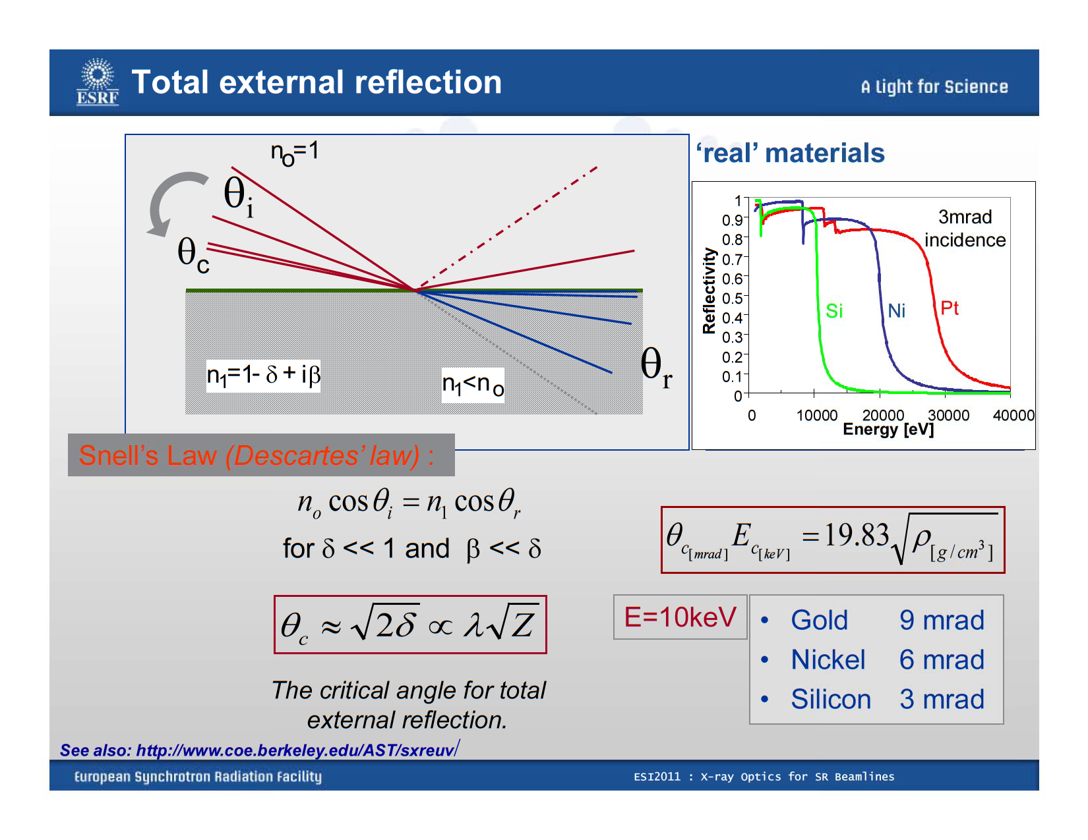

Slide 20
X-ray Focusing with Total Reflection Mirror
X-rays reflecting from an elliptical shaped mirror focus the beam
Demagnification = f₁/f₂
Equation of an Ellipse:

Slide 21
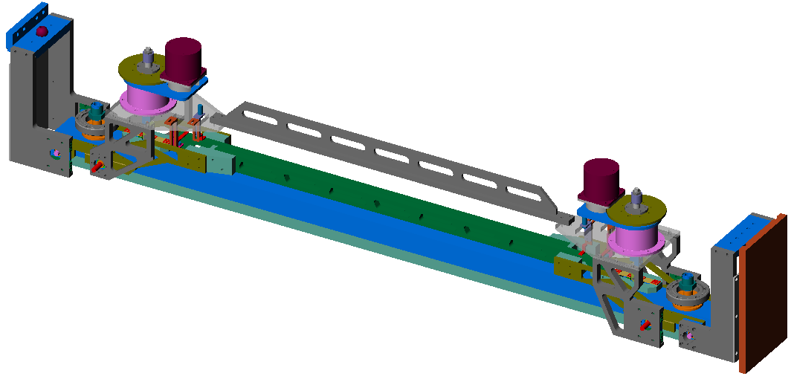
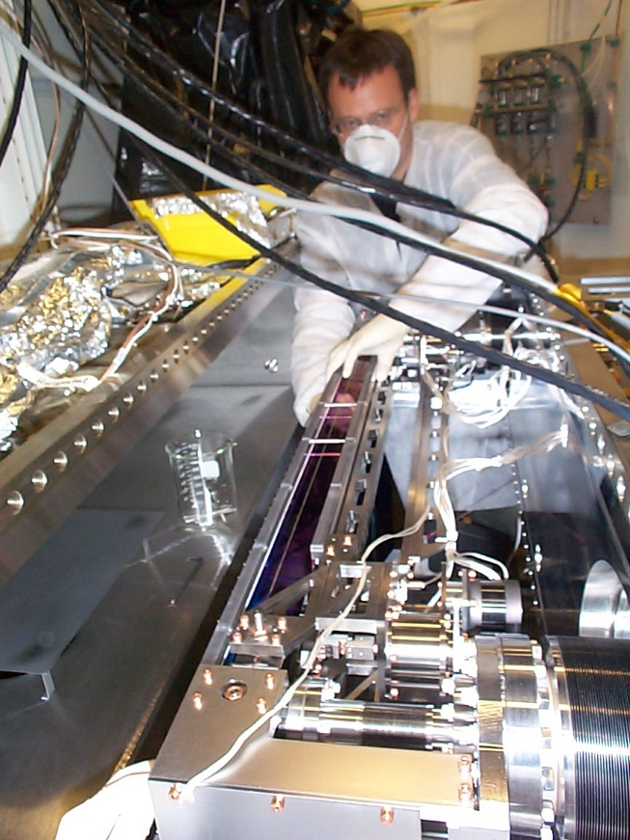
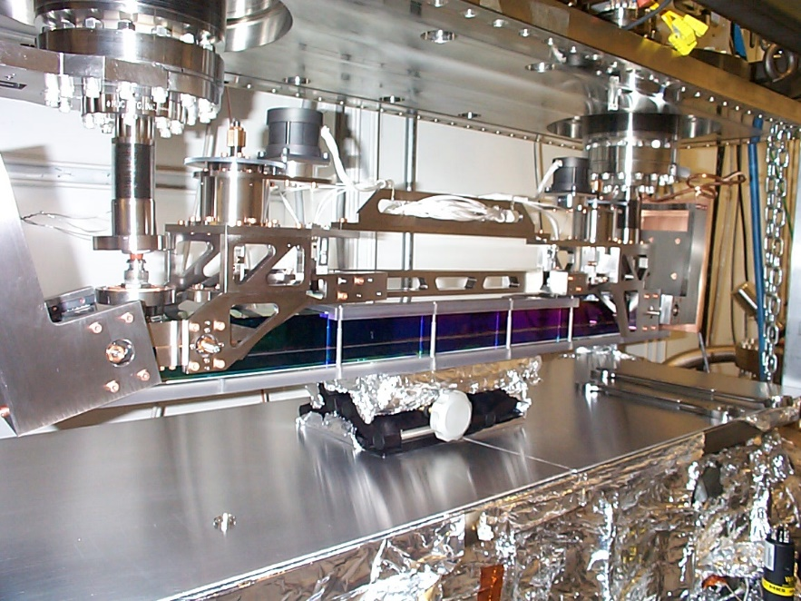
Large Focusing Mirror (1.1 m long)
DS Moment Actuator
Cu Cooling Mask
Support Leg
US Moment Actuator
Water Outlet
Support Leg
Reaction Platform
Water Inlet
Bending Rods
Crossed Bending Arms

Slide 22
Pink Beam in 13-BM-D
Upstream and downsteam slits (water-cooled)
Upstream Al and Cu absorption filters (water-cooled)
White-beam capable mirror (water-cooled)
  49.5 m from source
  1.2 m long mirror, 1.0 m optical aperture
  Bounces down
  Pt coated
  Can adjust pitch and bending
  Pitch controls cutoff energy to eliminate high-energy photons
  Bending curvature can be positive (focusing) or negative (defocusing)
  Use negative curvature to increase vertical beam size on sample at small pitch angles

Slide 23
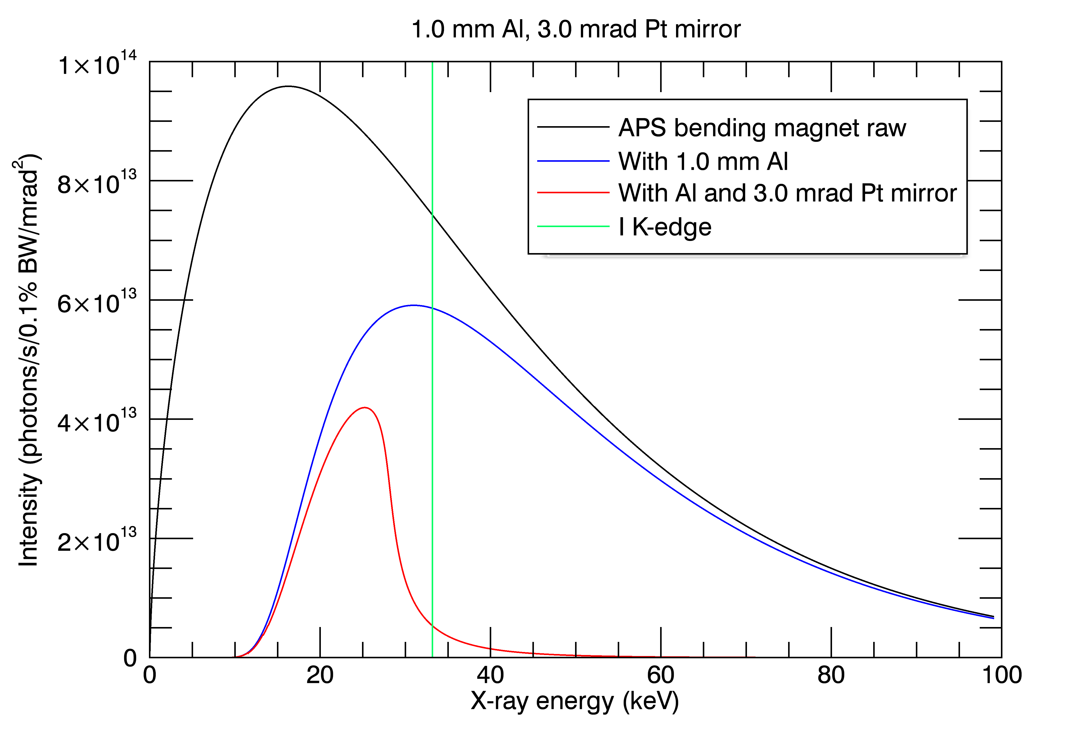
Pink Beam Spectrum
1 mm Al absorber, 3 mrad mirror angle

Slide 24
13-BM-D Beamline Layout
250-ton press
Slits
54.7 m
Mirror
49.5 m
Slits
Monochromator
27.0 m
Slits
23.8 m
Filters
23.0 m
Tomography
56.0 m

Slide 25
Absorption Tomography Setup
13-BM-D station at APS
X-ray Source
  Parallel monochromatic x-rays (10-80 keV) or pink beam
  APS bending magnet source, 20 keV critical energy
  1-50 mm field of view in horizontal, up to 6 mm in vertical
  1-20 micron resolution, depends on field of view
Imaging System
  LuAG single crystal scintillator
  5X to 20X microscope objectives, or zoom/macro lens
  1920x1200 pixel fast CMOS camera
Data collection
  Rotate sample 180 degrees, acquire images every 0.2 degrees
  Data collection time: 10-30 minutes (monochromatic), 10-100 seconds (pink)
  Reconstruction time: 2-5 minutes
Microscope objective
Scintillator
Sample
CMOS camera
X-rays
X-rays
Visible light
Rotation stage

Slide 26
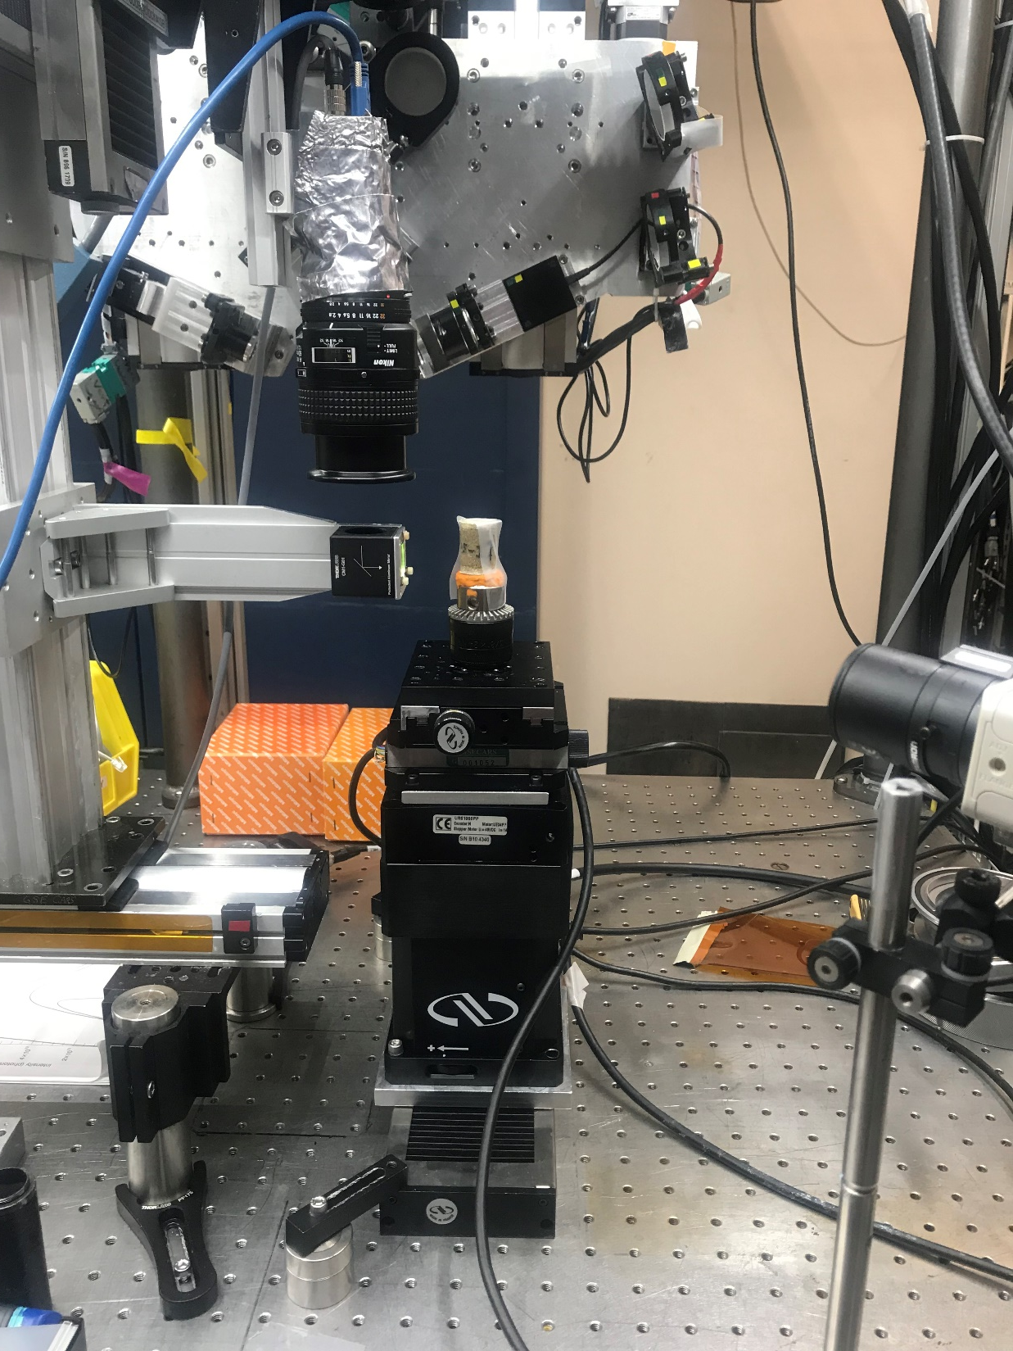
Tomography Apparatus in 13-BM-D
Sample at x-ray beam height
X-Z translation stages above rotation stage, 25mm travel
Rotation stage
Vertical translation stage, 30 mm travel
Horizontal translation stage, 100 mm travel
Optical table, 5 degrees of freedom (X, Y, roll, pitch, yaw)
Scintillator and 45 degree mirror
Nikon macro lens (others lenses available for higher magnification)
CMOS camera, 1920x1200 pixels, 163 frames/s maximum
X-Y-Z-theta stage to position camera
Z stage to change scintillator to sample distance for phase contrast
Brillouin spectroscopy optics for diamond anvil cell, not used for tomography
10
10
12
9
8
7
1
←X-rays
2
3
11
11
4
5
6

Slide 27
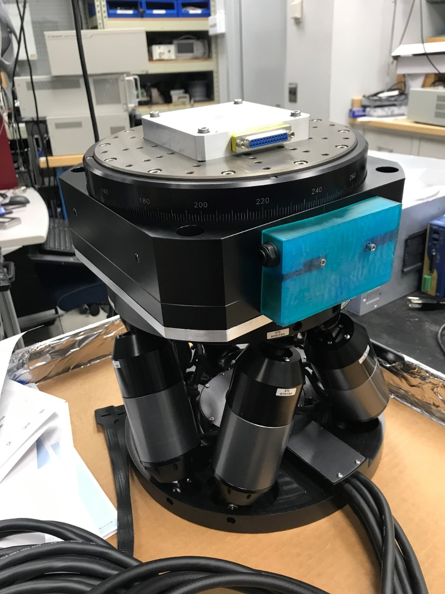
New Tomography Sample Stage
Existing stage
  < 3 kg load
  Maximum distance from pink beam to stage is ~75 mm
  Cannot use large in-situ apparatus
  Ball bearing stage, > 1 μm runout
New stage
  25 kg load
  Hexpod base, 6 degrees of freedom
  Air bearing rotation stage, 0.25 μm runout
  Requires hole in optical table to get low enough, currently being machined

Slide 28
Basic Principles of Tomography - Reconstruction from Projections
The attenuation of x-rays of wavelength λ is
I/I₀ = exp (- µ x)
where I₀ is the intensity of the unattenuated x-ray beam,
  I is the beam’s intensity after traversing
  x thickness of (homogeneous) material with
  µ being the linear attenuation coefficient.
Adding the increments of the attenuation along the direction of x-ray propagation yields the more general form I = I₀ exp [- ∫ µ(s) ds]
where µ(s) is the linear absorption coefficient at position s along ray s.
The problem is assigning the correct value of µ to each position along this ray (and along all the other rays traversing the sample) knowing only the values of the line integral for the various orientations of s, i.e.,
ds
s
μ_{i}
x-rays
Voxel dV
∫ µ (s) ds = ln (I₀/I)

Slide 29
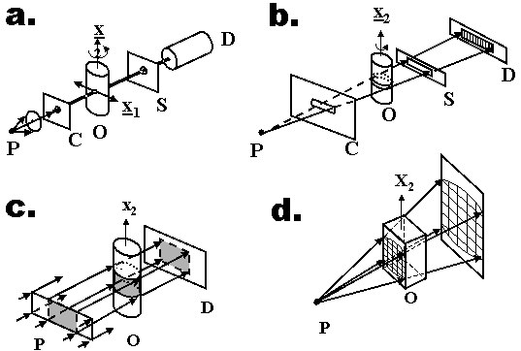
Experimental Computed Tomography Geometries
Fan beam
”Second Generation”
Pencil beam
“First Generation”
Parallel beam
(synchrotron)
“Third Generation”
Cone beam
“Third Generation”

Slide 30
Tomography “Requirements”
Sampling
NP ≥ π/2 * NX
  NP = number of projections
  NX = number of pixels in direction perpendicular to rotation axis (horizontal)
  Our detector: NX=1920, so NP should be at least 3016
This criterion is from sampling theory
  If this number of angles is used then a feature on edge of the field of view moves by 1 pixel in 1 angle step
In practice “good” reconstructions can be obtained with fewer projections, and often fewer are used to save time
Increasing the number of projections also improves image quality because of simple signal/noise arguments
  More measurements reduces the statistical noise

Slide 31
Tomography “Requirements”
Completeness
Must have uniform material outside of the object at all angles (e.g. air)
  Sample should remain completely in the field of view.
  Can do “local tomography” where this is not true, “zoom” into sample
  Absolute linear attenuation will be wrong
  Leads to artifacts depending on inhomogeneity outside field of view
Must collect full 180 degree dataset
  Sometimes 180 is not possible, e.g. diamond anvil cell, other container constraints
  Fewer angles leads to artifacts
  Iterative reconstruction techniques can minimize these artifacts using a-priori knowledge

Slide 32
Tomography “Requirements”
Alignment
Rotation axis must be perpendicular to the beam direction
  Mechanical alignment
  Cannot be fixed in post-processing
Rotation axis must be parallel to the columns of the camera
  Mechanical alignment
  Can be fixed in post-processing by rotating each image
Sample shape
Samples should be roughly equant in the horizontal plane
  Vertical size does not matter
  Thin plates are bad because in one orientation they are very thin (transparent), and at 90 degrees to that they are very thick (absorbing)

Slide 33
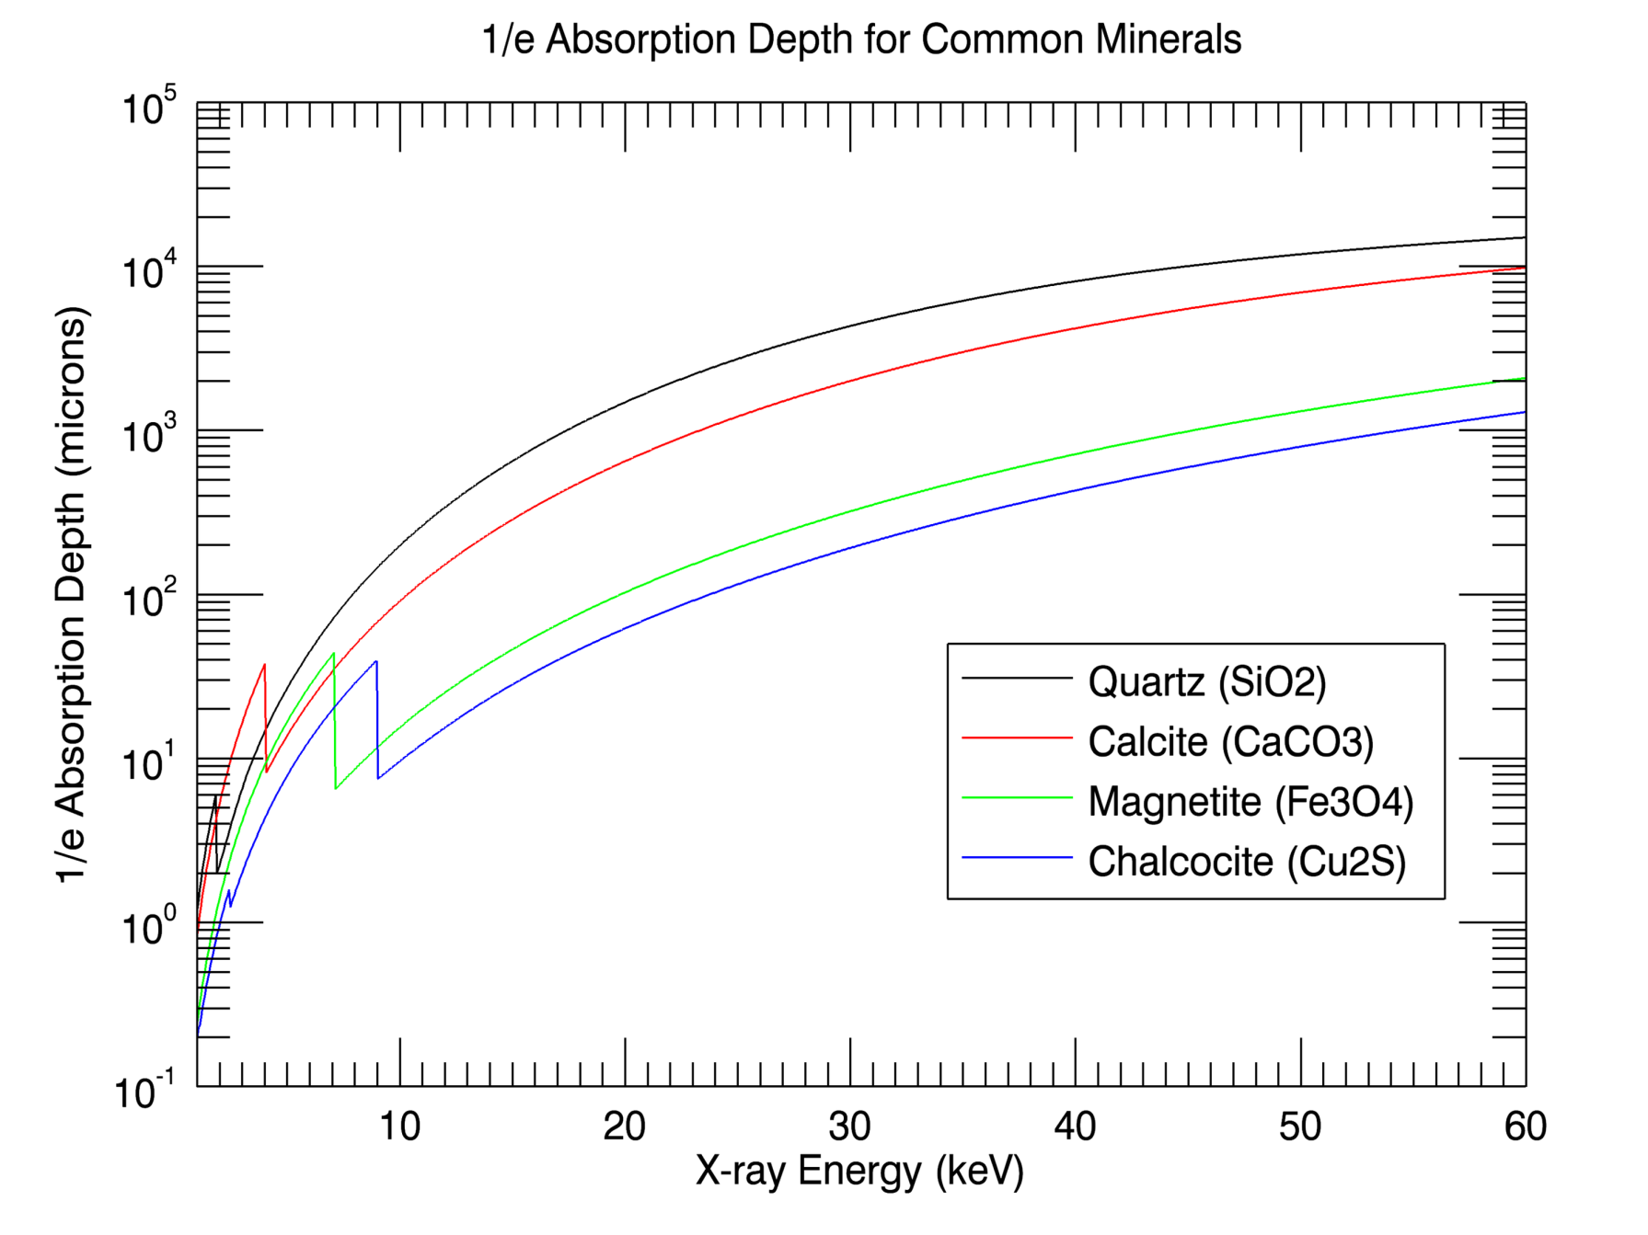
How Big Can my Sample Be and/or
What Energy X-rays Do I Need?

Slide 34
How Big Can my Sample Be and/or
What Energy X-rays Do I Need?
Twice the 1/e absorption depth is about the optimum size
Absorption varies
  Linearly with density
  Strongly non-linearly with atomic number (~Z³)
  Strongly non-linearly with x-ray energy (~E³)
At 30 keV 1/e is about 5mm for quartz, but only 0.2mm for chalcocite
At 8 keV (Cu Kα fluorescence energy) 1/e is 100 microns for quartz
It is the maximum absorption along any ray, not the average absorption that matters!
  2 chalcocite crystals that are in the same slice will align at some angle, and the absorption may be too large, leading to streak artifacts
Need to pick x-ray energy and sample size carefully depending on sample composition!!

Slide 35
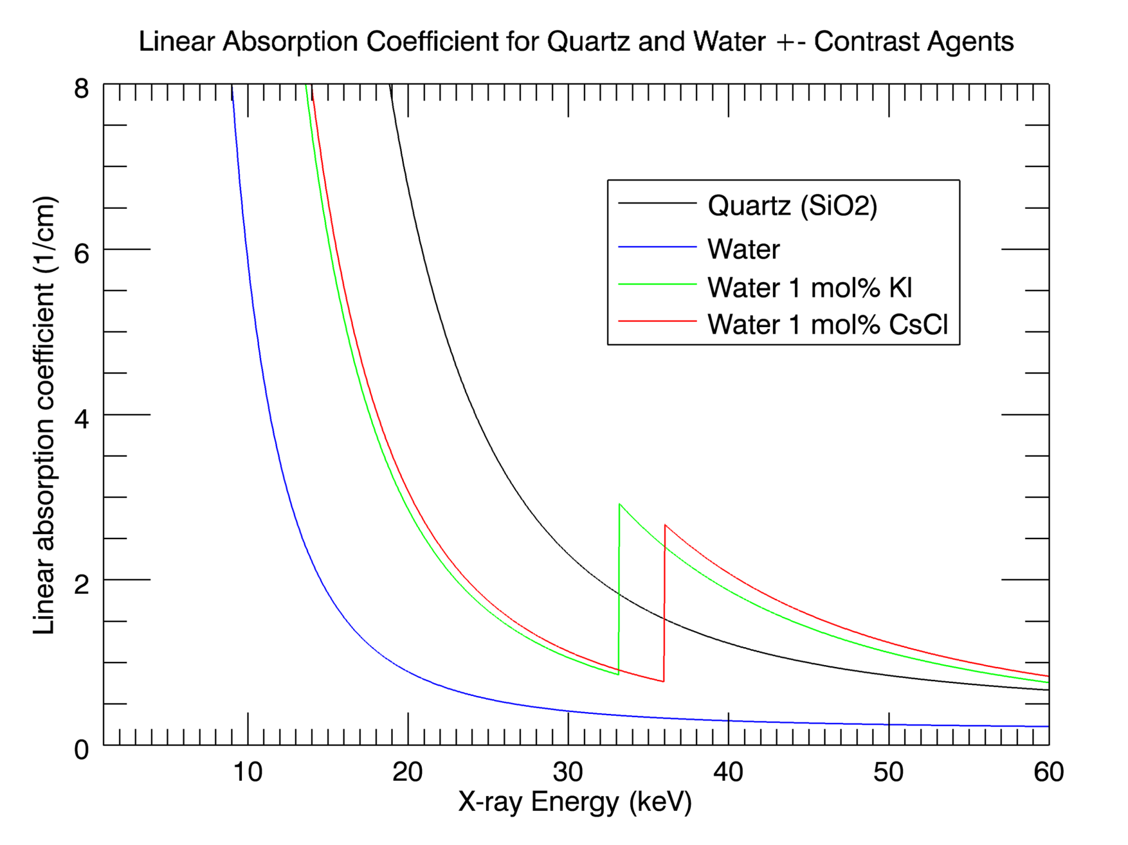
Differential Absorption Tomography

Slide 36
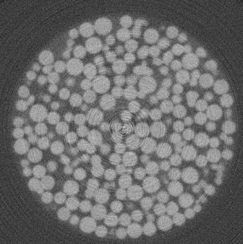
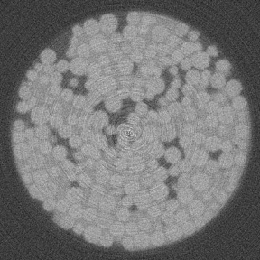
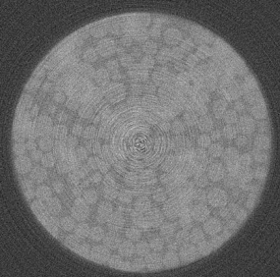
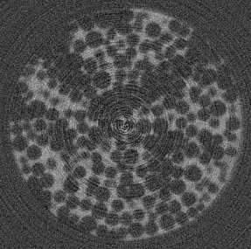
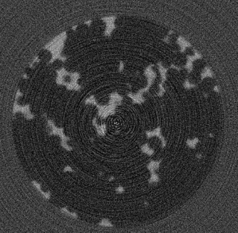
Differential Absorption Tomography
Clint Willson (Louisiana State University)
8mm diameter glass bead column with aqueous phase containing Cs and organic phase containing I.
32.5 keV, below I and Cs K absorption edges
33.2 keV, above I and below Cs K absorption edges
36.0 keV, above I and Cs K absorption edges
33.2 - 32.5 keV, showing distribution of I in the organic phase
36.0 - 33.2, showing distribution of Cs in the aqueous phase

Slide 37
Pink Beam Setup
Upstream and downsteam slits (water-cooled)
Upstream Al and Cu absorption filters (water-cooled)
White-beam capable mirror (water-cooled)
  49.5 m from source
  1.2 m long mirror, 1.0 m optical aperture
  Bounces down
  Pt coated
  Can adjust pitch and bending
  Pitch controls cutoff energy to eliminate high-energy photons
  Bending curvature can be positive (focusing) or negative (defocusing)
  Use negative curvature to increase vertical beam size on sample at small pitch angles
Rotation stage and detector mounted on 5-axis lift table
  Easily rotate entire apparatus so rotation axis is 90° to beam reflected from mirror

Slide 38
Pink Beam Optics
Vertical
(de)-focusing mirror
Filters
(Al, Cu)
APS bending magnet source
Slits
Slits
Sample
Detector
Rotation stage
5-axis lift table

Slide 39
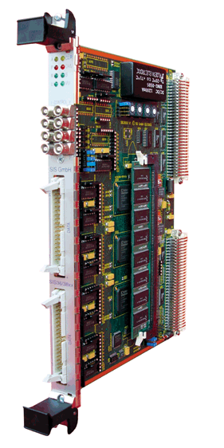
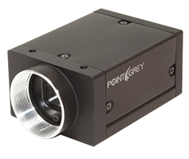
Acquisition Setup
On-the-fly scanning, continuous rotation stage motion
Detector trigger driven by motor steps divided by N
Rotation stage speed set so that the detector has just finished reading out frame N-1 when trigger N arrives
OMS-58
motor controller
(Pulse out)
SIS-3820 (÷ N)
(Motor pulse per pixel )
Trigger in
Grasshopper camera
Step-Pak
motor driver
Rotation stage

Slide 40
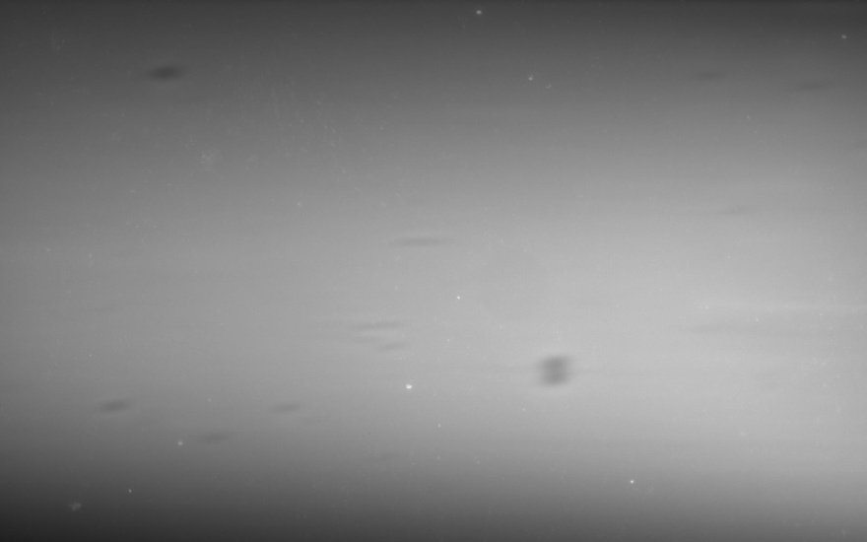
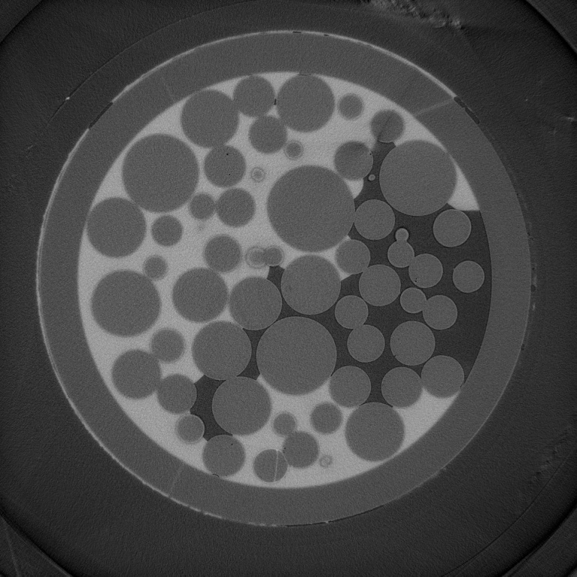
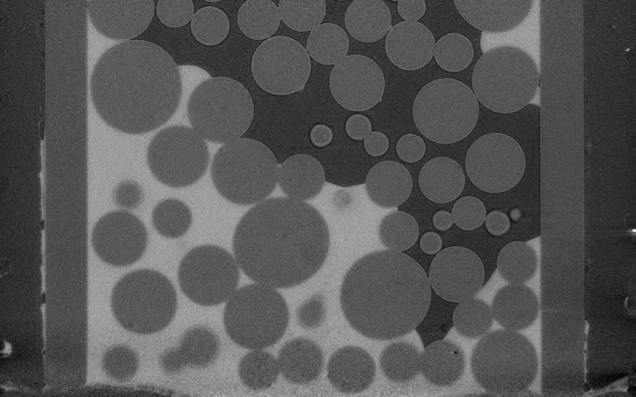
Monochromatic Beam Measurement
Standard for comparing pink beam experiments
Glass beads with water containing CsCl
Energy=36.100 keV (115 eV above Cs K-edge)
1.0 second exposure time, 900 projections, 900 seconds (15 minutes) total time
4.21 µm/pixel, 1920x1200 pixels projections
1920x1920x1200 reconstructed volume, 8.2GB
Field of view = 8.08x5.05 mm
Flat field
Vertical slice
Horizontal slice

Slide 41
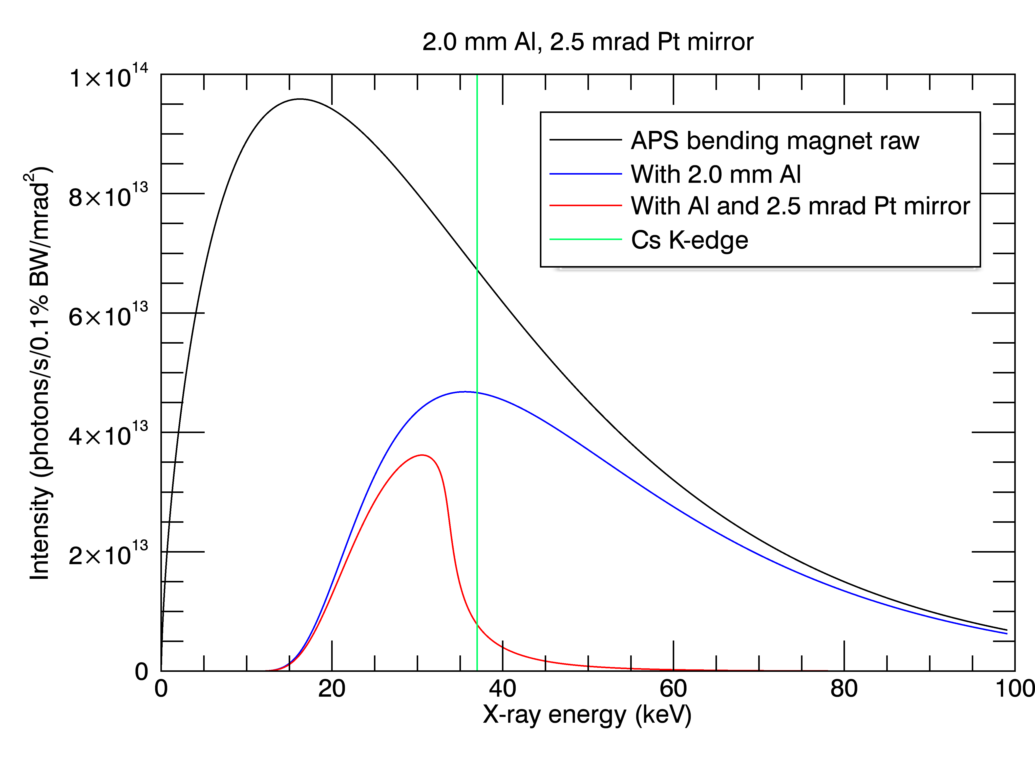
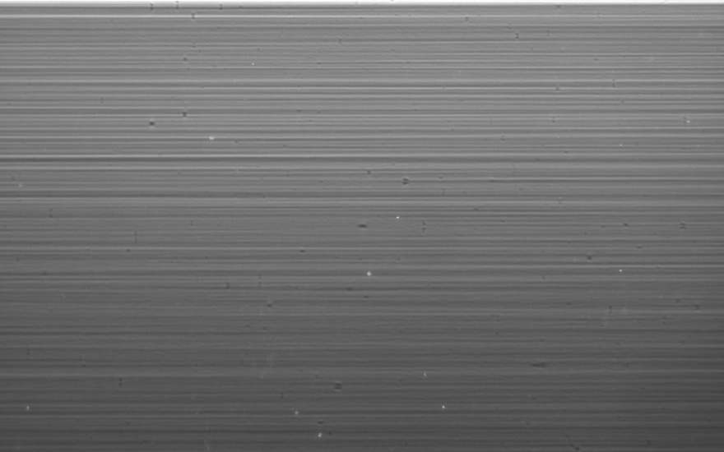
Pink Beam, Mirror=2.5 mrad
Mirror angle=2.5 mrad
2 mm Al absorber
1 ms exposure time, 70.7 frames/s, 12.7 seconds total
Flat field
(stripes are from mirror slope errors)

Slide 42
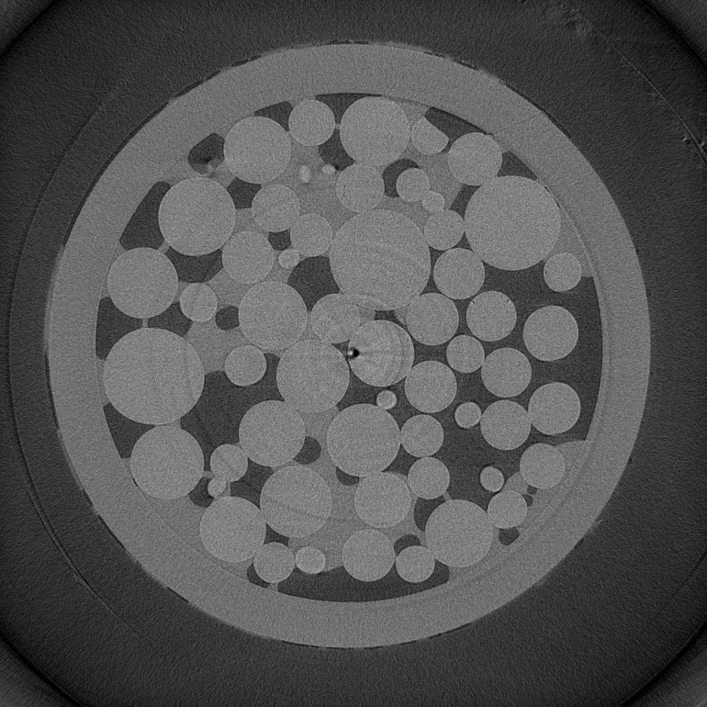
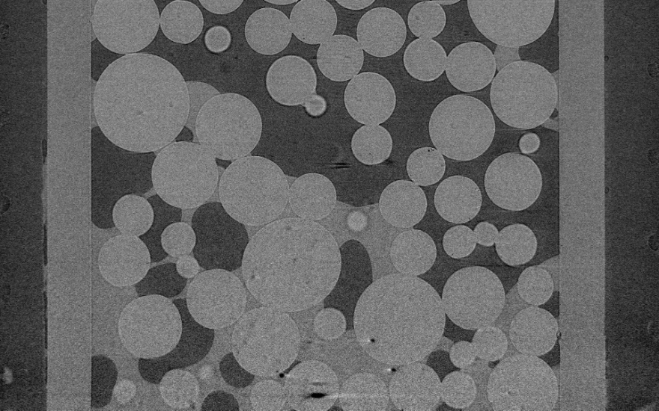
Pink Beam, Mirror=2.5 mrad
Mirror angle=2.5 mrad
2 mm Al absorber
1 ms exposure time, 70.7 frames/s, 12.7 seconds total
Vertical slice
Horizontal slice

Slide 43
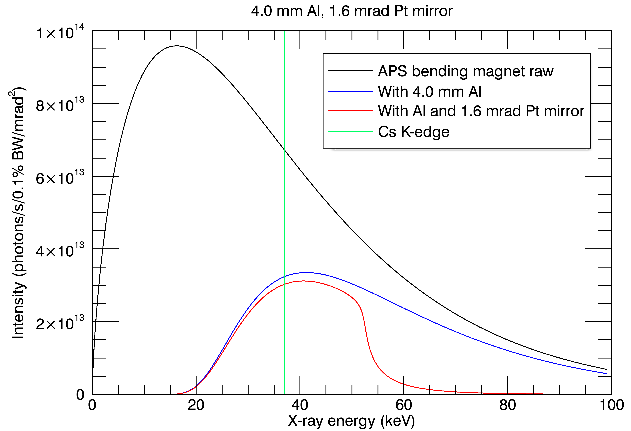
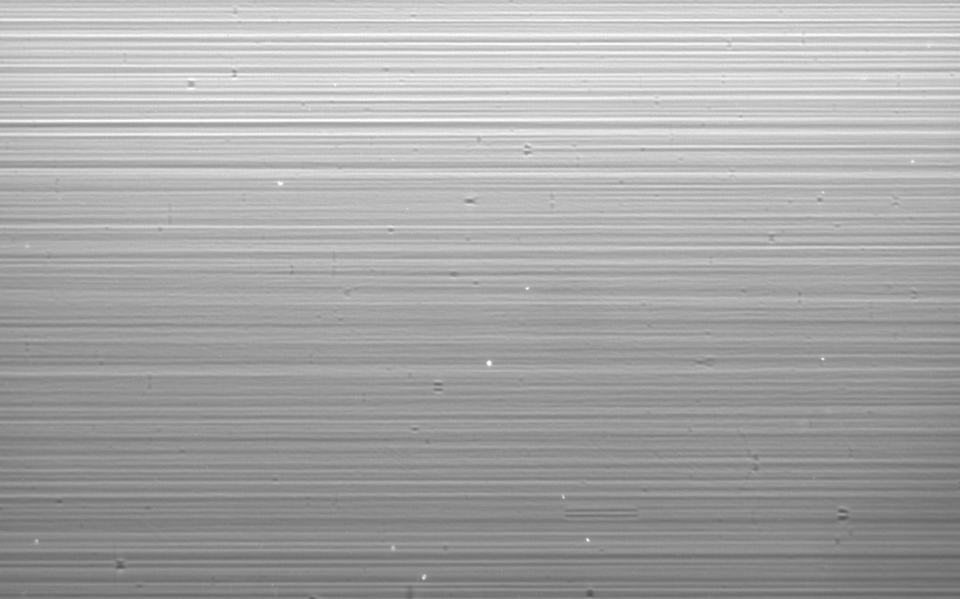
Pink Beam, Mirror=1.6 mrad
Mirror angle=1.6 mrad
4 mm Al absorber
2 ms exposure time, 66 frames/s, 13.6 seconds total
Flat field

Slide 44
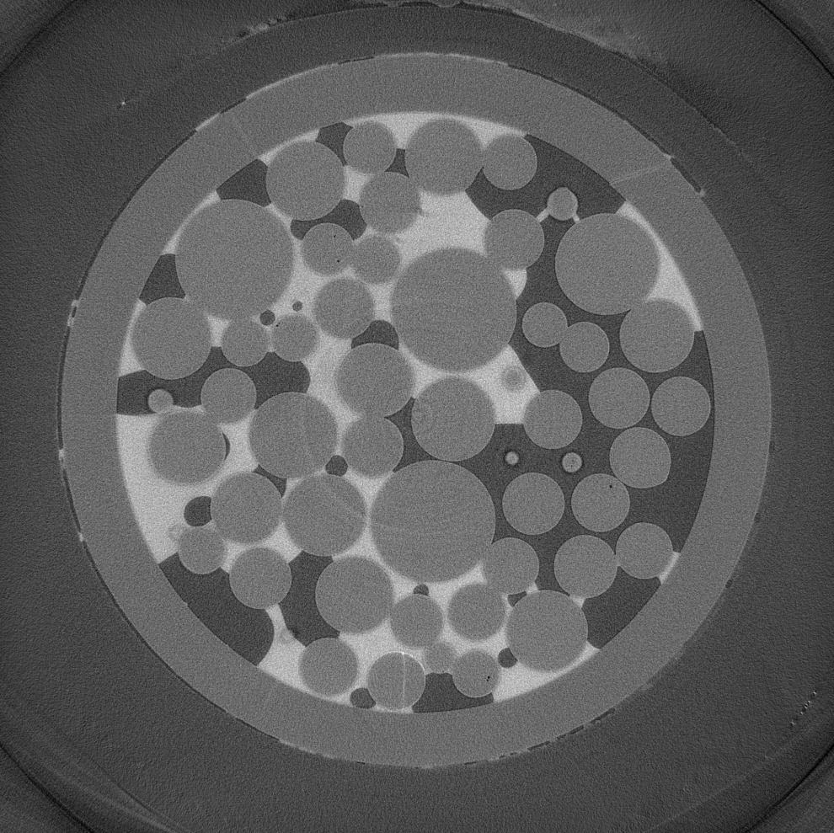
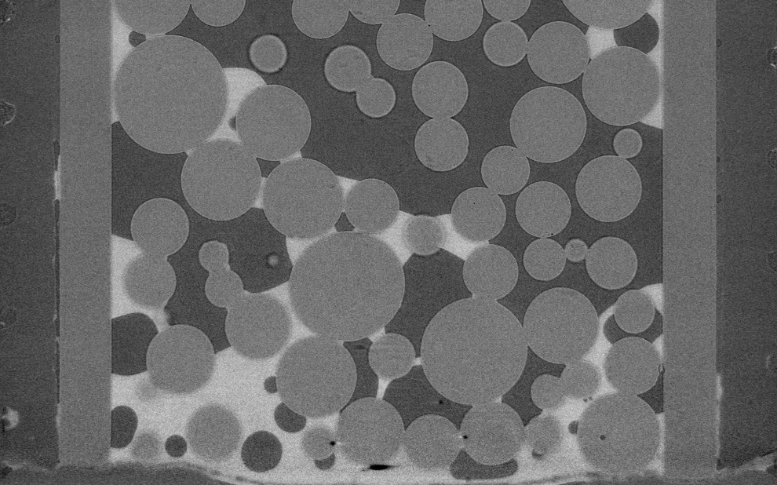
Pink Beam, Mirror=1.6 mrad
Mirror angle=1.6 mrad
4 mm Al absorber
2 ms exposure time, 66 frames/s, 13.6 seconds total
Vertical slice
Horizontal slice

Slide 45
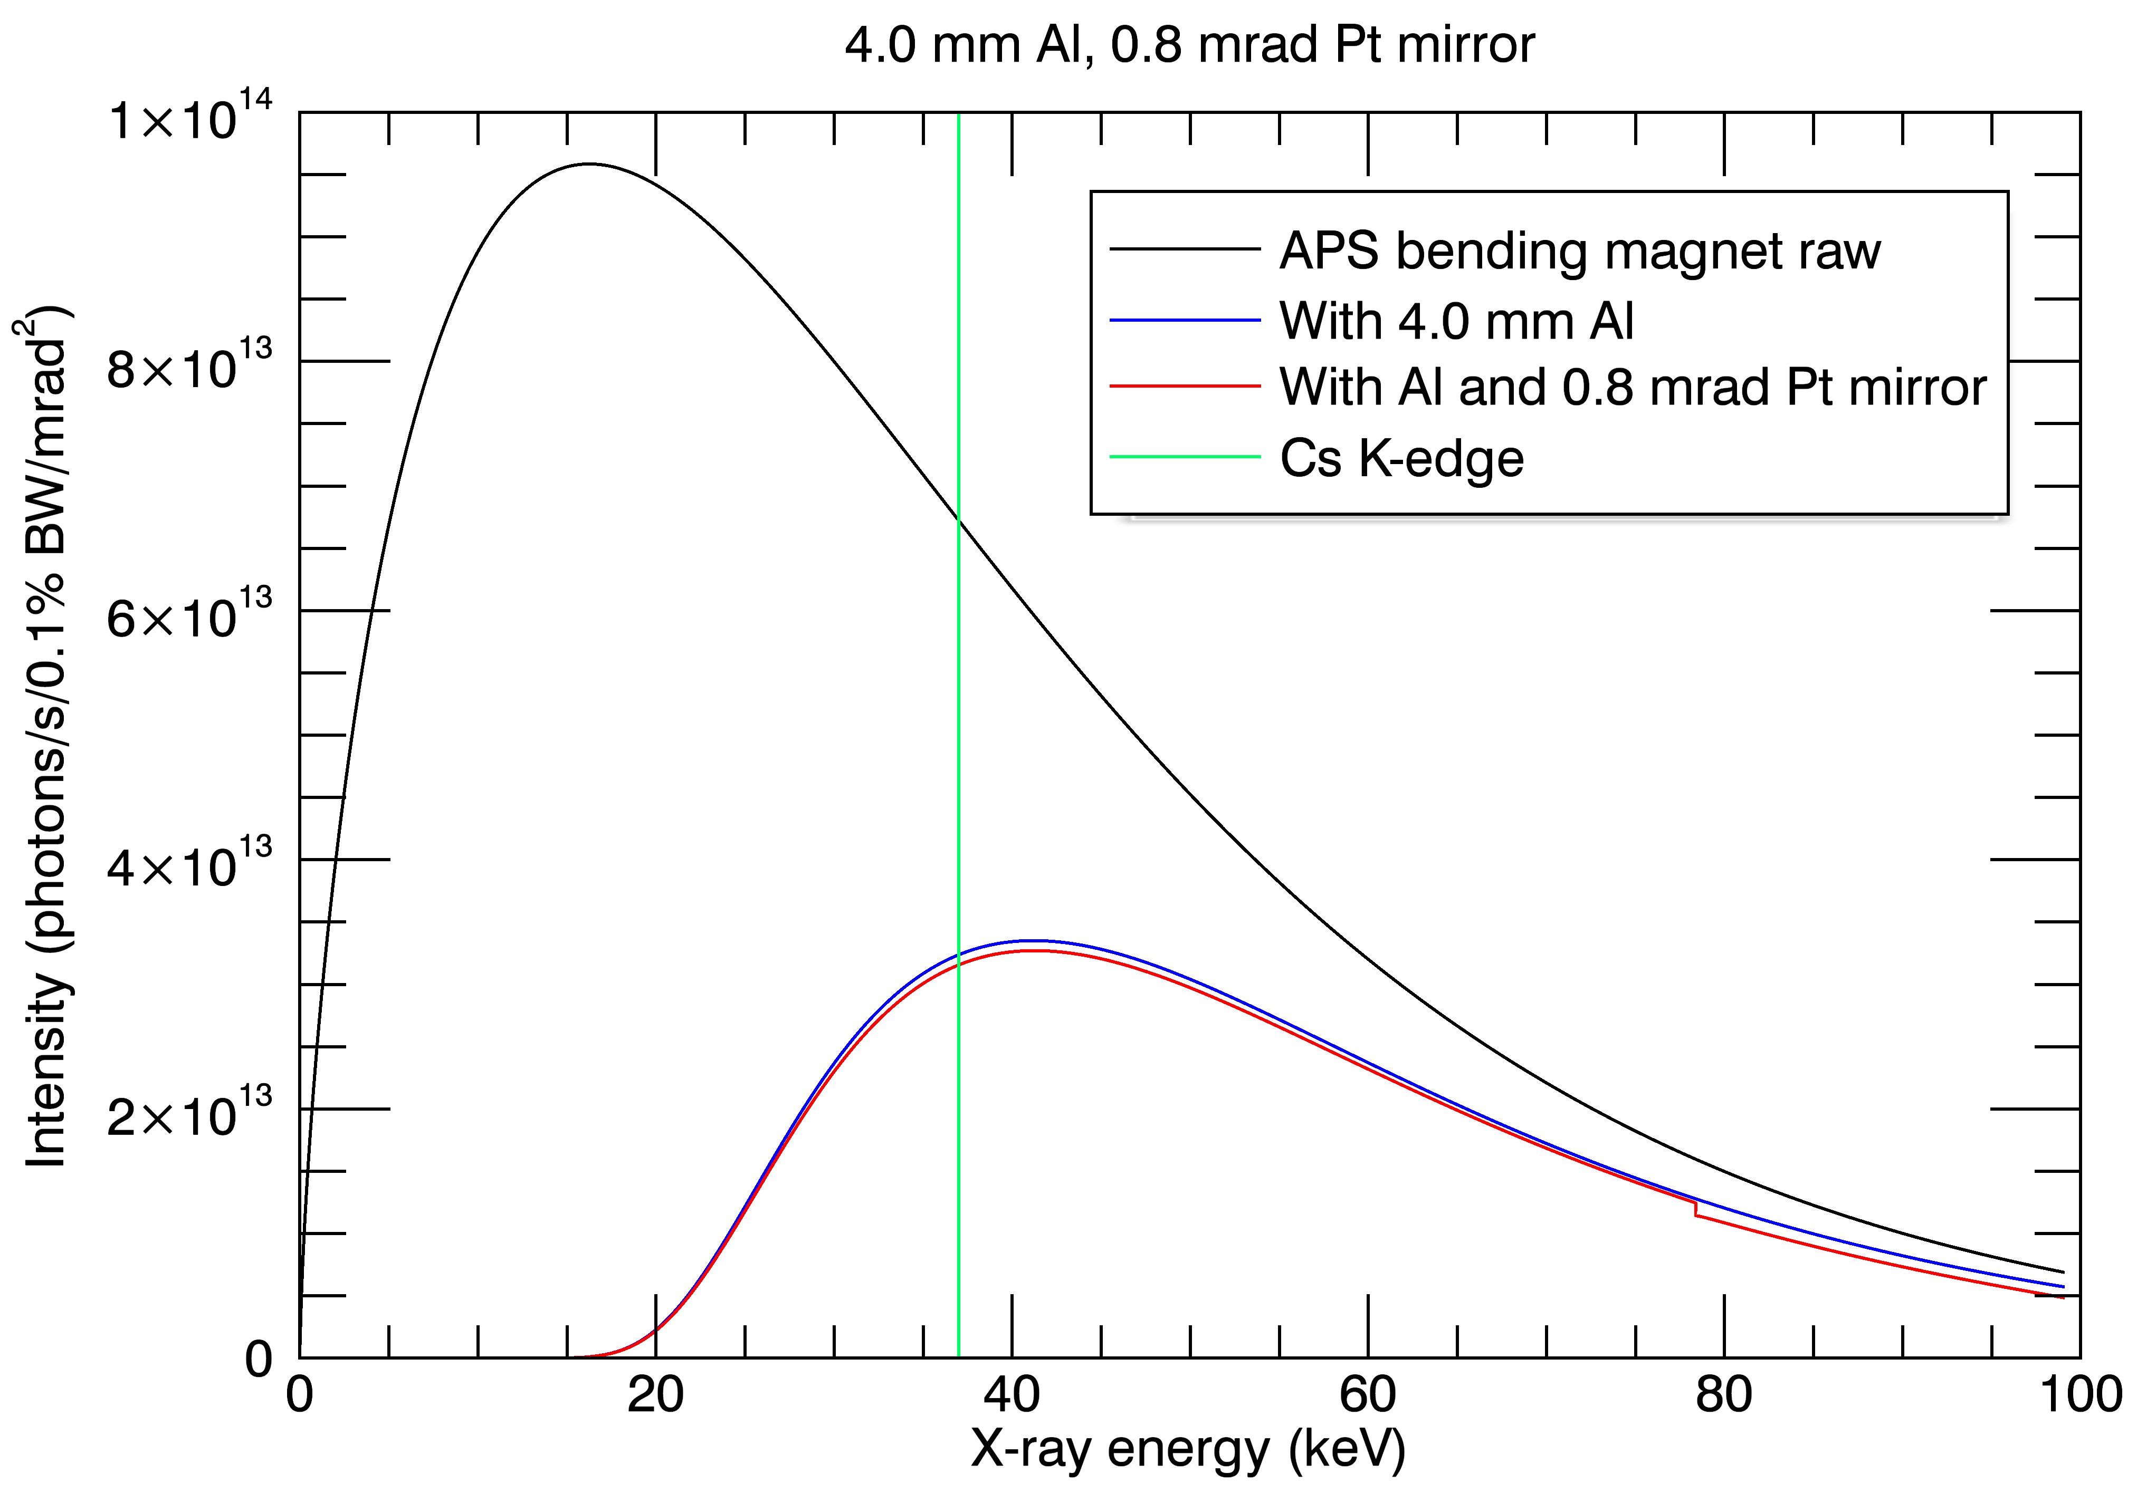
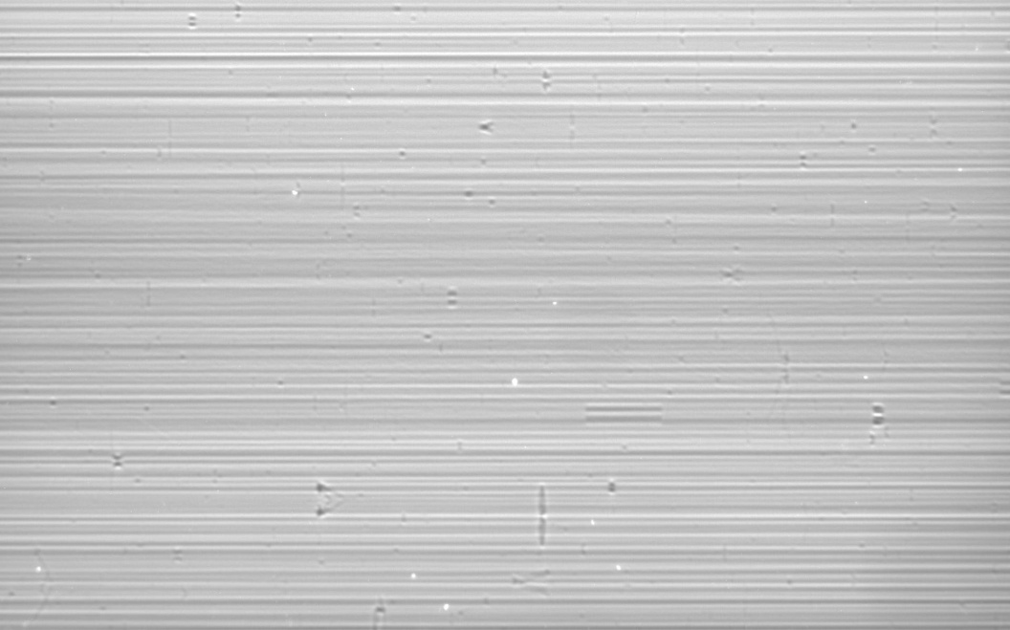
Pink Beam, Mirror=0.8 mrad
Mirror angle=0.8 mrad
4 mm Al absorber
5 ms exposure time, 55 frames/s, 16.4 seconds total
Flat field

Slide 46
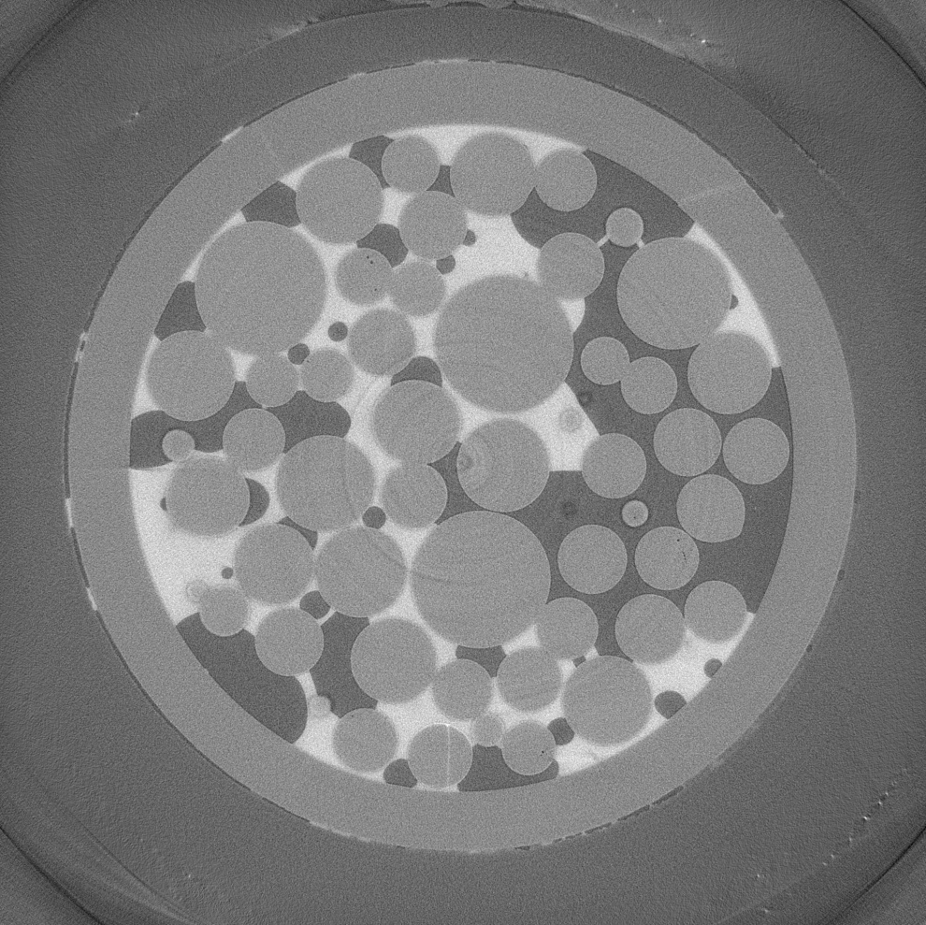
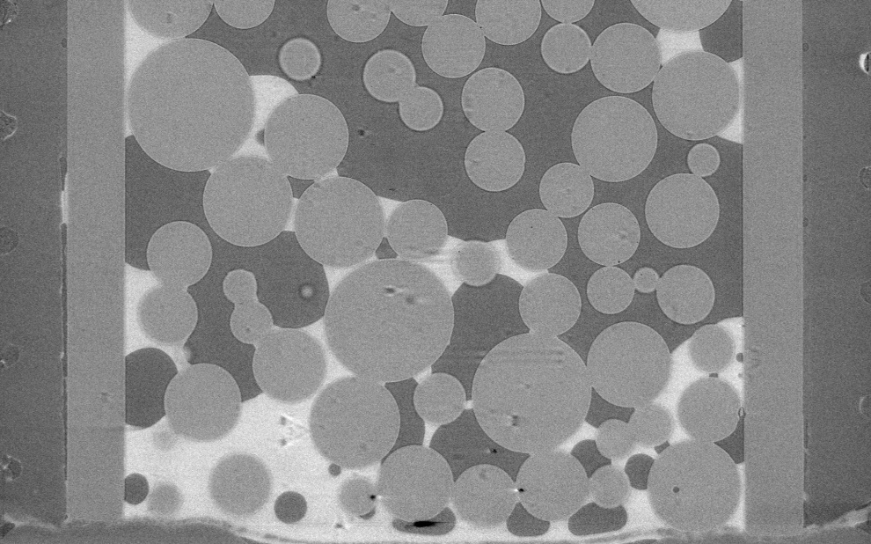
Pink Beam, Mirror=0.8 mrad
Mirror angle=0.8 mrad
4 mm Al absorber
5 ms exposure time, 55 frames/s, 16.4 seconds total
Vertical slice
Horizontal slice

Slide 47
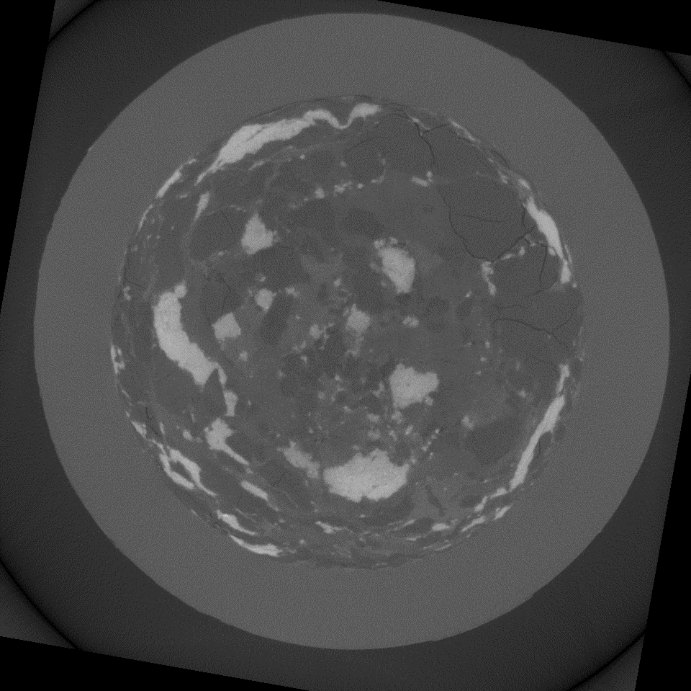
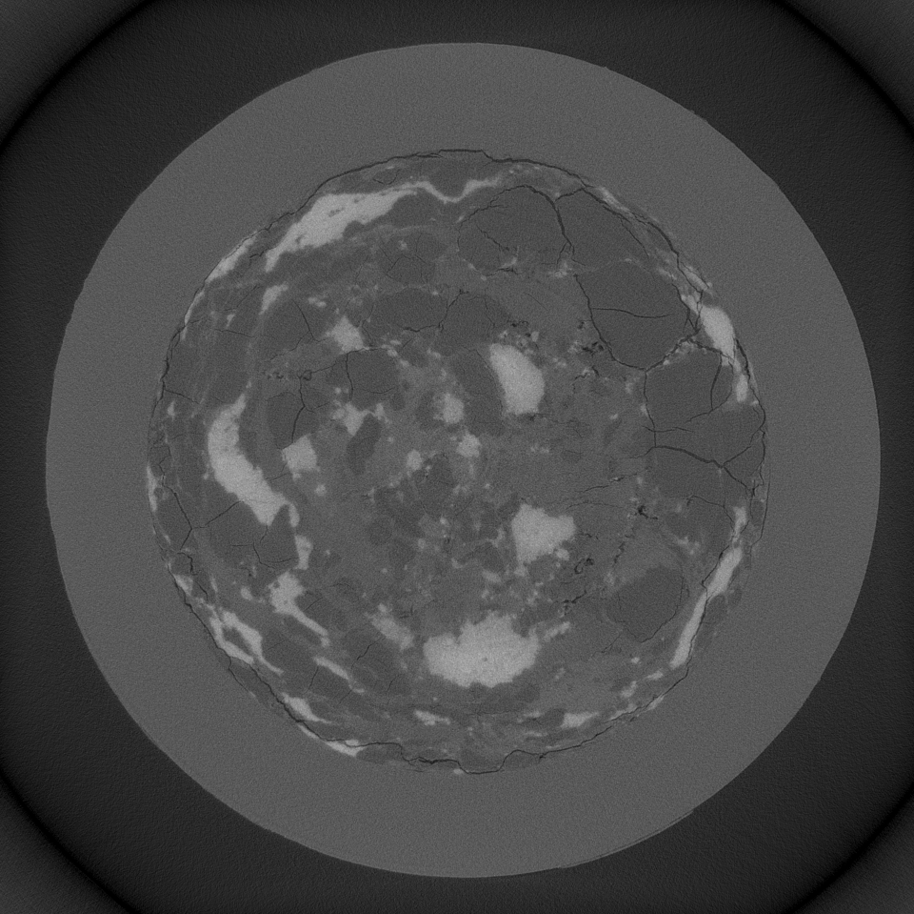
Application: Cement with I dopant
Monochromatic beam
33.269 keV
3.2 µm/pixel
31 minute total acquisition time
Pink beam
1 mm Ti, 2 mrad mirror
3.2 µm/pixel
9.5 second total acquisition time

Slide 48
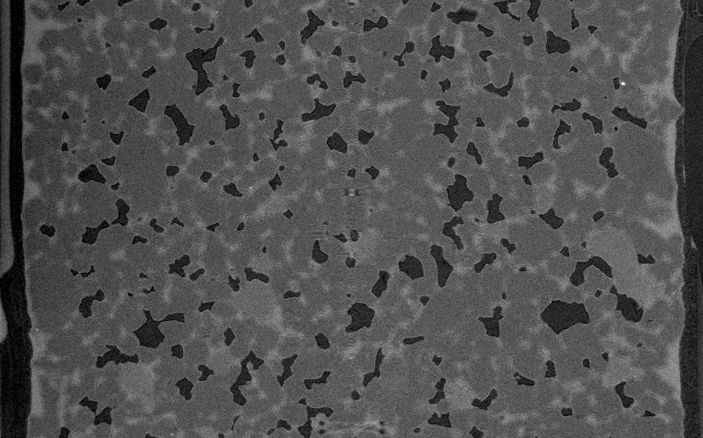
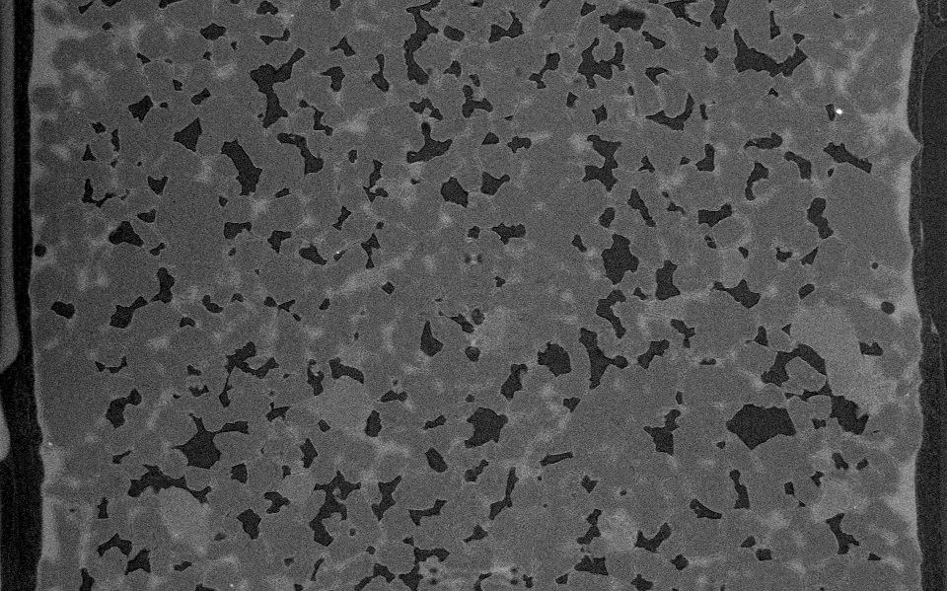
Application: Fluid drainage and imbibition in sandstone
Pink beam
3.2 µm/pixel
9.5 seconds per dataset
Collected datasets every ~60 seconds for 30 minutes while column was drained
Time 0 dataset
30 minutes later

Slide 49
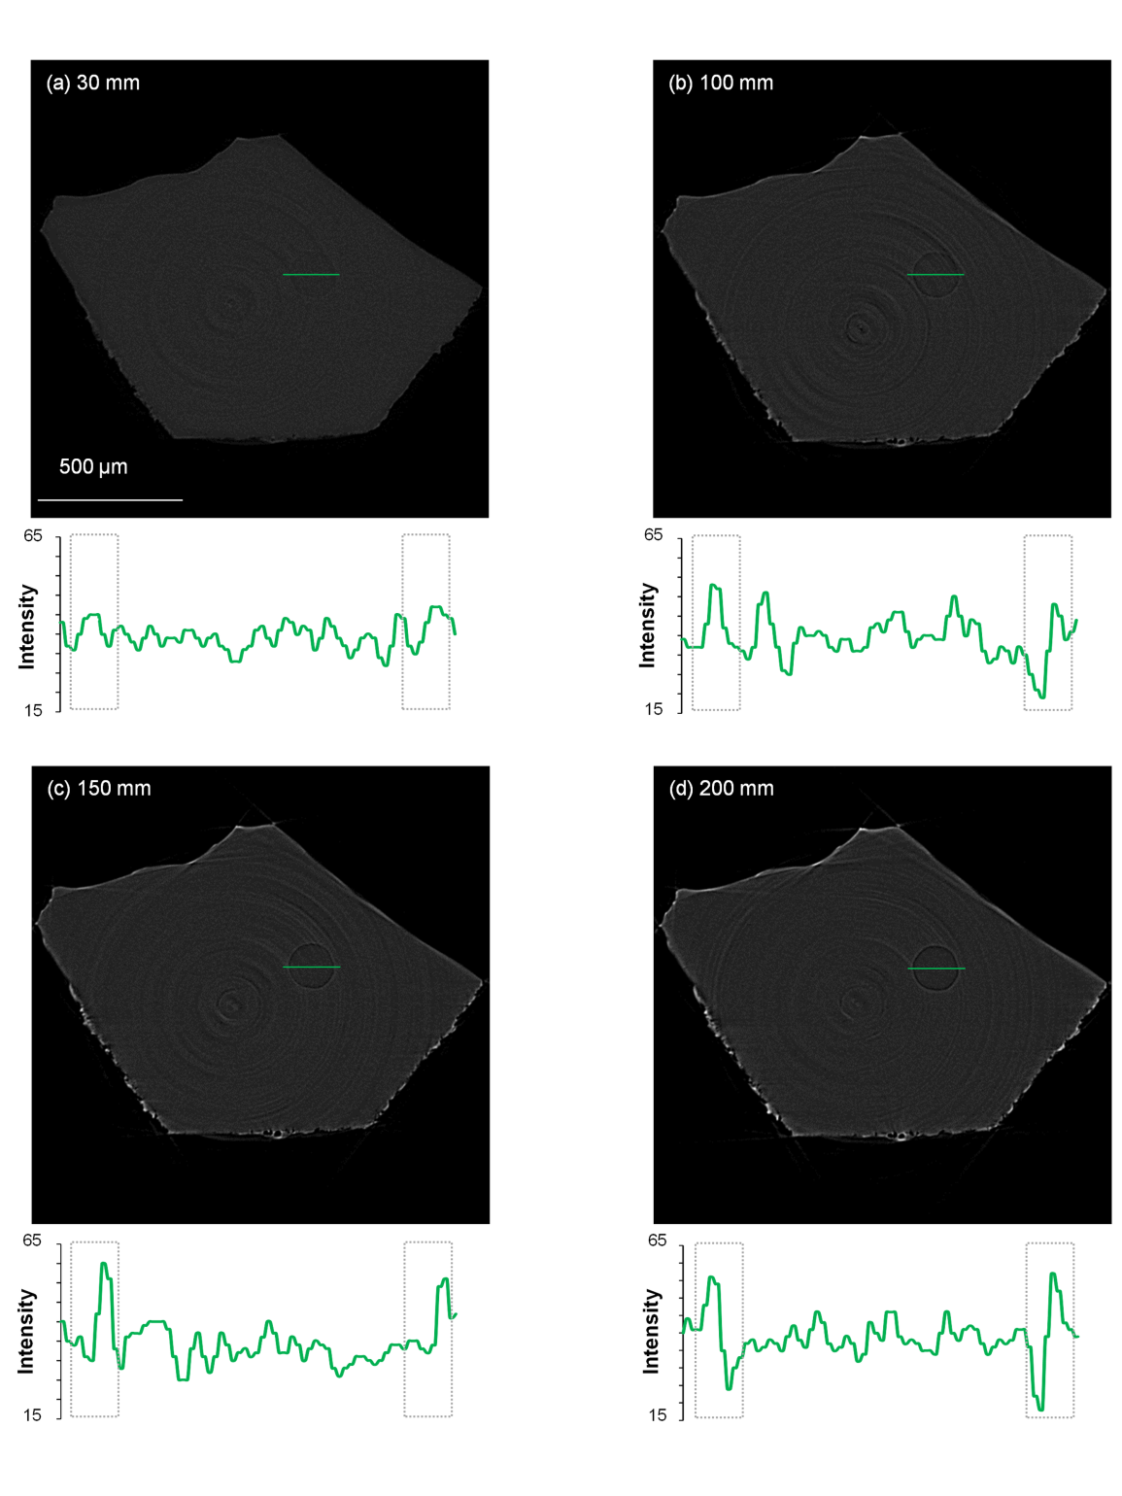
Phase Contrast Tomography
Refracted x-ray
Incident x-ray
X-ray are refracted at the boundary between different materials (refractive index).
This leads to edge contrast that increases with distance from the sample to the detector
Phase effect is strong even for materials with similar absorption
Example: rhyolite glass inclusions in quartz crystals

Slide 50
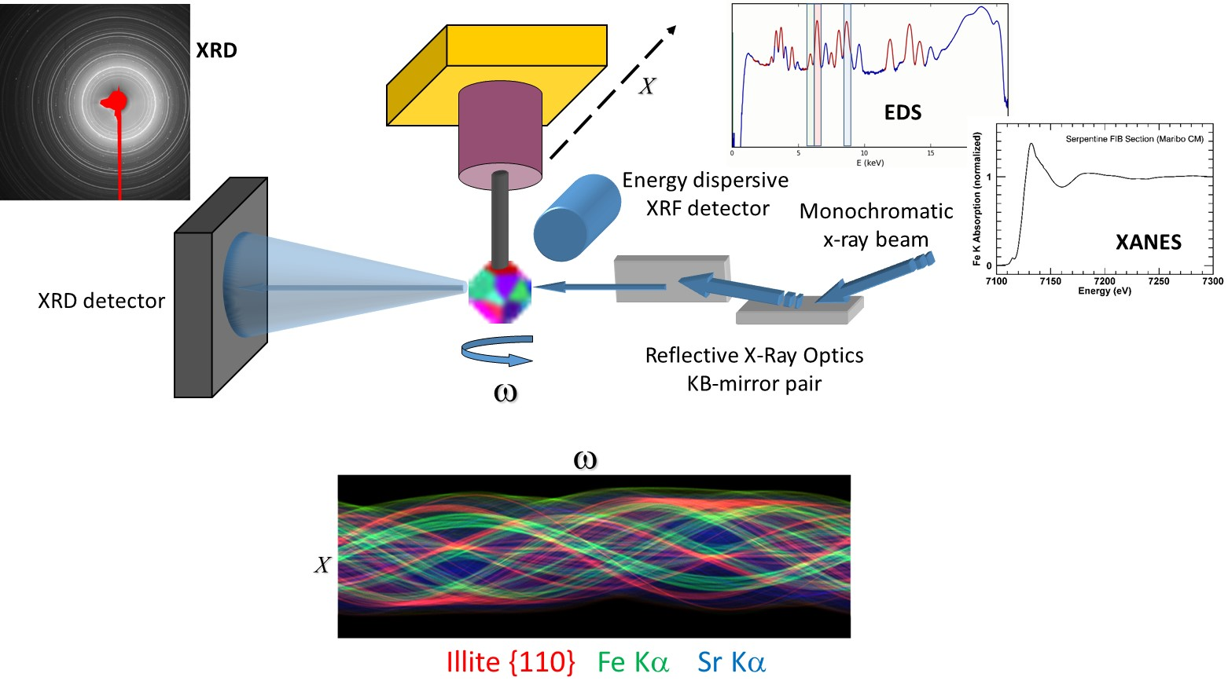
X-Ray Diffraction Tomography - 3D imaging of mineralogy in unsectioned geologic materials
Micro-XRD tomography allows imaging of internal mineralogy without sectioning.
Samples in sealed containers and capture media can be interrogated non-invasively, without the need for extraction, at micrometer scale.
Simultaneously provides information regarding the sample microstructure.
Sinogram of X-ray diffraction, fluorescence and absorption intensities can then be tomographically reconstructed

Slide 51
Diffraction Tomography
X-ray powder diffraction signal can be reconstructed tomographically
Requires first-generation tomography, because the powder diffraction detector measures the line integral of the diffraction intensity along the beam path with no spatial information.
Reconstruct integrated powder diffraction peak, which will correspond to the location of a single crystalline phase.
Grain size << voxel size, so that good powder diffraction statistics are obtained from each voxel.
The grains normally must not have strong preferred orientation, because the signal must be independent of the direction of the ray through a voxel.
Diffraction tomography is not strictly limited to crystalline phases, but in some cases can be used to map the distribution of amorphous phases as well.

Slide 52
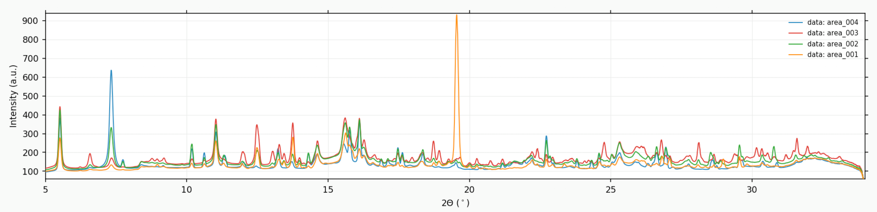
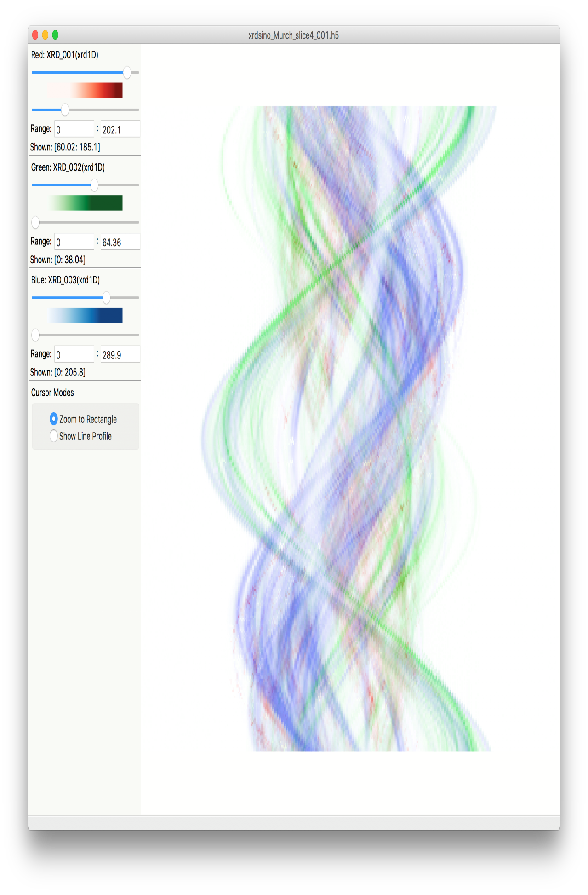
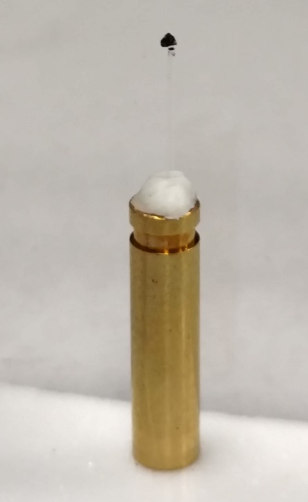
XRD Tomography - absorption contrast reconstructed through sample of Murchison meteorite
Cronstedtite 001
Tochilinite 002
Forsterite 020
absorption contrast sinogram
Murchison meteorite is a CM group carbonaceous chondrite, which are rich in carbon and among the most chemically primitive meteorites.
300 μm
Translation
2 μm x 1˚ pixel size, 70 msec/pixel, 18 keV
Rotation

Slide 53


XRD Tomography - XRD tomographic reconstructions of Murchison meteorite
Tochilinite rim on chondrule surface
Chondrule
100 um
Cronstedtite 001
Tochilinite 002
Forsterite 020
Absorption

Slide 54

Fluorescence Tomography

Slide 55

Fluorescence Tomography
Collected in continuous scan mode with modern electronics. Rotation is fast axis.
360° θ rotation, 0.3° in 15 msec, 1210 angles, 400 µm horizontal translation in 1µm increments, so 480,000 pixels in ~ 1.5 hrs
Tomo reconstruction for XRF generally fast, minutes at most for a single slice.
T. Punshon, Dartmouth College

Slide 56



High-P tomography: Instrumentation
250 T press frame
Die set
Harmonic
Drive
Transport
Rails
Thrust bearings
Hydraulic
ram
Max. load 50 tons

Slide 57


High pressure tomography: setup
CCD detector
Fe – S alloy
Top view
Al₂O₃
Microscope objective
Phosphor
(YAG)
Mirror
Sample
Monochromator
Rotation
Drickamer
Incident X-rays
(white)
Visible light
Transmitted X-rays
Monochromatic beam
Problems:
  Start/stop is hard on thrust bearings, they don’t last
  Maximum speed is only 0.05 deg/s, inefficient to start/stop
Solution: on-the-fly scanning, allows overlapping motion and exposure

Slide 58



Slide 59


High-P microtomography: 3D imaging of texture at P, T and strains
Notes:
In-situ microtomographic imaging of complex microstructure at high pressure and temperature
The high-pressure tomography apparatus (left) at GSECARS allows three dimensional imaging of complex materials an dmineral assemblies at various pressure, temperature, and deformation conditions, with a spatial resolution of a few microns. Shown on the right is an example of a composite material made of olivine (dunite) and FeS, collected at 3 GPa. The olivine matrix has been digitally removed, so the spatial distribution and shapes of individual FeS “inclusions” can be seen. With this unique technique we can study seggregation process of Fe-rich melts in silicate matrix, a problem directly related to understanding the formaiton of the Earth’s core. We can also study deformation of composite materials (such as the mineral assembly silicate peorvskite and ferropericlase, considered to be the main constituency of the lower mantle), to understand their rheological behavior

Slide 60

Deformation and Fluid Flow Cell
Major thrust is studies of fluids and deformation at shallow crustal conditions (3-5 km depth).
Triaxial deformation rig for tomographic imaging at high-pressure and temperature (Renard, 2016)
Plan to hold a workshop to finalize the design to maximize utility to the community.
NSF "Research Coordination Network: In situ Studies of Rock Deformation (ISRD)” (Wenlu Zhu PI) will be funded for workshops.

Slide 61




Beamline Control Screens
Monochromator
Slits

Slide 62



Beamline Control Screens
Filters
X-Ray Mirror
5-axis lift table

Slide 63


Tomography Control Screens
Camera stage
Sample stage
5-axis lift table

Slide 64

TomoScan Data Collection Screen
TomoScan Python program controls data acquisition
Collects dark fields, flat fields, and projections
Saves data in HDF5 files
Complete control through EPICS Process Variables, so everything can be controlled and scripted by any client on the network

Slide 65


TomoScan Metadata Screen
Metadata is saved for both user-entered information shown here, as well as many EPICS PVs for the state of the storage ring, beamline, sample stage, etc.
Can add additional metadata for a specific experiment (temperature, etc.)
EPICS scan record can scan any EPICS PV and collect a complete tomography dataset at each point in the scan.
Vertical sample position scanned here
Could scan monochromator energy, sample temperature, etc.

