Slide 1
Smaller and Faster:
Data Compression in areaDetector
Mark Rivers
GeoSoilEnviroCARS, Advanced Photon Source
University of Chicago

Slide 2
Data Compression Motivation
We are already in the era of “big data” with existing detectors. Eiger, Pilatus, Lambda, PCO, FLIR/Point Grey, Xspress 3, etc.
Can all produce data faster than most disk systems can handle
All exceed 1 Gbit network capacity, and some exceed 10 Gbit.
Rapidly fill up disks
Will become a more serious issue with the APS-U
Increased count rates will allow existing detectors to run at their maximum speed
New generations of even faster detectors will be coming
Data compression can help with these issues
Must be fast and easy to use

Slide 3
Support for Compressed NDArrays and NTNDArrays
NDArray has 2 new fields to support compression
.codec field (struct Codec_t) to describe the compressor
typedef enum {
NDCODEC_NONE,
NDCODEC_JPEG,
NDCODEC_BLOSC,
NDCODEC_LZ4,
NDCODEC_BSLZ4
} NDCodecCompressor_t;
typedef struct Codec_t {
std::string name; /**< Name of the codec */
int level; /**< Compression level. */
int shuffle; /**< Shuffle type. */
int compressor; /**< Compressor type */
.compressedSize (size_t) field with compressed size if codec.name is not empty.
pvAccess NTNDArray has always had .compressedSize and .codec fields, but never previously implemented in servers or clients

Slide 4
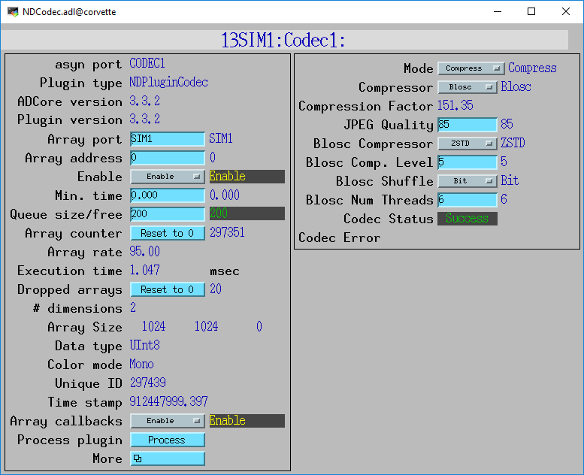
NDPluginCodec (R3-4)
New plugin for data compression and decompression
Written by Bruno Martins from FRIB
Mode:
Compress or Decompress
Compressor:
None
JPEG (JPEGQuality selection)
Blosc (many options, next slide)
LZ4
BSLZ4 (Bitshuffle/lz4)
CompFactor_RBV:
Actual compression ratio
CodecStatus, CodecError
JPEG is lossy, all others lossless

Slide 5
Blosc Codec Options
BloscCompressor options. Each has different compression performance and speed
BloscLZ
LZ4
LZ4HC
Snappy
Zlib
Zstd
BloscCLevel
Compression level: 0=no compression, 9=maximum compression.
Increasing execution time with increasing level.
BloscShuffle
Choices = None, Byte, Bit.
Differences in speed and compression performance.
BloscNumThreads
Number of threads used to compress each NDArray

Slide 6
LZ4 and BSLZ4 Codecs
These are the codecs used by the Eiger server from Dectris
They don’t use the Blosc codecs, but rather the native LZ4 and Bitshuffle/LZ4 codecs.
Dectris server can optionally use these compressions for HDF5 files saved locally on their server
Dectris server always uses one of these compressions for data streamed over the ZeroMQ socket interface to the ADEiger driver
These can now be decoded directly in ADEiger, or passed as compressed NDArrays to NDPluginCodec and other plugins
Compressed arrays can be passed directly to NDFileHDF5 to be written with newly supported direct chunk write feature. More on this later.

Slide 7
HDF5 Changes (R3-5)
NDFileHDF5 file writing plugin has always supported the “built-in” compression filters from HDF5:
N-bit
SZIP
ZLIB
R3-3 added support for Blosc filters
New support for LZ4 and Bitshuffle/LZ4 filters
All of these compressors are called from the HDF5 library.
Limits performance because of the overhead of the library.
New support for HDF5 Direct Chunk Write
The NDArrays can be pre-compressed, either in NDPluginCodec, or directly by the driver (e.g. ADEiger)
Much faster, much of the code in the HDF5 library is skipped.
Fixed a number of memory leaks, some were significant
Added FlushNow record to force flushing datasets to disk in SWMR mode

Slide 8
HDF5 Direct Chunk Write Performance
1024x1024 32-bit images
simDetector generating ~1350 frames/s = 5.4 GB/s.
Blosc LZ4 ByteShuffle compression
Compression level 6.
NDPluginCodec
6 Blosc threads
3 plugin threads.
Compression factor is ~64
Time to save a single HDF5 file with 10,000 frames.
 | No compression | NDFileHDF5 compression | NDPluginCodec compression, direct chunk write
File size (MB) | 40,000 | 650 | 650
Total time (s) | 106 | 32 | 7.4
Frame/s | 94 | 312 | 1,351
MB/s uncompressed | 389 | 1,250 | 5,405
MB/s compressed | N.A. | 20 | 88
HDF5 library can only compress 312 frames/s
NDPluginCodec & direct chunk write keeps up with simDetector 1,350 frames/s

Slide 9
HDF5 Decompression Plugin Filters (ADSupport R1-7)
HDF5 supports dynamic loading of compression and decompression filter libraries at run time.
The Blosc, LZ4 and BSLZ4 have been built into the HDF5 library in ADSupport so that dynamic loading is not required when using NDFileHDF5.
However, to decompress HDF5 files compressed with Blosc, LZ4 or BSLZ4 with other applications dynamic loading of the filters will be required
ADSupport now builds these dynamic filter libraries for Linux, Windows, and Mac.
Must set the following environment variable to use them:
HDF5_PLUGIN_PATH=[areaDetector]/ADSupport/lib/linux-x86_64

Slide 10
HDF5 Decompression Plugin Filters
>h5dump --properties test_hdf5_direct_chunk_3.h5
HDF5 "test_hdf5_direct_chunk_3.h5" {
GROUP "/" {
GROUP "entry" {
…
DATASET "data" {
DATATYPE H5T_STD_U32LE
DATASPACE SIMPLE { ( 100, 1024, 1024 ) / ( 100, 1024, 1024 ) }
STORAGE_LAYOUT {
CHUNKED ( 1, 1024, 1024 )
SIZE 4082368 (102.742:1 COMPRESSION)
}
FILTERS {
USER_DEFINED_FILTER {
FILTER_ID 32001
COMMENT blosc
PARAMS { 2 2 4 4194304 8 1 1 }
}
}
…
DATA {
(0,0,0): 173140, 173141, 173142, 173143, 173144, 173145, 173146,
(0,0,7): 173147, 173148, 173149, 173150, 173151, 173152, 173153,
(0,0,14): 173154, 173155, 173156, 173157, 173158, 173159, 173160,
(0,0,21): 173161, 173162, 173163, 173164, 173165, 173166, 173167,

Slide 11
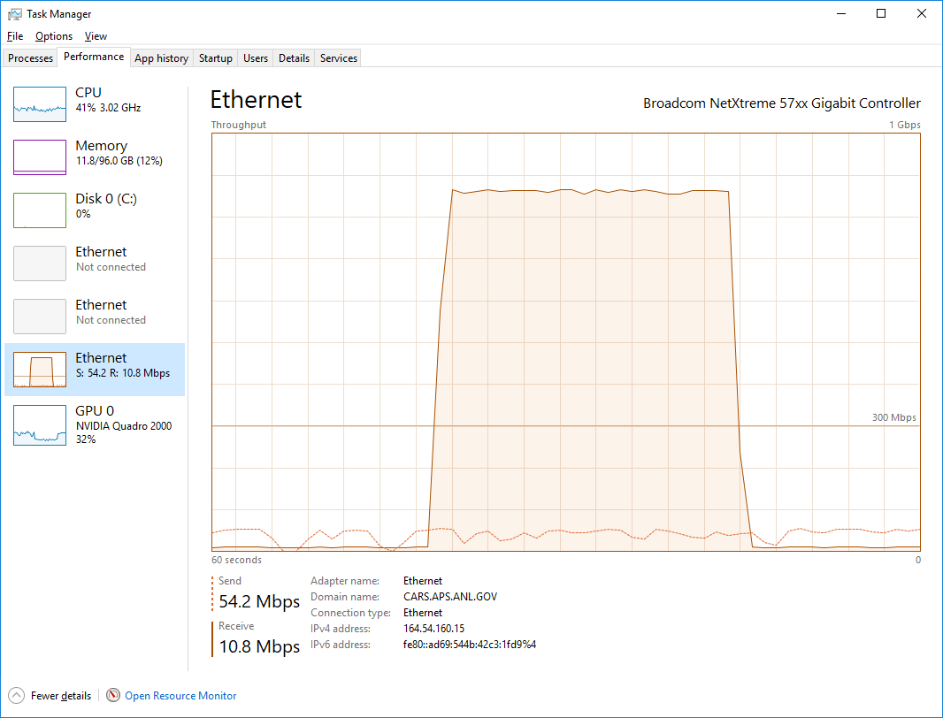
ImageJ pvAccess Viewer
Now supports displaying compressed NTNDArrays
Supports all compressions (JPEG, Blosc, LZ4, BSLZ4)
Can greatly reduce network bandwidth when the IOC and viewer are running on different machines
No compression
Blosc compression

