Slide 1
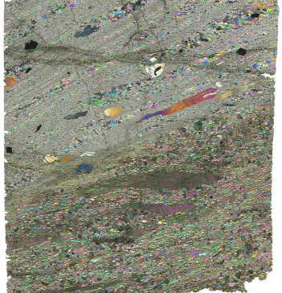
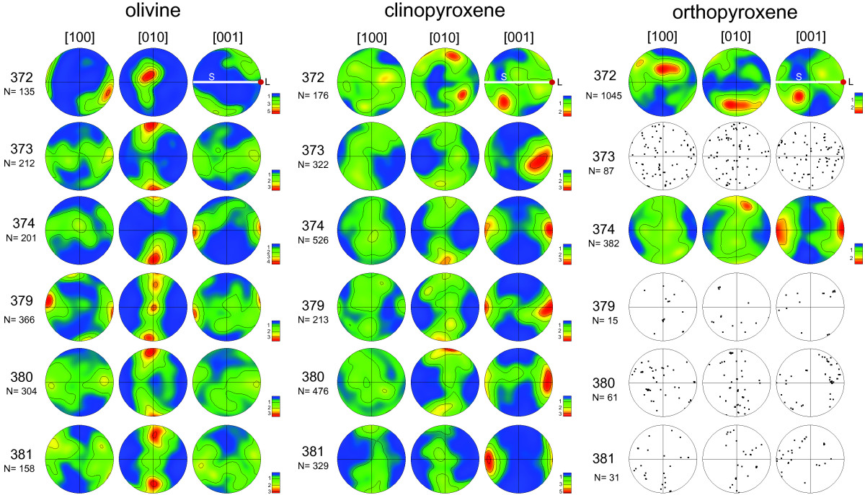
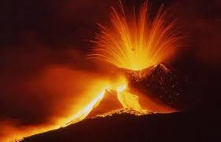
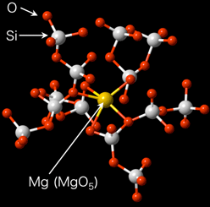
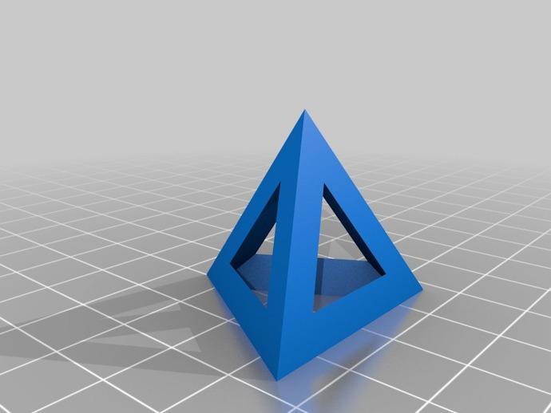
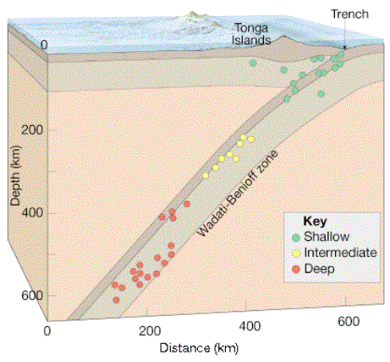
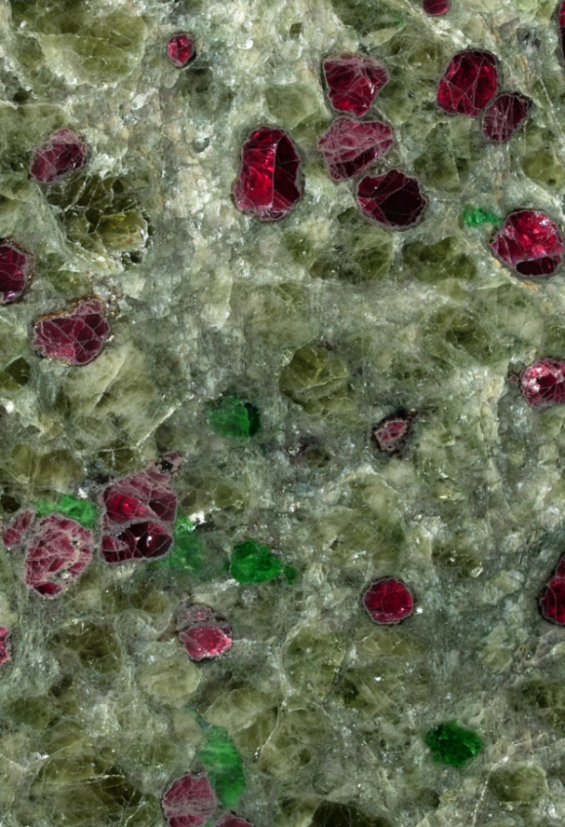
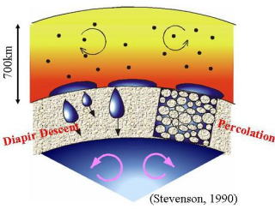
Ductile flow & texture
Melt separation & migration
Length scale: subatomic to >thousands of km
Dynamic response
(“performance”)
(P, T, σ, t, L)
LVP:
“the materials science approach”
Brittle failure
(multi-phase) Structure
(P, T, σ, t, L)
(multi-phase) Properties
(P, T, σ, t, L)
“processing”
(P, T, σ, t, L)
Time scale: sub-seconds to >billions of years
Heterogeneous & multi-scale nature of earth processes requires studies on large samples with various grain sizes in complex systems. Must combine synchrotron with other in-situ probes.
Core formation
Multiphase composites

Slide 2
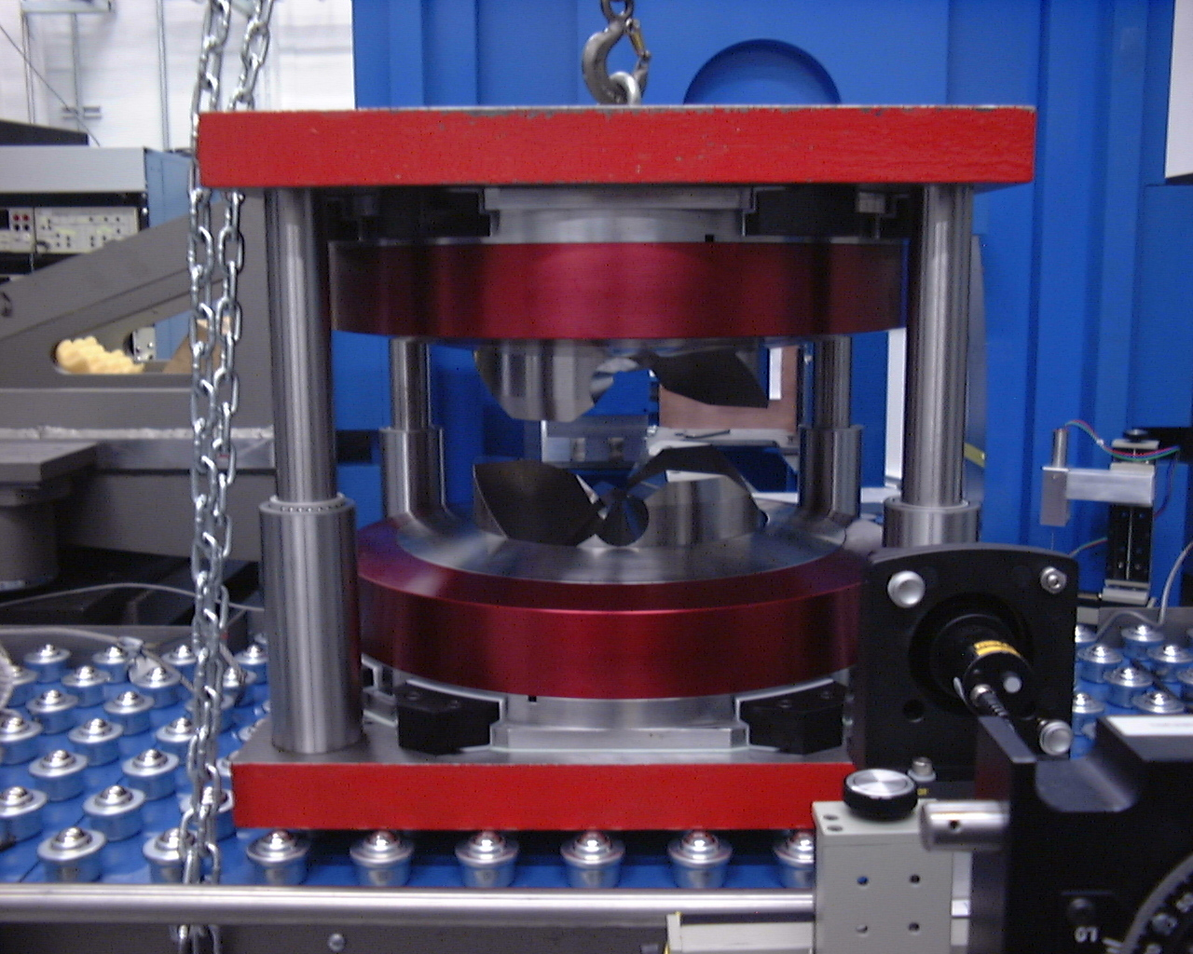
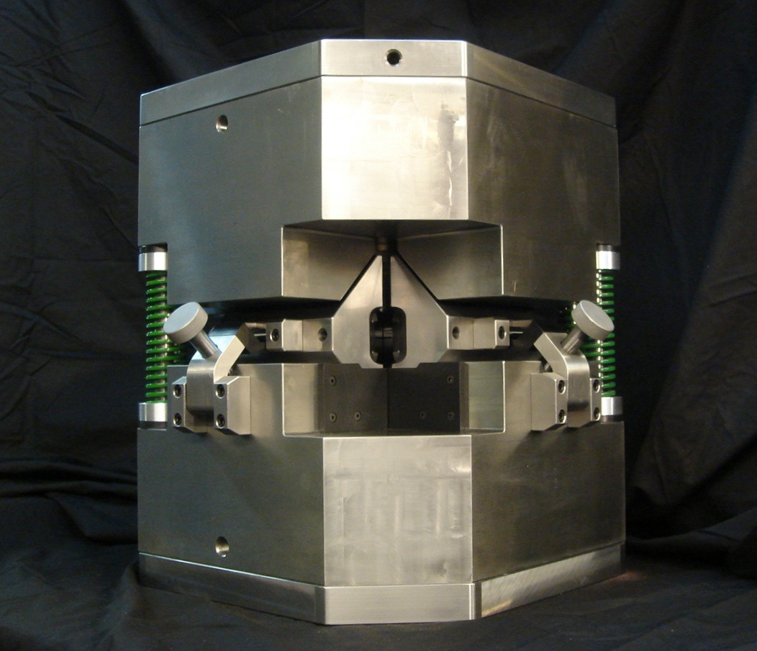
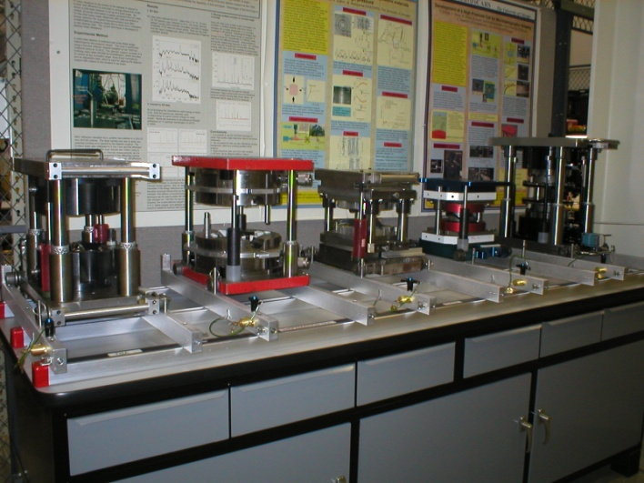
Most advanced LVP facility
XRD for crystallography (ADXD) and phase relation (EDXD)
P-V-T-V_{P}-V_{S}-K_{S}-G equations of state (XRD + acoustic velocities)
Rheology of mantle minerals and aggregates (XRD, imaging, controlled deformation)
Brittle failure and earthquake mechanisms (acoustic emission)
Geo-liquids: structure (XRD) and property systematics (viscosity, elasticity, density)
High-pressure tomography of complex geo-materials under high P and T
“Swiss-army knife” approach for maximum flexibility
So far 260 unique users, 10 post-docs (six moved to academic positions - 2 US, 1 Germany, 1 France, 1 Japan, 1 China)
T-25
DDIA-30

Slide 3
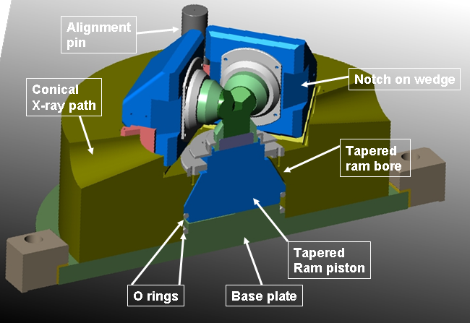
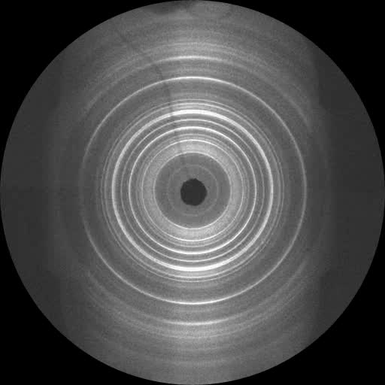
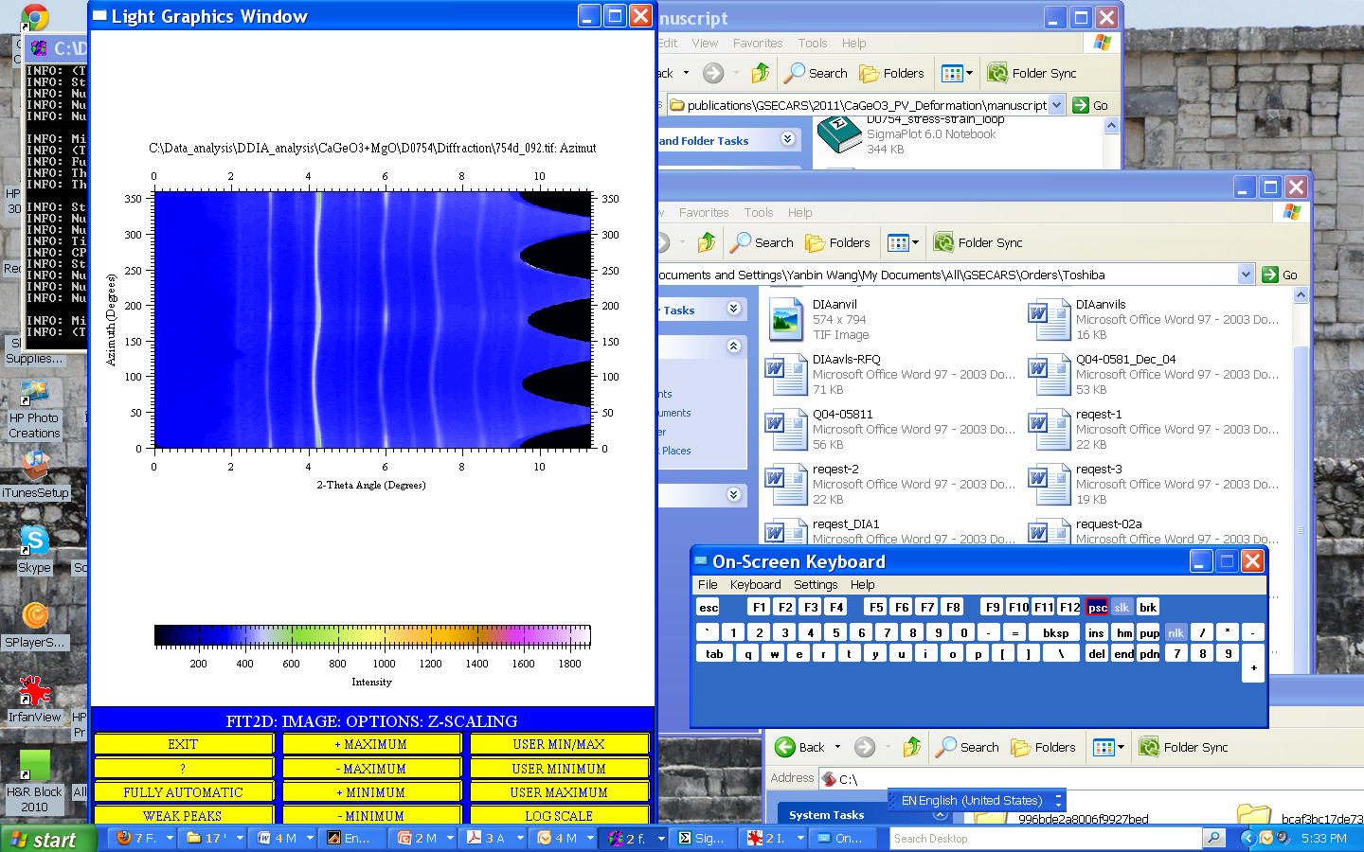
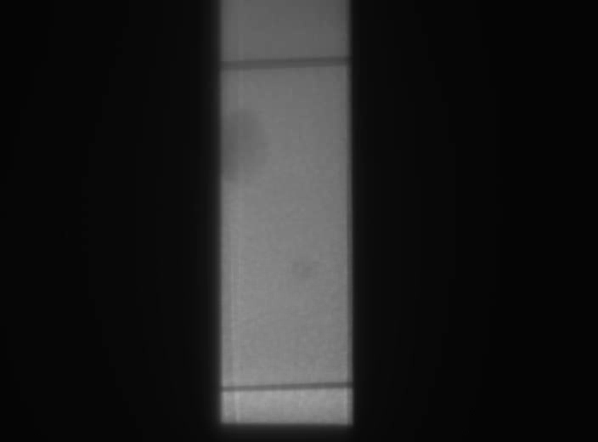
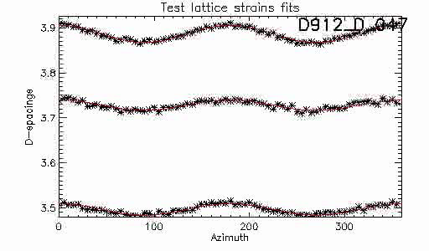
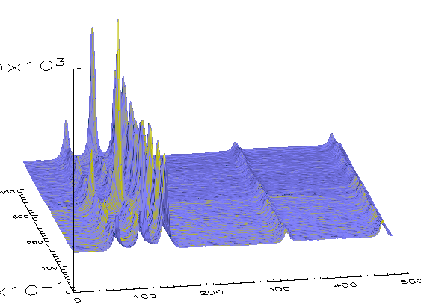
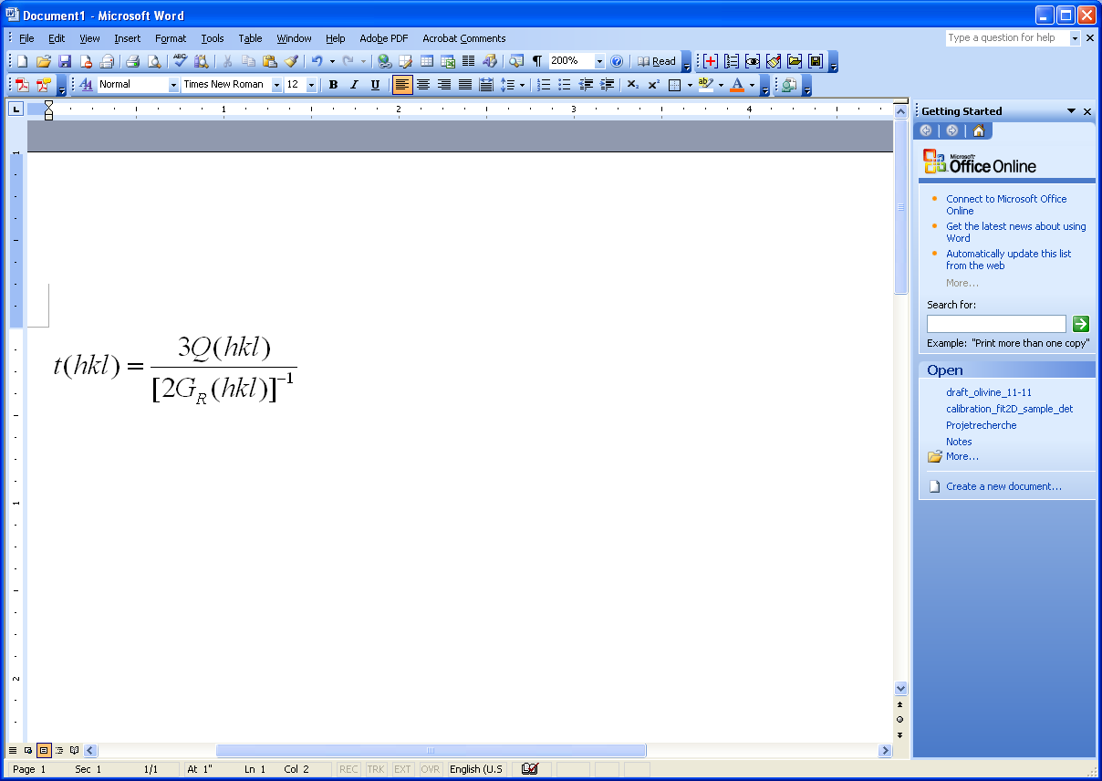
Controlled deformation at high P and T
Deformation DIA (D-DIA)
X-rays
2θ
ψ
Azim. angle, 0-360°
Wang et al., RSI, 2003
2D diffraction data
2theta
Azimuth, Ψ
Multiple (72) 1D patterns
Auto peak position fitting
ε(hkl) = [d(hkl)-d₀(hkl)]/d₀(hkl)
= Q(hkl) (1-cos²Ψ)
(t = σ₁ – σ₃)

Slide 4
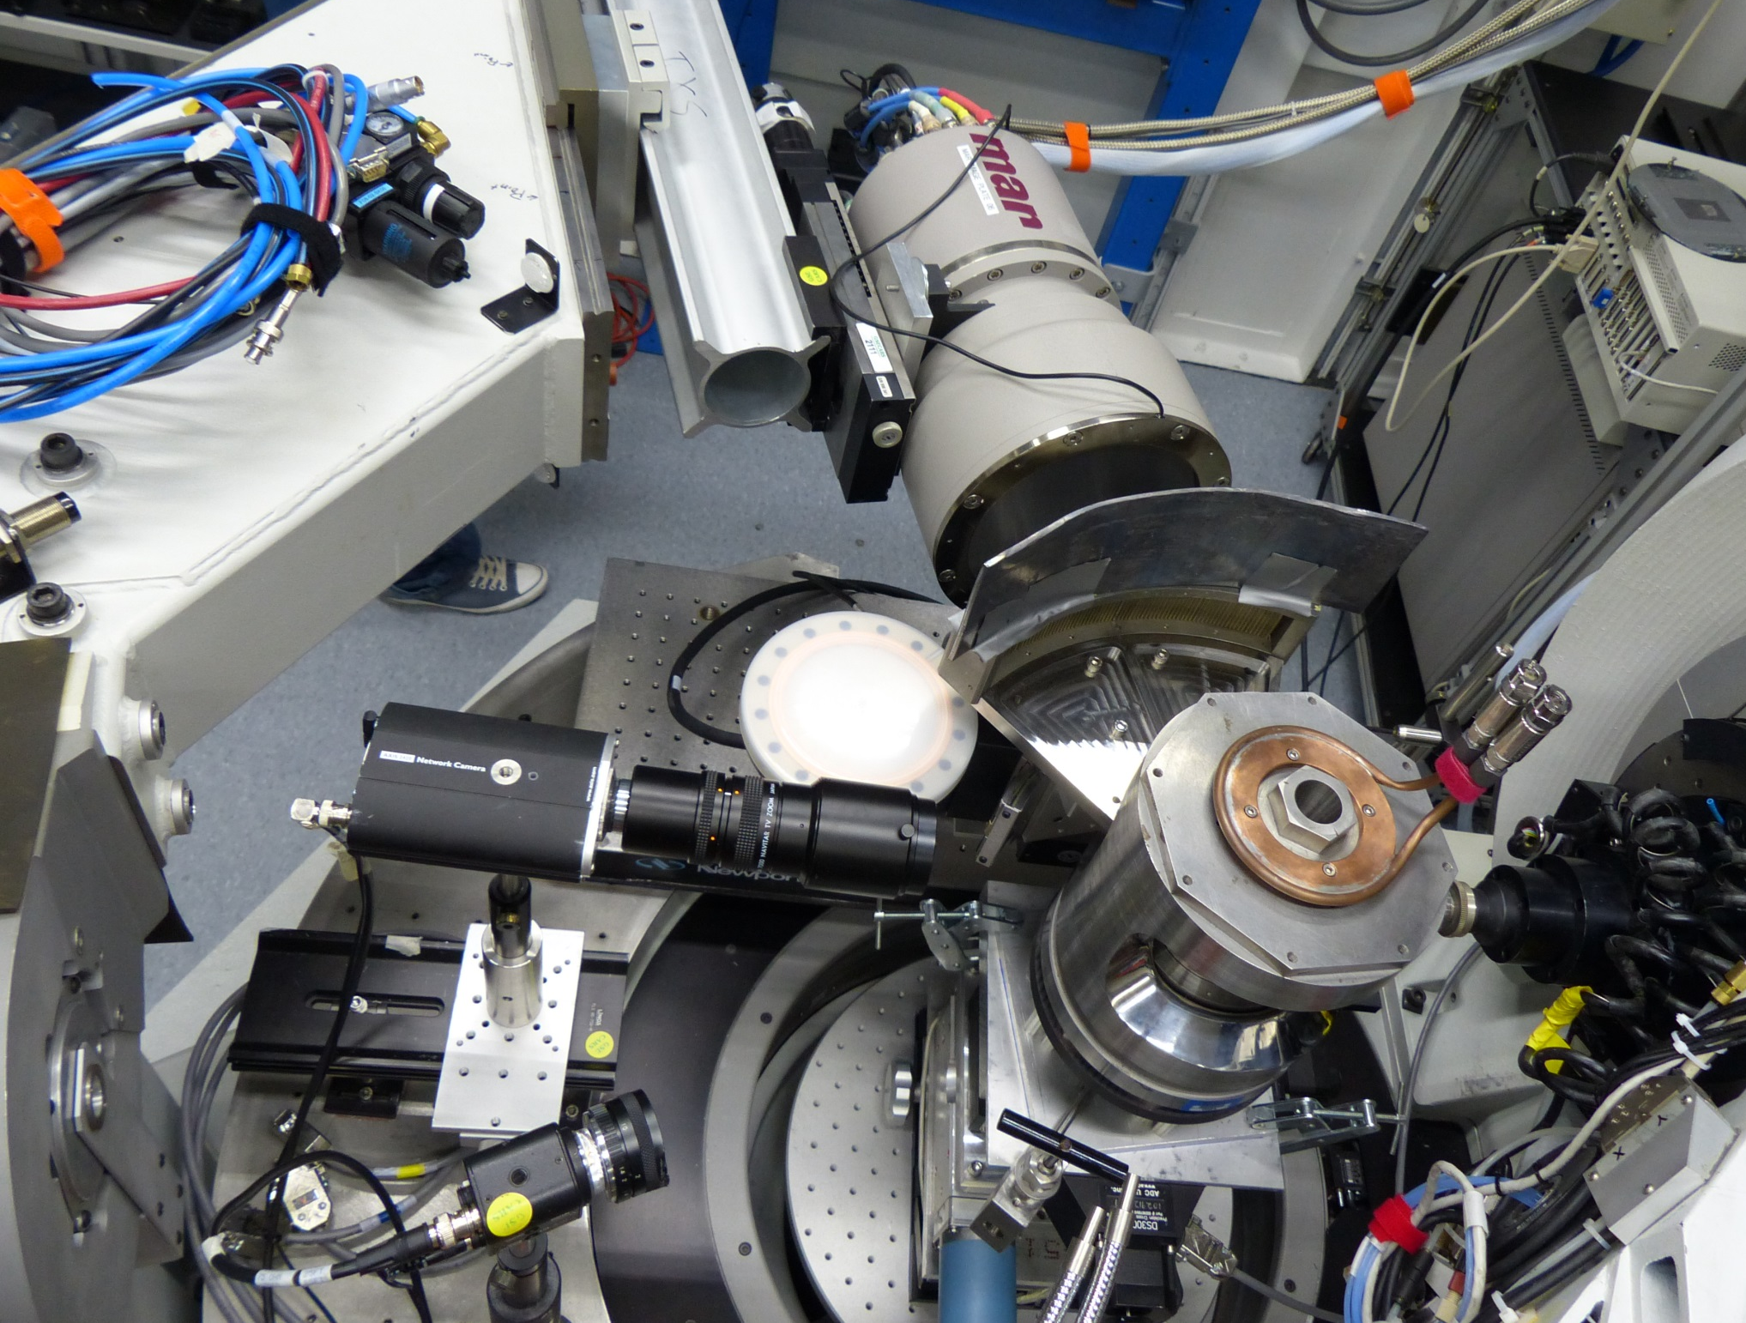
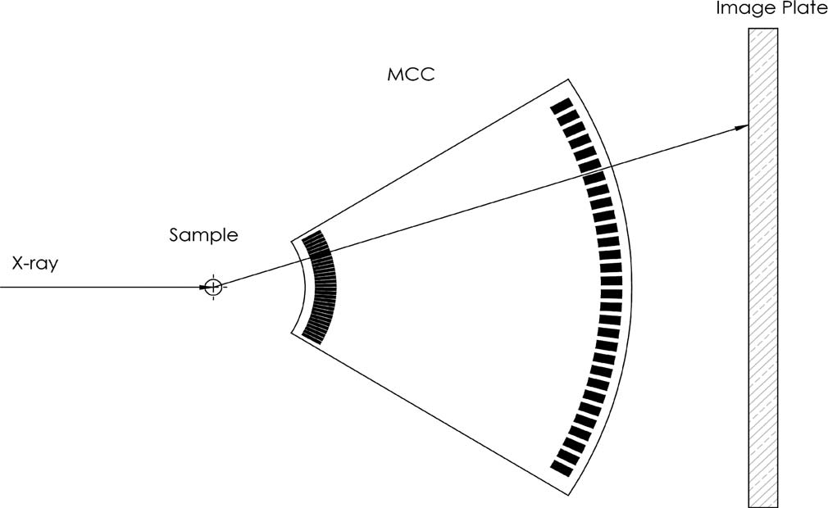
PE cell with multi-channel collimator (MCC) & mono diffraction: liquid structure and links to melt physics (another PEC with EXDX at 16-BM-B)
MAR CCD
MCC
PE

Slide 5
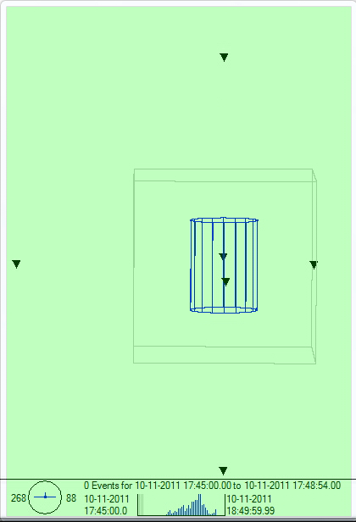
Highlight 1: acoustic emission in D-DIA - deep earthquakes
Schubnel et al., Science, 2013
SP
SP

Slide 6
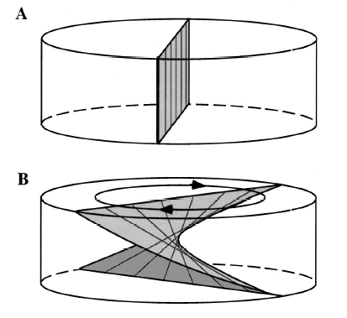
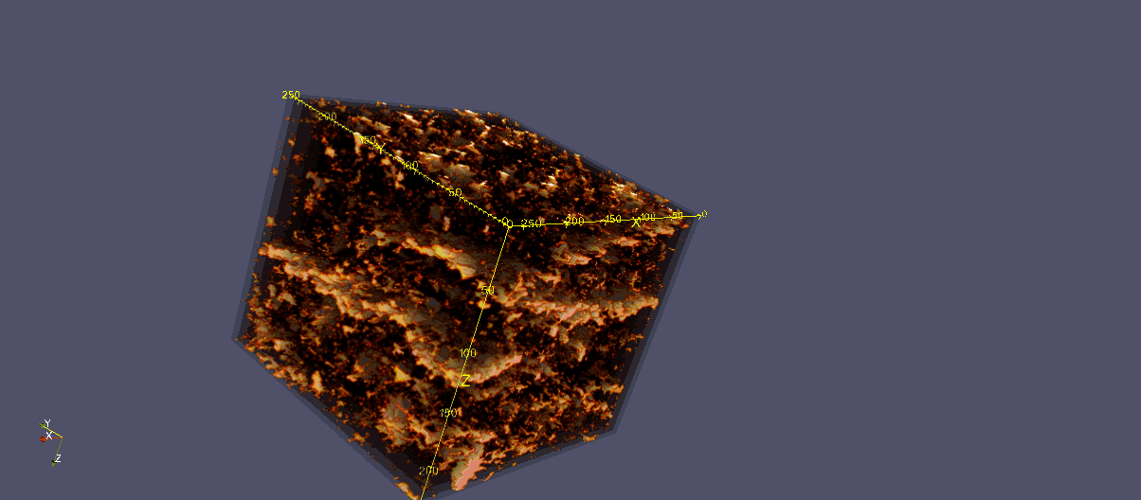
Highlight 2: Imaging shear-induced Fe-S melt segregation – core formation
Todd et al., Am Min, in press (Kasey Todd’s Master’s thesis)
Simple shear by high P-T torsional deformation
In-situ high pressure tomographic imaging

Slide 7
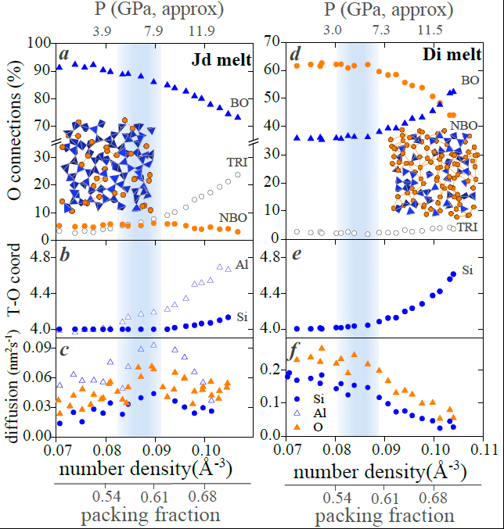
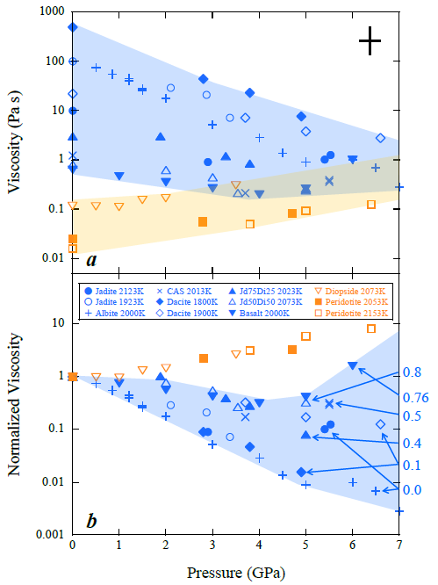
Highlight 3: Why do liquids with different NBO/T respond to P in differently?
Wang et al., Nat. Comm., 2014
(NBO/T~0)
(NBO/T~2)
NBO/T
2.0

Slide 8
LVP next 5 years: MBA upgrade in the horizon
--Taking advantages of high intensity AND high brightness
Megabar regime LVP experiments
  Unique double-stage system in the US (partially funded by COMPRES, 2007)
    Currently ~40 GPa and 2000 C
    New WC anvils capable of 50 GPa; sintered diamond anvils ~ 100 GPa
    Deep mantle petrology (an Infrastructural Development proposal submitted to COMPRES, March 2016)
Melt structure at megabar pressures
  DAC and double-stage Paris-Edinburgh cell to 100 GPa and beyond (PEC partially funded by COMPRES, 2010)
  Focused mono incident beam, MCC collimates diffracted signal
  Faster data collection (minutes) with “flash heating”
High-pressure diffraction tomography for 3D mapping
  Focused beam reduces collection time from weeks/days to a few hours
    Reaction/transformation kinetics
    Mechanical faulting
    Fluid-rock interaction
High-energy Laue mono is the key for these developments

Slide 9
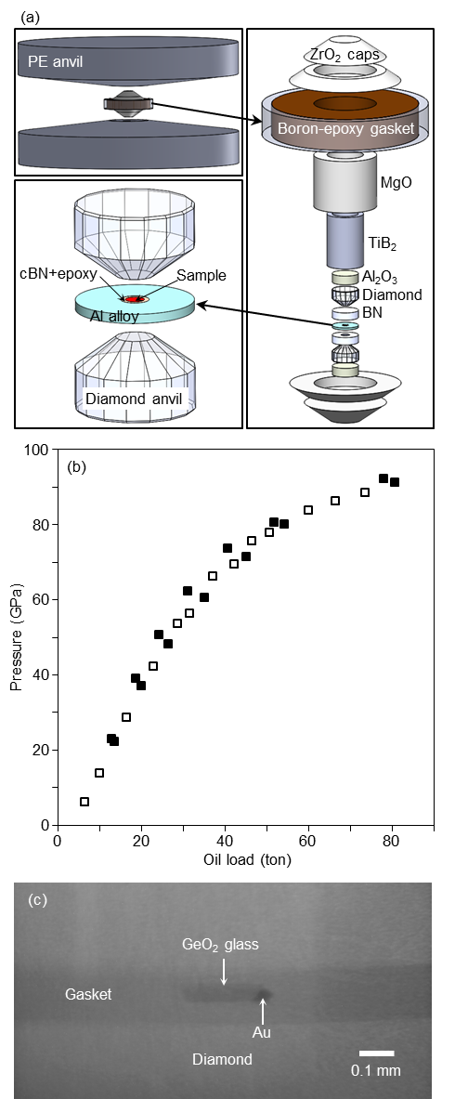
Structure of melts to megabar pressures
Kono et al., PNAS, 2016
(PEC at 16-BM-B)

Slide 10
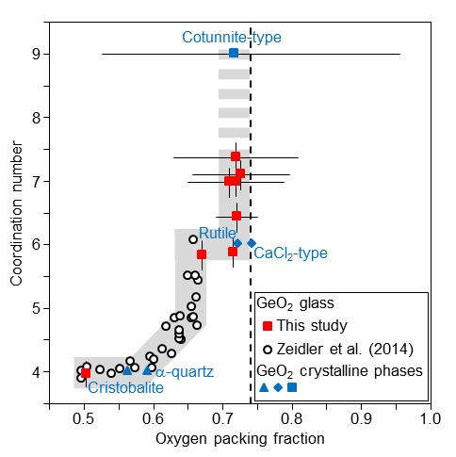
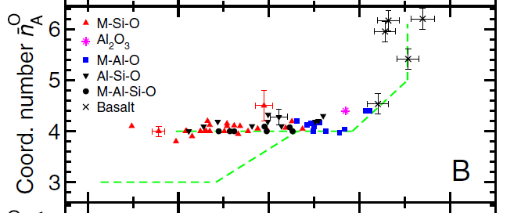
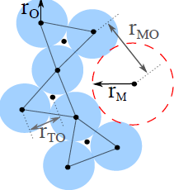

Glasses and melts under extreme compression
Kono et al., PNAS, 2016
High-energy Laue will deliver mono beams up to 120 keV, with unprecedented Q coverage for liquid studies.
~300 GPa
93 GPa
62 GPa
Densest random packing state
“KC”, ~ 0.74
50 GPa
20-40 GPa
MRJ state, ~ 0.64
Zeidler et al., PNAS, 2014

Slide 11
Next 5 years of ultrasonic studies:
velocities AND attenuation, solids, partial melts, AND liquids
Chantel et al., Sci. Adv., in press.
Associate Editor (Karen Fischer):
“The experimental results described in this study are very interesting and have the potential to shed new light on the degree of melt that is present in the asthenosphere.”
olivine
olivine
MORB
Proposed system upgrade will allow detection of multiple wave train reflections for better attenuation measurement. Wider frequency range also helps addressing dispersion issues.
V(ω,T)=V₀(T){1-cot(πα/2)/[2Q(ω,T)]}
Faul et al., JGR, 2004
torsional, seism. freq.
Q ∝ ω^{α}

Slide 12
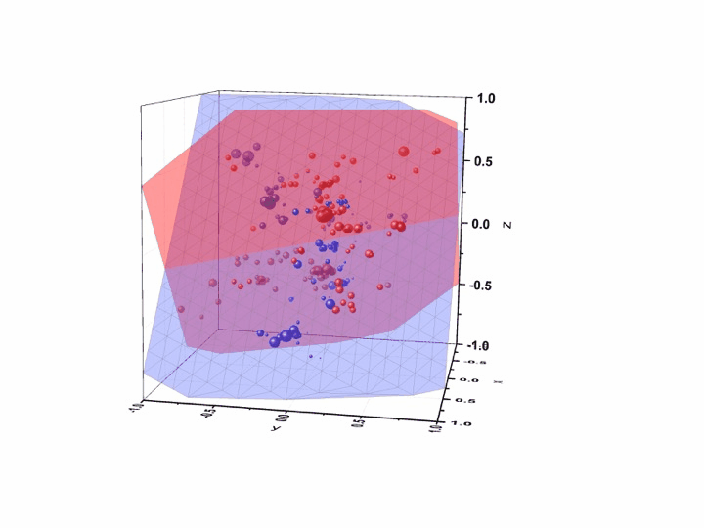
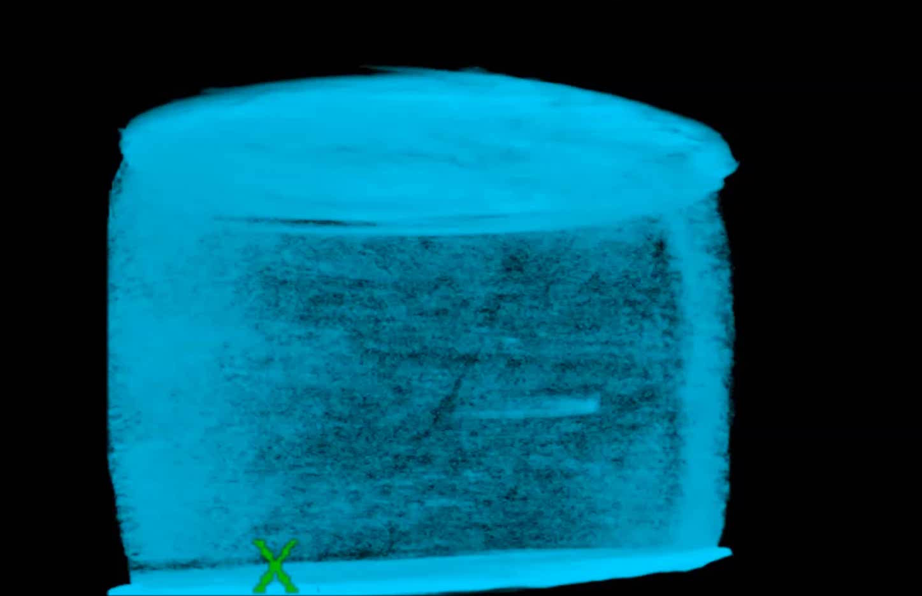
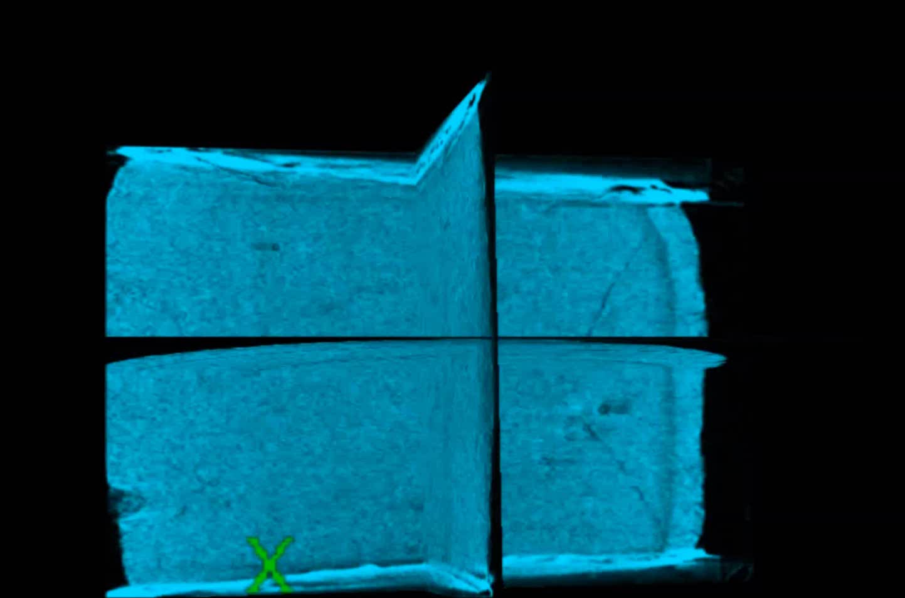
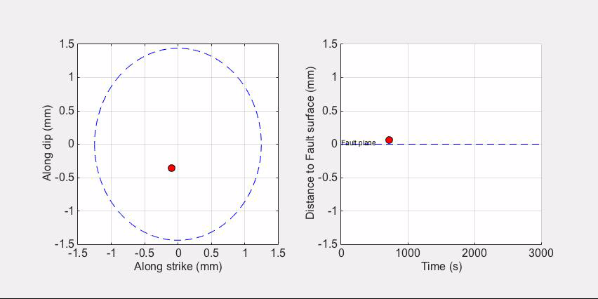
Next 5 years of AE studies: the making of deep faults
Wang, Zhu, Shi, Yu, et al., in prep.
Use of seismological algorithm HypoDD improves precision of hypocenter locations by a factor of ~20
Mo
1.0
5.0
Time series showing red events within 0.2 mm of the red fault plane

Slide 13
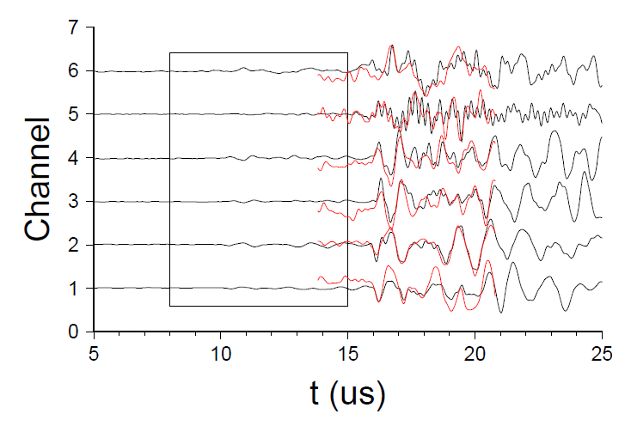
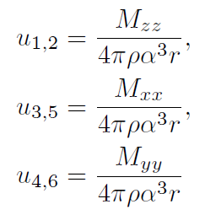
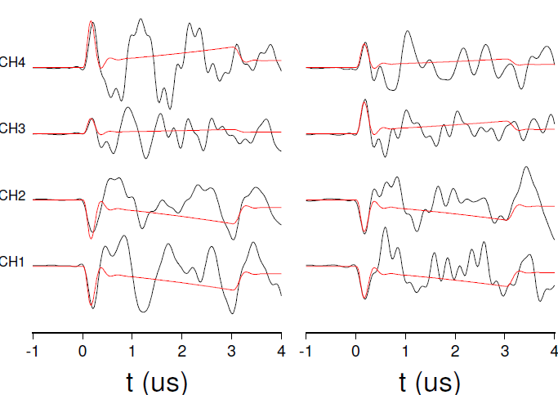
Seismology in the lab
Wang, Zhu, Shi, Yu, et al., in prep.
Whole-space approx., far-field P wave amplitudes are directly related to moment tensor diagonal components:
Waveforms in the black box multiplied by 10
593 events
Evet #528
Synth. P-wave 1st motions
Planning a CSEDI proposal for further AE development (with L. Zhu at SLU)
  Broadband P transducers (received)
  Broadband amplifiers (awaiting quotation)
  Add S wave transducers for 3-component (P, S_{V}, S_{H}) detection
  Upgrade AE system to 18 channels
  Develop calibration procedures to quantify transducer amplitude
Event 277
Event 288

Slide 14
Thank you!

