Slide 1

Moving on from OMS:
GSECARS Experience with Galil Motor Controllers
Mark Rivers
GSECARS, University of Chicago
APS TWG Meeting, February 19, 2026

Slide 2
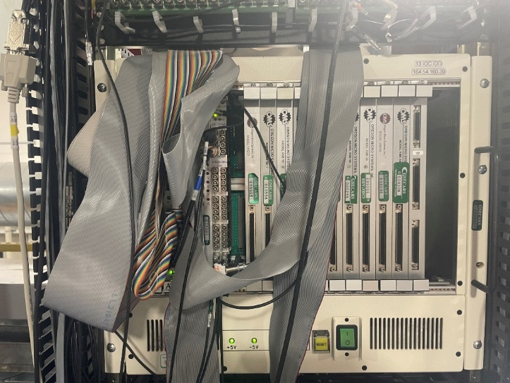
Motivation
GSECARS and nearly all other beamlines at the Advanced Photon Source (APS) used VME for motion control, A/D, D/A, digital I/O, and serial control
VME has many disadvantages:
  Very poor price/performance
  Difficult development/debugging environment
  Existing devices becoming obsolete and unsupported, e.g. OMS is going out of business
  Few new devices being developed
  Local vxWorks expertise is disappearing as staff retire
GSECARS decided to take advantage of the APS “dark year” in 2023-2024 to eliminate VME
Needed to be cost effective since we had a limited budget

Slide 3
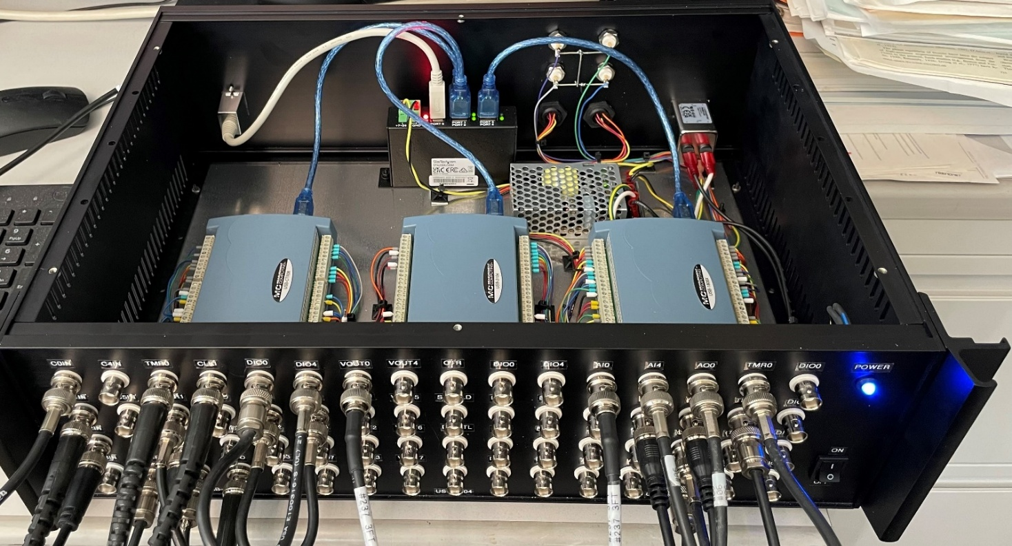
Measurement Computing Electronics
Functionality
8 analog inputs, 18-bit, 200 kHz streaming
10 analog outputs, 16-bit, 500 kHz streaming
8-channel counter/timer with same functions as Joerger scaler and SIS 3820 MCS
6 programmable pulse generators
20 digital I/O bits, each in or out
2 quadrature encoder inputs
GSECARS enclosure for USB-1808X, USB-3104, USB-CTR08
USB hub, 68 BNC connectors, 2 encoder connectors
$2,200 for electronics, plus packaging done at GSECARS

Slide 4
Motion Control
This was the most challenging aspect of moving away from VME at reasonable cost.
This was the count of the motor controllers and axes at GSECARS.
Motor controllers at GSECARS
 | VME |  | Non-VME
 | OMS-58 | OMS MAXv | Newport XPS | ACS MCB-4B | Aerotech | Delta Tau
Total controllers | 44 | 8 | 17 | 8 | 1 | 2
Total axes | 352 | 64 | 136 | 32 | 7 | 14
Total axes | 605
Two popular non-VME motor controllers at APS are Newport XPS and ACS MP4U. These each cost more than $16,000 for an 8-axis version.
GSECARS needed to replace 52 VME motor controllers, which would be $832K with those controllers.
  This was not feasible within our budgets.
Our VME modules were only controlling simple open-loop stepper motors, mainly with Step-Pak drivers.

Slide 5
Galil DMC-4183 8-Axis Controller
$2,330 base cost without amplifiers
7-8 times less expensive than XPS or ACS controllers.
Ethernet interface
Pulse and direction and analog drive outputs for steppers or servos.
  Directly replaces OMS for use with Step-Pak or Phytron drivers
Optional on-board stepper and/or servo drivers.
Supports incremental and absolute (BISS, SSI) encoders
8 analog inputs
16 optically isolated inputs and outputs

Slide 6
Galil DMC-4183 Important Features
Up to 15 MHz encoder frequency
Multitasking for concurrent execution of up to eight programs.
Optically isolated home and limit inputs.
PID compensation with velocity and acceleration feedforward, integration limits, notch filter and low-pass filter.
Modes of motion include point-to-point positioning, jogging, PVT, contouring, linear and circular interpolation, electronic gearing and ECAM.
Mature EPICS driver written by Mark Clift at the Australian Synchrotron
Supports complex coordinated motion (EPICS profile moves)
Supports Position Compare Output (PCO) for triggering detectors at specific positions
Optional plugin amplifier boards for steppers, brushed servos, and 3-phase brushless servos.

Slide 7
Current Status at GSECARS and 6-BM-B
55 Galil controllers (440 axes) at GSECARS
4 controllers (32 axes) at 6-BM-B
33 controllers using pulse & direction to Step-Pak and Phytron drivers
26 controllers using on-board amplifiers for steppers, servos, and 3-phase brushless servo motors
No failures in nearly 2 years of operation
Very smooth transition from OMS controllers.
  Motor numbers stayed the same
  Cabling was largely preserved
  Much more functionality than OMS provides

Slide 8
Amplifier Cards Used at GSECARS
Amplifier outputs
D4040 for small stepper motors ($205)
  4-channel stepper motor driver with 0.5, 0.75, 1.0, 1.4 A/phase
  Micro-stepping (x1, x2, x4, x16)
  0%, 25%, or 100% holding current
D4140 for larger stepper motors ($675)
  4-channel stepper motor driver with 0.5, 1.0, 2.0, 3.0 A/phase
  Micro-stepping (x64)
  0%, 25%, or 100% holding current
D3140 for small servo motors ($205)
  4-channel brushed servo motor driver with 1 A max. current, 20 W max. power
D3020 for larger servo motors ($505)
  2-channel brushed servo motor driver with 7 A max. current, 500 W max. power
D3547 for larger stepper, brushed servo, and =brushless servo motors ($1,400)
  4-channel driver for stepper, brushed servo, and 2 or 3-phase brushless motors
  Stepper motors: 0.75, 1.5, 2.0, 6.0 A/phase, micro-stepping (x256)
  Brushed and 3-phase brushless servos: 8 A, 600 W

Slide 9
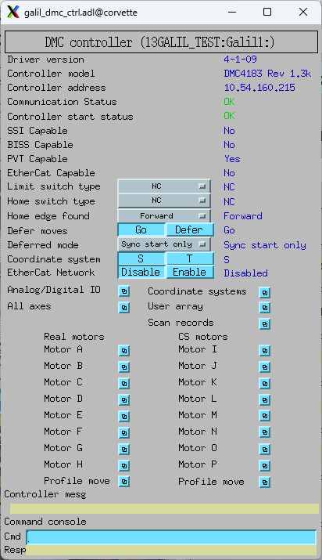
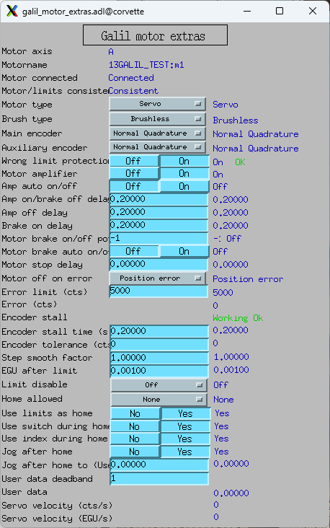
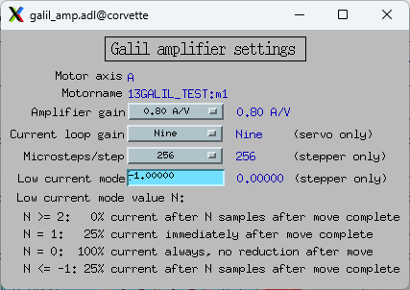
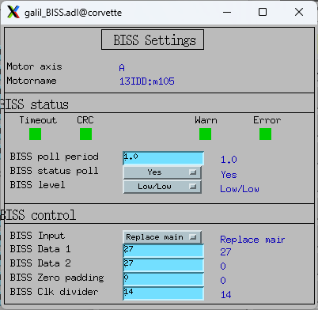
Galil Specific Screens – Rich Features

Slide 10
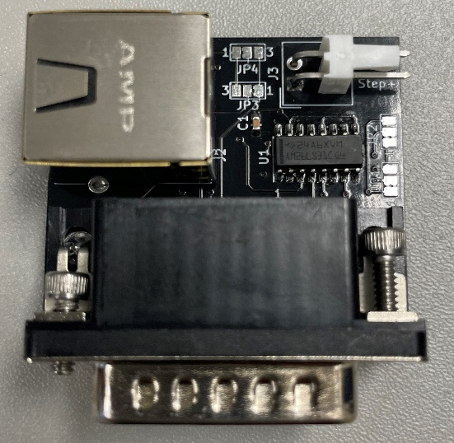
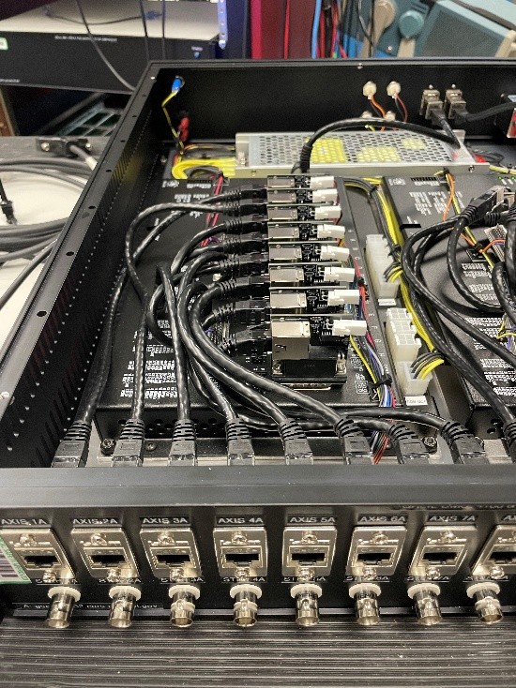
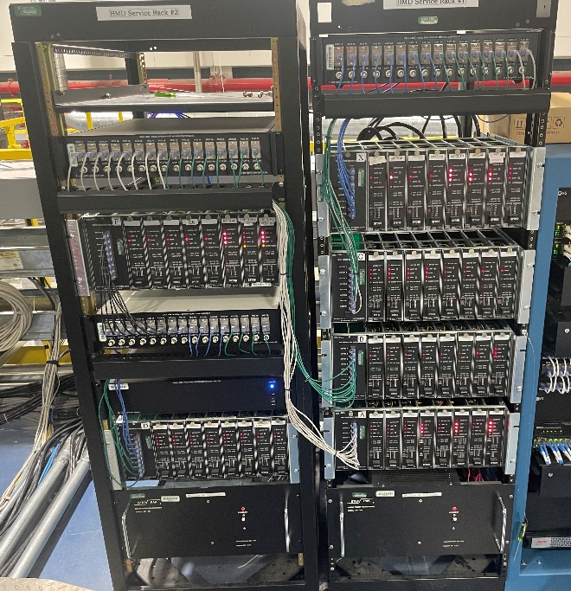
GSECARS Packaging for Galil Controllers with Step & Direction to
External Step-Pak or Phytron Amplifiers
Custom circuit board for each channel
HD-26 connector plugs into Galil controller
Step, direction, and limits on RJ-45 connector
Converts step and direction from single-ended to differential, required by Step-Pak and Phytron
2-pin Molex connector for step-out (single-ended), used for fly scanning.
Enclosure with 2 controllers (1 shown) with circuit boards in place.
RJ-45 connectors to Step-Pak/Phytron
BNC connector for step-out
Racks for 13-BM-D station
3 enclosures with 2 controllers each for Step-Paks
1 enclosure with on-board D4040 drivers and ELCO connectors in rear

Slide 11
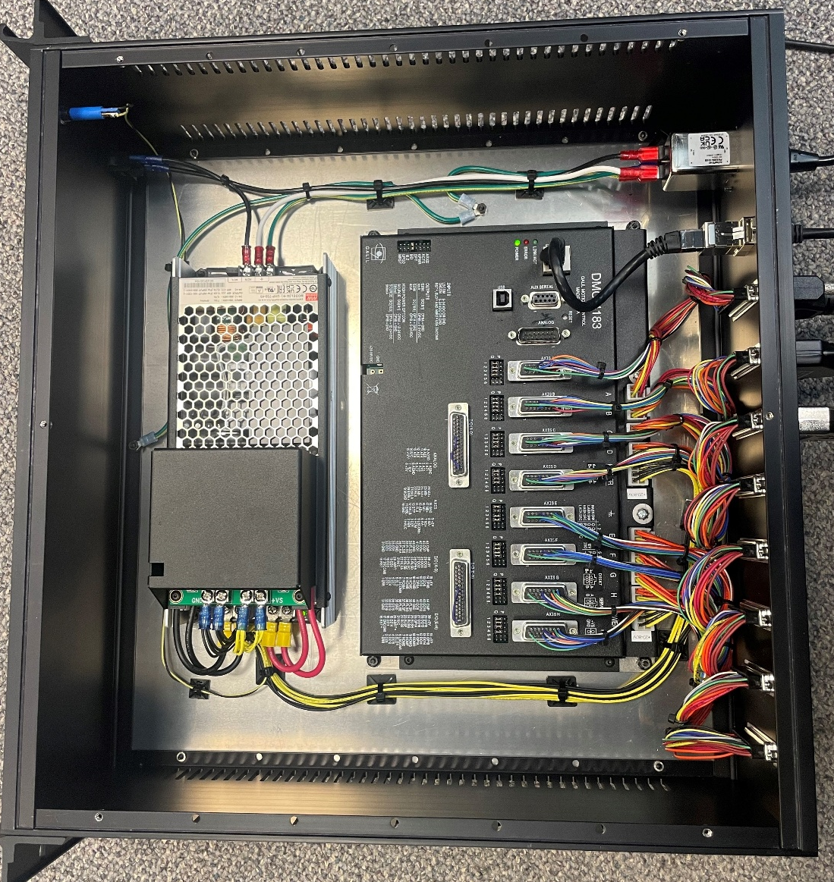
GSECARS Packaging for Galil Controllers with On-Board Amplifiers
HD-26 connectors for limits, encoders (8)
4-pin Molex connectors for motor drive output (8)
HD-44 connectors for limit common, position compare outputs, digital I/O (2)
Power supply chosen for expected motor currents
~15 minutes to replace controller if needed

Slide 12
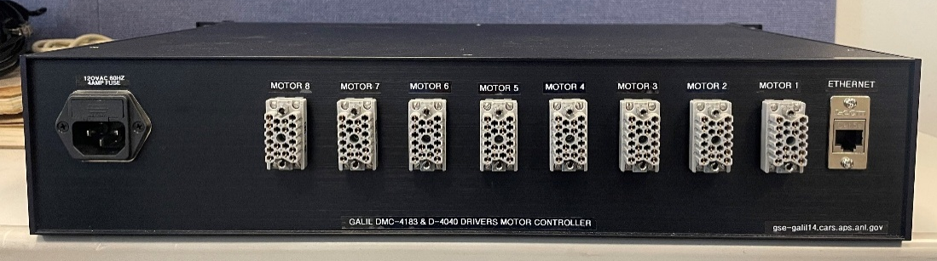
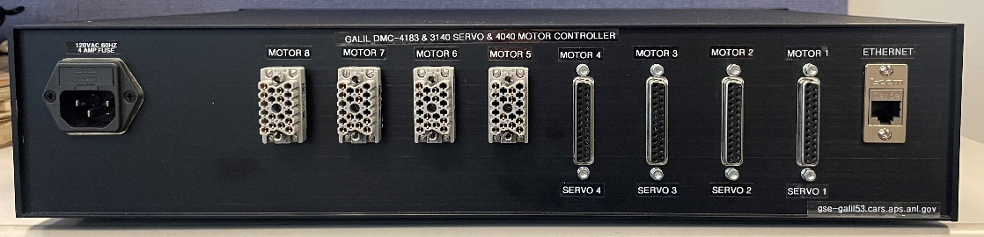
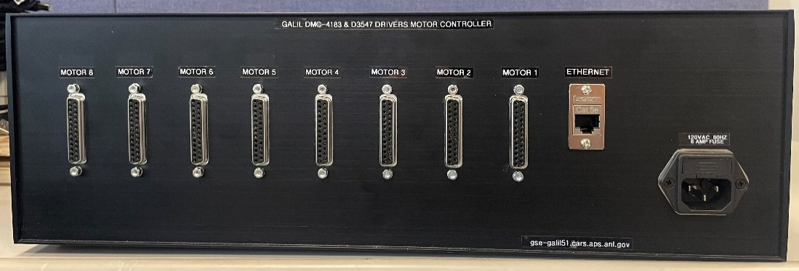
GSECARS Packaging for Galil Controllers with On-Board Amplifiers
Boxes all Constructed by Pasquale (Lino) Di Donna at GSECARS
D4040 (1.4A) or D4140 (3.0 A) stepper motor drivers with ELCO connectors using APS pinout.
Replaces OMS and Step-Pak or Phytron drivers.
4 D4040 stepper drivers using ELCO connectors with APS pinout.
4 D3140 servo drivers (1 A) with DB-25 connectors using standard Newport XPS pinout.
D3547 drivers with DB-25 connectors using standard Newport XPS pinout.
Can driver stepper motors (6 A), brushed servo motors (8 A), and 2 or 3-phase brushless motors (8 A).

Slide 13
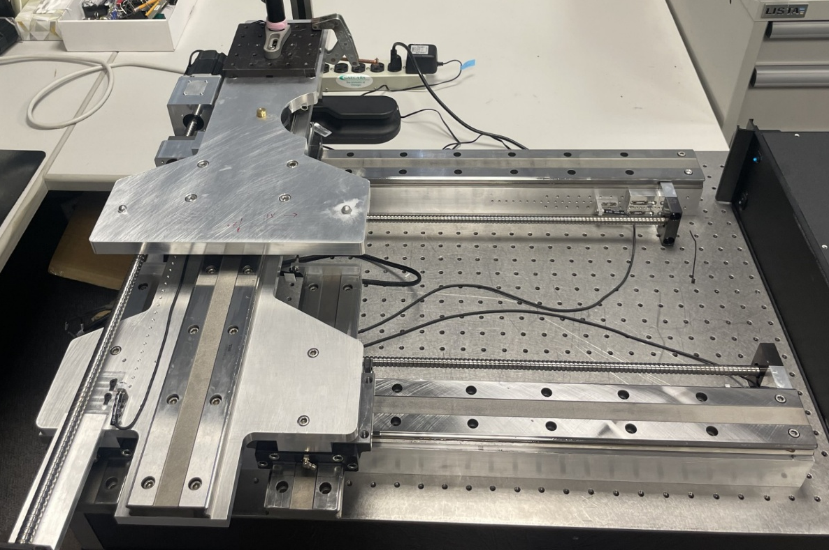
Coordinated Motion for Virtual 2-θ Detector Mount
3 Cartesian axes (Xu, Xd, Z), kinematic mount with Hudson 3-phase brushless motors
Want to move detector in polar coordinates on virtual 2-θ circle with variable sample-detector distance (SD) and variable X offset (Xo).
Ball
Detector
platform
X₁
Z
X₂
Plane
Vee

Slide 14
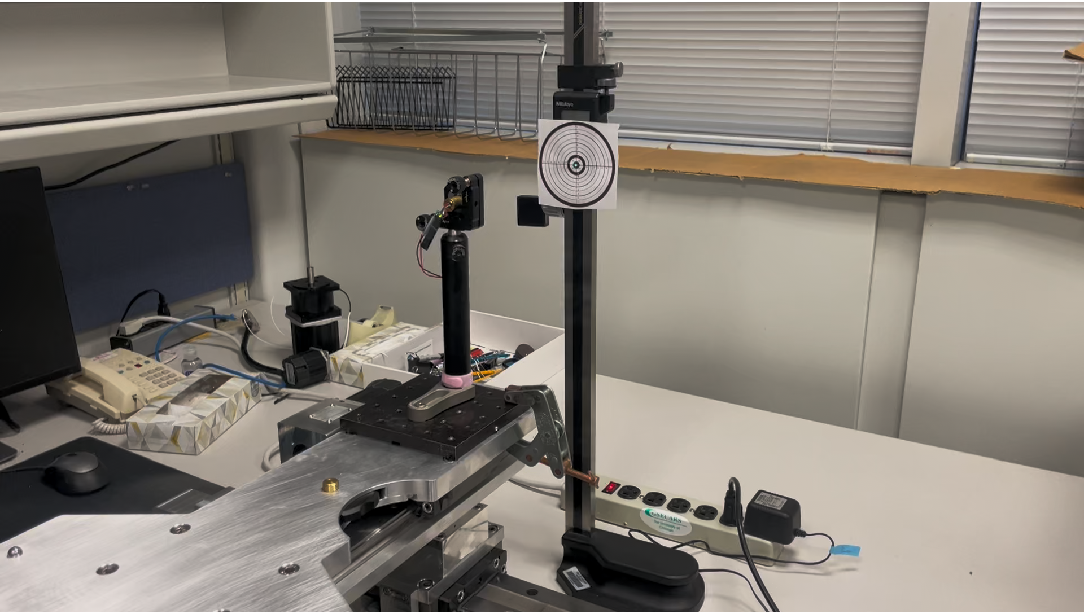
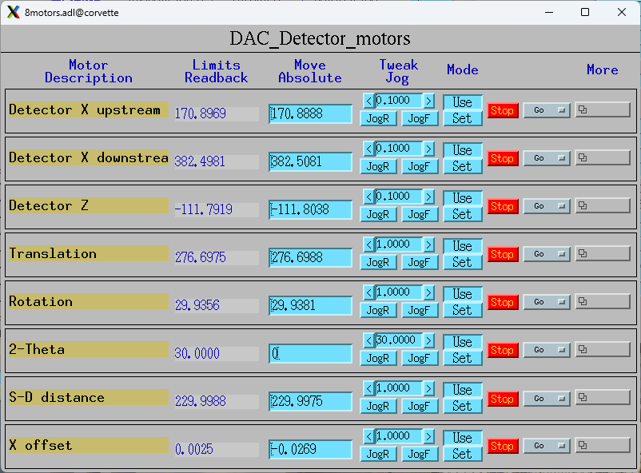
Simple Solution – Soft Motor Support
Motor records with soft device support for 2-θ, SD, and Xo.
Transform records to calculate the forward and reverse transformations.
This solution works but the motion is not coordinated, so it may lead to collisions and cannot be fly-scanned.
Moving soft motor 2-θ from 0° to 30°.
Motors are not coordinated

Slide 15
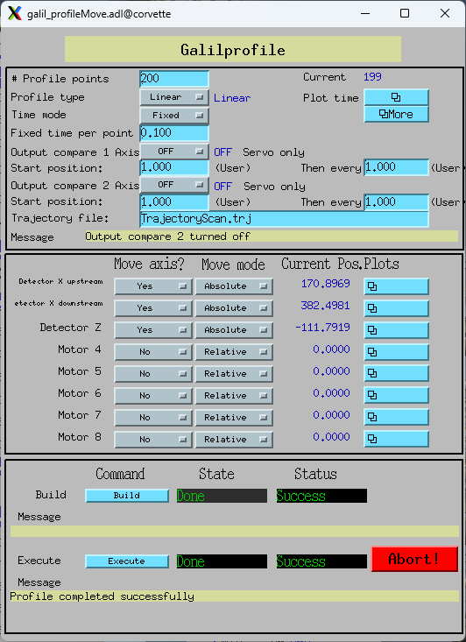
More Complex Solution – Profile Move Support
The EPICS driver for Galil controllers implements the Model 3 “Profile Move” interface.
This supports complex coordinated motion
PVs for the number of profile points and time per point.
Waveform records define the position of each enabled axis for each point in the profile.
Can use Position Compare outputs to trigger detectors at specific encoder positions
Very similar interface to the Newport XPS profile move.

Slide 16
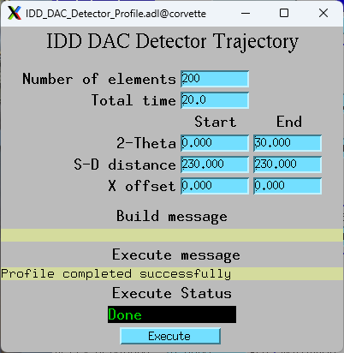
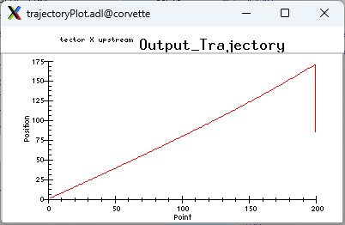
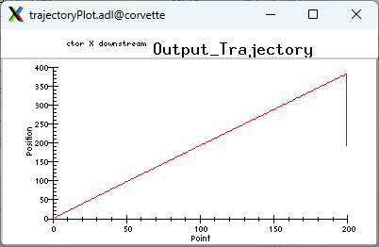
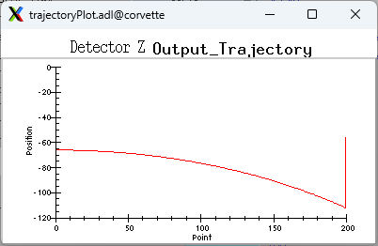
Coordinated Motion of Detector Mount
User interface defines:
  Number of profile elements (segments)
  Total time for the move
  Start and end points for 2-θ, SD, and Xo.
  Begin execution
The waveforms for motion of each real axis are computed in the IOC (not in a client) using acalcout records.
Database copies those waveforms to the Galil driver profile records, builds the profile, and executes it.
Upstream X position array
Downstream X position array
Z position array

Slide 17
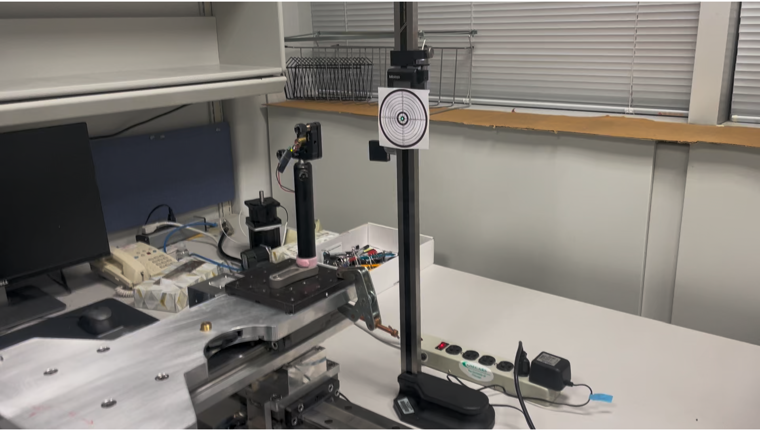
Coordinated Motion of Detector Mount

Slide 18
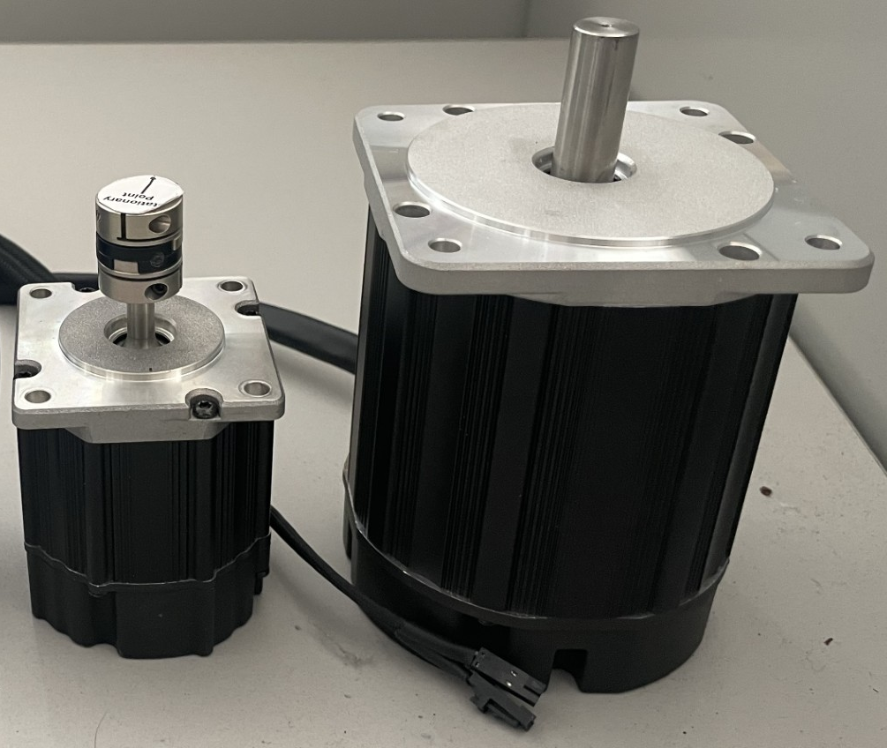
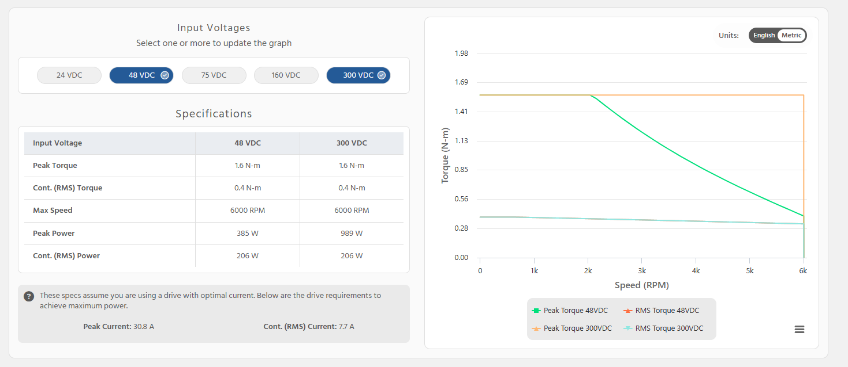
Teknic Hudson 3-Phase Brushless Motors
Very nice replacements for stepper motors
Built-in 8,000 counts/rev encoder
6,000 RPM maximum speed
NEMA 23 and 34 frame sizes
24-340 V operational range
Peak torque from 1.6 to 12.3 N-m
Work well with Galil controllers with 3547 amplifiers up to 80V (160V optional)

Slide 19
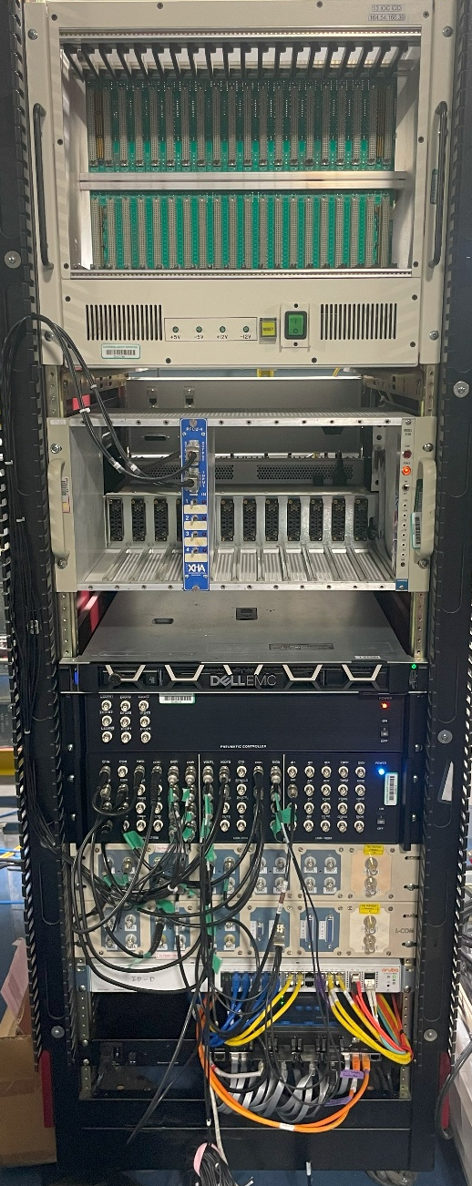
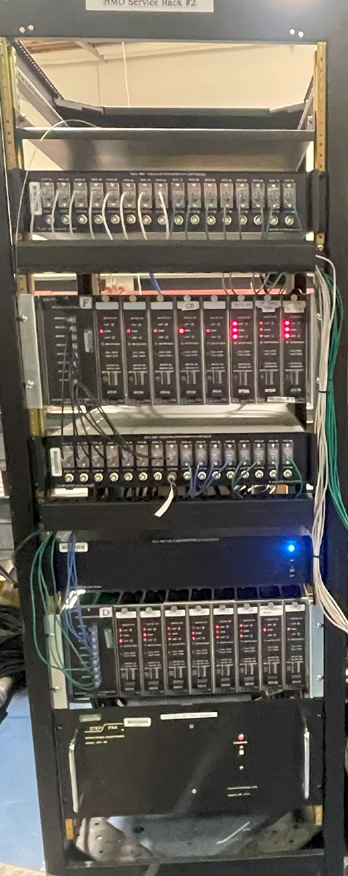
Equipment Racks
13-ID-D Control Rack
13-BM-D Motor Rack
VME crate, Unused
16-channel Galil step/direction controllers
NIM bin, XIA shutter control
8-channel Step-Paks drivers
RHEL 9 server
E-DIO24 for pneumatics
8-channel Galil with on-board stepper drivers
3 MeasComp modules
Patch panels to hutch
24-port network switch
16-port serial terminal server

