Slide 1
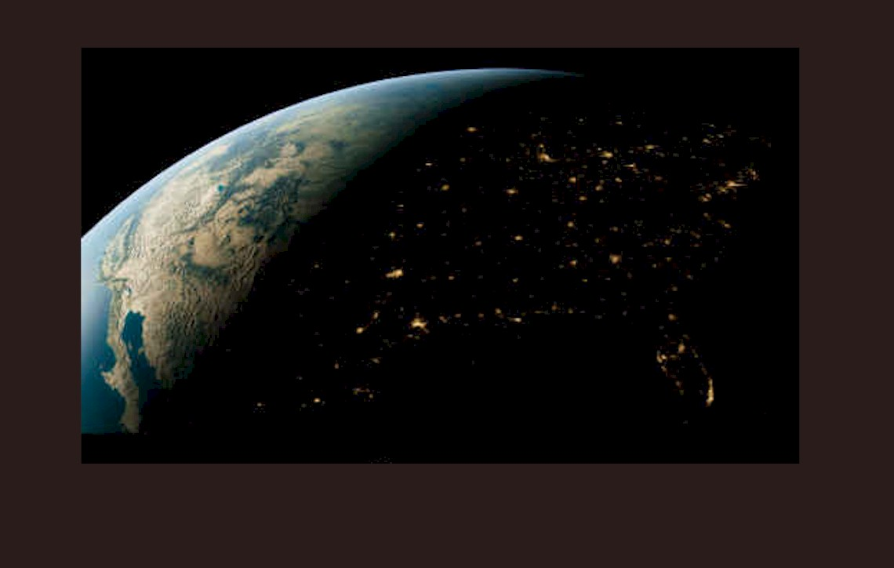
US Facilities for Diamond Anvil Cell Research
COMPRES Workshop
October 28, 2017

Slide 2
Outline
Comparison of source properties at the different synchrotrons
Overview of existing “dedicated” beamlines for diamond cell research in the US
My thoughts on what a proposal for DAC at NSLS-II will need

Slide 3
Synchrotron Sources for DAC Beamlines
Past sources
NSLS X-17 SCW | NSLS-X17 superconducting wiggler
Current sources
ALS SB | ALS superbend beamline 12.2.2
APS BM | APS bending magnet
APS UA | APS 33mm period undulator untapered
APS UA | APS 33 mm period undulator tapered
NSLS-II U20 | NSLS-II 20mm period undulator at HXN
NSLS-II DW90 | NSLS-II 90 mm period damping wiggler at XPD
Potential future sources
NSLS-II SCW 4T | NSLS-II 4 tesla superconducting wiggler at HEX
APS-U U27.5 | APS upgrade 27.5 mm period normal undulator
APS-U SCU18 | APS upgrade 18 mm period superconducting undulator
APS-U TPW | APS upgrade three pole wiggler

Slide 4
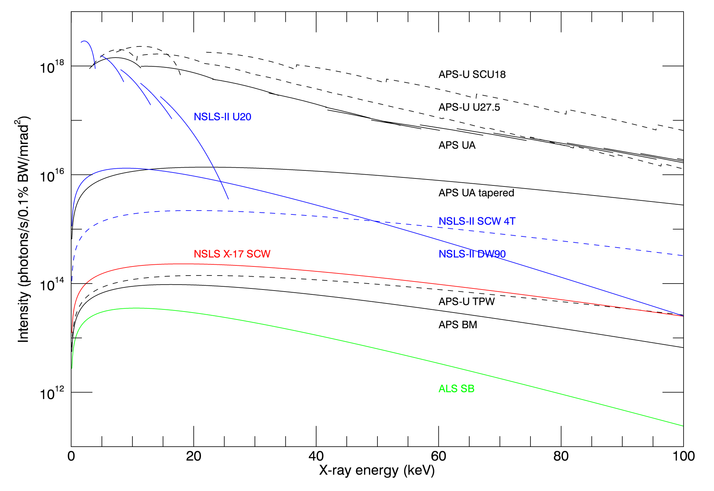
Intensity of DAC sources Figure of merit for beamline without focusing, e.g. slits on LVP

Slide 5
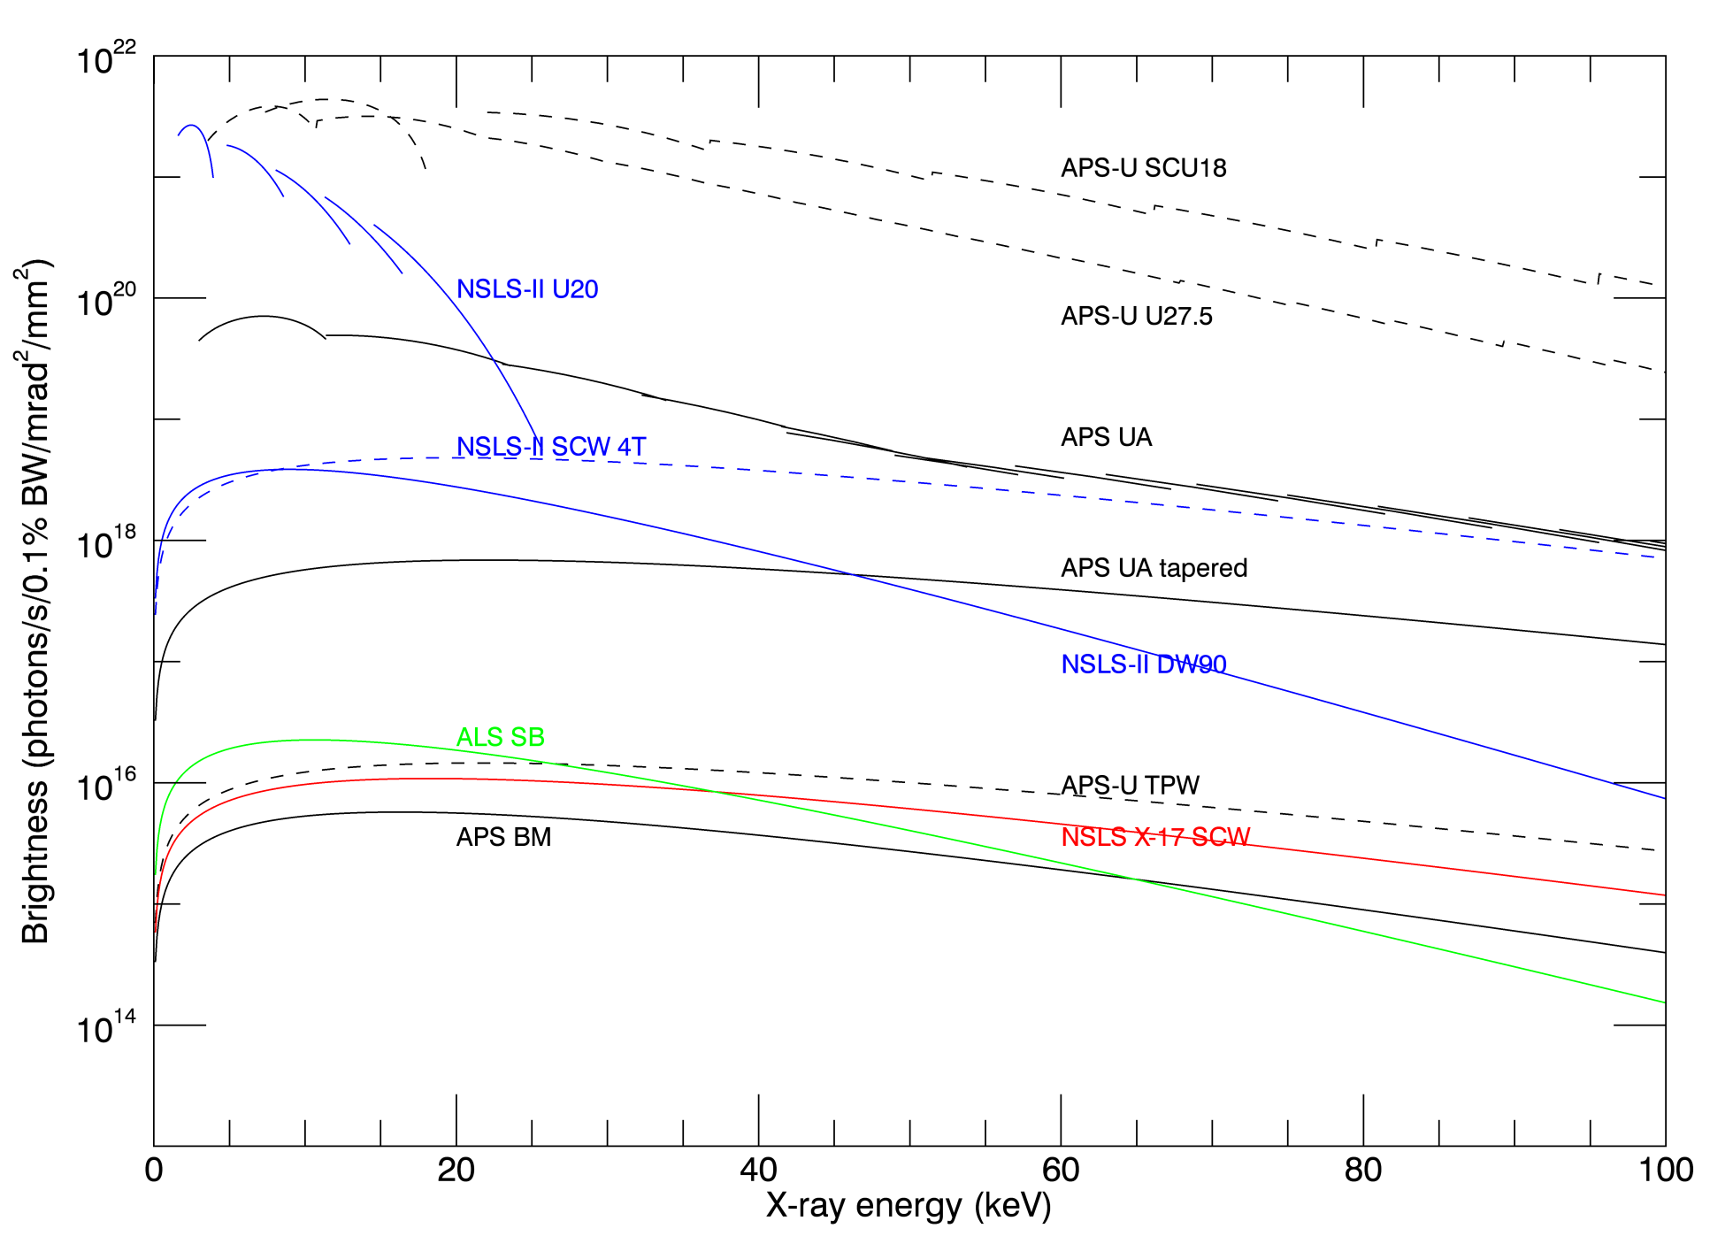
Brightness of DAC sources Figure of merit for beamline with focusing, i.e. diamond anvil cell

Slide 6
Brightness of DAC sources
APS undulator is 10X brighter than NSLS-II DW90 (XPD) APS undulator at 30 keV where much DAC diffraction is done.
NSLS-II SCW (HEX) is similar brightness to APS undulator above 50 keV
ALS superbend is brighter than APS bending magnet below 60 keV because the source is smaller.
APS-U undulators are 15-100x brighter than APS now and 1000x brighter than either NSLS-II DW90 (XPD) or NSLS-II SCW (HEX) at all energies

Slide 7
Beamline 12.2.2 at the Advanced Light Source
Superconducting bending magnet source
Approved Program with COMPRES guarantees 35% of beam time.
In practice >50%.
One other approved program HPSTAR has 15%
COMPRES proposals generally do well in General User program
COMPRES contributes 2 beamline scientists, Christine Beavers and Jinyuan Yan.
Technical specialties
Radial diffraction with external and laser heating
Single-crystal diffraction (still developing)

Slide 8
Beamline 12.2.2
Endstation 2 (ES2)
Endstation 1 (ES1)

Slide 9
Endstation 2- High Pressure
10x10 μm² X-ray spot
10-35keV
Axial & Radial Geometries
Shutterless Single Crystal
Laser Heating
Pyrometry and Peak Scaling method implemented.

Slide 10
Beamlines 3-ID and 30-ID at the Advanced Photon Source
Undulator sources
2x22.7 cm and 2x1.7cm period, optimized
COMPRES contributes 75% of beamline scientist, Wenli Bi.
No guaranteed beam time, but COMPRES users are successful in General User program
~40% of time to COMPRES community
Technical specialties
Nuclear Resonance Inelastic Scattering (NRIXS)
Synchrotron Mossbauer Spectroscopy (SMS)
High Energy Resolution Inelastic Scattering (HERIX)

Slide 11
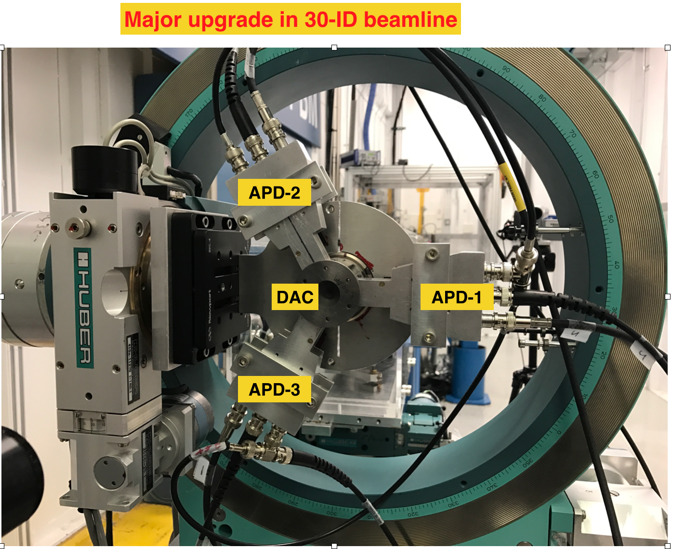

Slide 12
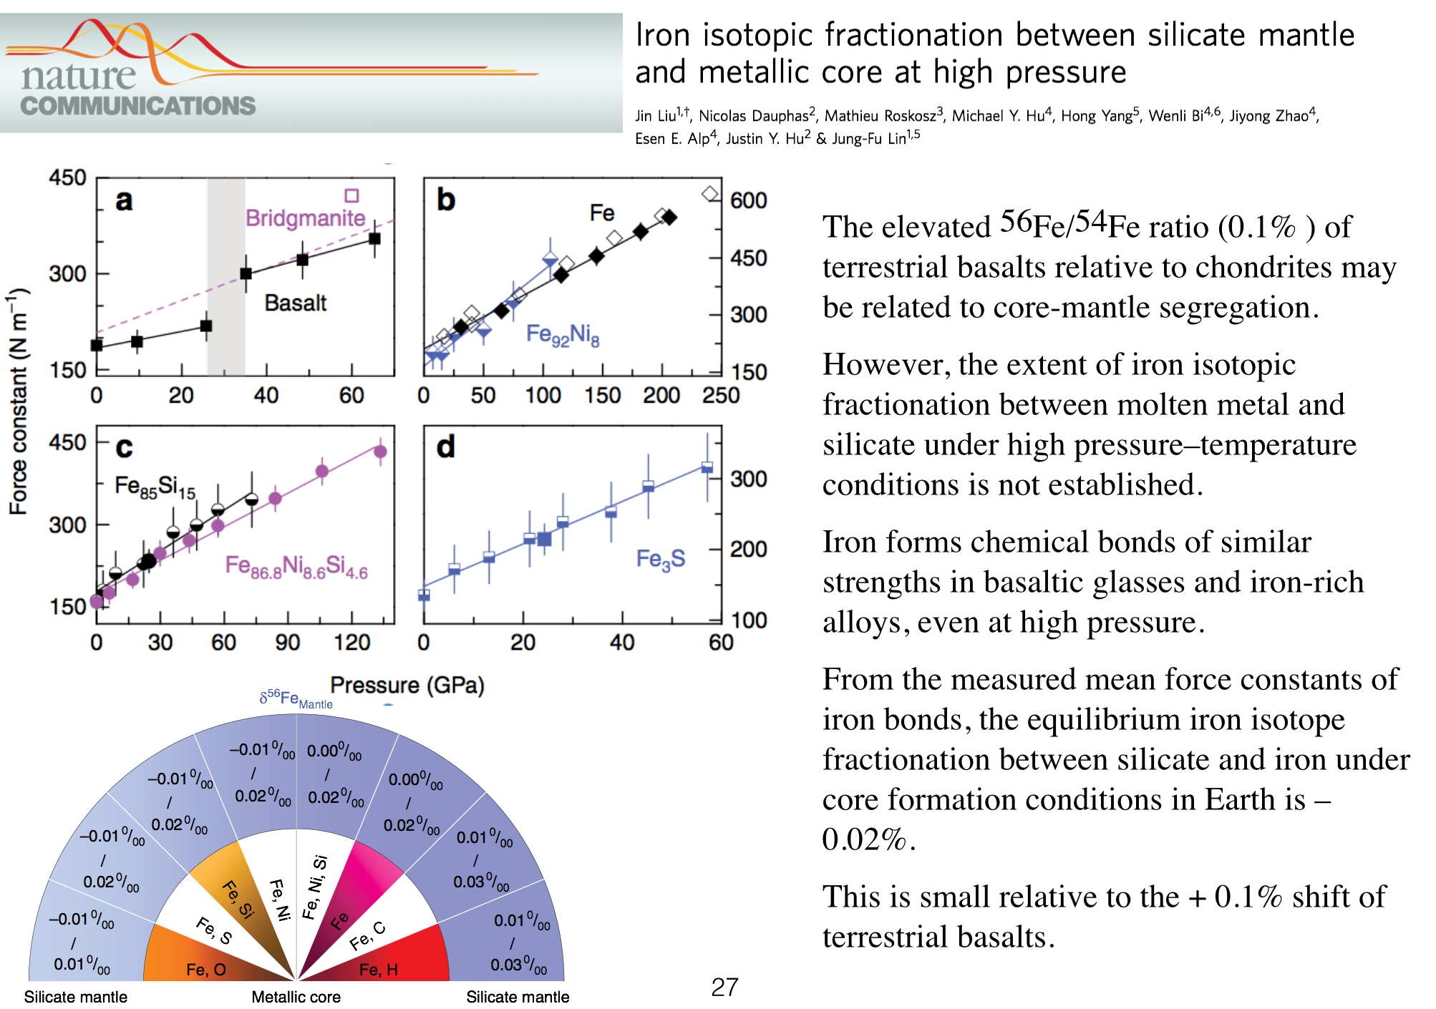

Slide 13
HPCAT Sector 16 at the Advanced Photon Source
2 undulator beamlines, 2 bending magnet beamlines
100% of time for high-pressure
DAC and Paris-Edinburgh cell
Major funding from NNSA with 75% of time to NNSA funded investigators
25% of time for General Users
COMPRES community typically 15%-20% of each beamline

Slide 14
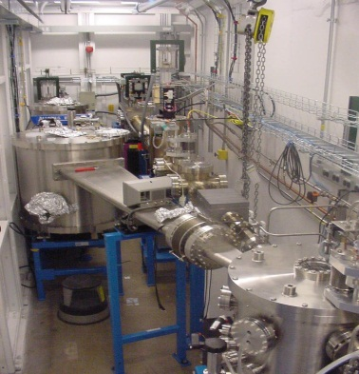
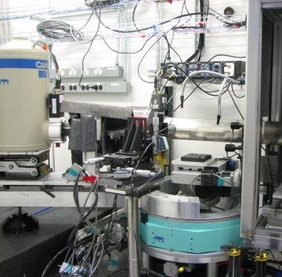
HPCAT – Four Beamlines
Sector 16
Canted undulator beams
Sector 16
Bending magnet beam
5-36 keV
Split in space
14-42 keV
ID-C/D/E:
Spectroscopy
Scattering
XES,IXS – 1eV
NRIXS – 2meV
IDB:
Micro-diffraction
(high photon flux)
Laser heating (>3000K)
Cryostat (<4k)
BM-C/D:
Micro-diffraction
XANES
BMB:
White Laue
Paris-Edinburgh
Press
(fast x-ray imaging)

Slide 15
GSECARS Sector 13 at the Advanced Photon Source
2 undulator beamlines, 2 bending magnet beamlines
Funding from NSF-EAR with 100% of time available to geoscience community through General User program
13-ID-D
Double sided laser heating (pulsed), emission spectroscopy, fast Pilatus 3X CdTe detector
~60% time
13-BM-D
Brillouin scattering with online x-ray diffraction, external heating
~50% time
13-BM-C (PX^2 partnership with COMPRES)
Single crystal diffraction in DAC, external and laser heating
~75% time

Slide 16
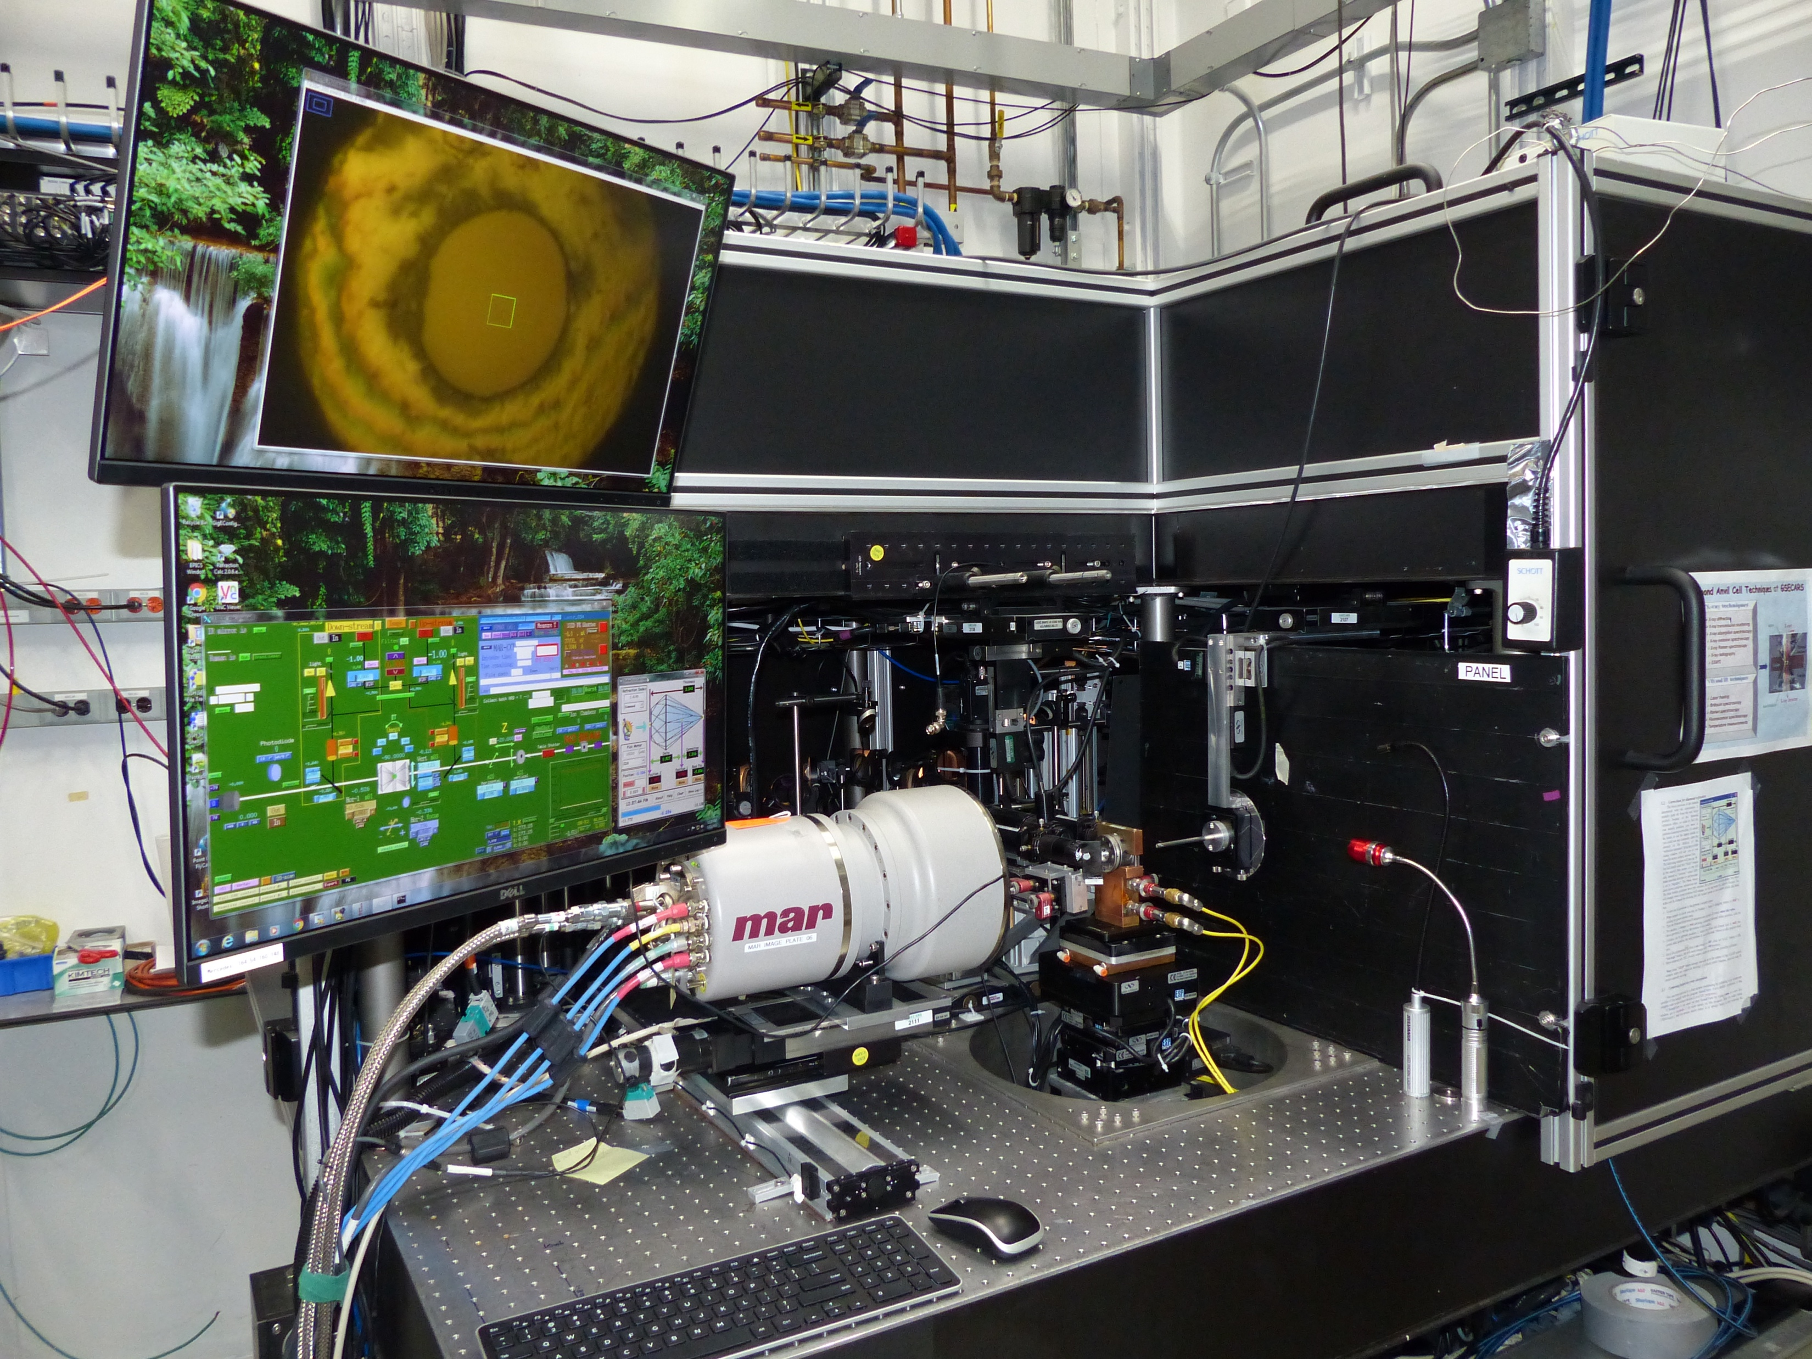
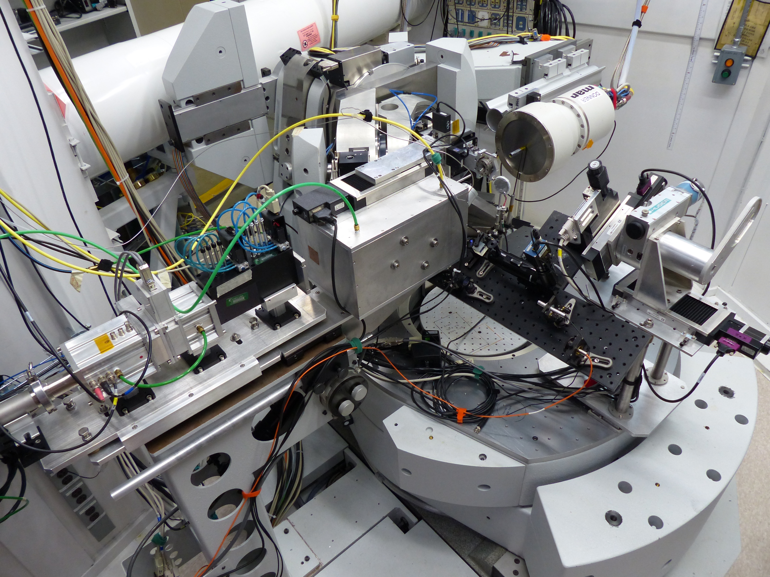
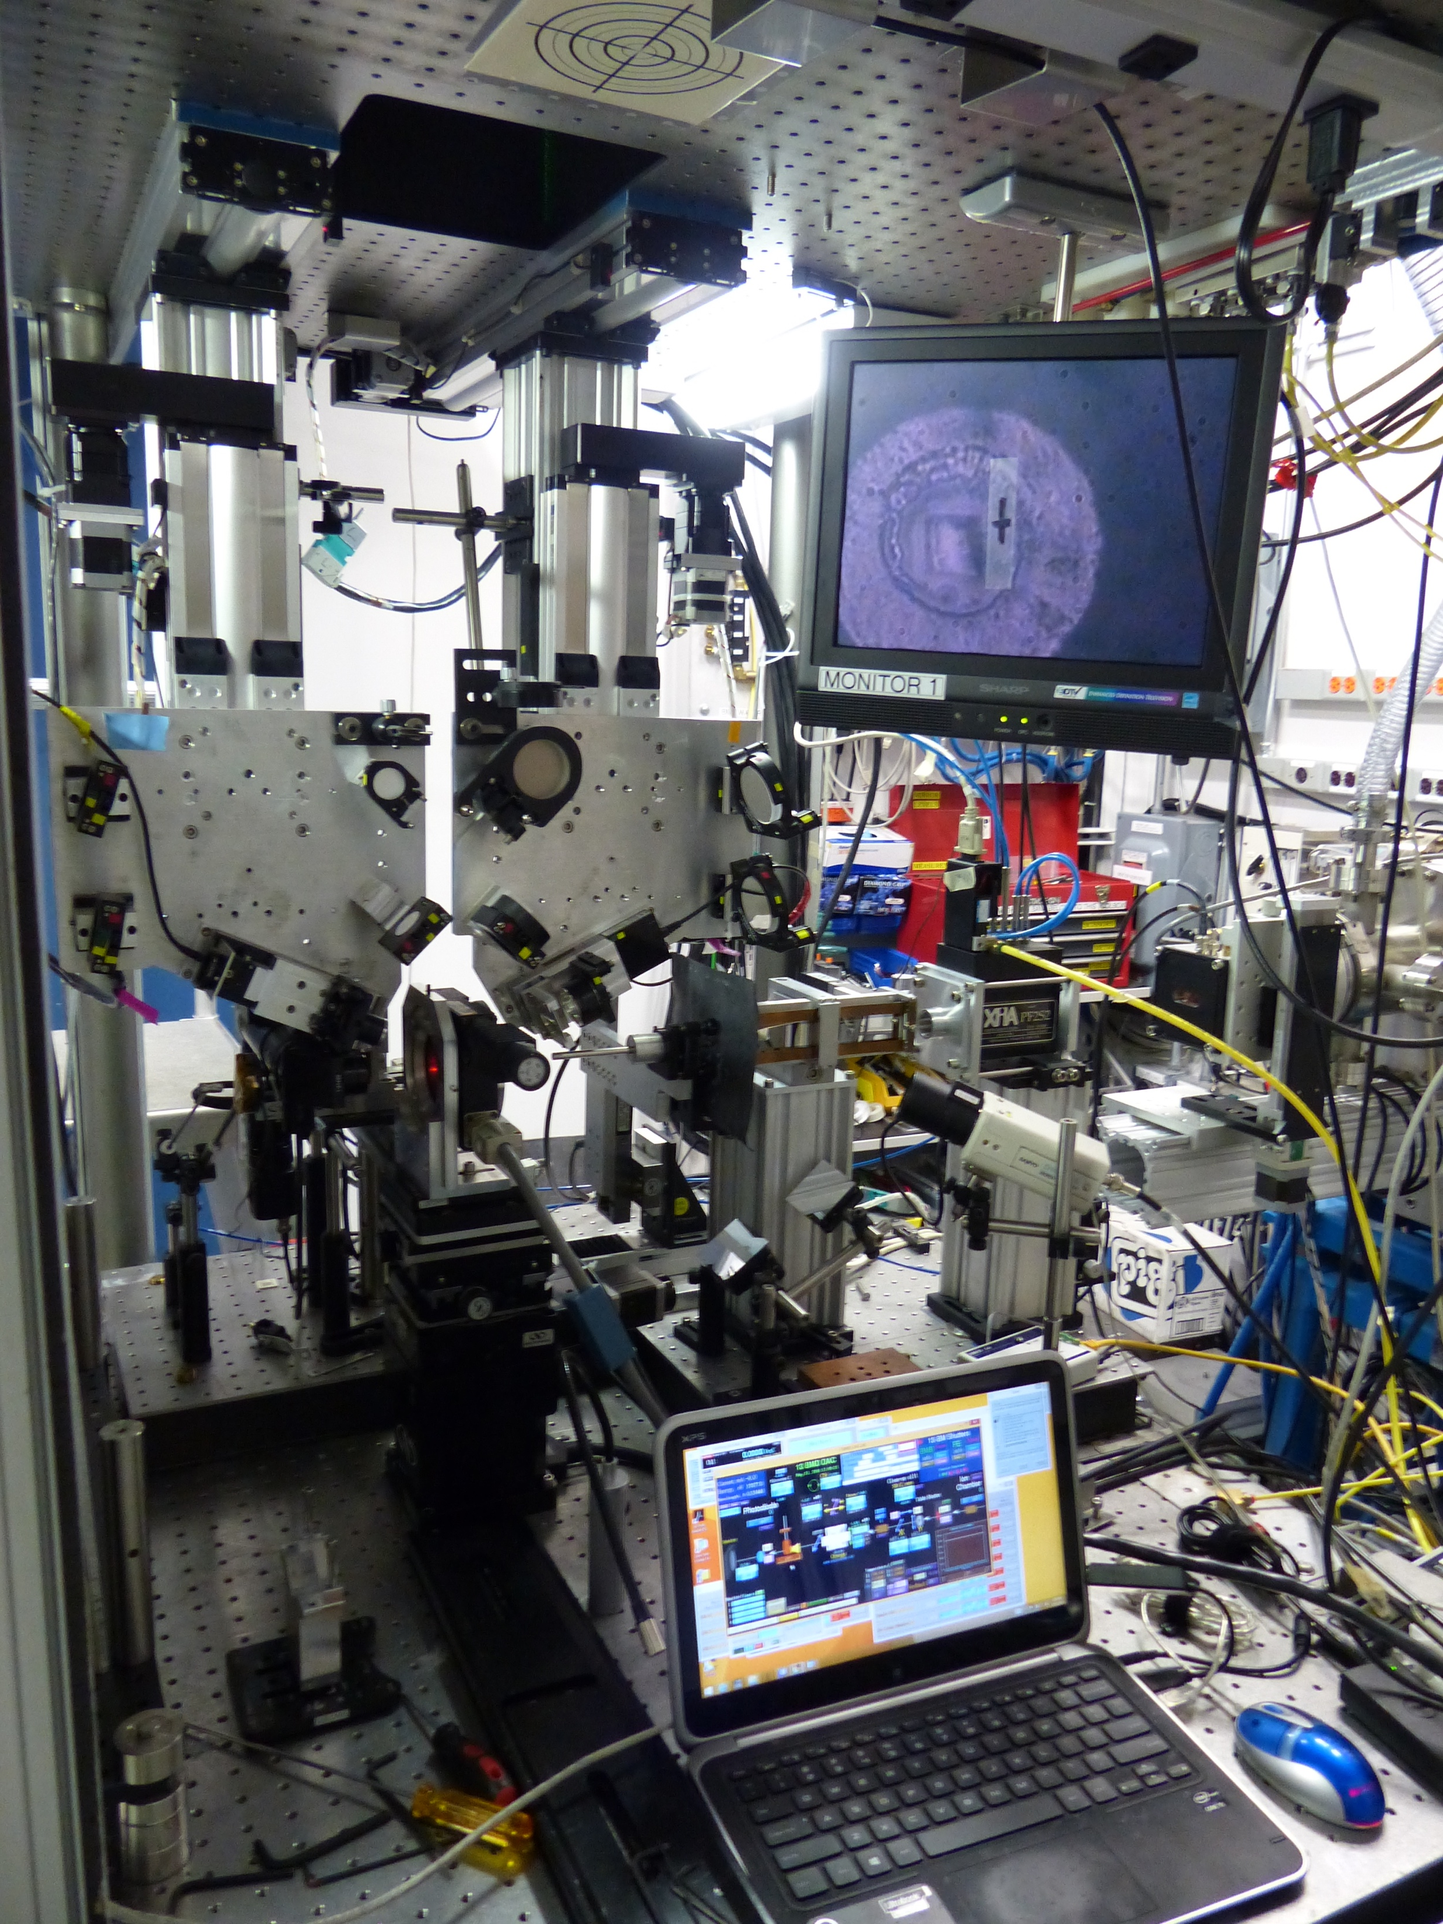
Five optical focal points (x-ray, lasers, spectroscopy)
are aligned with precision better than 1 µm in the DAC
13-BMD
13-IDD
13-BMC
X-ray energy 5-80 keV
beam size ~3 µm
XRD, sXRD, XES
on-line laser heating,
Raman and
VIS-IR spectroscopy
X-ray energy 15, 28.6 keV
beam size ~ 15 µm
sXRD
on-line laser heating, Raman and
VIS spectroscopy
X-ray energy 5-80 keV
beam size ~6 x 12 µm
XRD, sXRD
on-line Brillouin, Raman
VIS-IR spectroscopy
Notes:
To utilize different approaches for sample characterization we have built three dedicated stations: main IDD combined with LH and on-line advanced optical spectroscopy, BMD coupled with BS, and BMC for sXRD where 6-axis diffractometer is combined with LH, Ruby and Raman

Slide 17
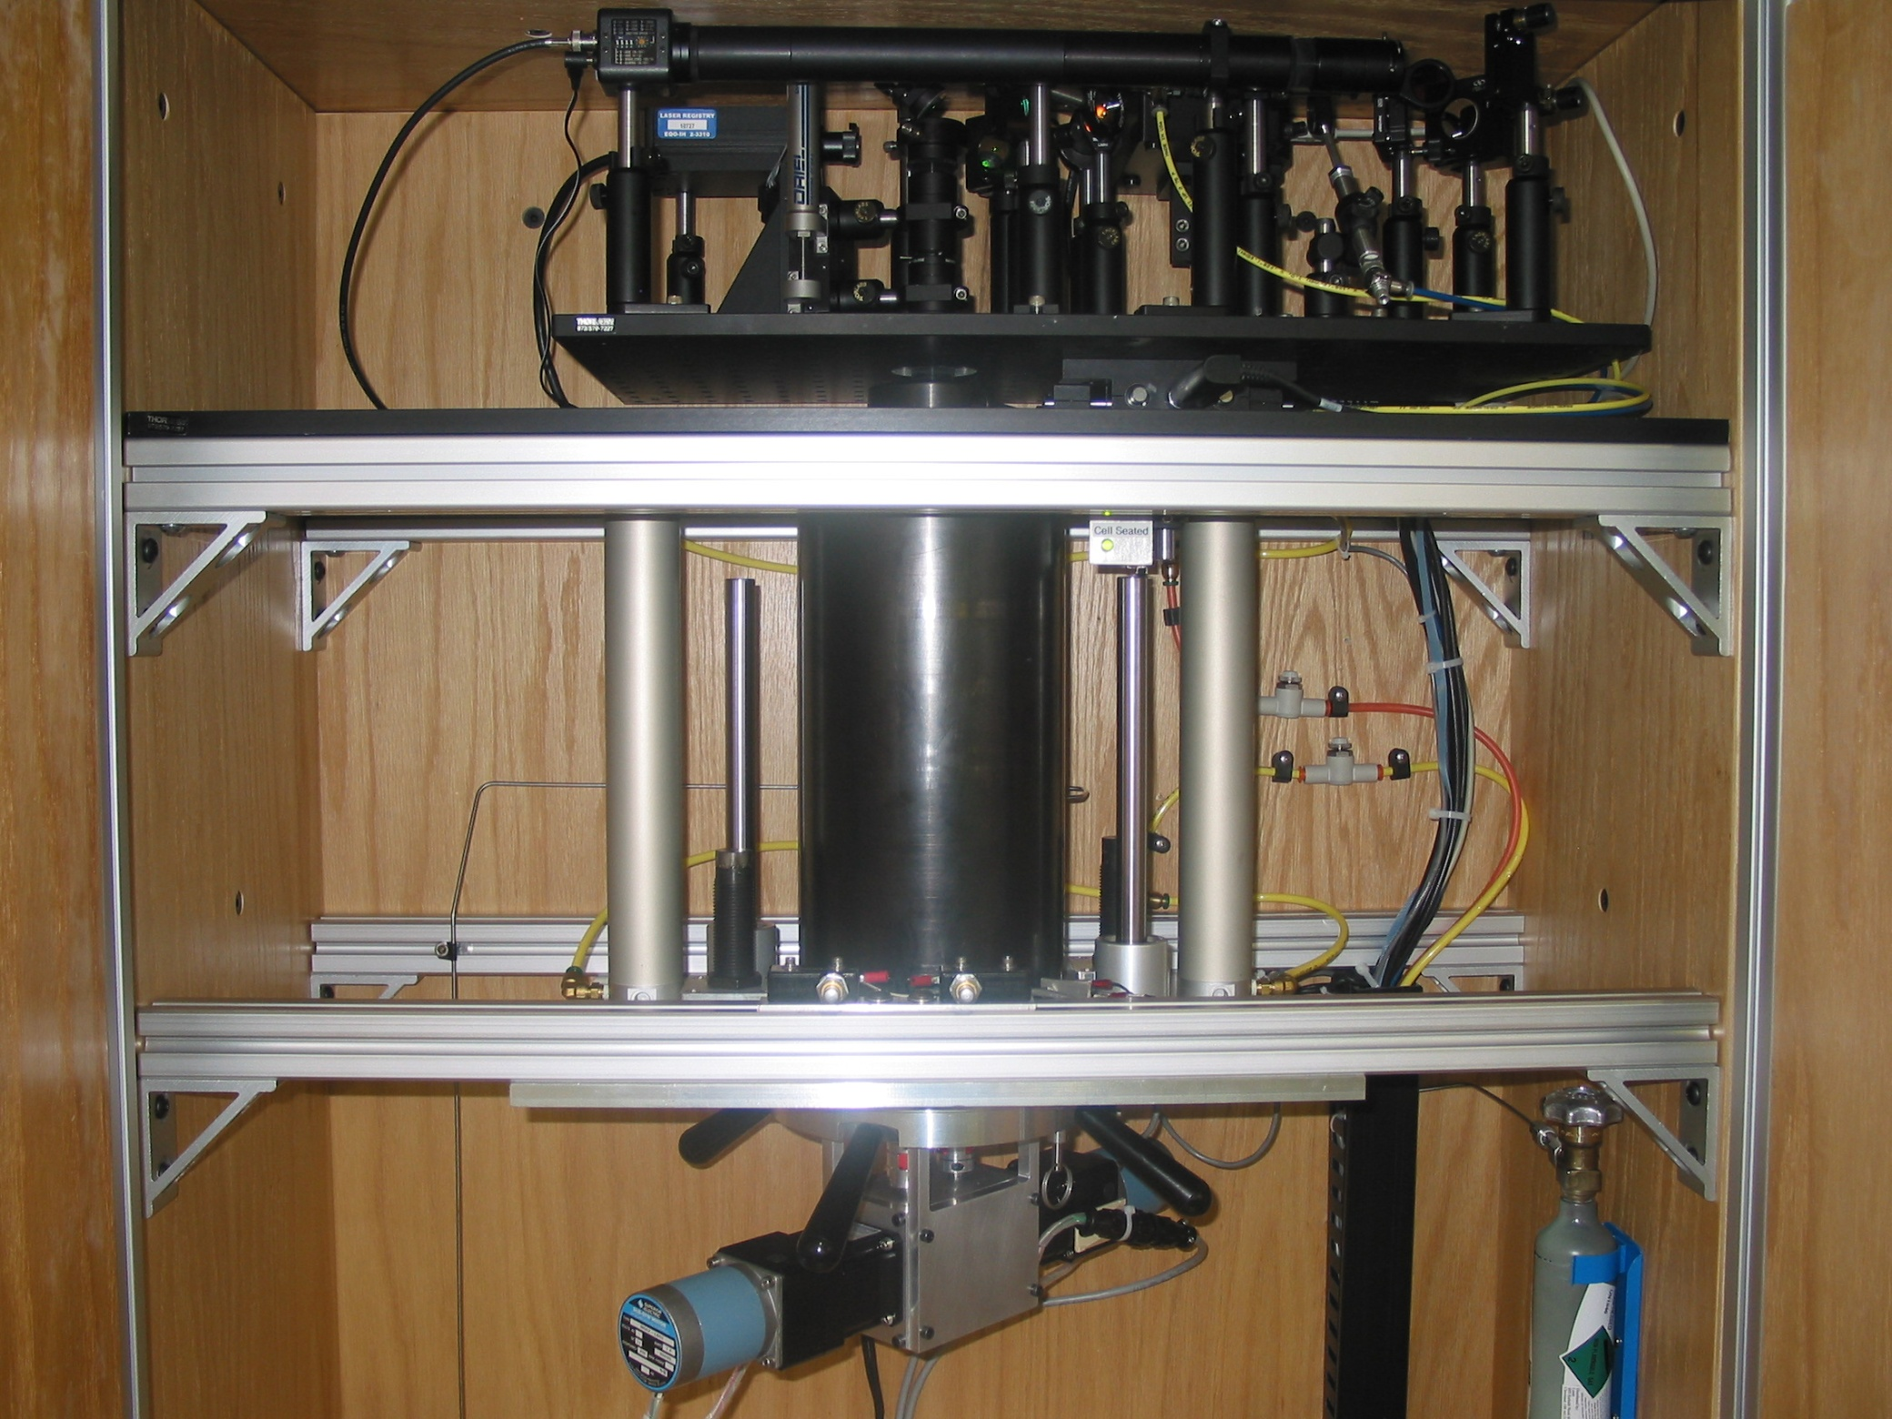
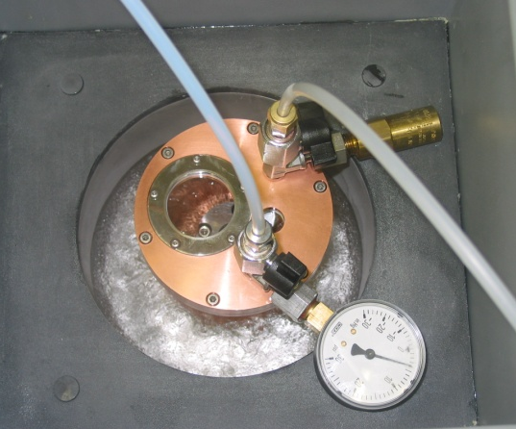
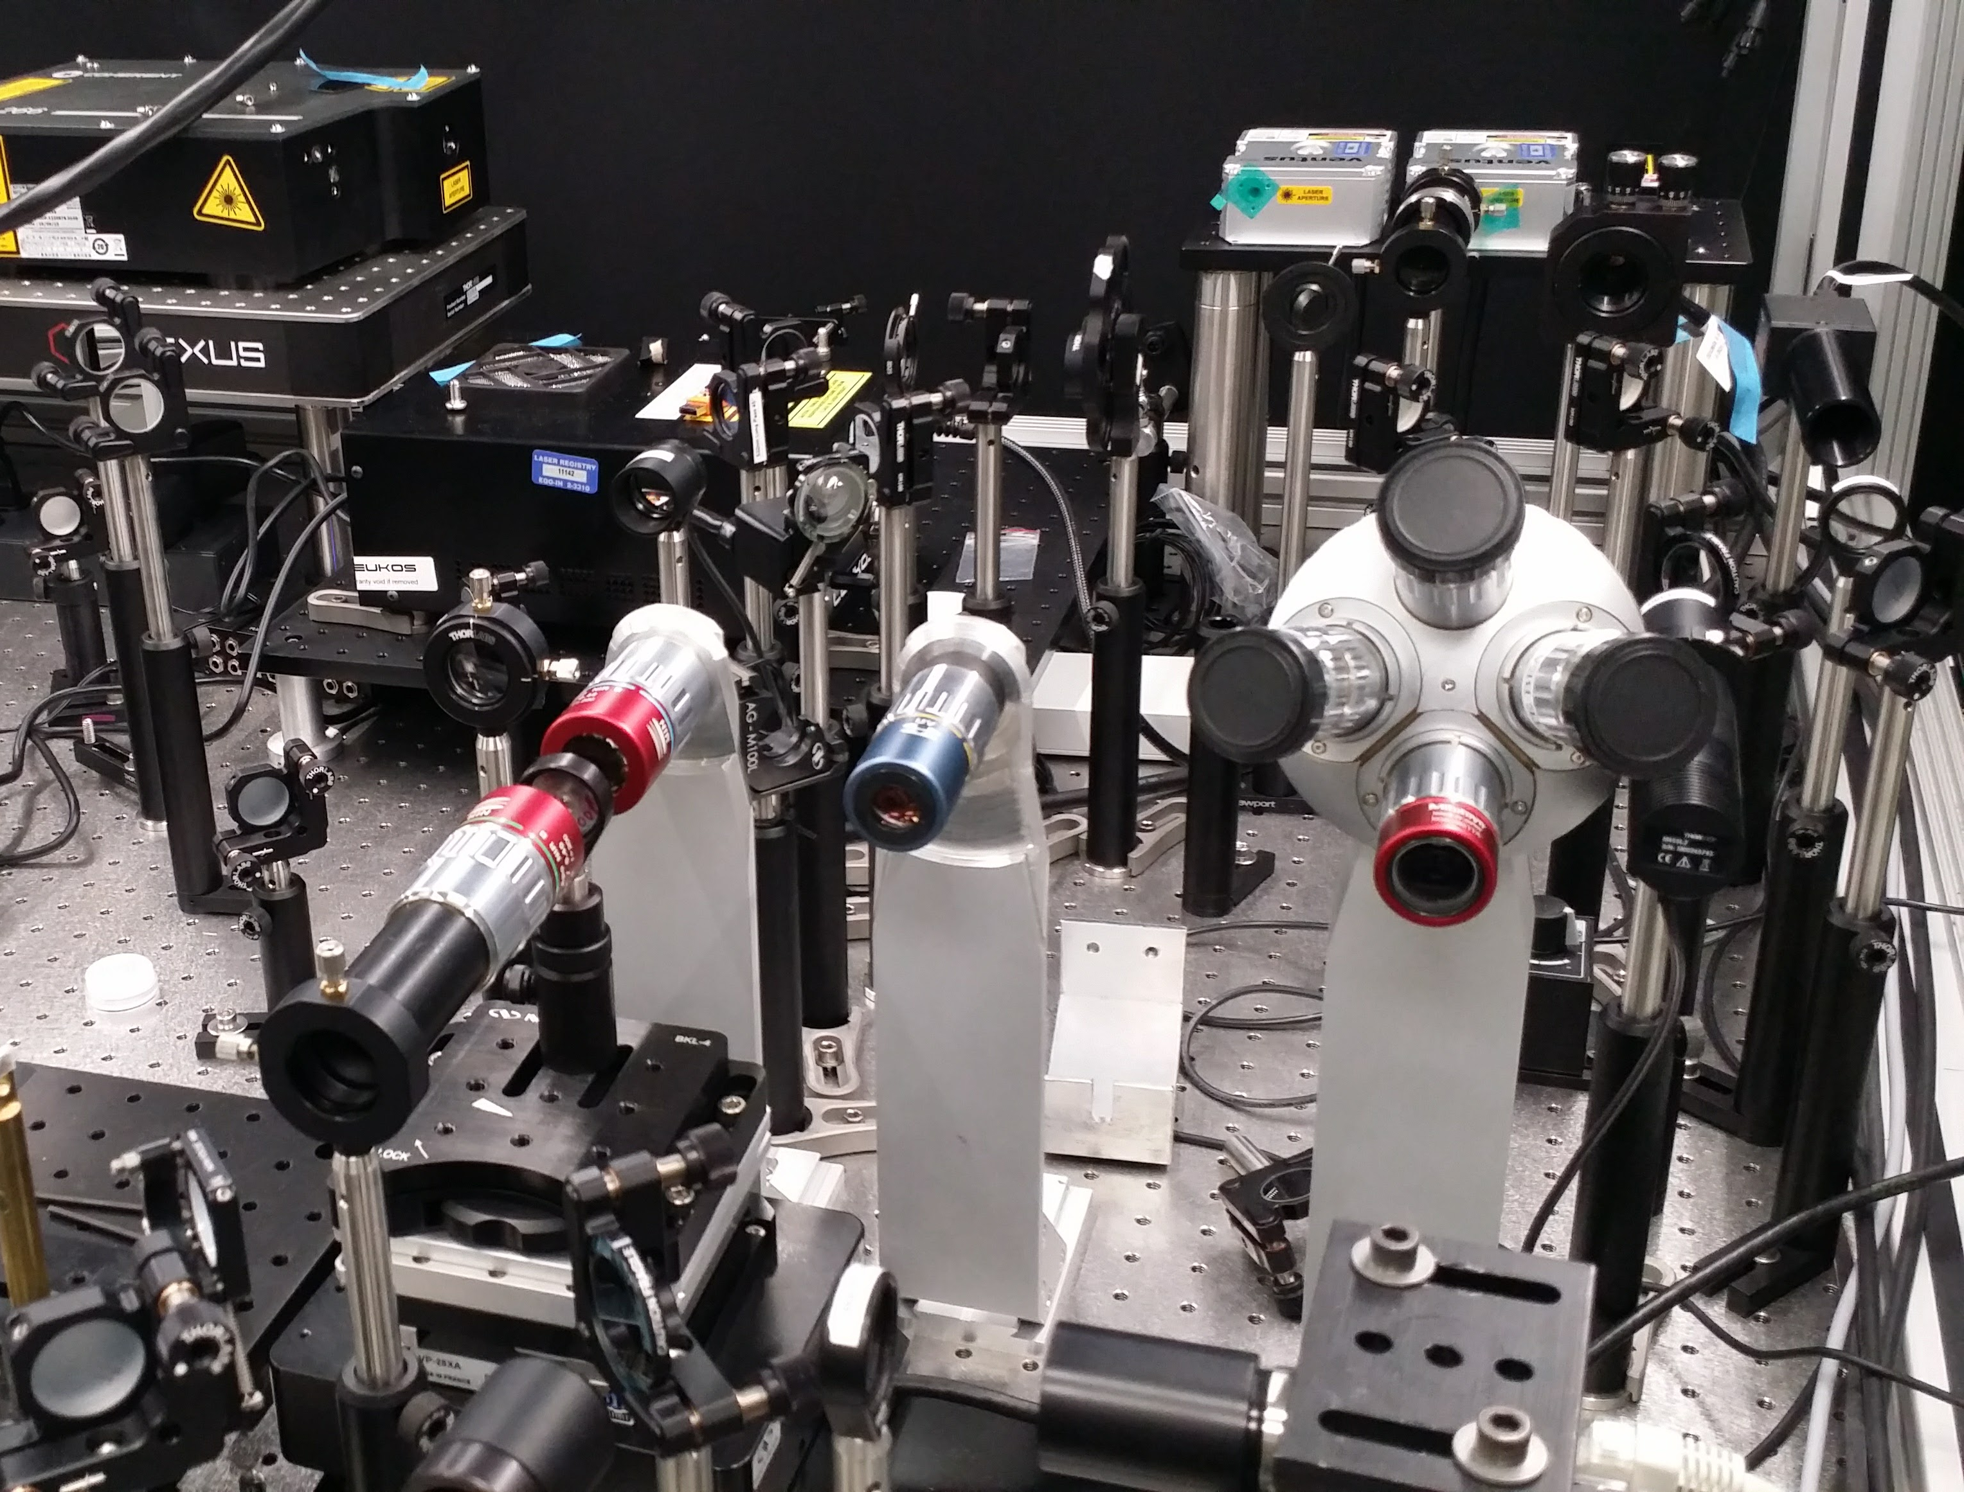
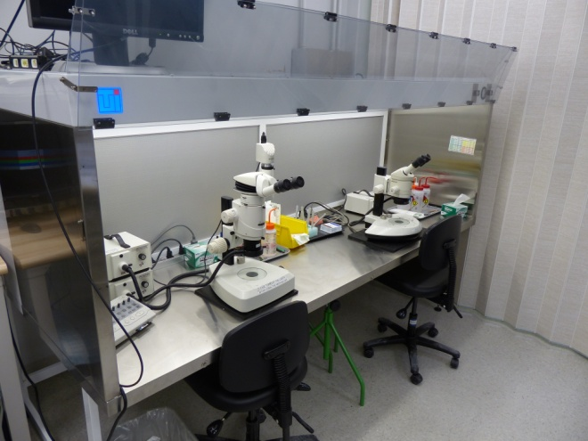
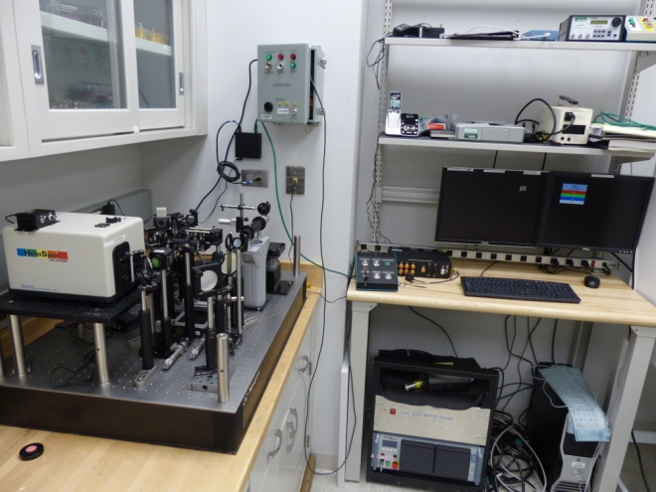
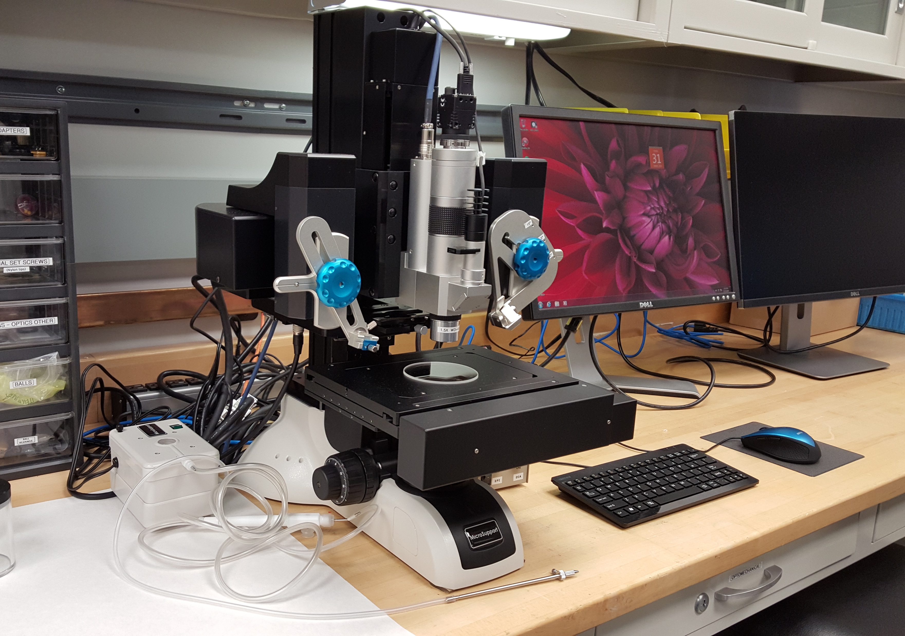
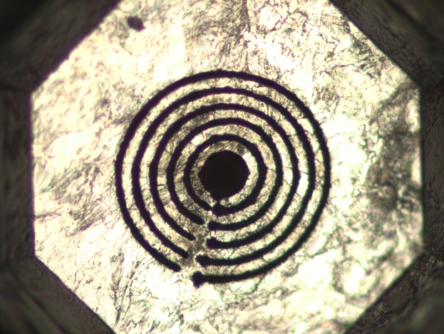
Supporting equipment
Gas-loading system
Cryogenic loading
Raman system
Preparation lab
Laser heating/cutting
Micro-manipulator
Notes:
Significant infrastructure development is required to maintain DAC program

Slide 18
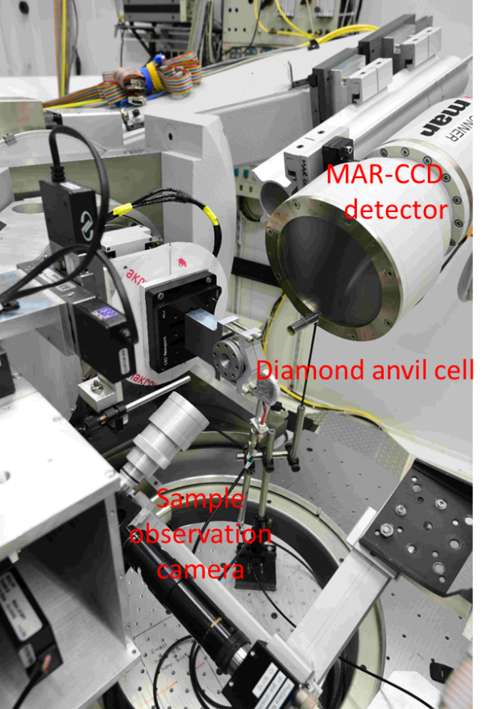
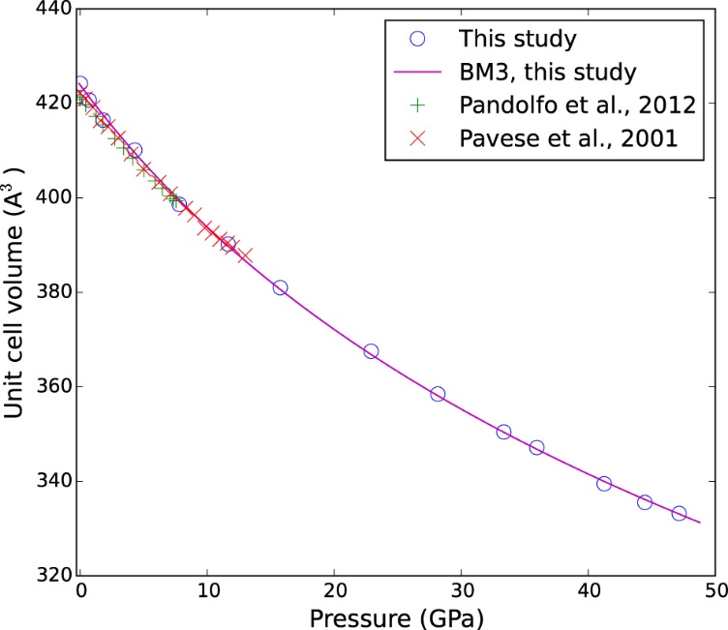
PX^2: high pressure meets single crystal diffraction
High pressure single crystal diffraction setup at 13-BM-C
Diffraction peaks rendered with ATREX/RSV software package
Pressure-volume equation of state of omphacite and elasticity
Crystal structure of omphacite resolved at high pressure
Zhang, Hu and Dera, under review
Partnership for eXtreme Xtallography (PX^2) is supported by:
Diffraction image

Slide 19
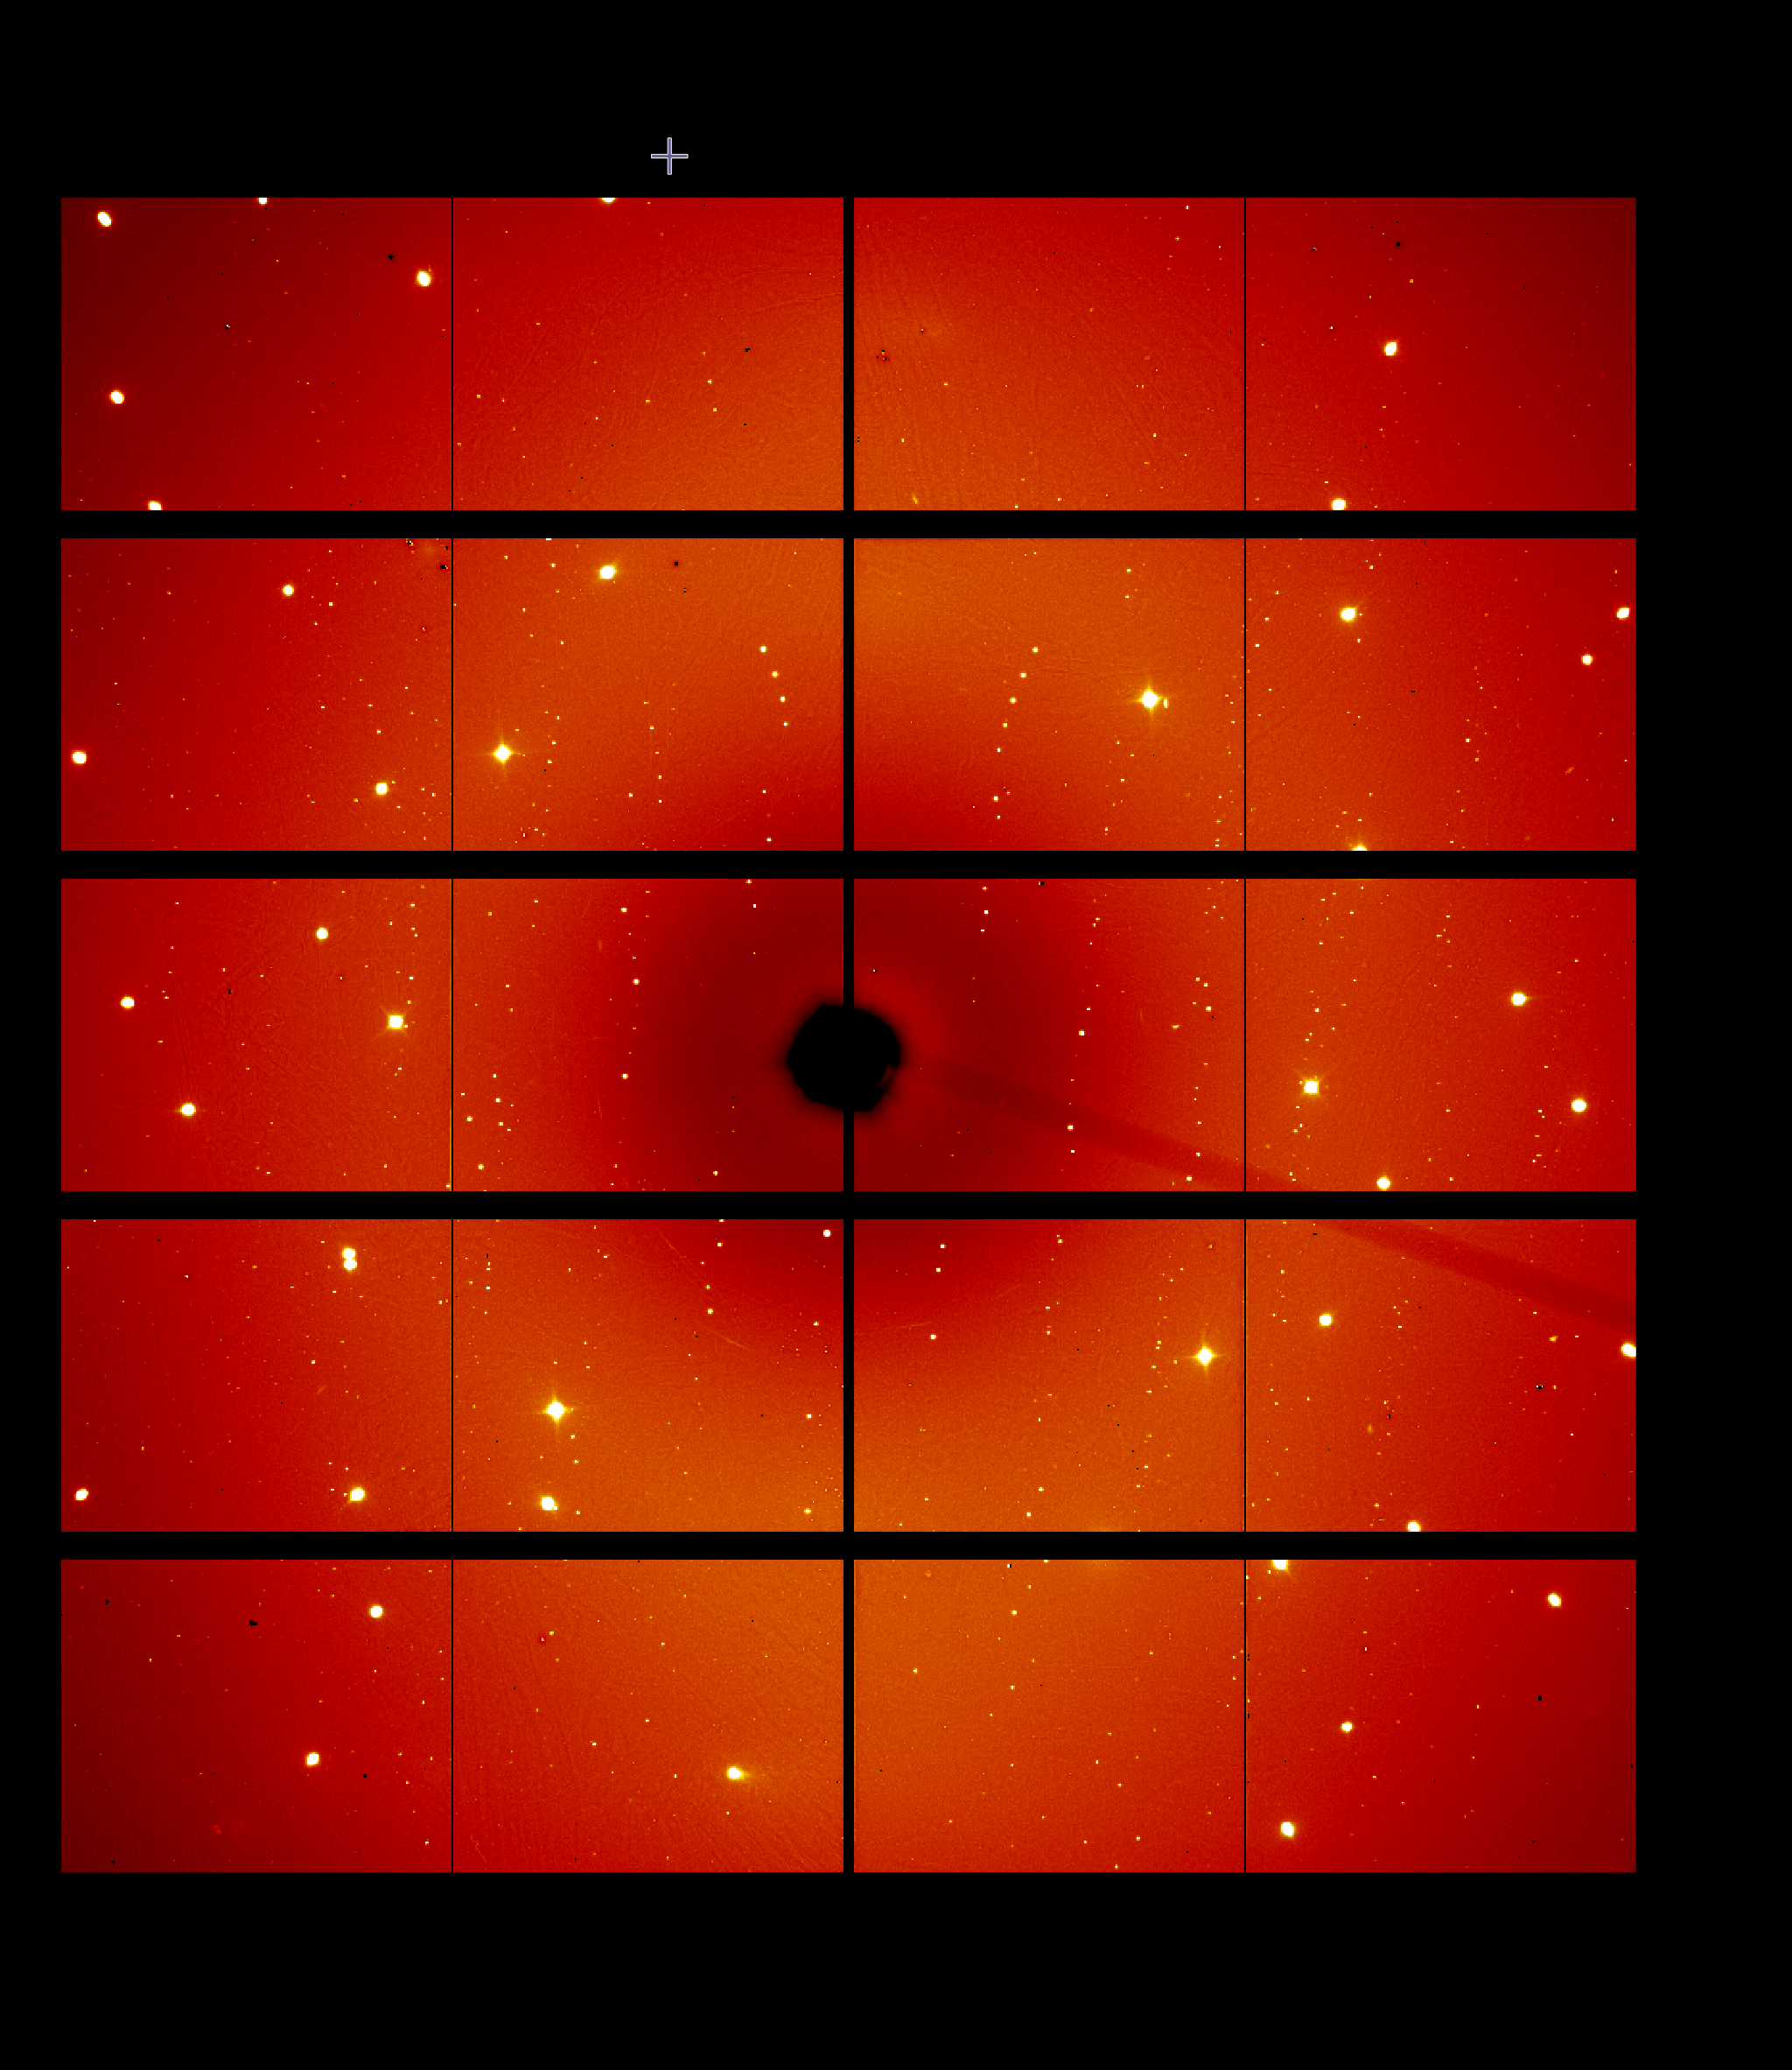
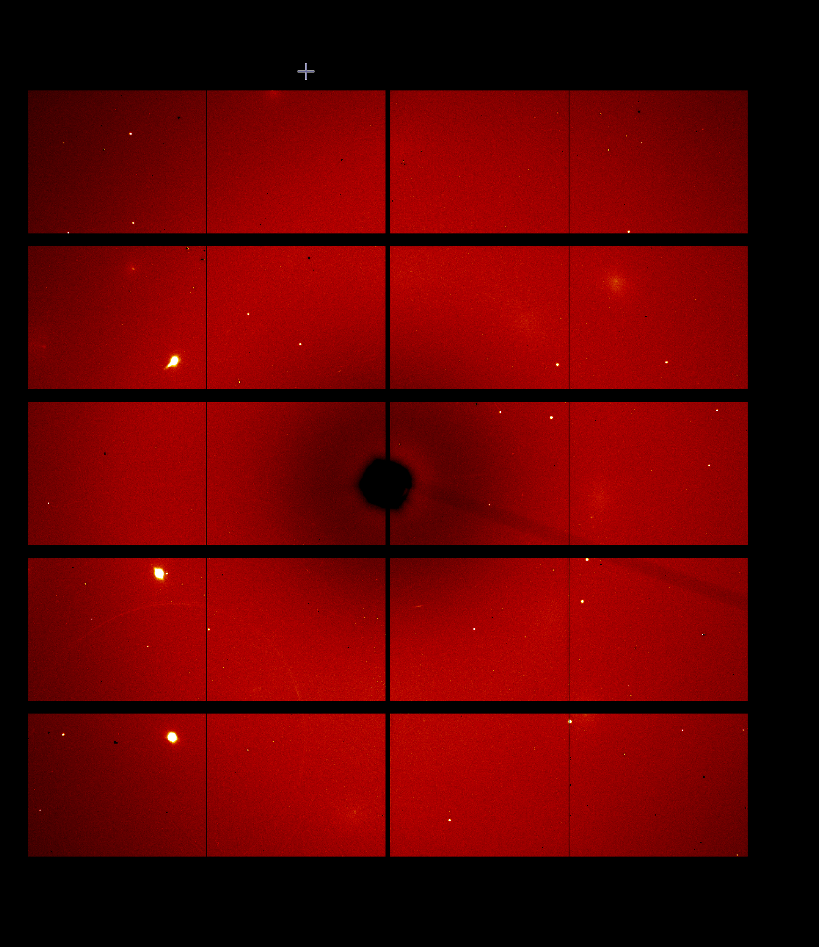
Fast high pressure single crystal measurements
Sample rotation
Wide scan
X-ray
beam
+/-33 degrees, 0.5” step, 0.2s exposure, 133 files => 27s
Step scan
Log file from Newport XPS
File | STX.CurrentPosition | STX.FollowingError | STX.SetpointPosition | STX.CurrentVelocity | STZ.CurrentPosition | STZ.FollowingError | STZ.SetpointPosition | STZ.CurrentVelocity | STY.CurrentPosition | STY.FollowingError | STY.SetpointPosition | STY.CurrentVelocity | OM.CurrentPosition | OM.FollowingError | OM.SetpointPosition | OM.CurrentVelocity
enst_s1_001 | 1.2783 | 0 | 1.2783 | 0 | 3.3528 | 0 | 3.3528 | 0 | -2.1040404 | 0 | -2.1040404 | 0 | -123.001 | 0.001 | -122.9997996 | 0.354583658
enst_s1_001 | 1.2783 | 0 | 1.2783 | 0 | 3.3528 | 0 | 3.3528 | 0 | -2.1040404 | 0 | -2.1040404 | 0 | -122.9 | 0 | -122.8998 | 0.408675801
enst_s1_001 | 1.2783 | 0 | 1.2783 | 0 | 3.3528 | 0 | 3.3528 | 0 | -2.1040404 | 0 | -2.1040404 | 0 | -122.8005 | 0.0005 | -122.7998 | 0.58559678
enst_s1_001 | 1.2783 | 0 | 1.2783 | 0 | 3.3528 | 0 | 3.3528 | 0 | -2.1040404 | 0 | -2.1040404 | 0 | -122.7 | 0 | -122.6998 | 0.696227079
enst_s1_001 | 1.2783 | 0 | 1.2783 | 0 | 3.3528 | 0 | 3.3528 | 0 | -2.1040404 | 0 | -2.1040404 | 0 | -122.6 | 0 | -122.5998 | 0.484909907

Slide 20
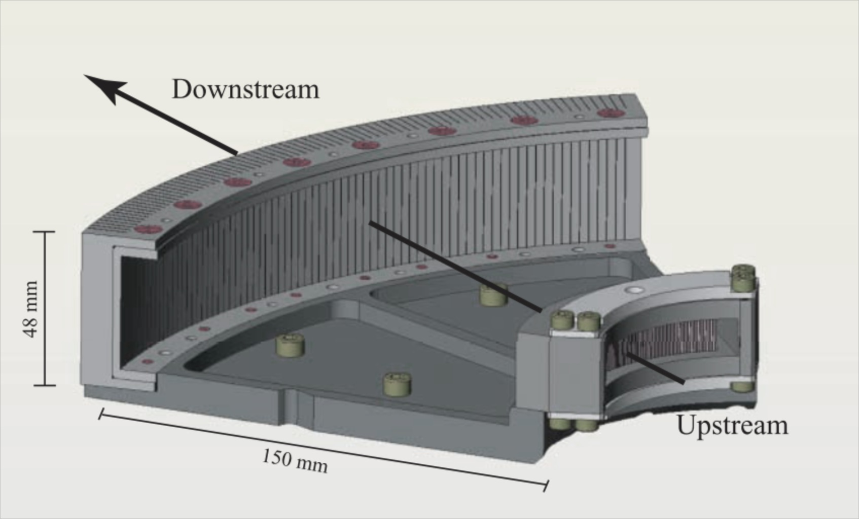
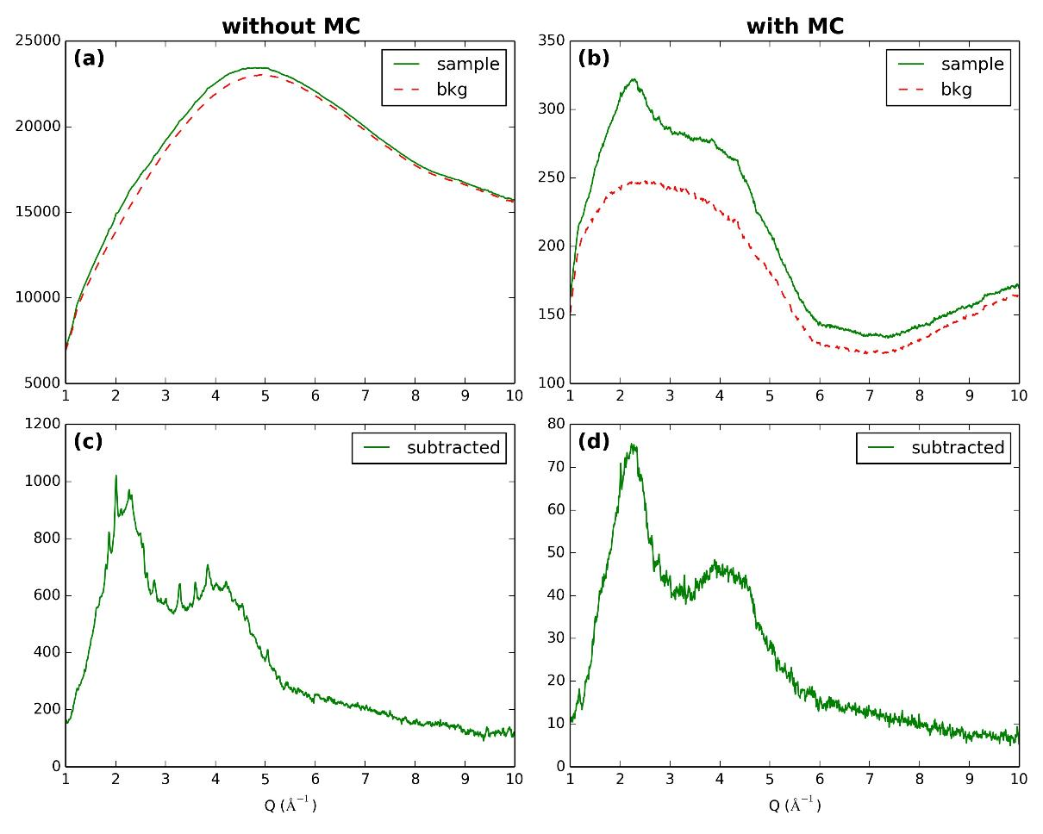
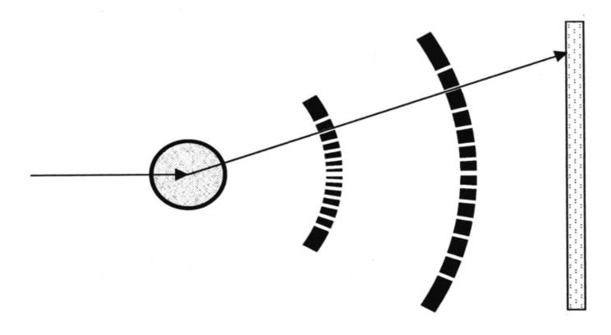
Multichannel Collimator
Comparison between measurements of Mg₂SiO₄ sample in a Diamond Anvil Cell with and without Multichannel Collimator (MCS).
Detector
Sample
X-ray beam
MC
The upstream block is composed of 75 slits of 50 µm positioned at a distance of 50 mm from the sample. The downstream block is composed of 75 slits of 200 µm positioned at 200 mm
Notes:
One of the central aspects for obtaining high quality structural information of disordered materials by X-ray diffraction is perfect background subtraction. This is particularly difficult when employing high-pressure vessels, such as diamond anvil cells (DAC) and Paris-Edinburgh large volume presses (PEP). Their background contribution is very high compared to the low diffuse scattering signal of the sample, especially at high diffraction angles, and furthermore the background is changing during compression and decompression.
In order to overcome this challenge we have successfully installed a multichannel collimator (MCC) for the DAC setup at the GSECARS 13-IDD beamline, APS

Slide 21
Summary of US DAC Beamlines
Beamline | % of time for COMPRES DAC | Laser heating | Specialty Techniques
ALS 12.2.2 | 60% | Yes | Radial diffraction; single-crystal
APS 3-ID | 40% | Yes | NRIXS, SMS, HERIX
APS 16-ID-B | 20% | Yes | Cryostats, time-resolved
APS 16-ID-D | 15% | No | NRIXS, SMS, emission spectroscopy
APS 16-BM-B | 15% | No | Laue diffraction, PE cell
APS 16-BM-D | 20% | No | XANES
APS 13-BM-D | 50% | No | Brillouin
APS 13-BM-C | 75% | In commissioning | Single crystal
APS 13-ID-D | 60% | Yes | Pulsed heating, emission spectroscopy
TOTAL | 355%

Slide 22
Questions for NSLS-II DAC Proposal
What would be the specialty techniques at XPD?
Would it include online laser heating?
Who would be in charge of getting it working?
Is laser heating equipment from X17-B3 available for use at NSLS-II?
Who are the major potential users of the facility?
Important to identify a core set of users who view the NSLS-II facility as critical to their research.
Need to be members of the COMPRES community, i.e. users from US whose research is focused on earth science problems.
What is the management plan?
Who will be local to the NSLS-II to keep the project on track?
Who will provide the scientific driving force?

Slide 23
Questions for NSLS-II DAC Proposal
What capital equipment expenditures will be required to produce a competitive DAC station?
Micro-focusing optics
Detectors
Laser heating
Sample manipulation
Equipment for specialty techniques
What fraction of time can COMPRES DAC users be guaranteed
What is the maximum amount of time they might realistically be expected to receive if they write excellent General User Proposals?

