Slide 1

Synchrotron Radiation in the Earth Sciences
Mark Rivers
University of Chicago
Northwestern University
January 25, 2019

Slide 2
Outline
A little history …
Brief introduction to synchrotron sources
The Advanced Photon Source (APS)
  GeoSoilEnviroCARS
Applications in earth sciences
  Imaging
  Diffraction and scattering
  Spectroscopy
Future prospects, APS Upgrade

Slide 3
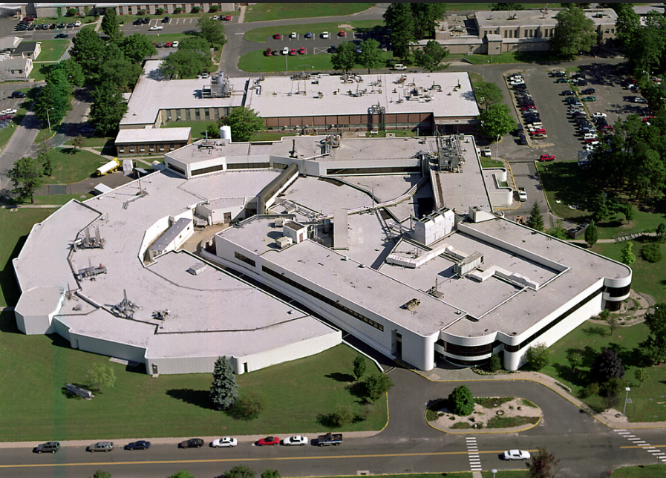
National Synchrotron Light Source (NSLS), Brookhaven National Laboratory
First dedicated x-ray synchrotron light source in the world (1985-2014)
First geoscience beamlines:
  X-ray microprobe: Joe Smith, Steve Sutton, myself (UChicago), Keith Jones (BNL)
  Diamond anvil cell diffraction: Dave Mao (CIW)
  Multi-anvil press diffraction: Don Weider, Bob Liebermann (Stony Brook)
  Infrared spectroscopy: Rus Hemley (CIW)

Slide 4
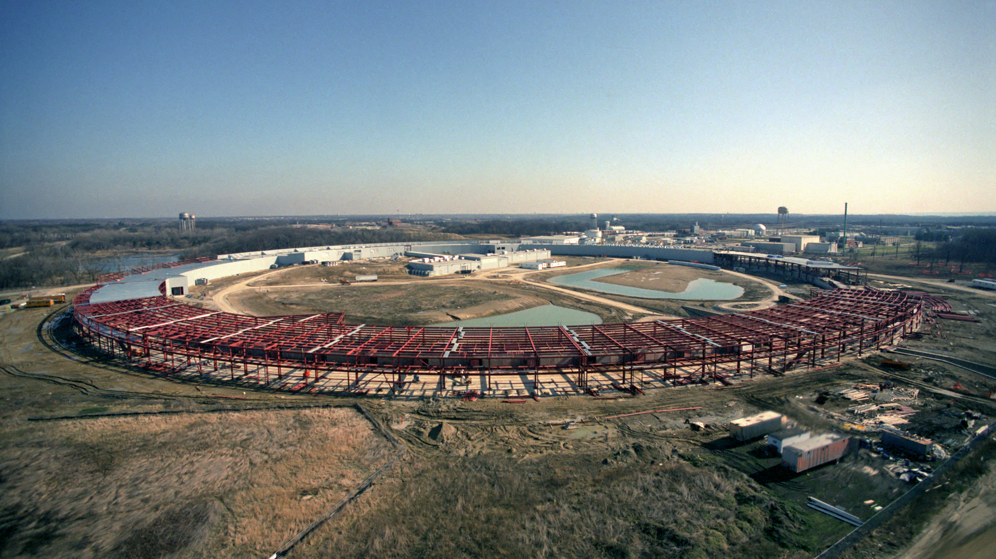
The Next Generation
NSLS was built to use x-rays from bending magnets and wigglers
By mid-1980’s the potential of undulators was being realized
Planning began for a new, much larger synchrotron optimized for hard x-ray undulators
1990 construction began on the Advanced Photon Source at Argonne National Lab
Began first operations in 1995

Slide 5
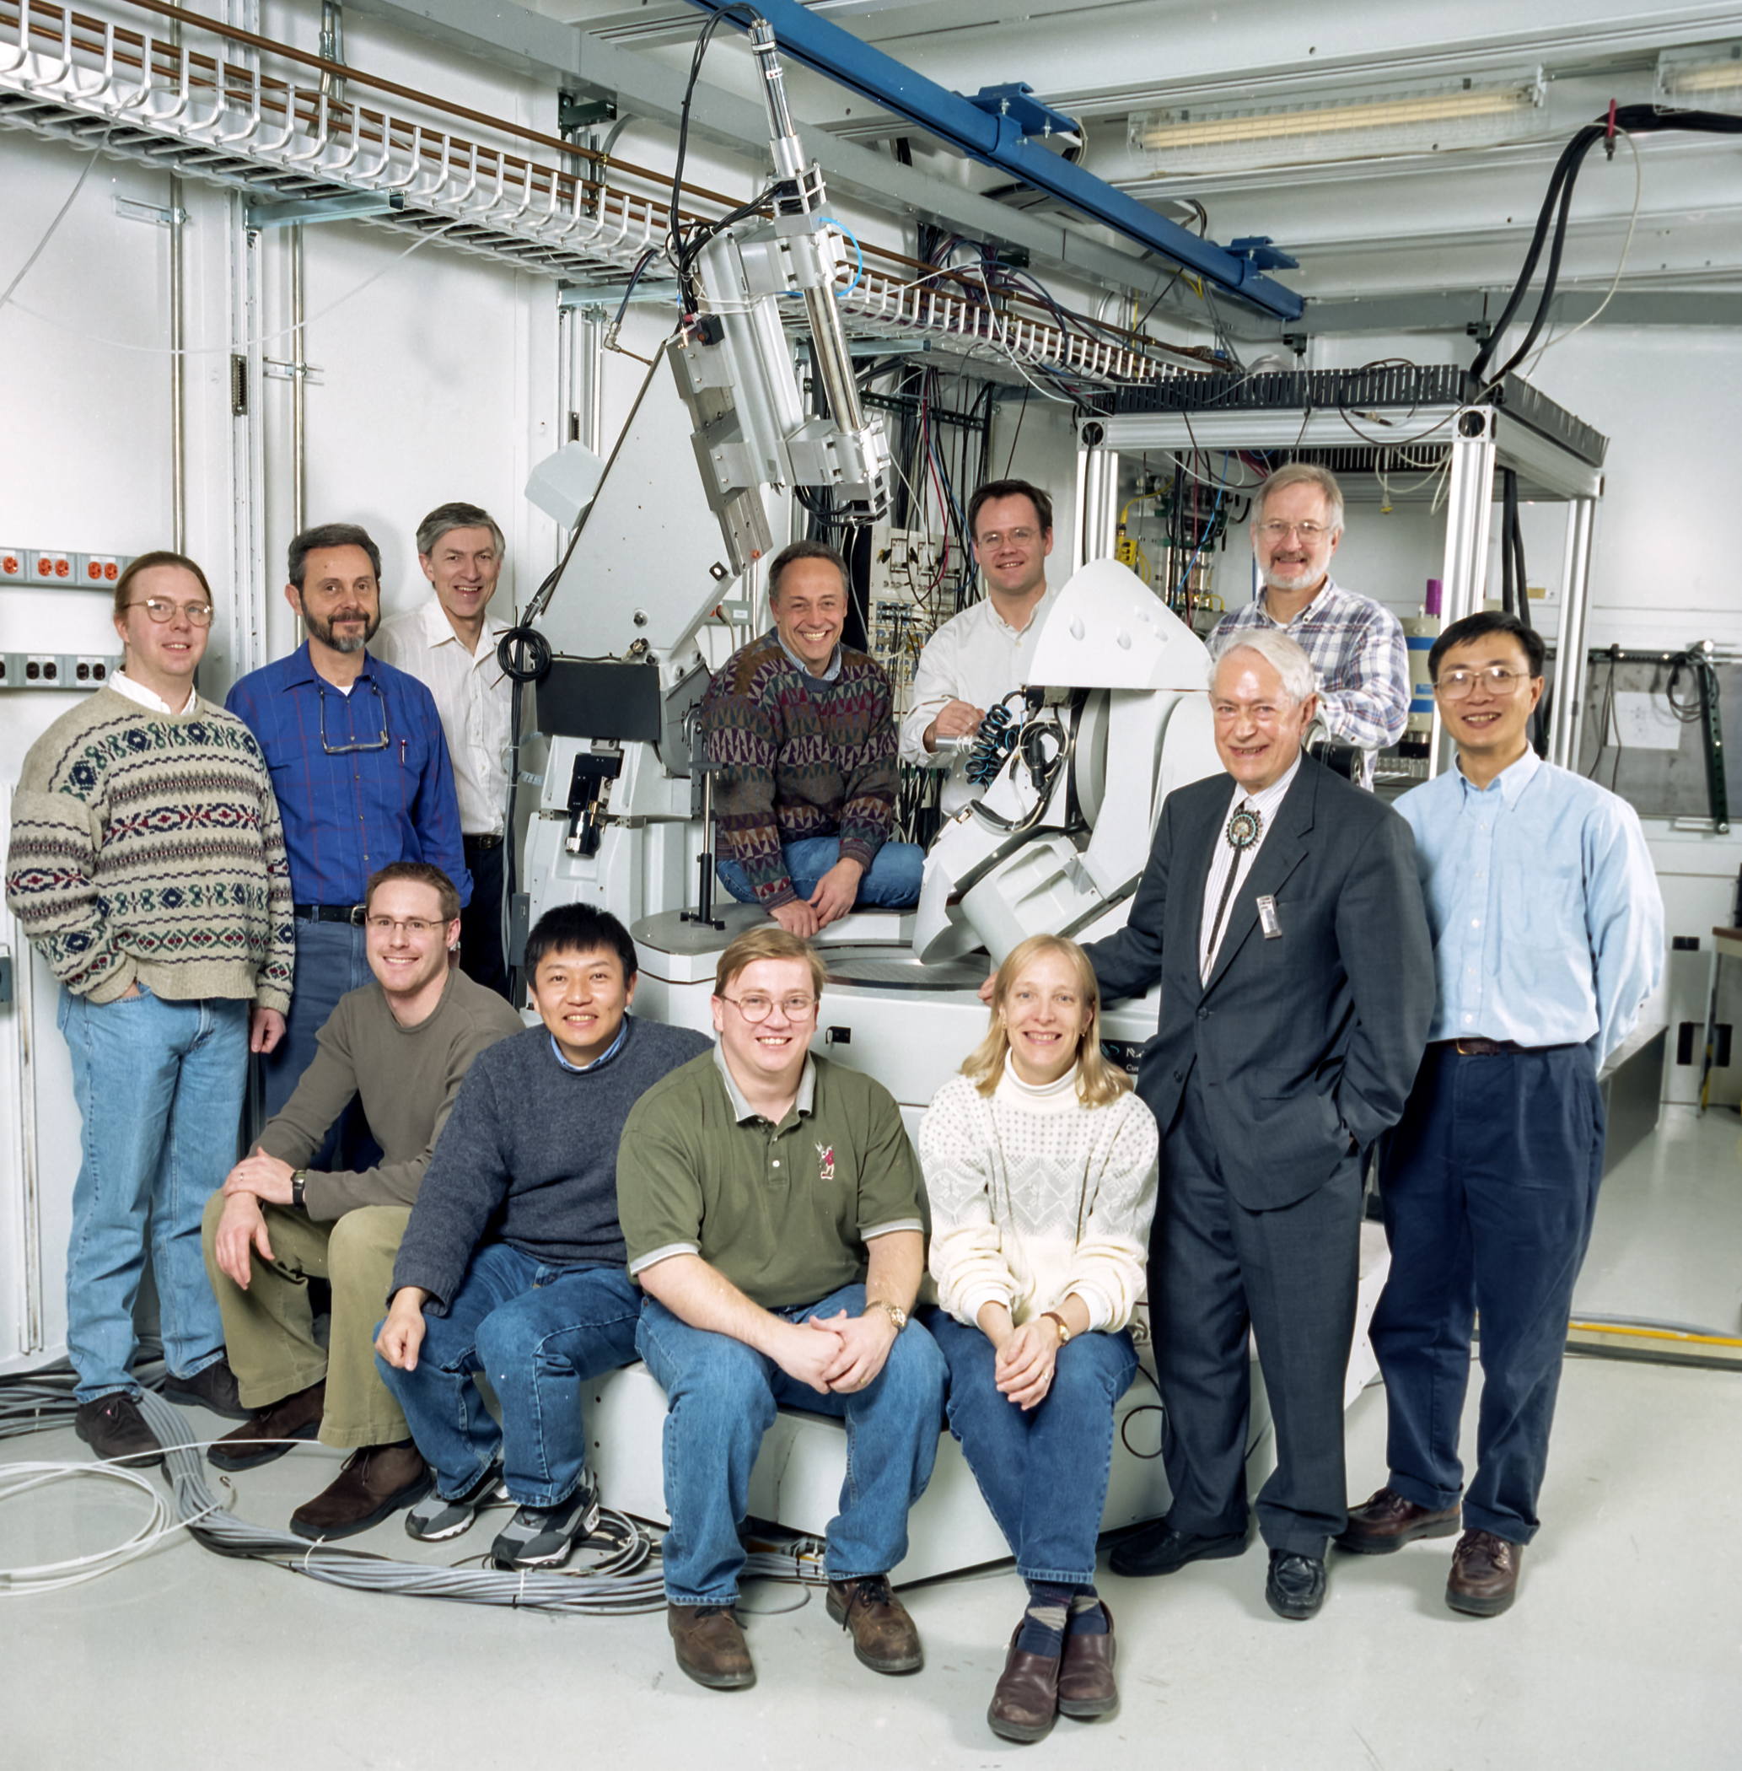
Geoscience at the APS
J.V. Smith formed the Center for Advanced Radiation Sources (CARS) at UofC to build multiple beamlines at the APS (Biology, Chemistry/Materials, Geoscience)
Organized the geoscience community effort for science case and technical design (1988-1994)
Group called GeoSoilEnviroCARS received major funding from NSF-EAR and DOE Geosciences to construct and operate sector 13 at the APS

Slide 6
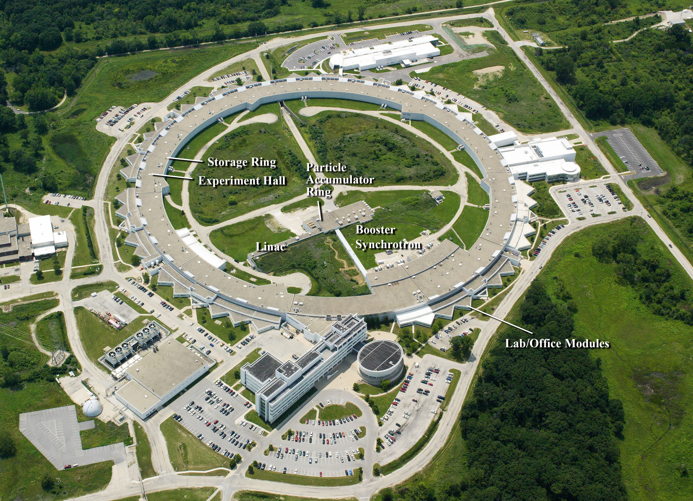
Advanced Photon Source: 7 GeV, high-brightness electron storage ring
GSECARS

Slide 7
Synchrotron Radiation Properties
Broad spectral range (IR to hard x-rays)
Brightness (highly collimated, small source)
  High intensity, lots of photons in a small spot
  Can be focused well with x-ray optics
Polarization (linear, circular, tunable)
Time structure (short pulse)
Partial coherence (laser-like beam from ID)

Slide 8
Relativistic electrons
γ = m/m₀, ratio of mass m of a relativistic electron to its rest mass m₀,
γ = 1957 E (GeV)
E = energy of the electron in GeV.
1/ γ ~= FWHM opening angle of the synchrotron radiation at the characteristic “critical energy”
E_{c} = 0.665 * E²(GeV) * B(T) Critical energy, half-power point
Facility | Energy | γ | 1/γ
Advanced Light Source (LBL) | 1.9 GeV | 3718 | 269 μrad
NSLS-II (BNL) | 3.0 GeV | 5871 | 170 μrad
Advanced Photon Source (ANL) | 7.0 GeV | 13699 | 73 μrad
APS bending magnet:
73 μrad at 60 meters ~4.4 mm vertical beam size
E_{c} bending magnet = ~20keV
At APS electrons have ~7.5 times rest mass of proton! (normally 1/1837)

Slide 9
Simple Synchrotron Description
Storage Ring
GeV
RF Cavity
Booster Synchrotron
Cathode
Linear Accelerator
MeV
Bending Magnet

Slide 10
Sources of Synchrotron Radiation
Bending magnets (dipole magnets)
Periodic magnetic field devices, called insertion devices
  Wiggler: high field and/or large period Electron beam angular deviation >> 1/γ
  Undulator: medium field with small period
    Electron beam angular deviation < ~1/γ

Slide 11
Undulator
How are X-rays Produced in a Synchrotron?
Bending Magnet
Relativistic
electrons
N
N
X-rays
S
S
S
Notes:
X-rays are a form of EM radiation.
QUESTION: Why does this bulb light?
Filament is conductor, outer shell electrons free to move. Random acceleration of these electrons by applied electric field causes collisions, collisions mean dramatic velocity changes, these accelerations produce light.
In general: accelerating electric charges. (eg. transmitting antennae make radio waves)
QUESTION: WHAT CONTROLS ON A CAR ALLOW YOU TO ACCELERATE?
(certainly, synchrotron speeds up charged particles in linac and booster, but these are not source of used radiation)
Synchrotron accelerates particles, (initially, speeds up) but also by forcing charges to follow a curved path (remember change in velocity is req’d for acceleration)
Undulator
Each oscillation produces a wavefront; If electron makes one complete wiggle in the time it takes wavefront to advance in same distance, then constructive addition of waves occurs
Advantage of undulator: Brilliance = More photons in small area (to sample)

Slide 12
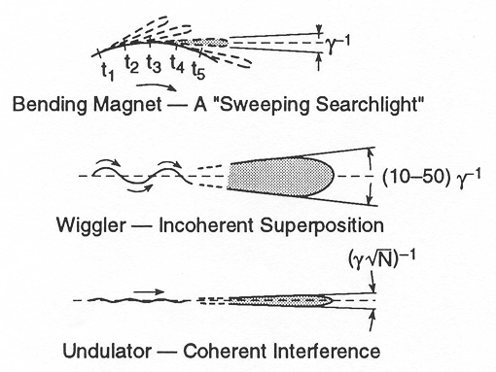
Spatial distribution
  For Undulators
  Characteristic opening angle
  σ’ = (λ_{n}/2L)^{0.5}
  At APS if λ = 1Å = .1nm and L=72 periods * 3.3cm, then
  σ’ = 4.6 μrad (=460 microns at 100m from source)
  17 times smaller than bending magnet opening angle, both vertical and horizontal!
  Radiation is quasi-monochromatic, with fundamental and odd hardmonics
  Can tune energy by adjusting the magnetic gap and thus the field

Slide 13
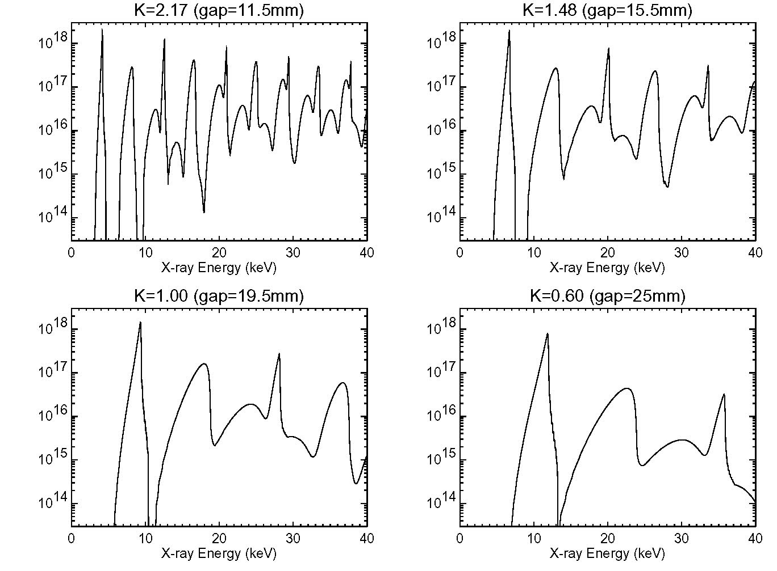
Tuning Curve of APS 3.3 cm Period Undulator

Slide 14
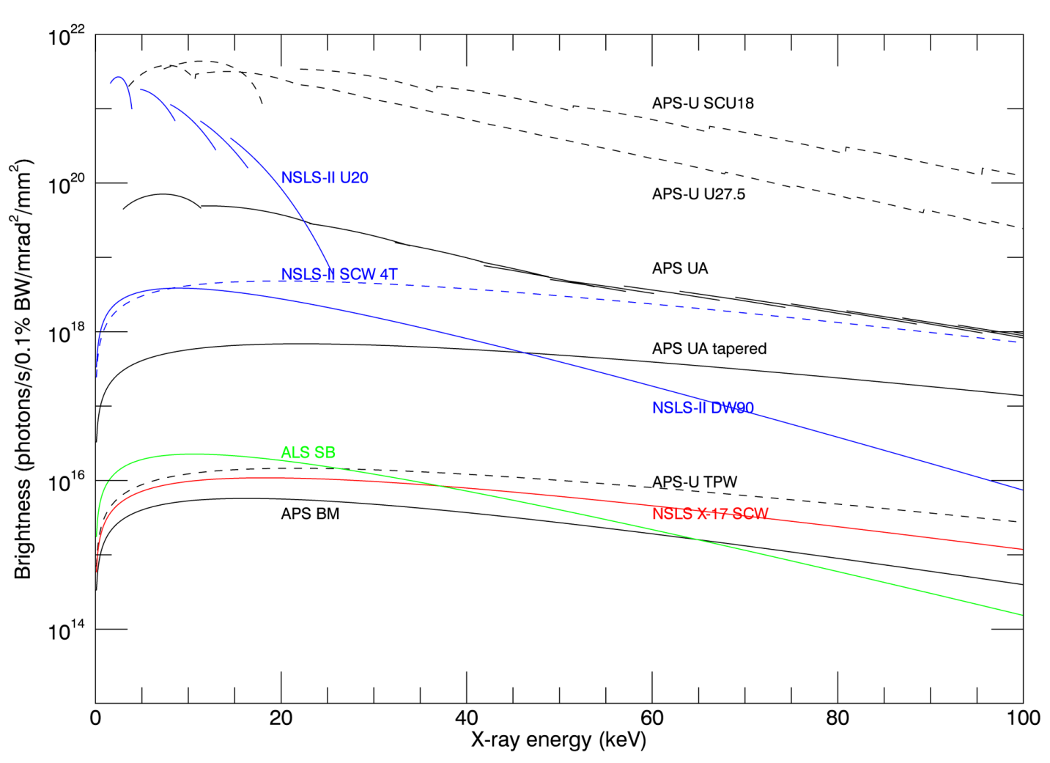
Brightness of synchrotron sources

Slide 15
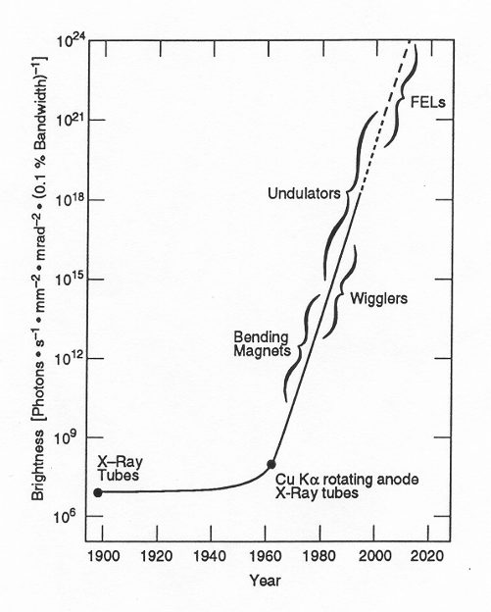
Discovery
of x-rays
We are here
H. Winnick, “Synchrotron Radiation Sources a Primer”, World Scientific,Singapore, 1994

Slide 16
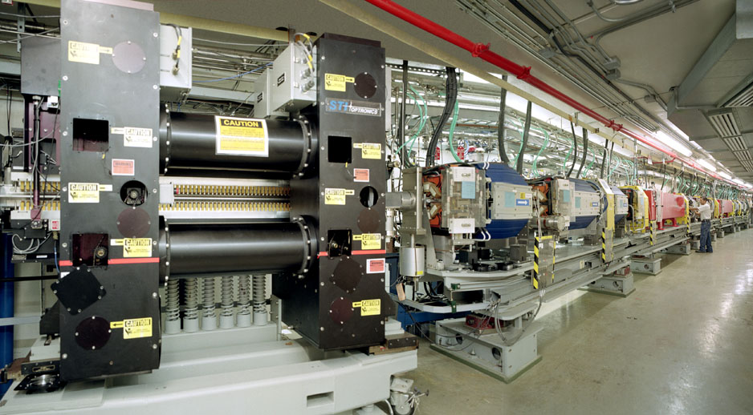
APS Storage Ring

Slide 17
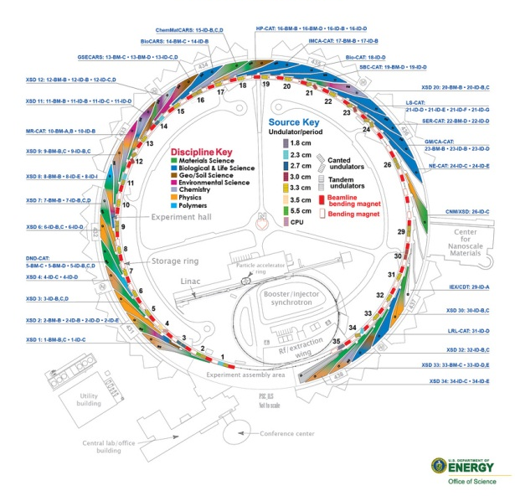

Advanced Photon Source
7 GeV, 100 mA
35 sectors (bending magnet plus 5 meter straight section for insertion devices)
67 operating beamlines
~50% run by APS
~50% run by Collaborative Access Teams (CATs)
Sectors with geoscience programs:
  3: Nuclear resonance scattering
  6: Multi-anvil press
  13: GSECARS
  16: HP-CAT
  34: sub-micron probe
  35: Dynamic compression sector
Northwestern U. sectors:
  5: DND-CAT (small-angle scattering, power diffraction, tomography)
  LS-CAT (protein crystallography)

Slide 18


GSECARS at a Glance
Run 4 simultaneously x-ray beamlines at the APS sector 13
  3 undulator stations, 2 bending magnet stations
All beam time allocated through APS General User Program
  Proposal-based allocation system
  Free to use (only travel and lodging)
Funding from NSF-EAR, DOE Geosciences, NASA
Staff: 11 scientific, 5 post-docs, 4 support
Operating since 1996
>800 user visits per year, typically 1-5 days per visit
>150 publications per year
http://gsecars.uchicago.edu/

Slide 19
GSECARS Facilities and Techniques

Slide 20
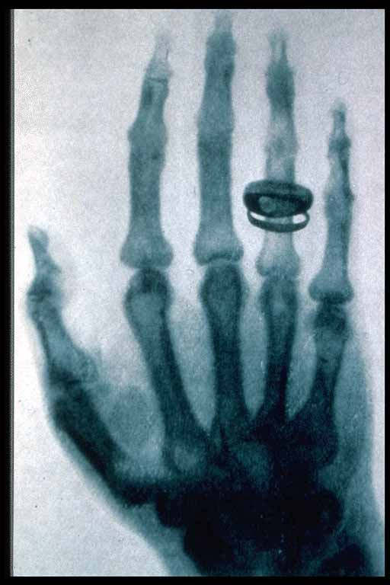
Synchrotron X-ray Imaging
Source is bright: intense, well-collimated, with a small source
  High flux in beam for full-field imaging
  Can focus to a small spot for fluorescence or projection imaging
X-ray spectrum is continuous:
  With monochromator
    Energy optimized for specific sample thickness and composition
    Energy optimized for exciting a specific element
    Energy scanned for X-ray absorption fine structure analyses
  No monochromator
    10⁴ more flux for high-speed imaging
    Efficient excitation of a large number of elements for fluorescence
Source is partially coherent – useful for phase contrast imaging
Discovery of X-rays W. C. Röntgen, 1895
Radiograph of his wife’s hand, 1896

Slide 21
Absorption Tomography Setup
13-BM-D station at APS
X-ray Source
  Parallel monochromatic x-rays, 7-65 keV
  APS bending magnet source, 20 keV critical energy
  1-50mm field of view in horizontal, up to 6 mm in vertical
  1-20 micron resolution, depends on field of view
Imaging System
  LuAG single crystal scintillator
  5X to 20X microscope objectives, or zoom/macro lens
  1920x1200 pixel fast CMOS camera
Data collection
  Rotate sample 180 degrees, acquire images every 0.2 degrees
  Data collection time: 3-20 minutes
  Reconstruction time: 1-2 minutes
Microscope objective
Scintillator
Sample
CMOS camera
X-rays
X-rays
Visible light
Rotation stage

Slide 22

Soil Aggregate Reconstruction
Fly through in X direction
Soil aggregate
6.5 um/pixel
28 keV
Sasha Kravchenko
Michigan State
Studying decay of organic material with time

Slide 23
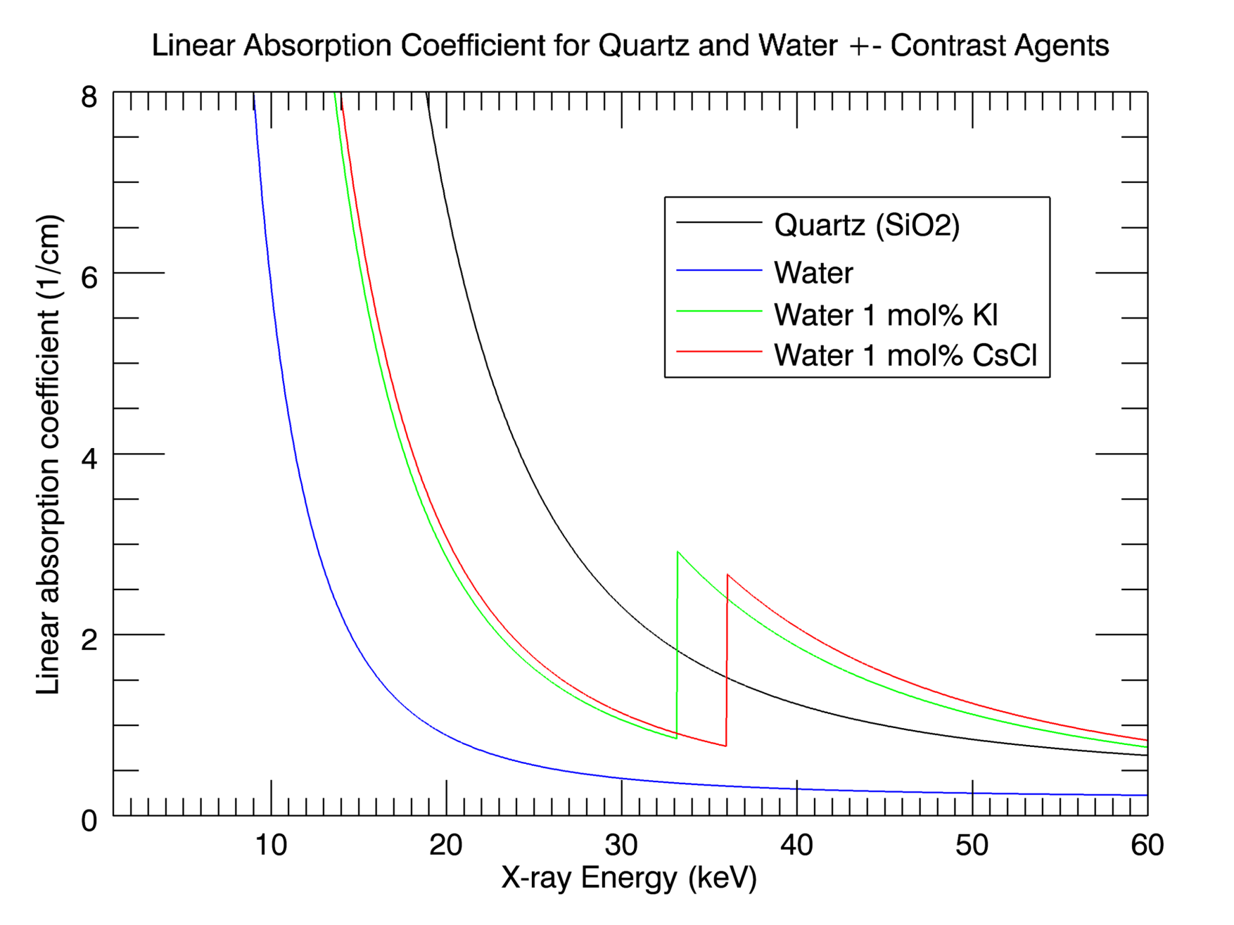
Differential Absorption Tomography

Slide 24
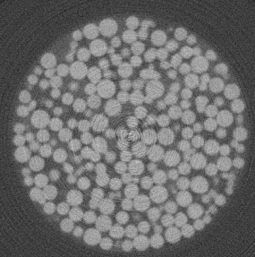
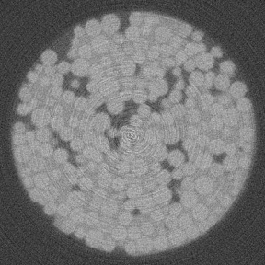
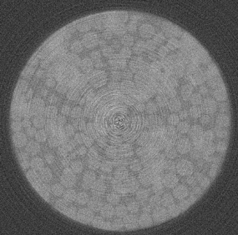
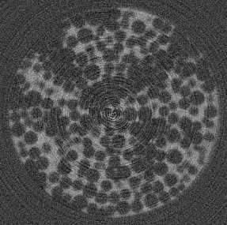
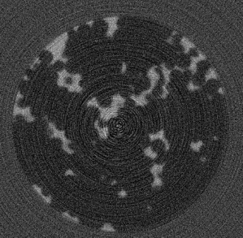
Differential Absorption Tomography
Clint Willson (Louisiana State University)
8mm diameter sand column with aqueous phase containing Cs and organic phase containing I.
32.5 keV, below I and Cs K absorption edges
33.2 keV, above I and below Cs K absorption edges
36.0 keV, above I and Cs K absorption edges
33.2 - 32.5 keV, showing distribution of I in the organic phase
36.0 - 33.2, showing distribution of Cs in the aqueous phase

Slide 25
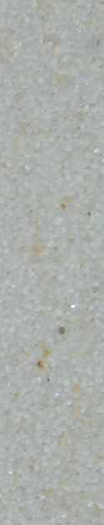
Organic Liquid Dissolution
Mark Brusseau, University of Arizona
Initial Residual Saturation
After First Water Flush
After Second Water Flush
After Third Water Flush

Slide 26
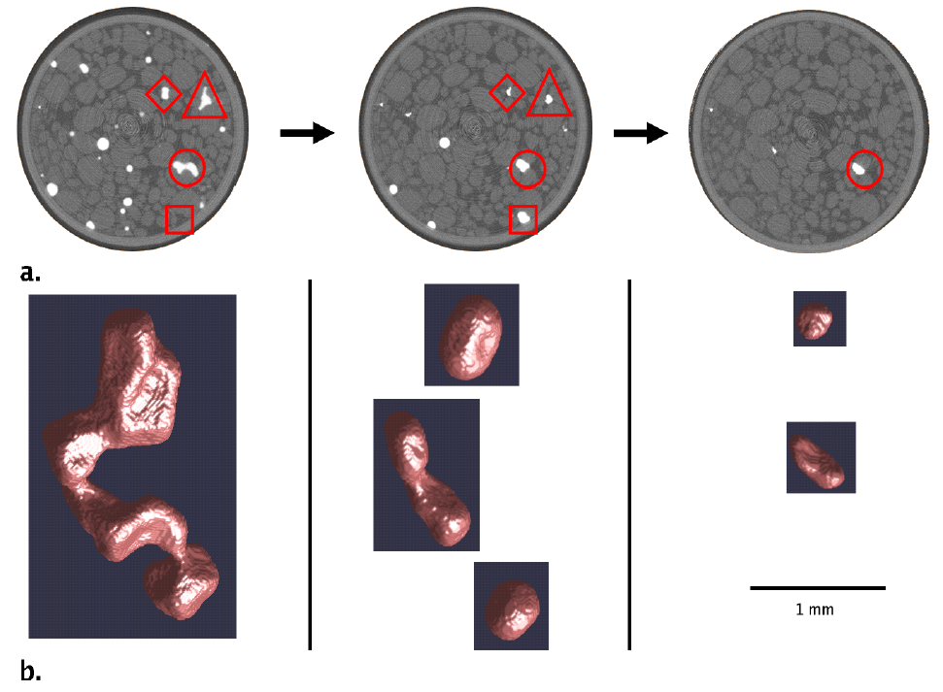
Organic Liquid Dissolution

Slide 27
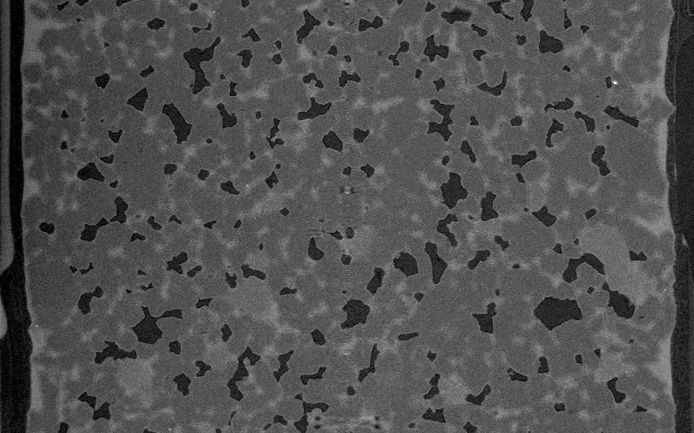
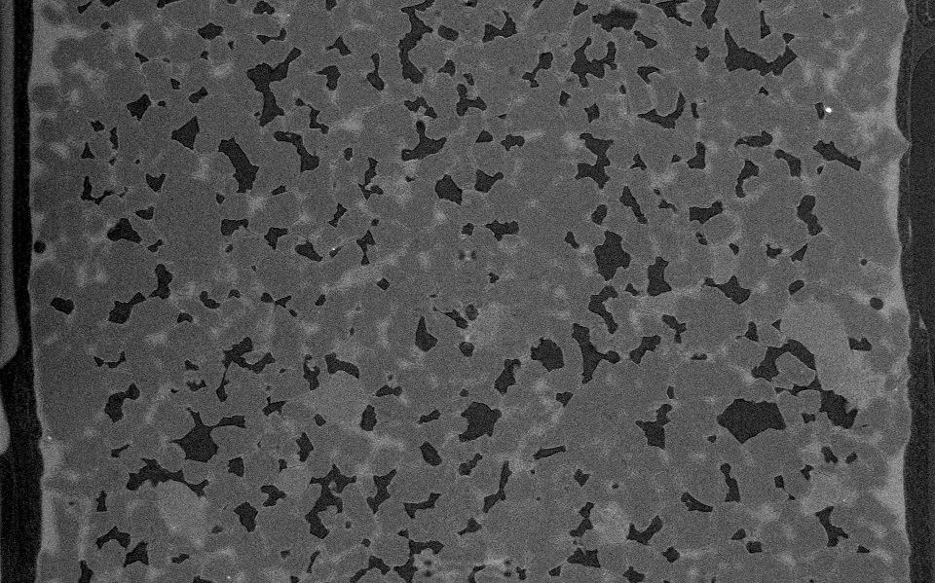
High speed Tomography
Fluid drainage and imbibition in sandstone
Douglas Meisenheimer, Oregon State University
Pink beam
3.2 µm/pixel
9.5 seconds per dataset
Collected datasets every ~60 seconds for 30 minutes while column was drained
Time 0 dataset
30 minutes later

Slide 28
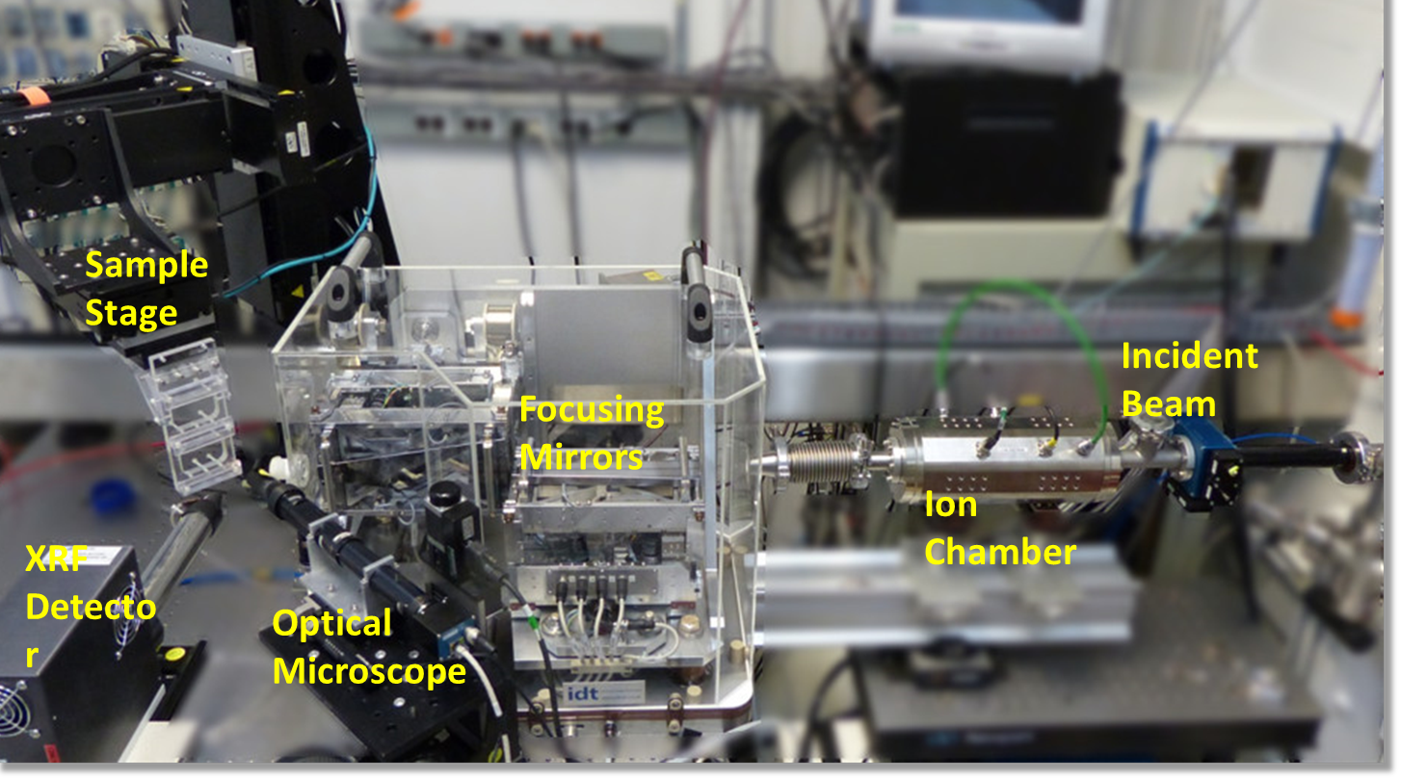
X-ray Fluorescence Microprobe
Methods:
Trace element composition (attogram MDL)
Oxidation state and speciation (1 ppm XANES, 100 ppm EXAFS)
Element mapping: 2D composition and oxidation state imaging
Fluorescence CT: Internal 2D and 3D elemental imaging
XRD: phase identification and correlation with elemental and
Instruments (APS 13-ID-E):
Monochromatic (undulator; 2.3-26 keV)
X-ray microfocusing with KB mirrors (1 μm resolution)
Multi-element solid state X-ray detector for high count rates
WDS for high energy resolution applications
Environmental chambers (hot, cold, He, etc.)
Applications:
Spatially-resolved chemical contents and speciation in heterogeneous systems
Speciation of elements in buried phases (fluid inclusions )
Valence state determinations for multi-valent elements (e.g., Ti, V, Cr, Mn, Fe, Eu, U)

Slide 29
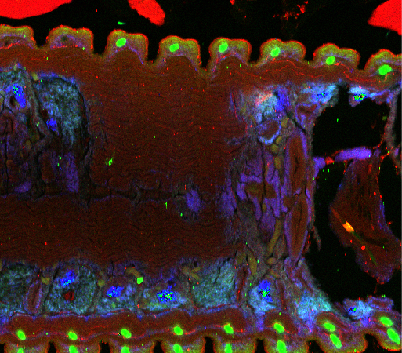
Ca, Zn, Pb: 1176 x 1031 pixels2.35 x 2.06 mm, 2µm
10 msec/pixel, 3.3 hrs total
Earthworm introduced to Pb-contaminated soil
Pb-rich areas in the earthworm digestive system accumulated in biogenically formed metal-rich granules.
Zn-enriched areas at the margins are Zn localized in setae, growths on used for locomotion.
J. Seiter, U.S. Army Corps of Engineers

Slide 30
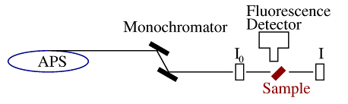
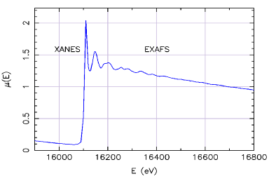
X-ray Absorption Spectroscopy: XANES and EXAFS
Measure energy-dependence of the x-ray absorption coefficient μ(E) of a core-level of a selected element
Element Specific: Z>20 can have EXAFS measured at the APS.
Valence Probe: XANES gives chemical state and formal valence of selected element.
Local Structure Probe: EXAFS gives atomic species, distance, and number of near-neighbor atoms around a selected element.
Natural Samples: samples can be in solution, liquids, amorphous solids, soils, aggregrates, plant roots, surfaces, etc.
XANES = X-ray Absorption Near-Edge Spectroscopy
EXAFS = Extended X-ray Absorption Fine-Structure

Slide 31
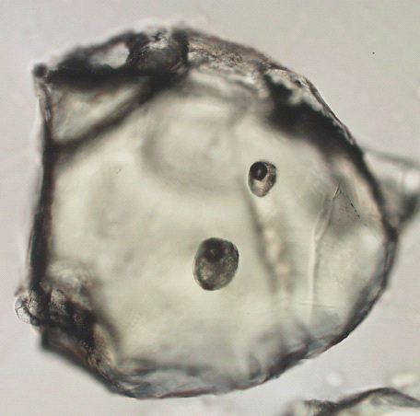
Oxidation state of iron in komatiitic melt inclusions
indicates hot Archean mantle
Komatiites are volcanic rocks mainly of Archean age that formed by unusually high degrees of melting of mantle peridotite.
Their origin is controversial and has been attributed to either anhydrous melting of anomalously hot mantle or hydrous melting at temperatures only modestly greater than those found today
Minerals contain inclusions of trapped magma.
Can use ferrous/ferric ratio determined by microXAFS to distinguish between these two hypotheses.
We measured reduced Fe (Fe²⁺ dominated) in the inclusions (valence=2.1).
Berry, A. J., et al. (2008) Nature 455, 960-964.
50 μm

Slide 32
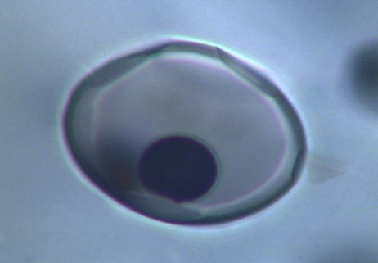
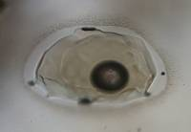
Komatiites
Hydrous melting model requires 3-5 wt% H₂O (subduction)
Komatiite inclusions: H₂O 0.18-0.26 wt% (dry) much less than required by the wet-melting model.
Loss of H₂O as H₂ can result in Fe oxidation:
H₂O + 2FeO → Fe₂O₃ + H₂ H₂O + 3FeO → Fe₃O₄ + H₂
No petrographic evidence of water loss
Loss of only 1.5 wt% H₂O from the inclusion would completely oxidize iron (Fe³⁺/ΣFe = 1)
Thus, reduced Fe consistent with ‘anomalous hot mantle’ model for Archean.
komatiite
20 μm
30 μm
shoshonite

Slide 33
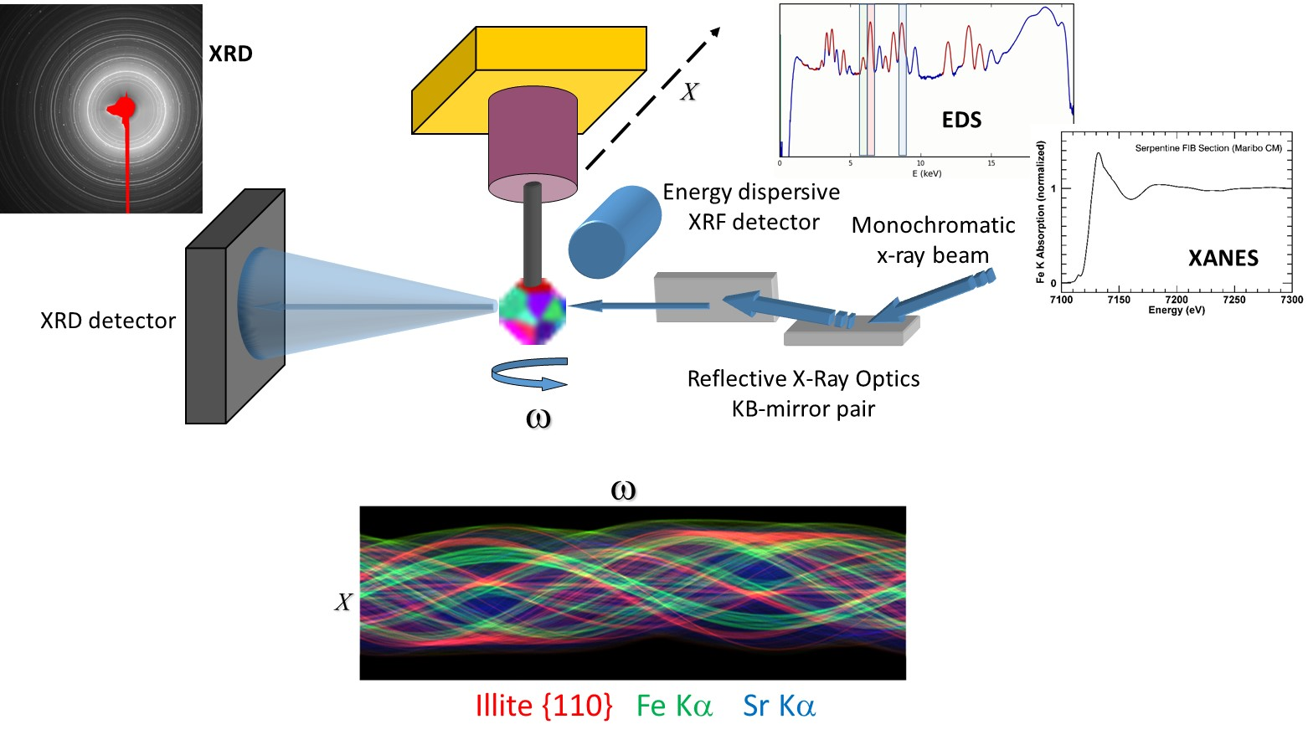
XRD Tomography - 3D imaging of mineralogy in unsectioned geologic materials
Micro-XRD tomography allows imaging of internal mineralogy without sectioning. Samples in sealed containers and capture media can be interrogated non-invasively, without the need for extraction, at micrometer scale. Simultaneously provides information regarding the sample microstructure.
Sinogram of X-ray diffraction, fluorescence and absorption intensities can then be tomographically reconstructed

Slide 34
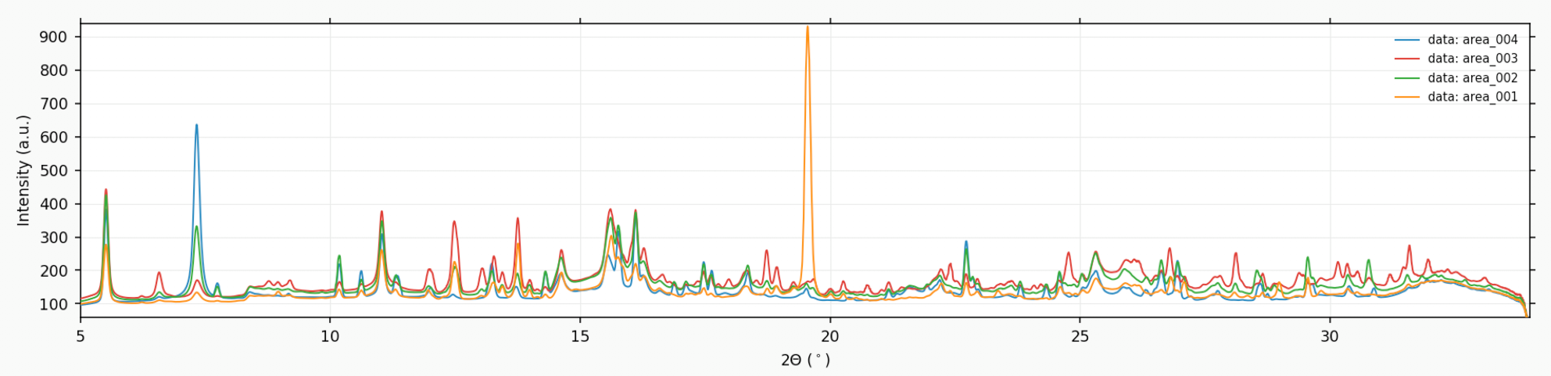
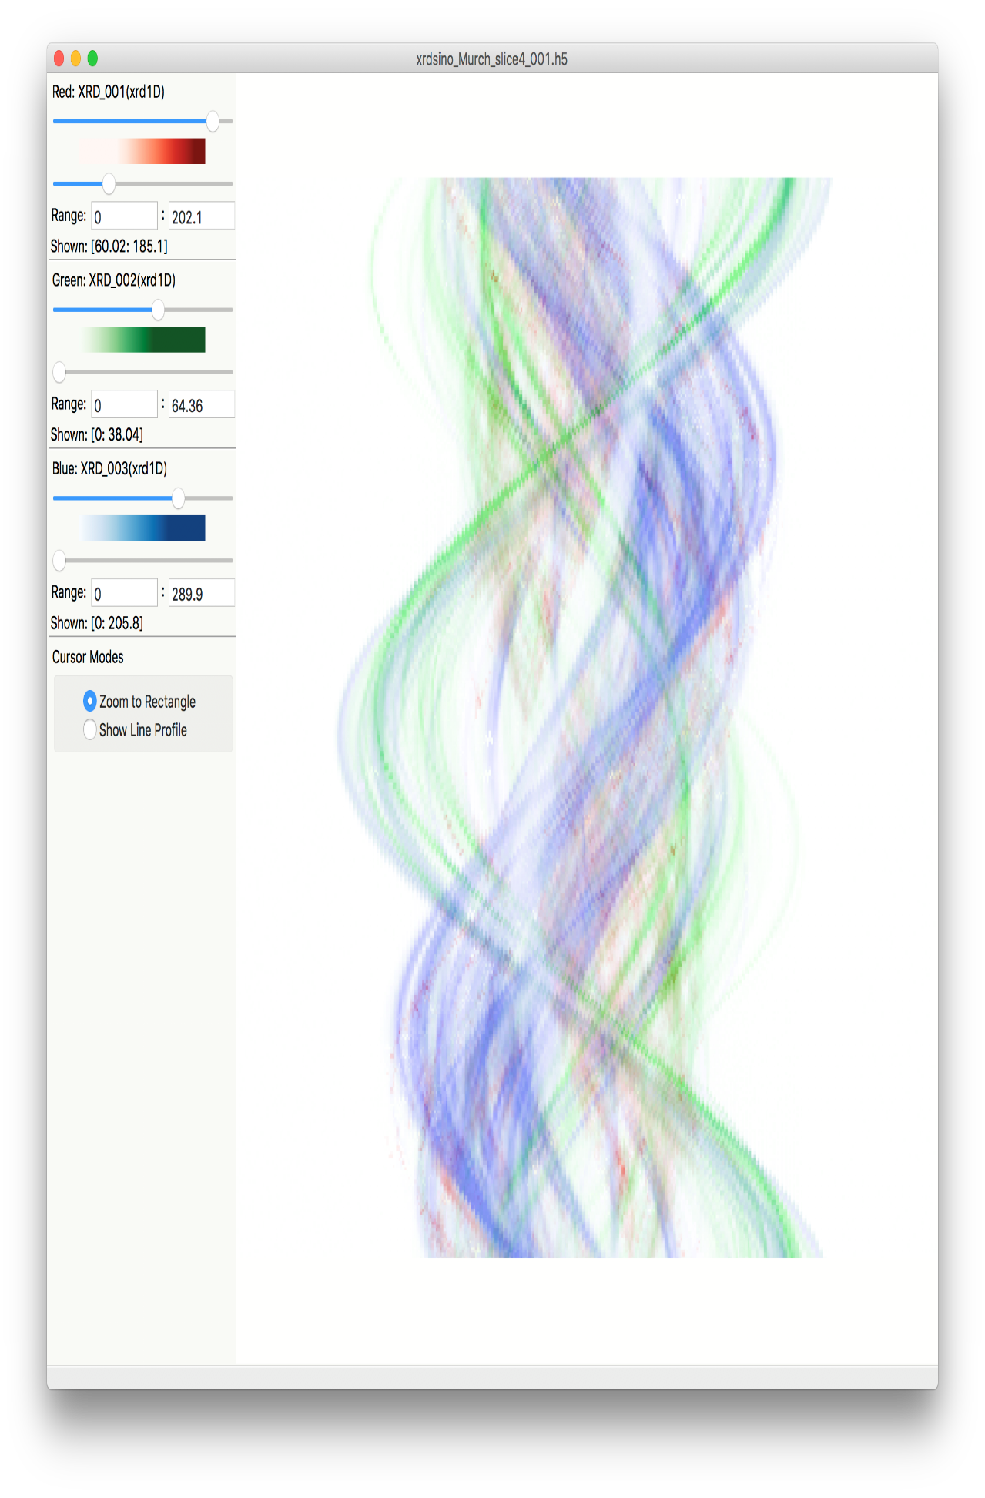
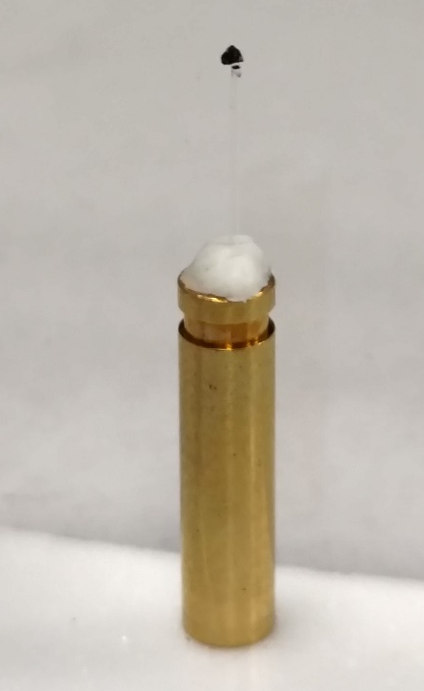
XRD Tomography - absorption contrast reconstructed through sample of Murchison meteorite
Cronstedtite 001
Tochilinite 002
Forsterite 020
absorption contrast sinogram
Murchison meteorite is a CM group carbonaceous chondrite, which are rich in carbon and among the most chemically primitive meteorites.
300 μm
Translation
2 μm x 1˚ pixel size, 70 msec/pixel, 18 keV
Rotation

Slide 35
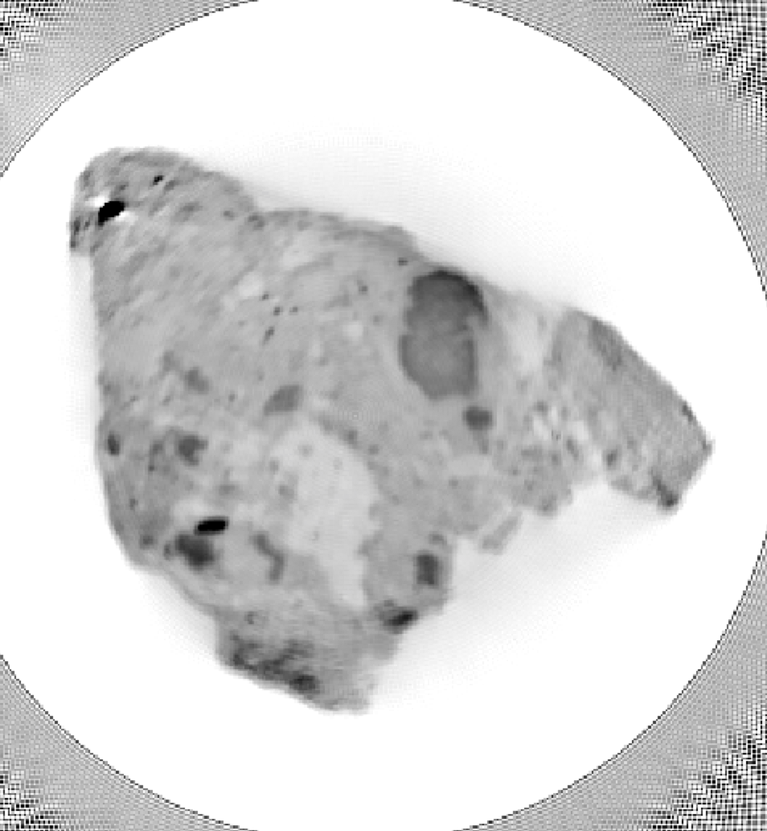
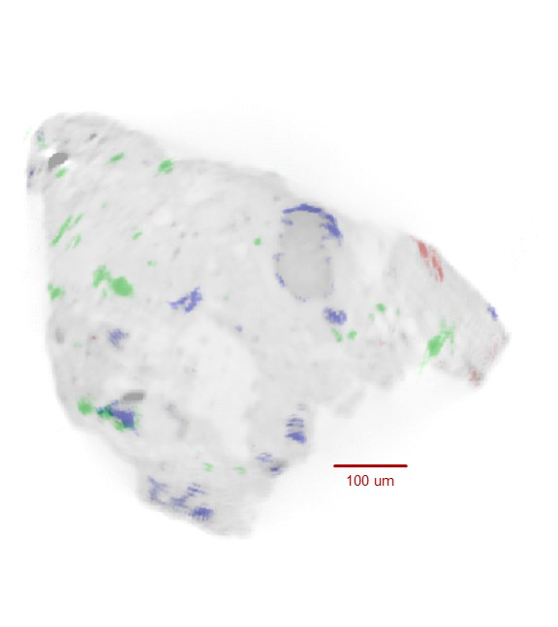
XRD Tomography - XRD tomographic reconstructions of Murchison meteorite
Tochilinite rim on chondrule surface
Chondrule
100 um
Cronstedtite 001
Tochilinite 002
Forsterite 020
Absorption

Slide 36
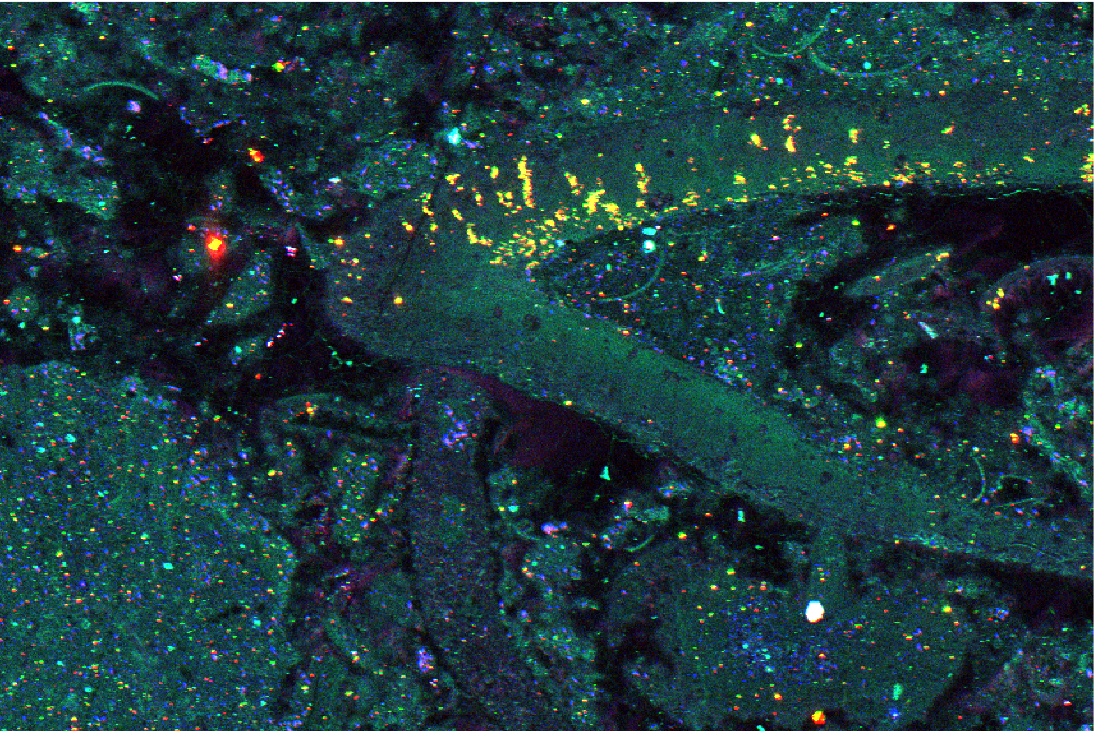
Sulfur speciation imaging of carbonate fossils
Data show differences in sulfur speciation between major phases (e.g., clasts and cement) as well as subtle differences in sulfate concentrations from fossil clades (e.g., crinoids vs. gastropods).
D. Fike (Wash. Univ. S.L.) and C. Rose (Trinity Coll. Dublin)
Cambro-Ordovician carbonate strata, Argentinian Precordillera.
δ³⁴S in carbonate rocks Ü secular changes in the global S cycle.
Discordant Isotope data
  Primary differences in water column chemistry?
  Geochemical alteration during or after deposition?
1 mm
3 µm pixel, 50 msec
Sulfide (2471.2 eV) Sulfate (2481.7 eV) Total S (2520 eV)
Notes:
60 seconds : 7.2 minutes total

Slide 37
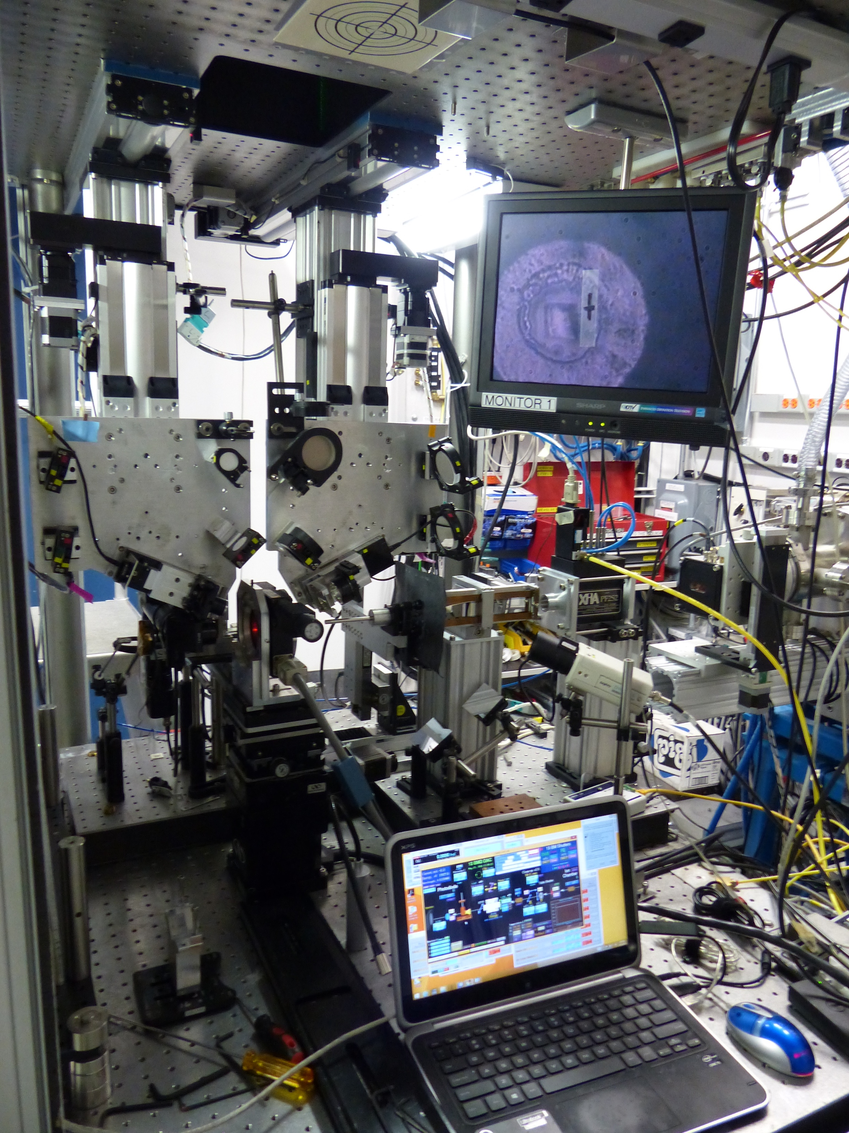
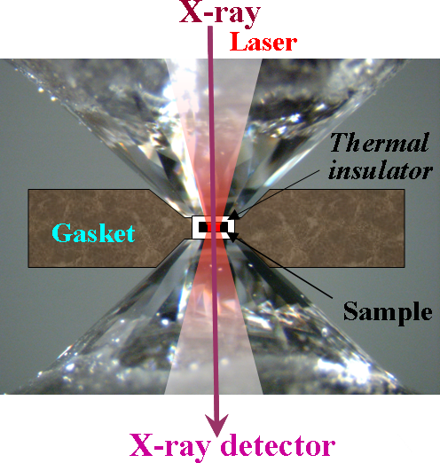
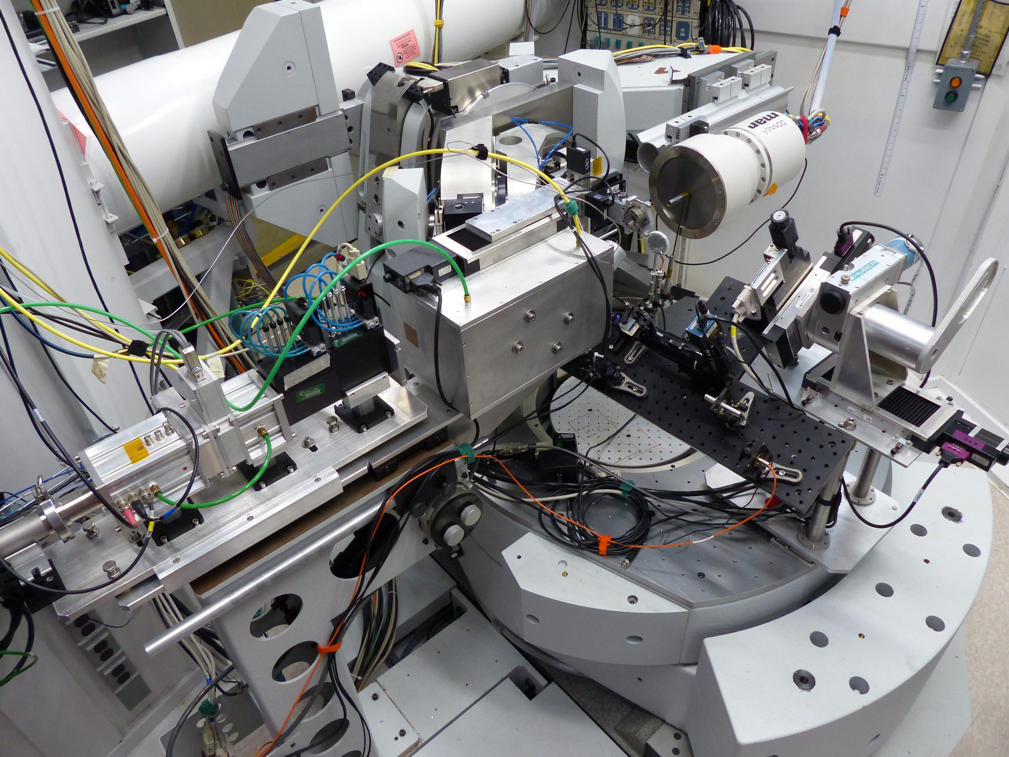
Diamond Anvil Cell Program at GSECARS
Multiple optical axes (x-ray, lasers, spectroscopy/ imaging) should be aligned with precision better than 1 µm in the DAC
13-IDD
13-BMD
X-ray energy 5-80 keV
beam size ~3 µm
XRD, sXRD, XES
on-line laser heating,
Raman and
VIS-IR spectroscopy
laser
13-BMC
X-ray energy 15, 29 keV
beam size ~ 20 µm
sXRD
on-line laser heating, Raman and
VIS spectroscopy
X-ray energy 5-80 keV
beam size ~6 x 12 µm
XRD, sXRD
on-line Brillouin, Raman
VIS-IR spectroscopy
spectrometer
Notes:
To utilize different approaches for sample characterization we have built three dedicated stations: main IDD combined with LH and on-line advanced spectroscopy, BMD coupled with BS, and BMC for sXRD where 6-axis diffractometer is combined with LH , details during the tour.

Slide 38
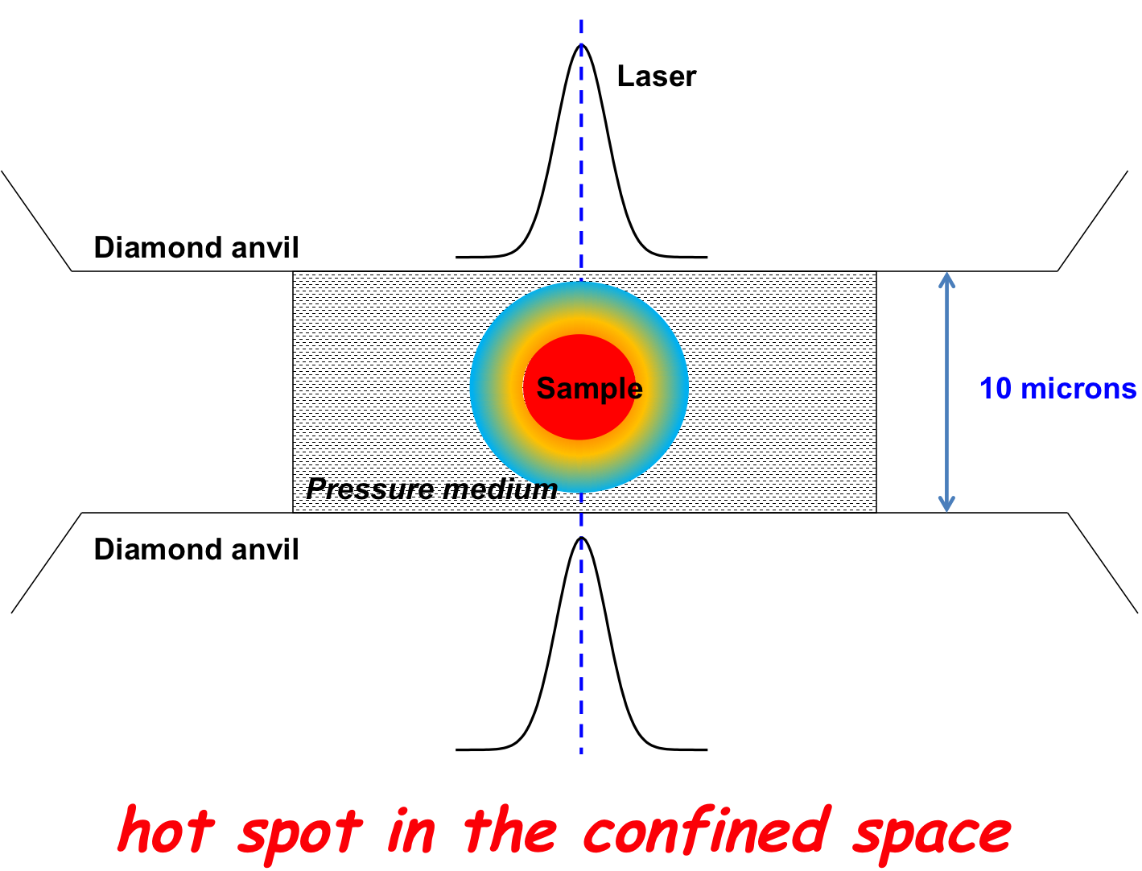
Phase relations of Fe₃C and Fe₇C₃ up to 185GPa and 5200K:
Implication for the stability of iron carbide in the Earth’s core
Jin Liu, Jung-Fu Lin, Vitali B. Prakapenka, C.Prescher, and T. Yoshino
GRL, 2016
Integrated diffuse scattering signals from the liquid were calculated from their integrated intensity after subtraction of diffraction peaks from solids as well as the background
Observed phases in the Fe-rich Fe-C system with Fe3C as the starting sample at high pressure and temperature
The higher melting point and relative stability of Fe₇C₃ in Fe-rich Fe-C system at Earth’s core conditions indicate that Fe₇C3 could solidify out of the early Earth’s molten core to become a constituent of the innermost inner core.

Slide 39
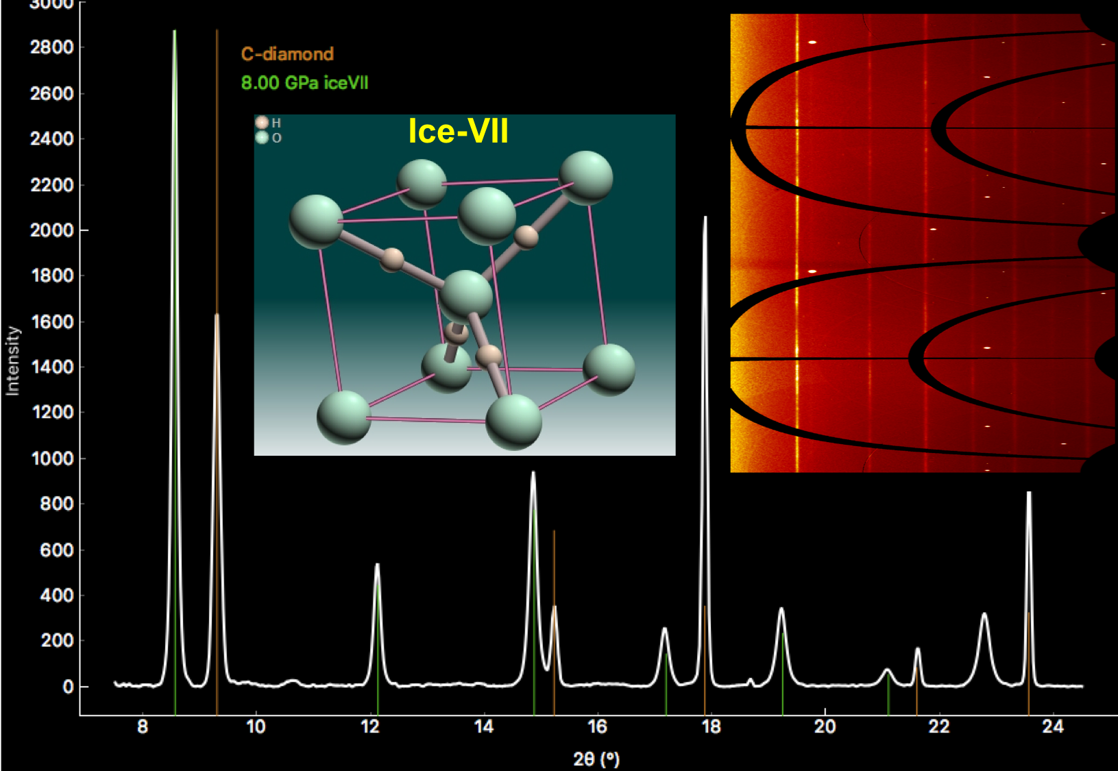
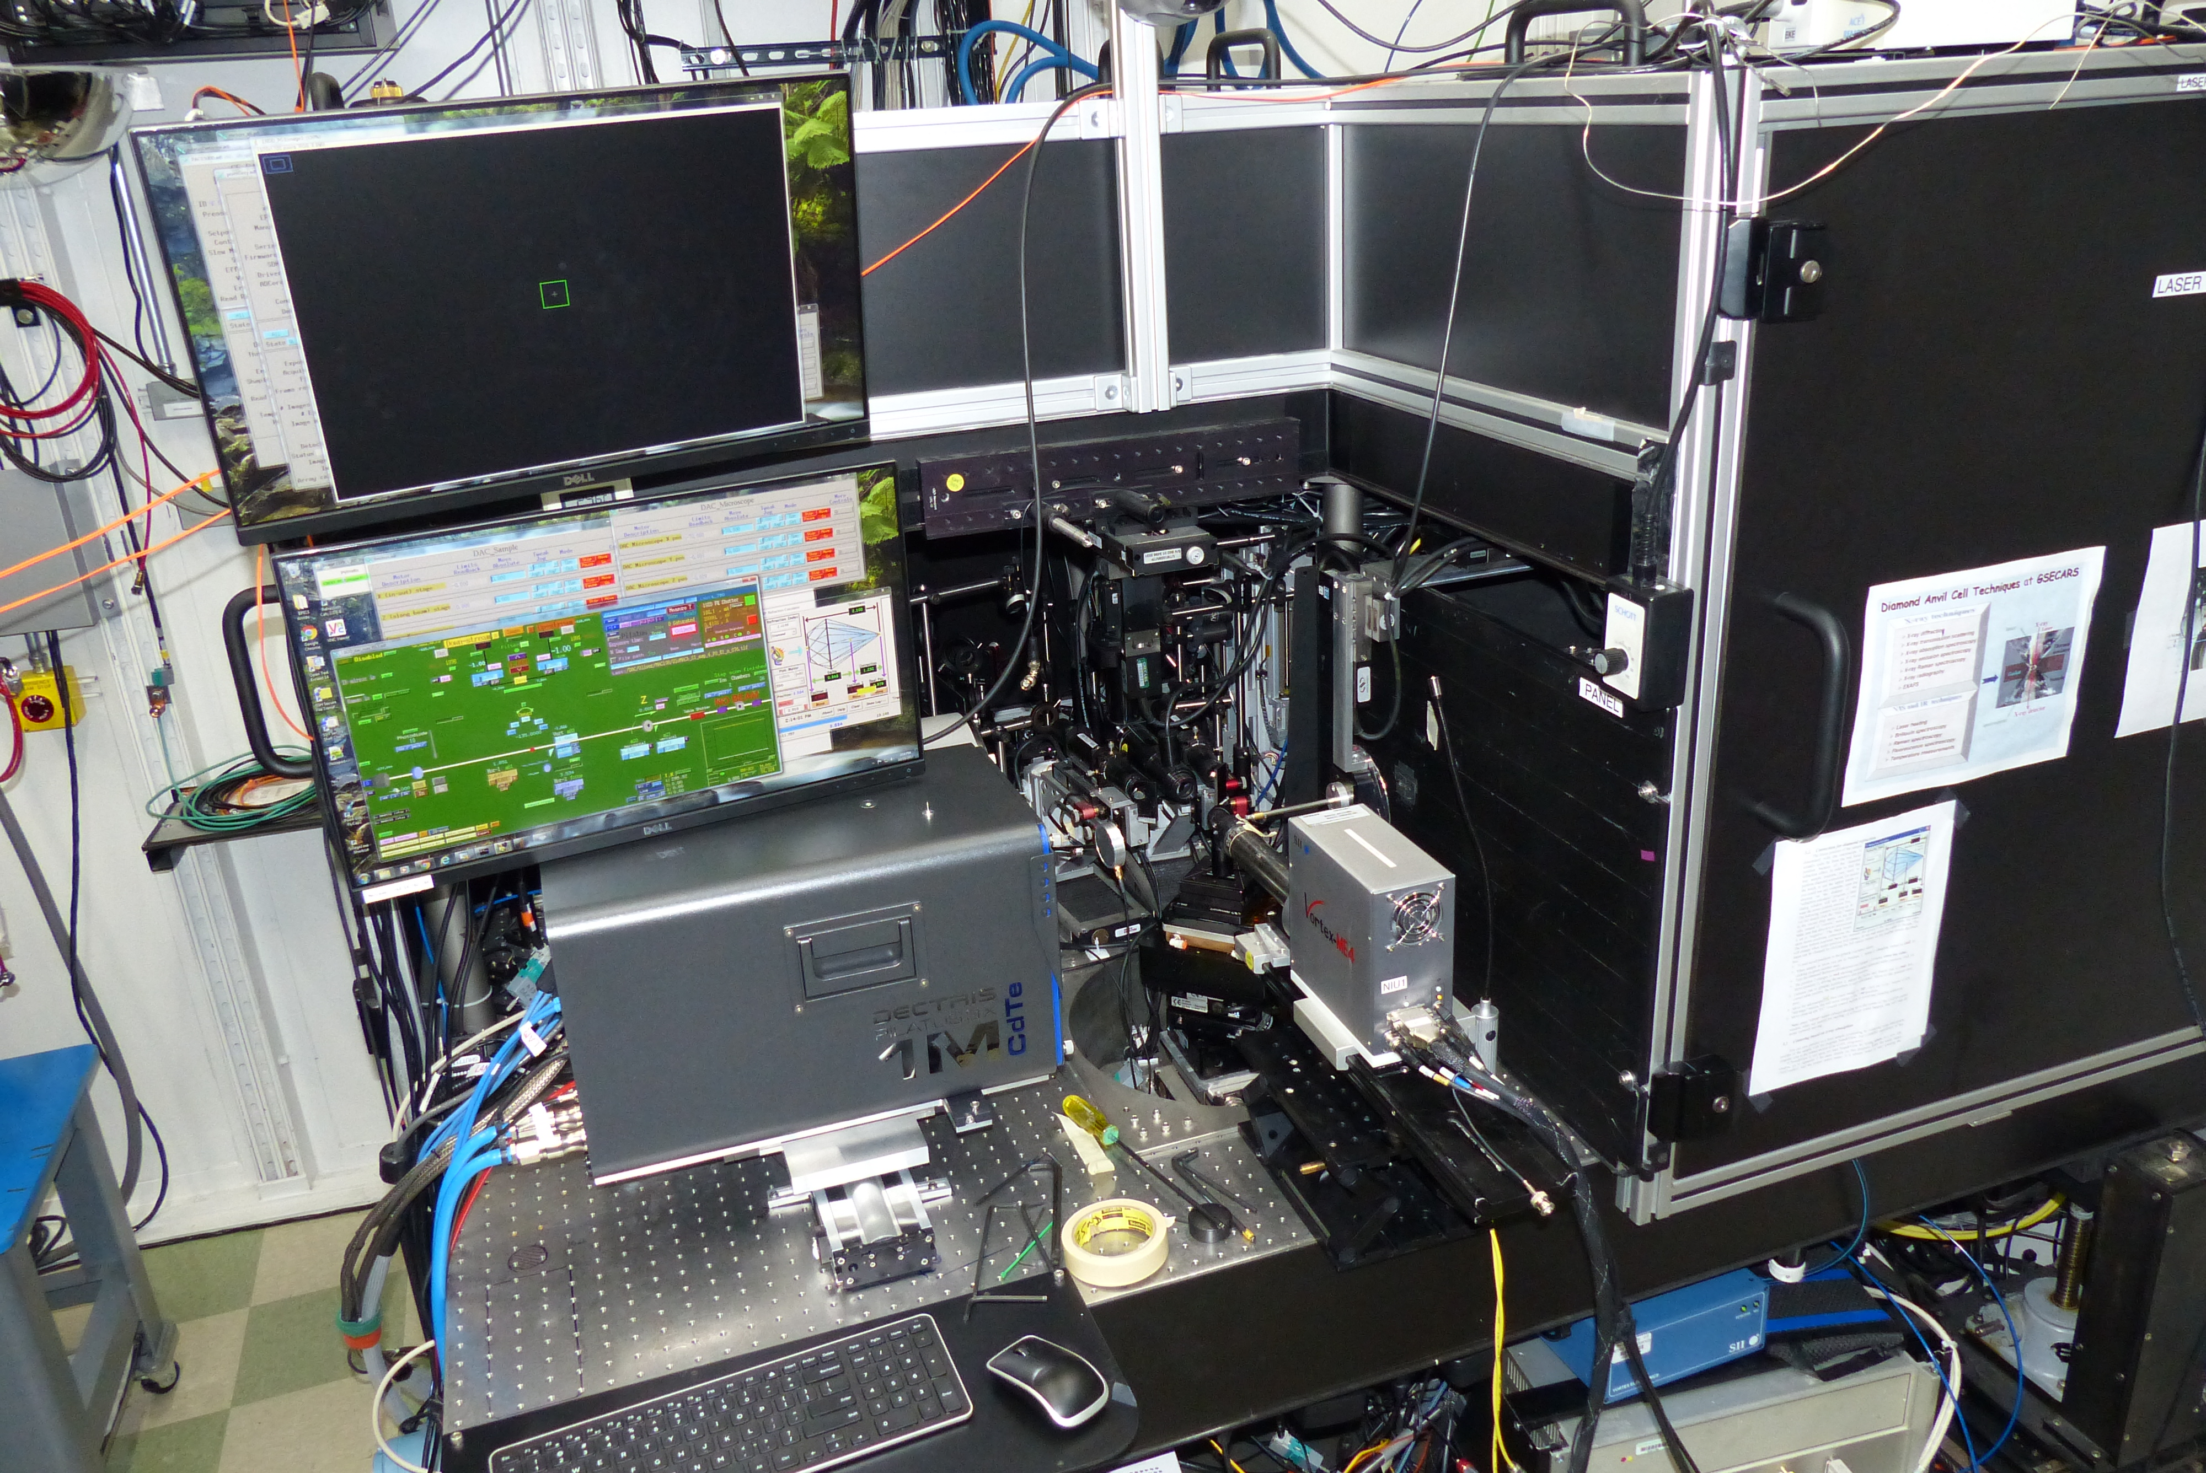
Ice-VII inclusions in Diamonds: Evidence for aqueous fluid in Earth’s deep Mantle
Identified Ice-VII trapped within diamonds that crystallized deep in the Earth’s mantle.
First time Ice-VII has been discovered in a natural sample, making the compound a new mineral accepted by the IMA
O. Tschauner¹*, S. Huang¹, E. Greenberg², V.B. Prakapenka², C. Ma³, G.R. Rossman³, A.H. Shen⁴, D. Zhang^{2,5}, M. Newville², A. Lanzirotti², and K. Tait^{6.} Science 359, 1136 (9 March 2018)
Notes:
Ice-VII is a high pressure polymorph of water-ice and has been recently approved as a mineral by the International Mineralogical Association based on X-ray diffraction data collected at GSECARS. Earth scientists have long debated how much water may be preserved in the regions of the mantle from where these diamonds are believed to have formed, the transition zone and at lower mantle boundary. These inclusions are believed to be residues of aqueous fluids present in the mantle when the diamonds formed, at pressures as high as 24 GPa, with the ice-VII phase crystallizing within the diamond upon ascent. The included ice-VII preserves the high pressures at which the fluids were included and represent the highest pressure of a molecular solid directly observed in nature. This finding has important implications for our understanding of how water and heat-generating elements such as K, U, Th, which have increased solubility in aqueous fluids, may be recycled in the deep Earth, for example though subduction zone processes.

Slide 40
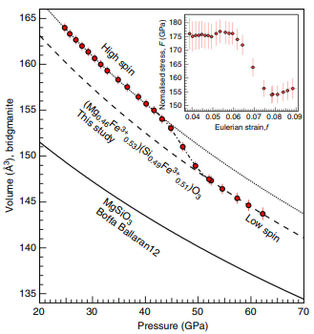
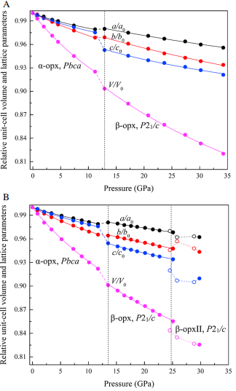
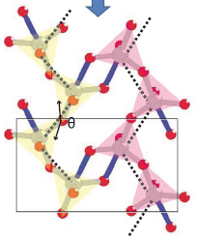
High pressure crystallographic research at 13-BM-C
Single-crystal x-ray diffraction in the diamond anvil cell
High-quality crystal structures to lower-mantle conditions
  Crystal structure of minerals
  Density and elasticity in the mantle and the core
  Phase relations in the earth’s deep interior
Penta-coordinated silicon found in high pressure γ-diopside
Density and sound velocities of Fe-rich bridgmanite over the spin transition
Effects of water and transition metal on the phase transitions of orthoenstatite
Hu et al., GRL (2017), 44, 11340
Liu et al., Nature Comm (2018), 9, 1284
Xu et al., JGR-Solid Earth (2018), 123, 2723

Slide 41
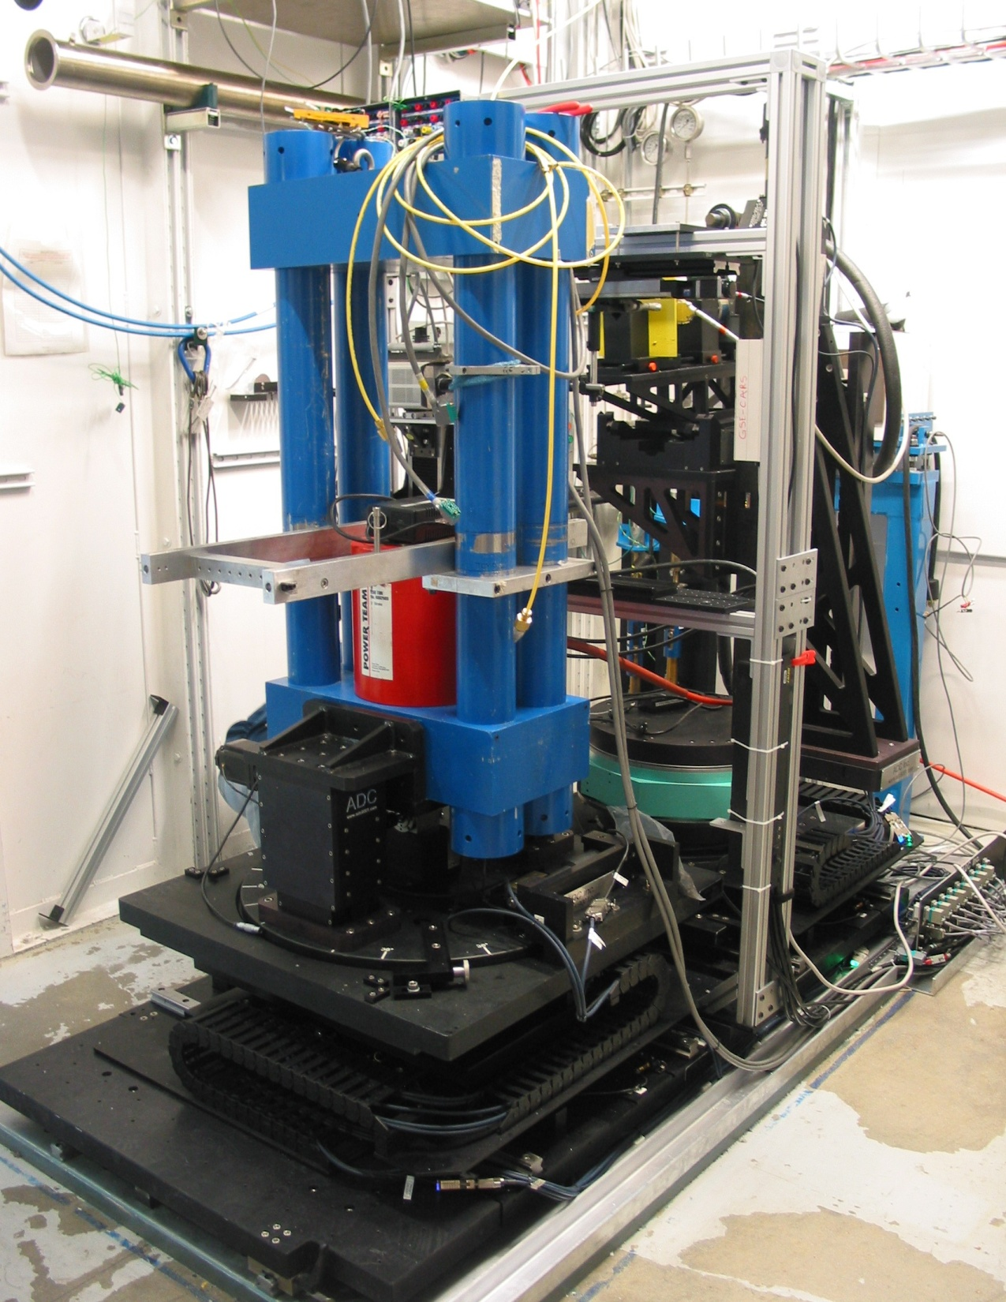
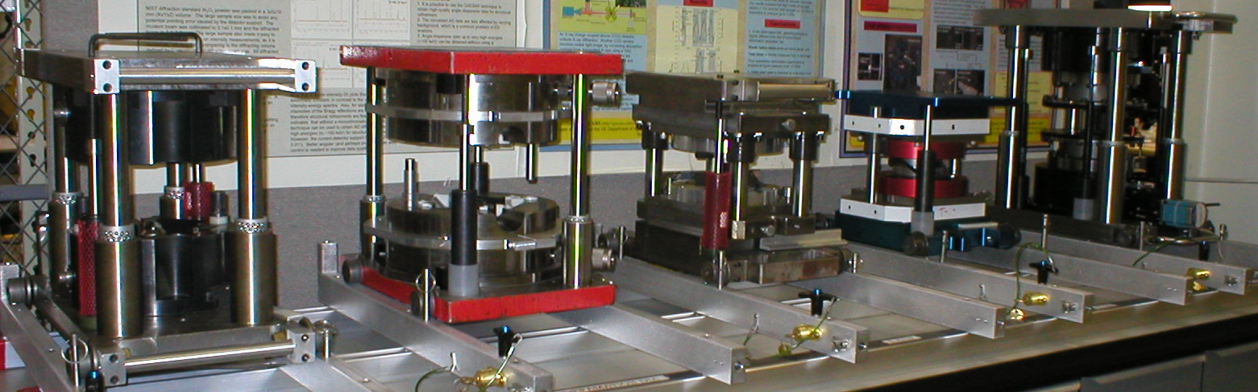
Large Volume Press Program: 250 ton LVP in 13-BM-D
Mono and white radiation, switchable in seconds
Multiple techniques to meet user needs
  DDIA – controlled deformation
  High-pressure tomography
    3D imaging with mono- or pink-beam
    XRD with focused white/pink beam
Other in-situ probes
  Ultrasonics
  Acoustic emission
  Electrical conductivity (user contribution)

Slide 42
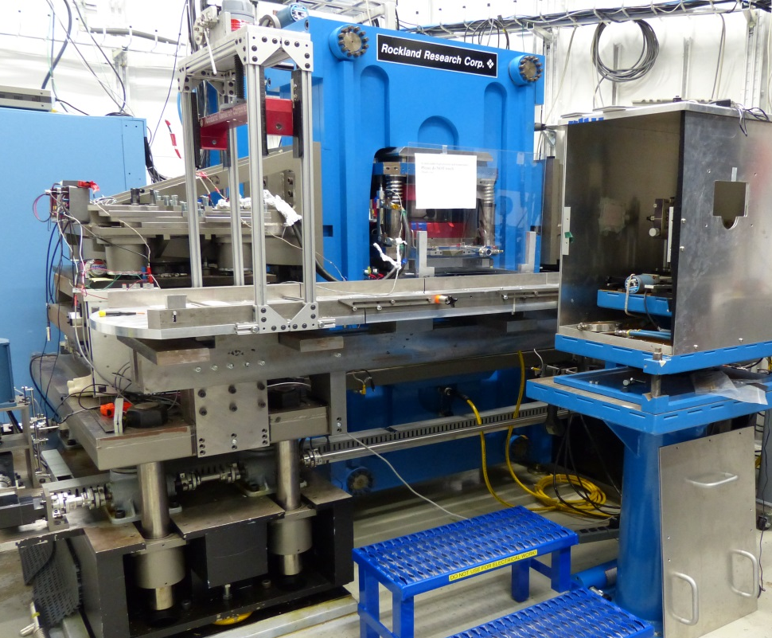
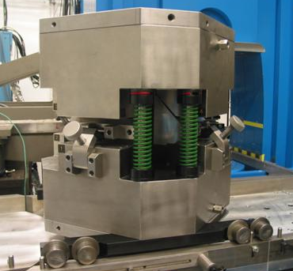
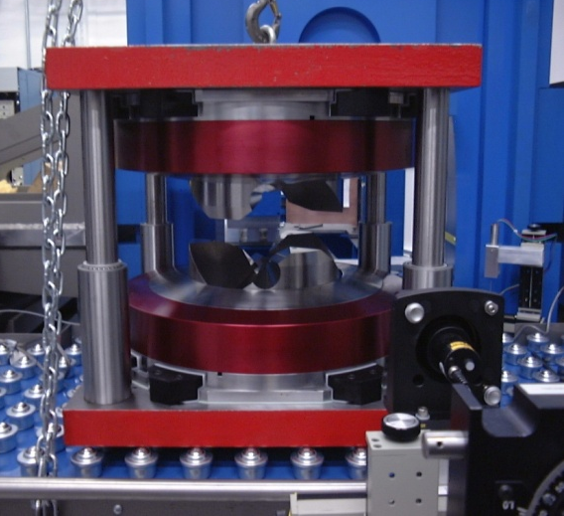
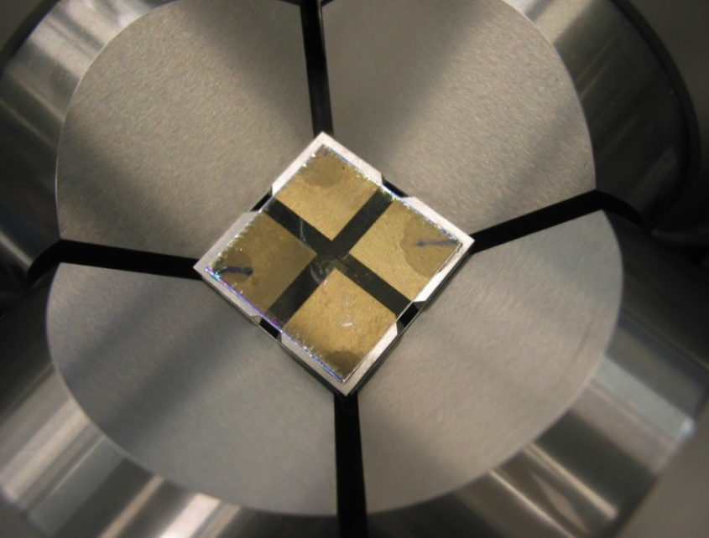
LVP Program: 1000 ton press in 13-ID-D
Primarily white mode, mono since 2012
T-25 module (30 GPa, 3000 K)
DDIA-30
  Deformation mode (25 GPa, 2300 K)
  Double stage mode (50 GPa, 2000 K)
Other in-situ probes
  Ultrasonics
  Acoustic emission
  Electrical conductivity

Slide 43


LVP program: 180 ton Paris-Edinburgh press in 13-ID-C
Combined expertise with DAC (focusing optics) and surface diffraction (general-purpose diffractometer)
PE press in collaboration with HP-CAT
Angle-dispersive diffraction for liquid structure studies
  Double focusing
  Soller slits for beam collimation
  CdTe single photon counting detector
  Structure of silicate melts to 10 GPa
  Double-stage for glasses to ~100 GPa
System portable
  13-IDD
  13-BMD

Slide 44



Puzzling deep focus earthquakes
Intermediate depth
earthquakes
“Goetze criterion”:
When P > strength, cracks cannot develop.
Deep earthquakes
Deep-focus
earthquakes
Metastable slab
Central Japan
(Green, 2005)
Jiang et al., PEPI 2015

Slide 45



Acoustic emission and “nanoseismology”
SP
SP
Schubnel et al., Science, 2013

Slide 46


Tracking AE events in 4D using seismological tools
HypoDD algorithm increases spatial resolution by >10x
Faulting during olivine-spinel transition in Mg₂GeO₄
Fault 2
Fault 1
Group 1: 122 events
Group 2: 97 events
Mo (N m)
0.0001
Wang et al., Nat. Comm., 2017
0.0003
Moment magnitudes based on displacements (converted with piezo constant 0.586 nm/V)

Slide 47

Crystal truncation rod (CTR) x-ray diffraction
CTR
L
102 Bragg peak
105
108
Bragg peak
H
K
surface unit cell
|F_{HKL}|
bulk unit cell
L (reciprocal lattice units)
Highly sensitive to surface termination
Allows work at atmospheric pressure and under liquid
Surface signals orders of magnitude weaker than Bragg peaks – need synchrotron x-rays
Notes:
For the the electron microscopists in the room, CTR’s are very closely related to relrods in the TEM, and arise from the truncation of a crystal in a nearly atomically flat way

Slide 48

UO₂ (111) surface oxidation under dry O₂ gas
Uraninite (UO₂)
Central to nuclear fuel cycle
10L rod
Most abundant uranium ore
Nuclear fuel = synthetic UO₂
Environmental bioremediation strategies focus on producing UO₂
Uranium is redox active:
U(VI) soluble, mobile
U(IV) insoluble, precipitates as UO₂
Thin-film oscillations
Superlattice peaks
Oscillations →
film of differing e- density from bulk
Oscillations on off-specular rods →
lateral registry with bulk
Near-integer peaks → 3-layer superlattice
Asymmetry about Bragg peaks →
lattice contraction
Advancing oxidation front
Stubbs et al. (2015), Phys. Rev. Lett. 114: 246103

Slide 49


(111) Oxidation Model
1/4 sites occupied, every third layer
Rotated/Truncated to (001)
1/6 sites occupied, every other layer
[111] (surface normal)
[001] (surface normal)
[112]
[100]
Interstitial O
Model developed to describe (111) oxidation is geometrically consistent with (001)
Same structure forms beneath both surfaces
Lattice O
U

Slide 50



Transmission X-ray Microscope: 20-50 nm resolution
APS beamline 32-ID-C: specs and capabilities
Resolution: 50 nm (30 nm voxels) up-to to 20 nm
Image exposure time: 0.5s - 1s
Energy range: 6 to 12 keV, ∆E/E = 10⁻⁴
Techniques: combination of nano-scale imaging
with absorption, phase contrast & spectroscopy
2-D scans and nano-tomography
Operation in a wide range of samples environments
(T = ambient to 1500 ºC, P up to 100 GPa), chemical bath
50

Slide 51







Nuclear Resonant Scattering
Kr, Fe, Eu, Sn, Dy
Inelastic X-ray Scattering
HERIX-3
2.2 meV
HERIX-30
1.4 meV
• Phonon density of states
• Velocity of sound
• Isotope fractionation
• Valence and spin change
• Structural and magnetic phase transitions
• Phonon dispersion relation
• Velocity of sound & Young’s modulus
• Elasticity tensor
• Magnetoelastic coupling
• Structural phase transitions

Slide 52


Multi-bend Achromat Magnet Lattice
Lattice design evolution from double-bend achromats (DBA) to multi-bend achromats (MBA): lower emittance from increased number of dipole magnets
DBA
7BA
D. Einfeld et al., Proc. PAC 95, Dallas TX
Emittance ε is the product of the size and divergence of the electron beam. Thus, a lower emittance results in a higher brightness X-ray source.
Factor of > 40 improvement in emittance from cubic scaling
Notes:
I've shown you what I hope are compelling examples of future science that will be enabled by the new, 4th generation of storage ring x-ray source using MBA magnet lattice technology
So what does this MBA technology consist of?
These diagrams schematically show the magnet structure between each of the straight sections in the storage ring. The yellow boxes are the dipole bending magnets, and the other symbols are the higher-order focusing magnets.
Most light sources today operate with what is known as a double-bend achromat. There are two bending magnets between each straight section.
To make an MBA lattice you split the bending magnets up into smaller lengths separated by focusing magnets. As you increase the number of bending magnets, you can get can a very rapid reduction in the emittance. The emittance scales as the inverse cube of the number of dipoles. A seven-bend achromat can provide 40 times better performance.
The first ring to be built with an MBA lattice is now under construction in Sweden. Other MBA rings are being built or proposed, for example at ESRF. Because of the space needed for the additional magnets, MBA lattices are well suited to large circumference rings like APS.

Slide 53



APS MBA Improvement
Particle Beam Profiles
Dramatically enhance the performance
of the APS as a hard x-ray source
APS Now
MBA
1 mm

Slide 54
APS Multi-Bend Achromatic (MBA) Upgrade
Planned upgrade to the APS storage ring lattice
>100 increase in brightness at insertion device (ID) sources over a wide range of hard X-ray energies
Became an official DOE project (CD-2) this year.
$815M budget
APS will be shut down for 1 year, starting sometime in 2022.
Beamline optics (mirrors and monochromators) and detectors will need to be upgraded to take advantage of increased brightness

Slide 55
Brightness of synchrotron sources

Slide 56




Pushing the limits of ultra-high pressure and temperature experiments to beyond 1 TPa
GSECARS
Dubrovinsky et al, Nature communication, December 2012
World record for static pressure: Au at 1 TPa
15 um
Dubrovinskaia et al. Sci. Adv. 2016; 2 : e1600341
Today we can only measure scattering in these tiny volumes from very high Z materials (Re, Au)
With APS-U we can focus enough x-rays into these volumes to measure silicates, Fe, etc.

Slide 57
Summary
Synchrotron sources enable important new science in geochemistry and geophysics
The APS Upgrade promises 2 more decades of frontier research
We welcome new users!
  Contact us if you have an idea where we might be able to help your research
Thanks for your attention!

