Slide 1
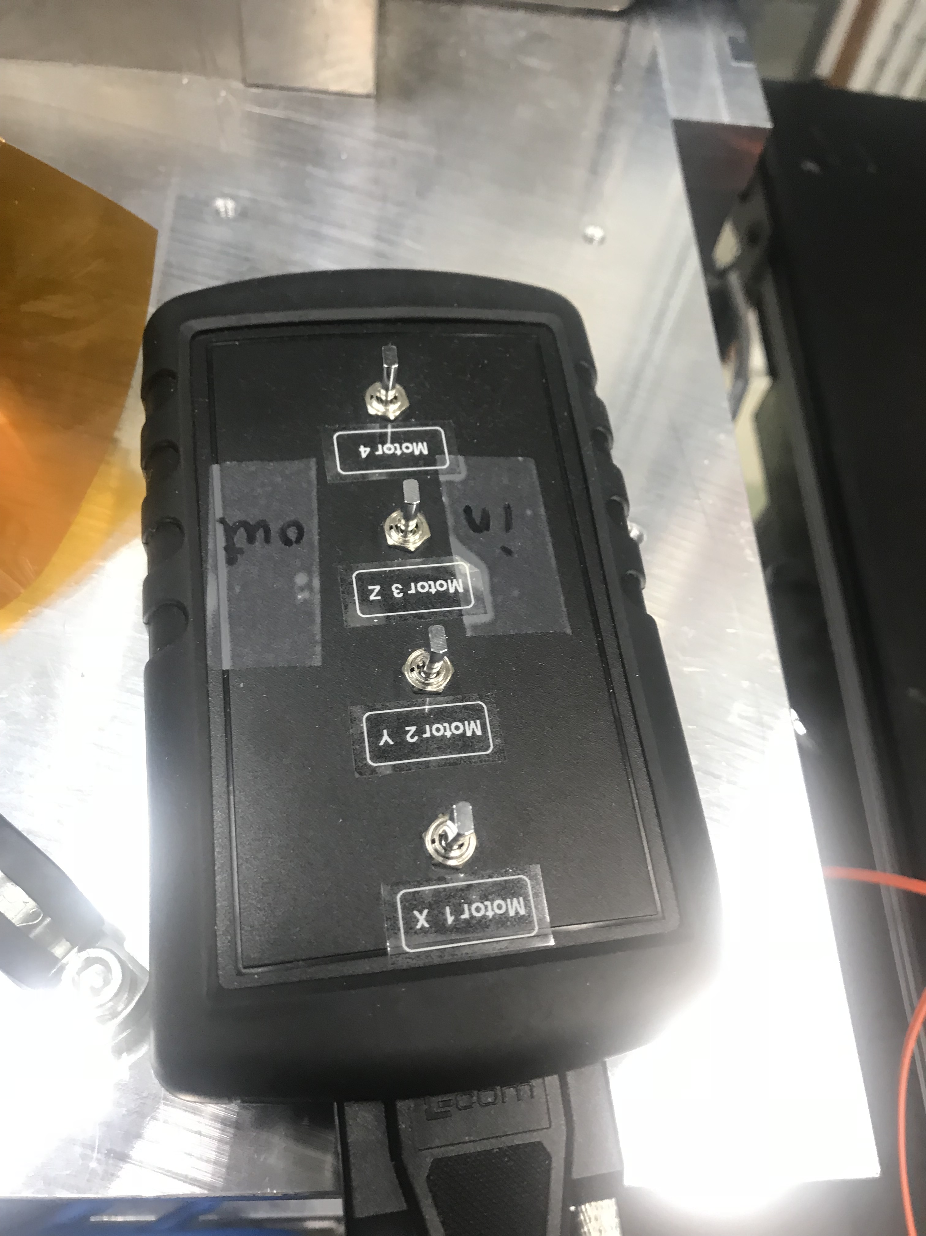
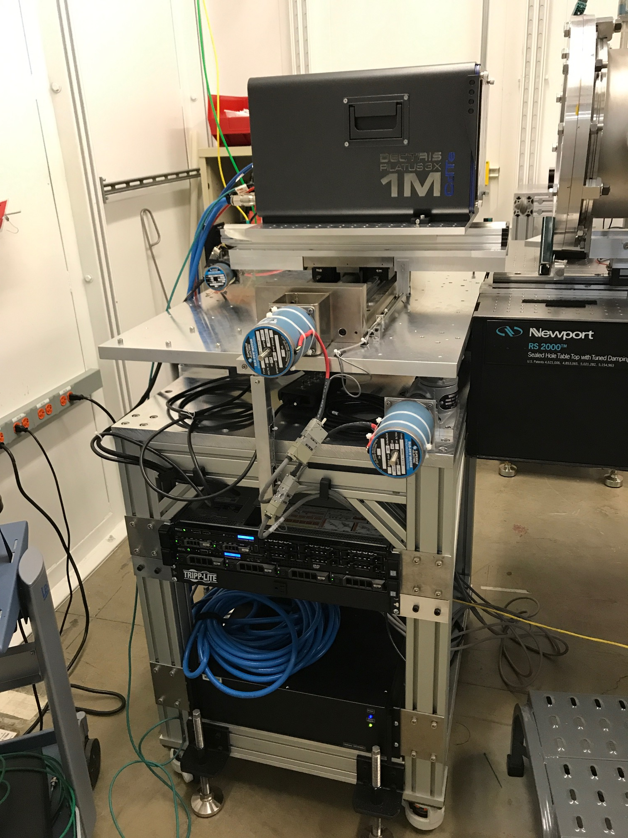
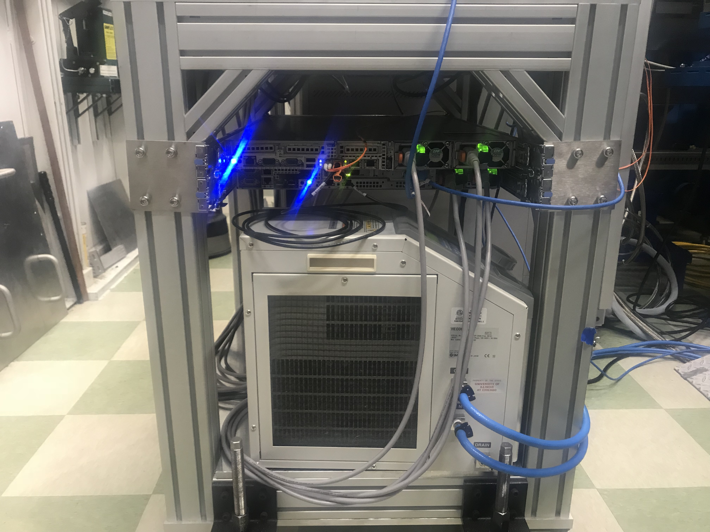
Pilatus3 X 1M CdTe Detector
2015 NSF-MRI award jointly to GSECARS and ChemMatCARS (Mark Schlossman at Univ. of Illinois Chicago)
Custom made cart with X-Y-Z motion, space for chiller.
  Very convenient for moving from station to station
Manual motion controller
Detector
X-Y-Z table
DEC and PPU computers
Chiller
EPICS/manual motion controller

Slide 2
Pilatus3 X 1M CdTe Detector
981x1043 pixels
172x172 micron pixel size
20 bit counts
500 frames/s (2 GB/s)
0.95 ms readout time
5x10⁶ counts/s/pixel
77% efficient at 80 keV
~$700,000

Slide 3
Pilatus 3X Architecture with areaDetector
Pilatus 2M Detector
10GBit (2X)
DEC computer
PPU computer
camserver
areaDetector
TIFF or CBF files
10GBit
ramdisk (32 GB)
ramdisk (320 GB)
FURKA
GRIMSEL
Local hard drive (270 GB)
External File System
NDFileTIFF
NDFileHDF5
etc.

Slide 4
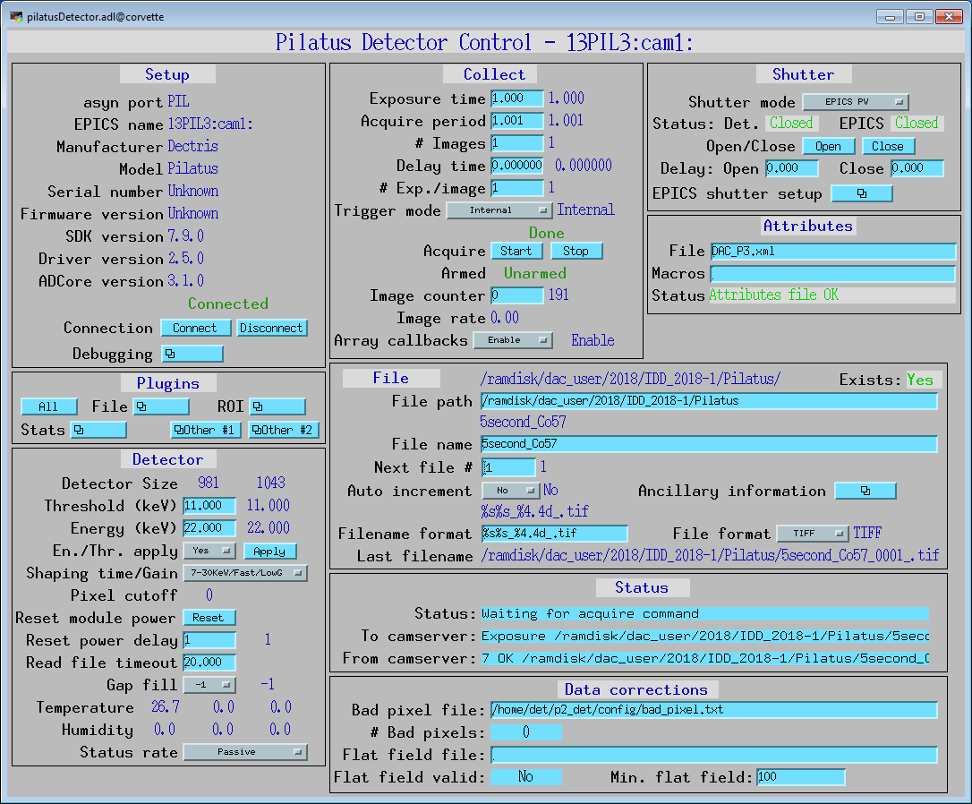

Slide 5
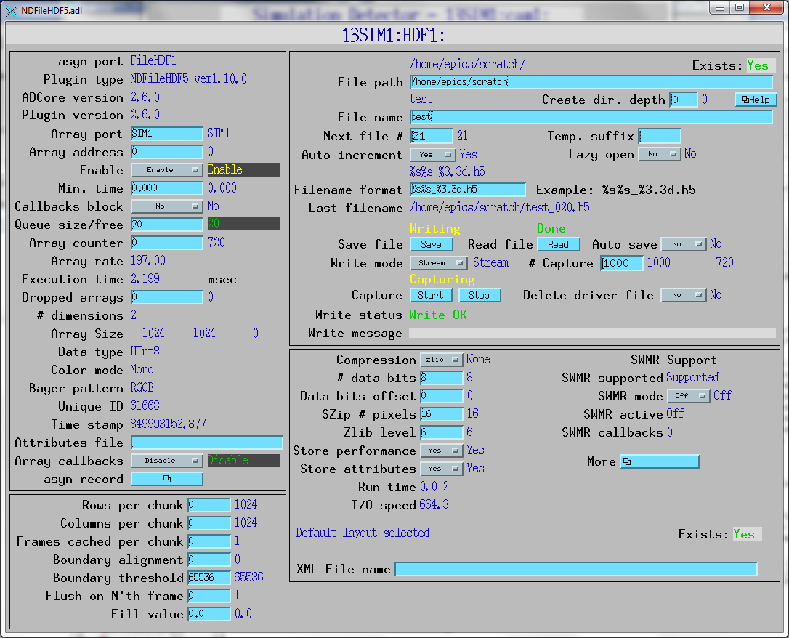

Slide 6
Pilatus CdTe Flat Field Issues
We observe systematic structure in the images that are not corrected with the camserver flat field correction.
Experimental conditions:
Beam energy: 37 keV
Pilatus threshold 18.5 keV
Collection time: 60 seconds
Data files: 5 files, Fe3O4_047.tif through Fe3O4_051.tif.

Slide 7
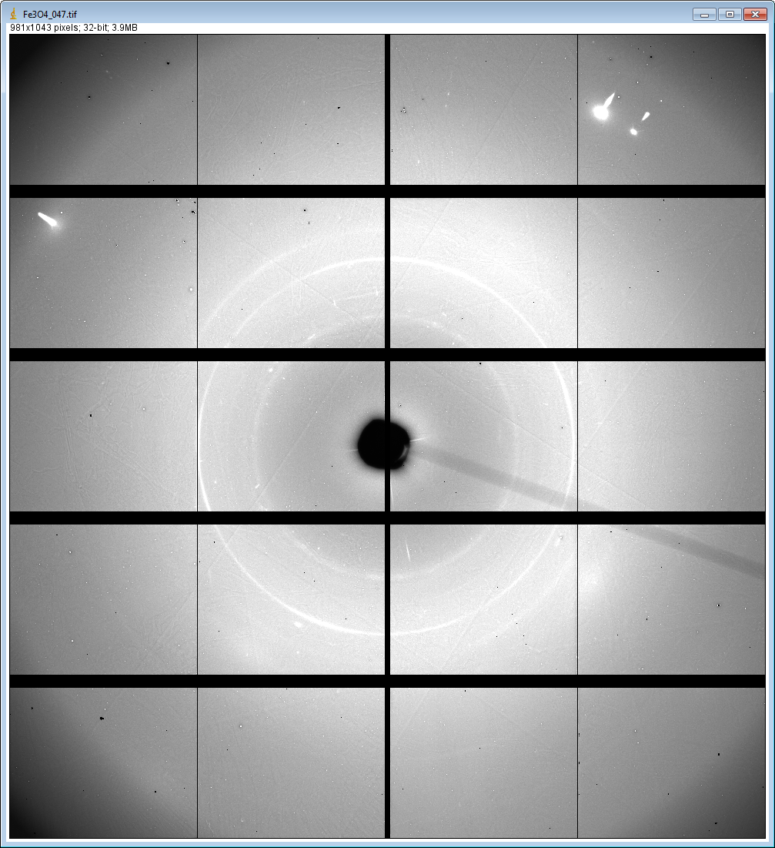
Fe3O4_047.tif displayed from 0 to 50000 counts

Slide 8
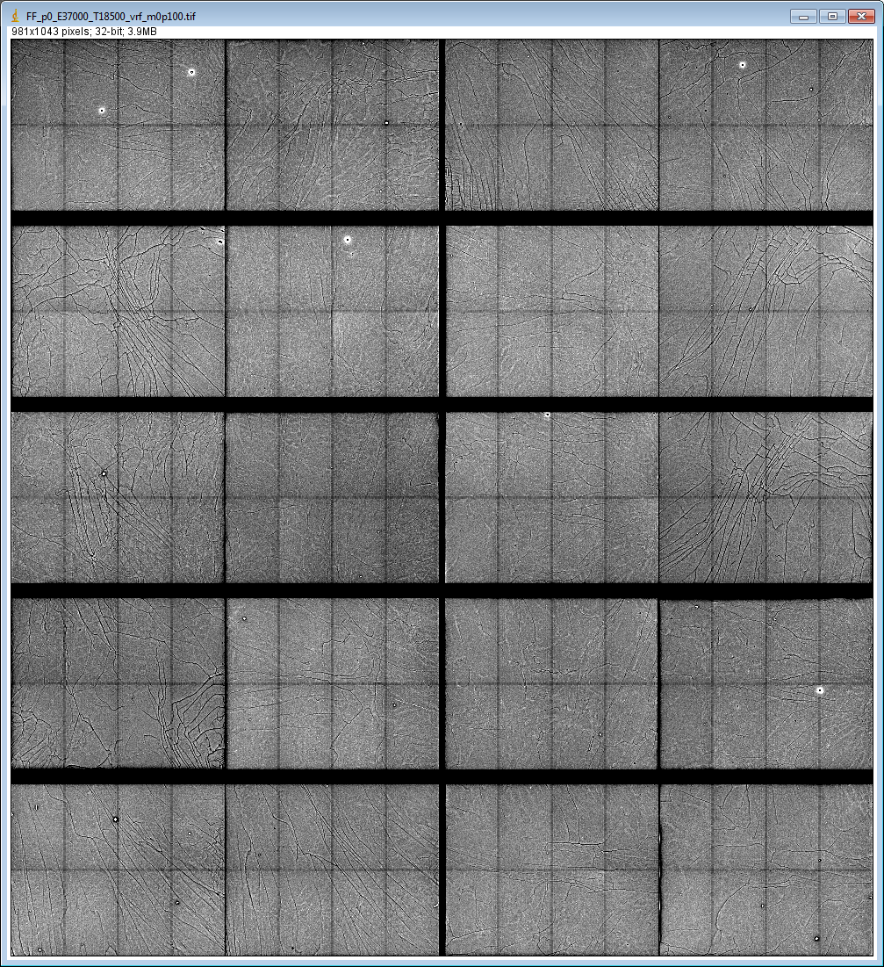
Flat field file FF_p0_E37000_T18500_vrf_m0p100.tif
Displayed over intensity range 0.90 to 1.10.
Study this chip

Slide 9
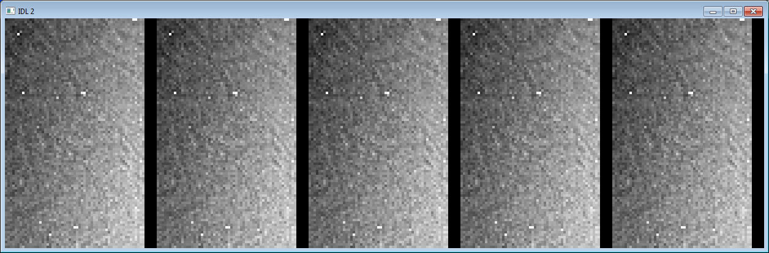
Chip [3,2] in 5 Separate Measurements
Displayed over range 0.8 to 1.2 of mean (34,300 counts)
These images have an overall variation in intensity, brighter in the lower right, and darker in the upper left, due to the x-ray scattering from the sample. To remove this effect and enhance the high-frequency structure of the systematic variations, the images were corrected as follows:
The average of the 5 images in Figure 3 was computed.
This average image was smoothed with a 20x20 boxcar filter.
This smoothed image was subtracted from each of the 5 images.
The mean value of the smoothed image was added to the difference computed in step 3.

Slide 10
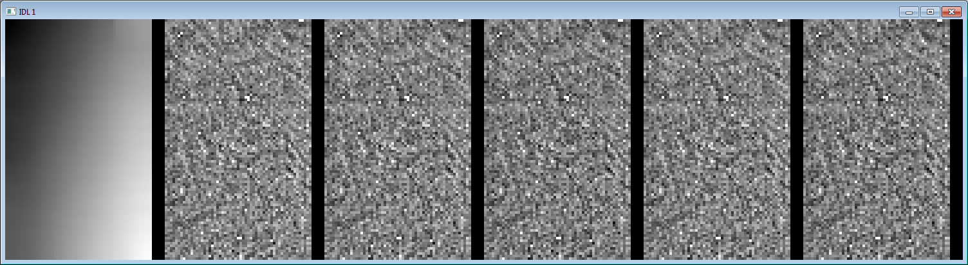
5 Measurements after Subtracting Smoothed Image (Left)
Displayed over range of 0.9 to 1.1 of mean
These images area clearly highly correlated. How correlated?

Slide 11
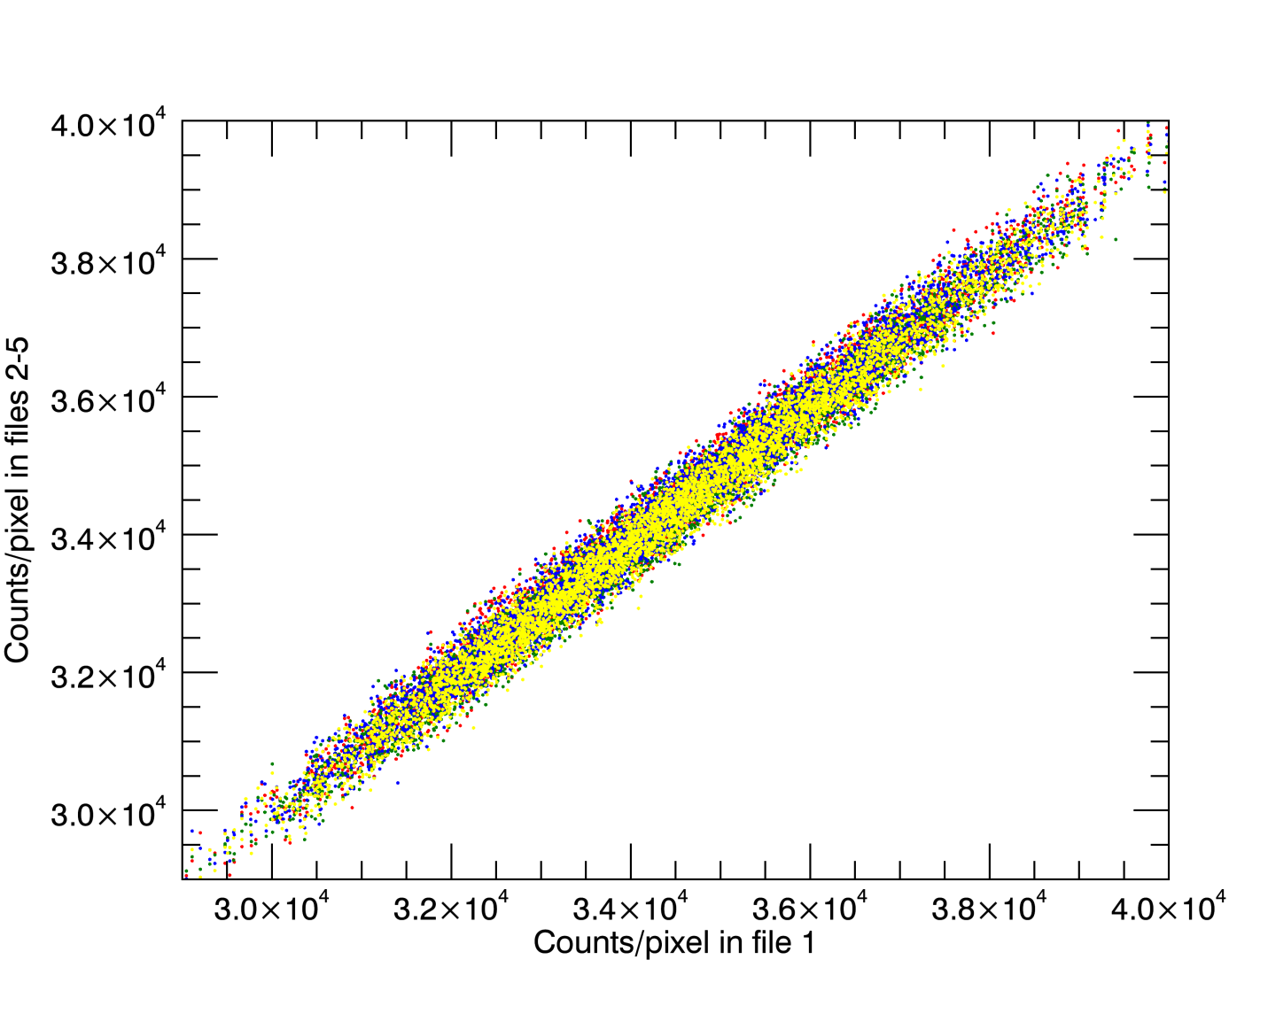
Plot of Intensity of Each Pixel in File 1 (X)
vs Intensity in Files 2-5 (Y)

Slide 12
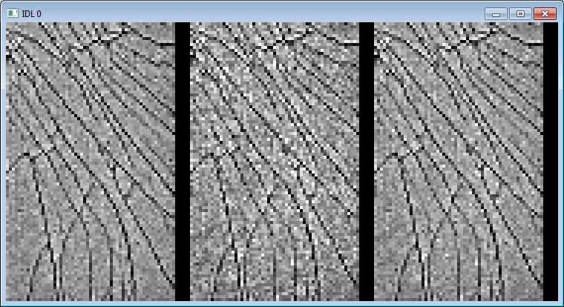
Flat Field Measurements and Interpolation for this Chip
Displayed over range of 0.9 to 1.1 of mean
32.190 keV
Ba Kα
mean=1.012
sigma=0.034
42.980 keV
Gd Kα
mean=1.013
sigma=0.040
3.70 keV
Interpolated
mean=1.012
sigma=0.035

Slide 13
Flat Field Measurements and Interpolation for this Chip
Displayed over range of 0.9 to 1.1 of mean
32.190 keV
Ba Kα
mean=1.012
sigma=0.034
42.980 keV
Gd Kα
mean=1.013
sigma=0.040
37.0 keV
Interpolated
mean=1.012
sigma=0.035

Slide 14
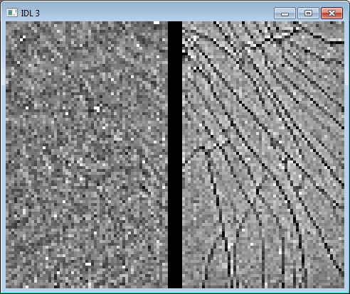
Comparison of Flat Field and Average of 5 Measurements
Displayed over range of 0.9 to 1.1 of mean
Average of 5 measurements with smoothed average subtracted
37.0 keV
interpolated
Flat field
The residual structure has some correlation with major features in the flat field, but also some features that are different.
Flat field correction has removed much of the structure.
How much correlation?

Slide 15
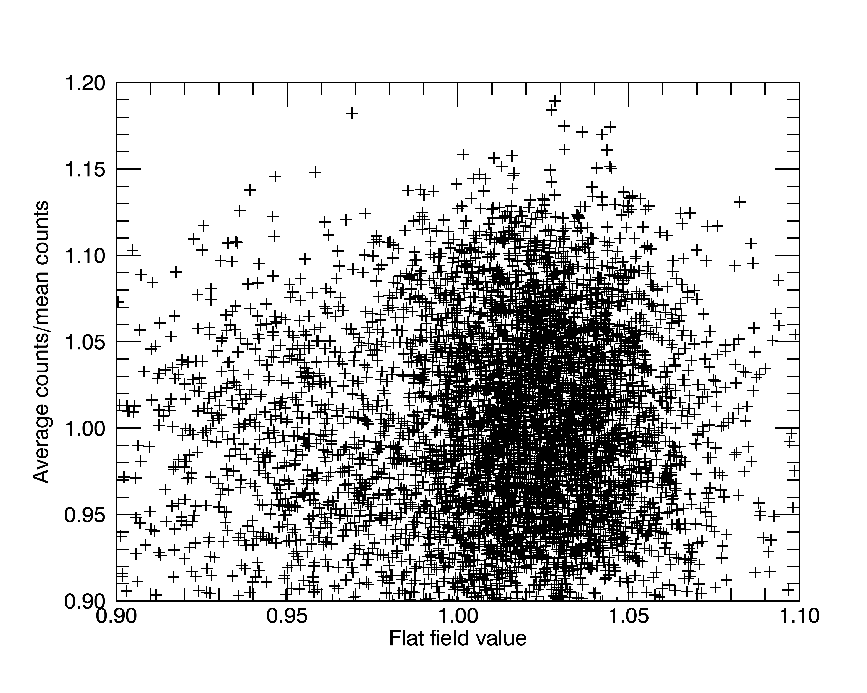
Correlation of Average Measured Pixel Itensities vs Intensity in Flat Field
This plot shows lack of correlation of intensity of pixels in measured image vs intensity of the pixel in the flat field.

Slide 16
Statistics after Subtracting Smoothed Image
These are the statistics of the corrected images above.
File=1 mean=34423.4 sqrt=185.5 sigma=1053.7 sigma/sqrt= 5.68
File=2 mean=34350.2 sqrt=185.3 sigma=1053.2 sigma/sqrt= 5.68
File=3 mean=34255.7 sqrt=185.1 sigma=1048.8 sigma/sqrt= 5.67
File=4 mean=34340.4 sqrt=185.3 sigma=1050.0 sigma/sqrt= 5.67
File=5 mean=34258.9 sqrt=185.1 sigma=1048.6 sigma/sqrt= 5.67
Mean = 34325; square root of this value is 185.
If the pixels in this image were randomly distributed around the mean then the inter-pixel variation sigma would be 185, or 0.54%.
However it is actually 1053, which is 5.6 times larger, and is 3.1% of the mean value.

Slide 17
Flat Field Conclusions
Statistics over pixels after subtracting average image and adding mean.
Mean=34329.7 sqrt=185.3 sigma= 178.4 sigma/sqrt= 0.95
This says that once the average image is subtracted, the sigma is 178.4 which is very close to the square root of the mean. This indicates that these are indeed the expected Poisson statistics.
What it the source of the systematic variations in the image intensity which has a sigma of 3.1%. Much larger than we would like for doing studies of amorphous scattering where accurate estimates of small intensity variations are required.
We need to do our own flat field measurements. Not yet done; need uniform scattering source and good statistics

Slide 18
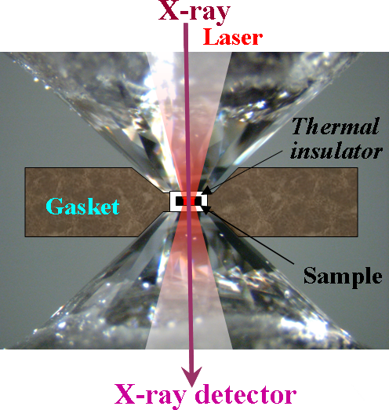
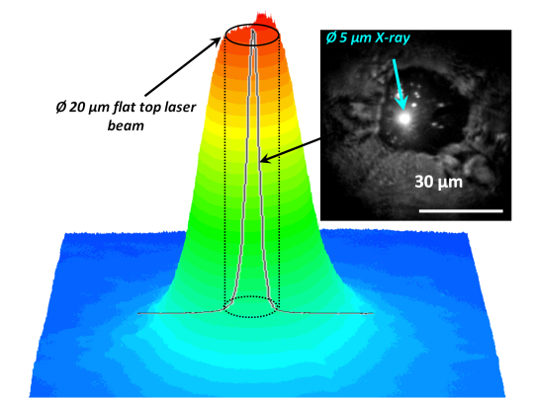
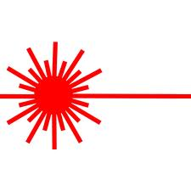
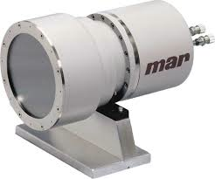
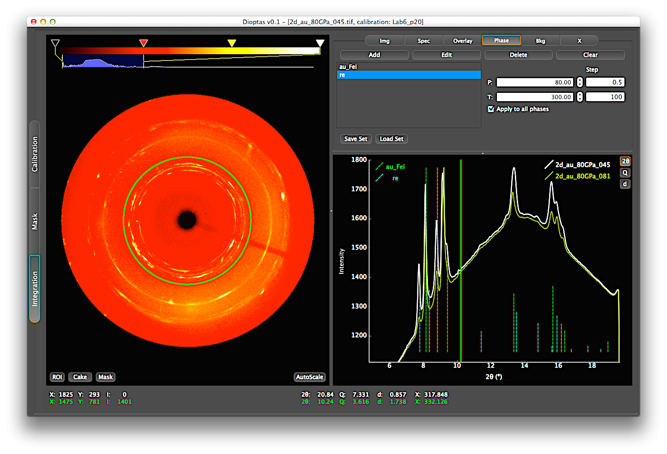
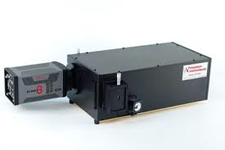
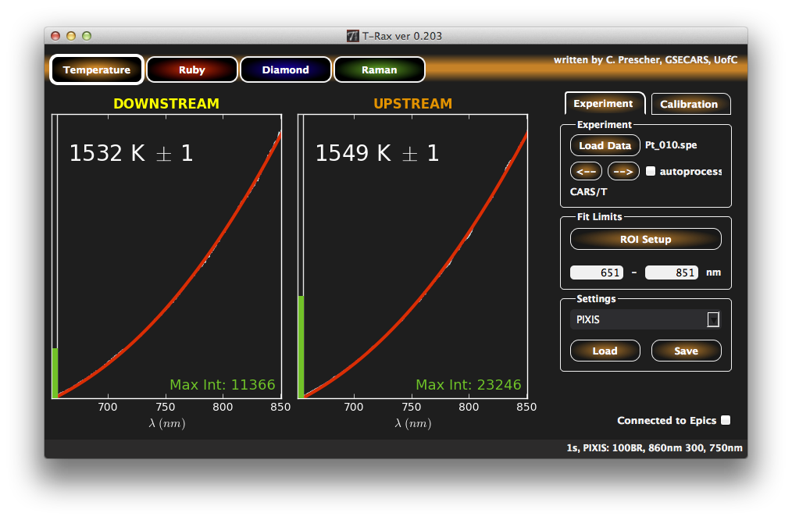
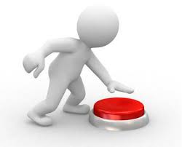
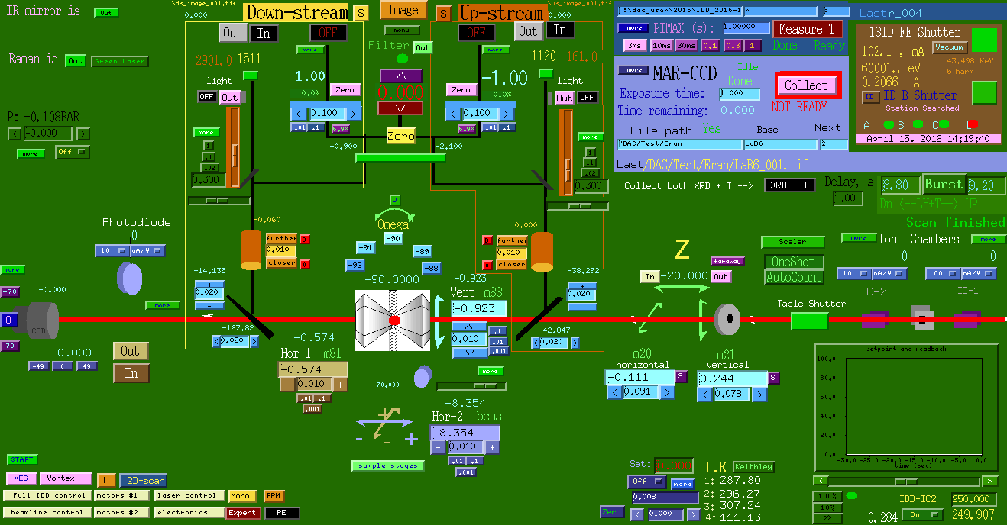
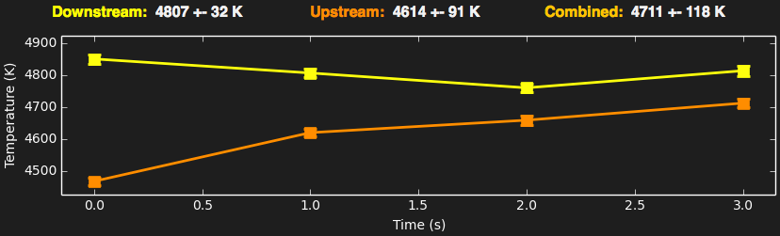
Burst laser heating & XRD
Precise alignment of sample image
with five optical axes:
x-ray(1), lasers(2) and spectroscopy(2)
start
Laser ON (0.2s – 10s)
stop
delay
power
calculate T
→ integrate XRD
→ RT XRD
→ update log-file
Laser
X-ray detector ON
no user interaction
CdTe
exposure
Detector
T measurements ON
exposure
Temperature
EPICS control
Notes:
To encourage young scientist to do challenging experiments, very efficient

Slide 19
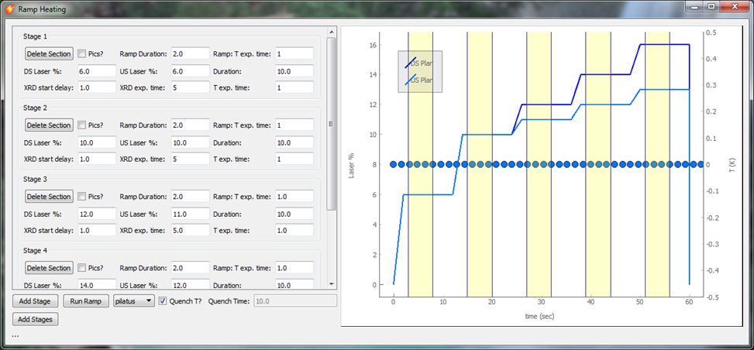
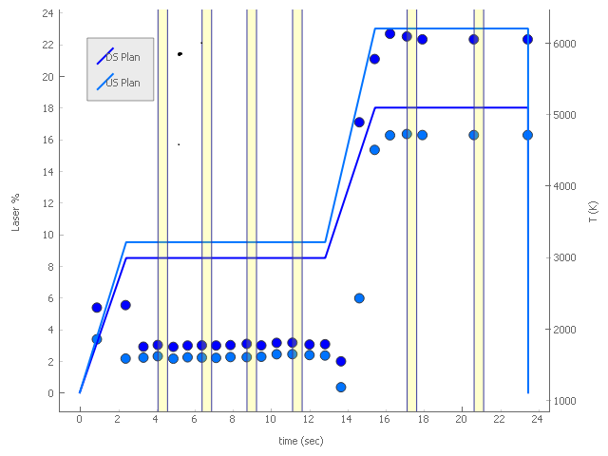
Multi-level ramp laser heating & XRD
Eran Greenberg, GSECARS
Notes:
Logfile can be opened offline with the LogFile software.
The logfile is also saved in a format easily imported as a spreadsheet.
It is possible to decide which PVs are recorder (and whether they are recorder at the start of collection (black) or at the end (blue).

Slide 20
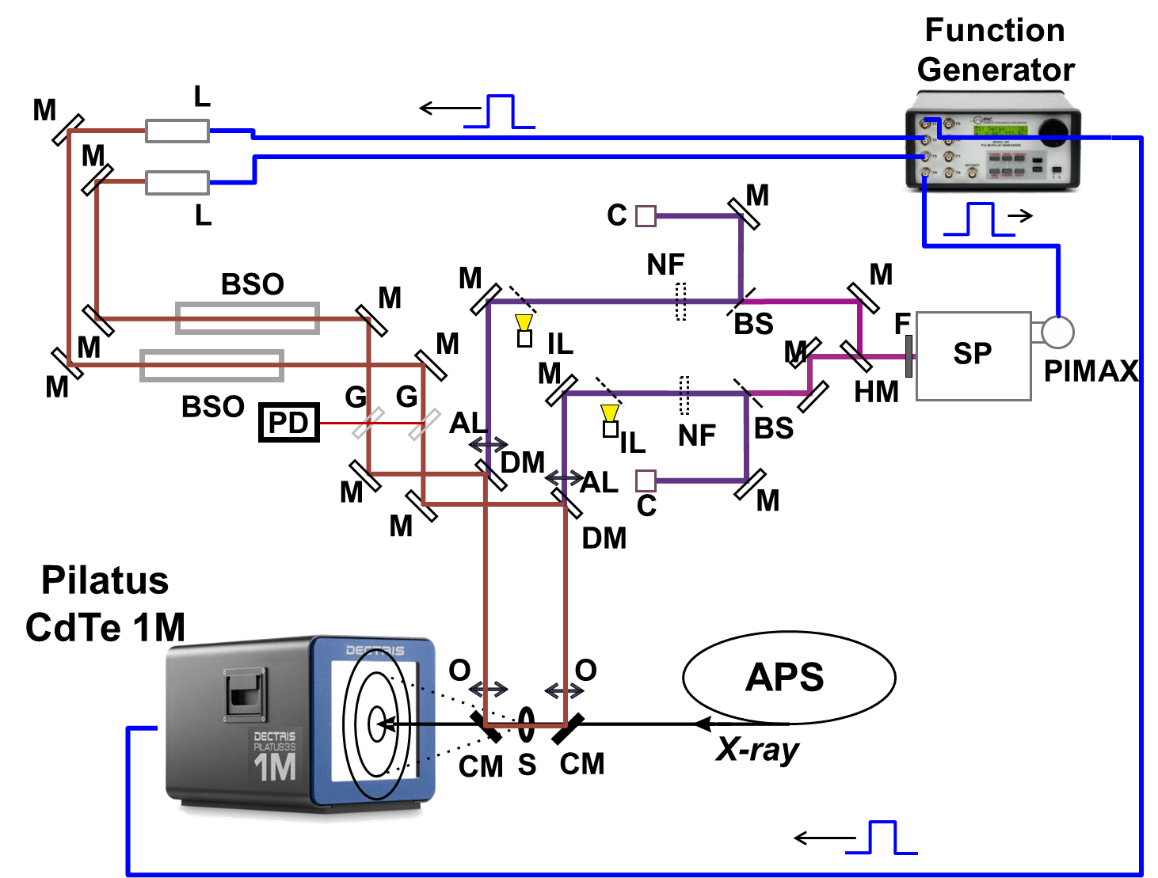
Figure: Optics path for pulsed laser heating (L), x-ray, temperature measurement (SP+PIMAX), and visualization (C+IL).

Slide 21
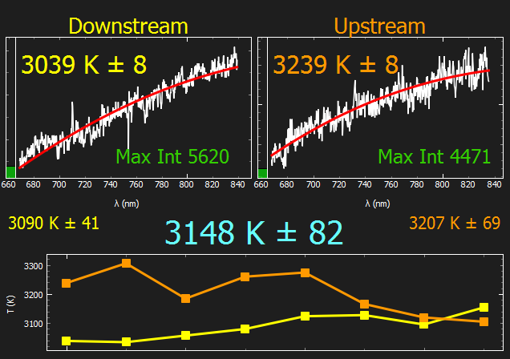
Figure: Example of timing of Pilatus detector window and measured pulse profile of the lasers at the photodiode. Inset: Example of temperature fitting.

Slide 22
Figure: XRD patterns of Fe₃O₄ at 163 GPa (a) and 176.5 GPa (b) and (c). a) Starting from the cold-compressed sample, the Pmma phase partially transforms to a new phase upon laser-heating. b) Starting from the HTO Pnma phase laser-heating partially transforms the sample to the new phase. c) The quenched patterns exhibit distortion of the new phase. λ=0.3344 Å.

Slide 23
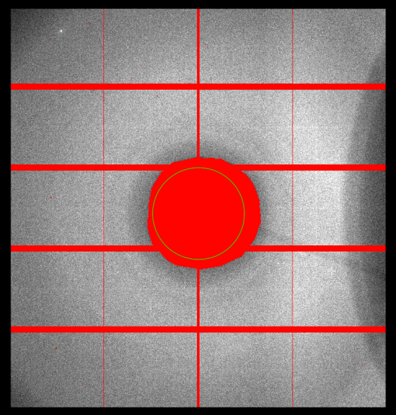
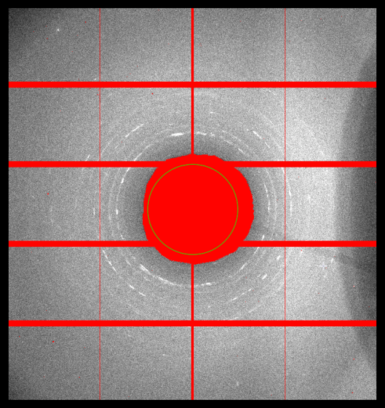
Combined pulsed laser-heating and XRD for ultra-high temperature studies of materials in the Mbar pressure range.
Structural phase transition during pulsed laser-heating
RT
2200 K
Thermal shift of sample and neon comparing between 2200 K and quenched
100,000 pulses of 1 μs

Slide 24
PHYSICAL REVIEW B 95, 140101(R) (2017)
Stable high-pressure phases in the H-S system determined by chemically
reacting hydrogen and sulfur
Alexander F. Goncharov, Sergey S. Lobanov, Vitali B. Prakapenka, and Eran Greenberg
Theoretically predicted Cccm and Im¯3m H3S to be the reaction products at 50 and 140 GPa, respectively. Im¯3mH3S is a stable crystalline phase above 140 GPa and it transforms to R3mH3S on pressure release below 140 GPa.
Pilatus CdTe detector
XRD patterns of Im¯3m H3S directly synthesized from H2 and S. We suggest that the superconducting properties of the directly synthesized H3 S should be examined as such a prepared material has a much better crystallinity compared to that obtained by H2 S decomposition

Slide 25
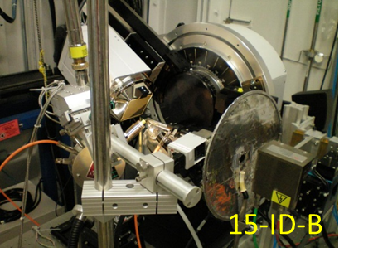
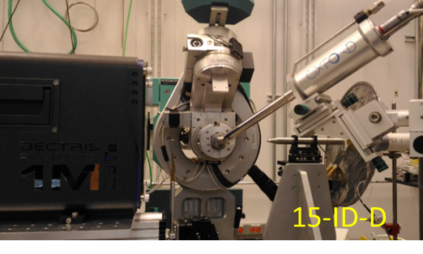
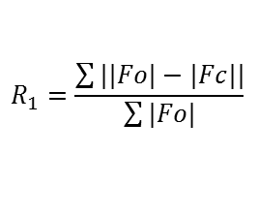
Instrumentation at ChemMatCARS
Note for Mark R.
The measurement used the same crystal at room temperature. The size of the crystal is (50x70x40 um^3).
Comparison of different detectors
Hutch | Energy (keV) | Total Time (minutes) | D space (Å) | R₁
15-ID-B APEXII | 30 | 40 | 0.6 | 0.044
15-ID-D Pilatus 1M | 30 | 5 | 0.6 | 0.026
In-house Photon100 | 17.5 | 300 | 0.6 | 0.044
Hutch | 15-ID-B | 15-ID-D
Shutter | Rotatory Shutter | Shutterless
Sample Alignment | Manual | Motorized
Software | APEX II Suite | “User friendly”
Detector Size (mm²) | 62 x 62 | 168 .7 x 179.4
Energy Region (keV) | 5 - 30 | 16 - 70
Fast Data Collection Time | 0.2 s/frame | 0.002 s/frame
$$R_{1}=\frac{\sum{||Fo|−|Fc||}}{\sum{|Fo|}}$$
F₀: measured structure factor
F_{c}: calculated structure factor
Notes:
The measurement used the same crystal at room temperature. The size of the crystal is (50x70x40 um^3).

Slide 26
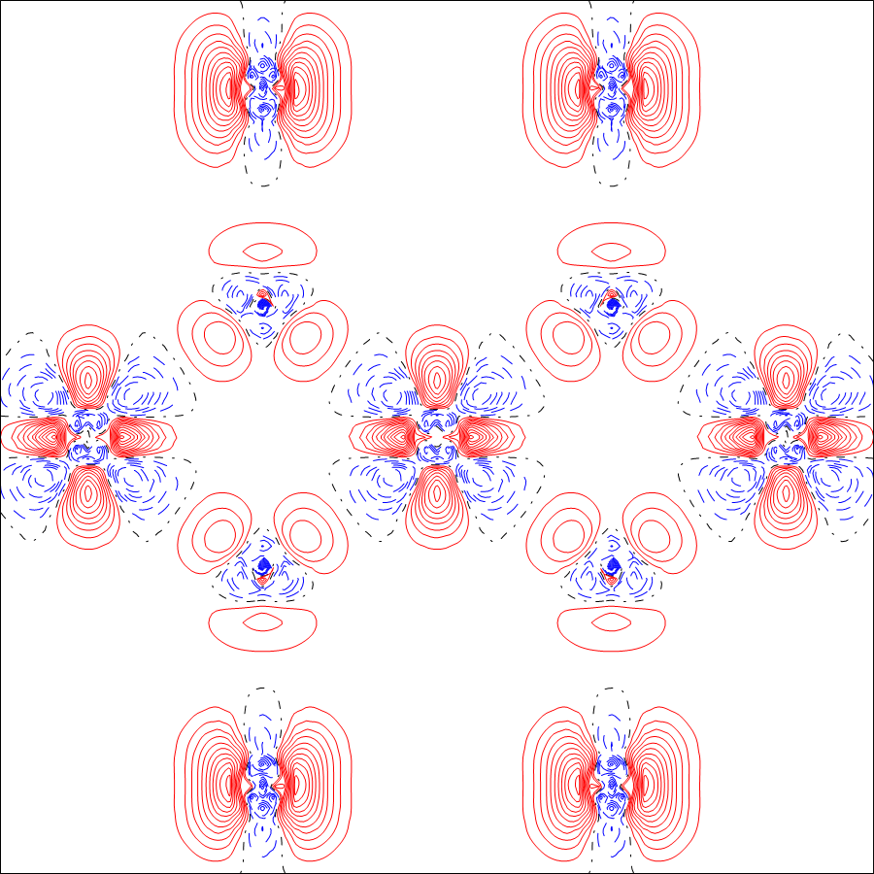
High energy high resolution charge density(50keV)
OsO₂
O
O
Os
Os
Os
O
O
This measurement is in one detector setting(at sample to detector distance 100mm, beam center is on one edge of the detector)
It can record Os and O scattering powers at the same frame.
Scale factors are flat in each reciprocal space means is a quality data(shown on the right).
Faster data collection( 2 hours). Normally with CCD, it will take one day with several detector settings and different exposure time to avoid saturation of the detector.
Os d-orbits
Measured by Pilatus(CdTe) 1M detector
Crystal size: 5x4x4 um^3
Data collection: 0.3 degree / 0.3 s
Total collection time: 2 hrs at 15k

Slide 27
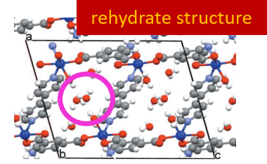
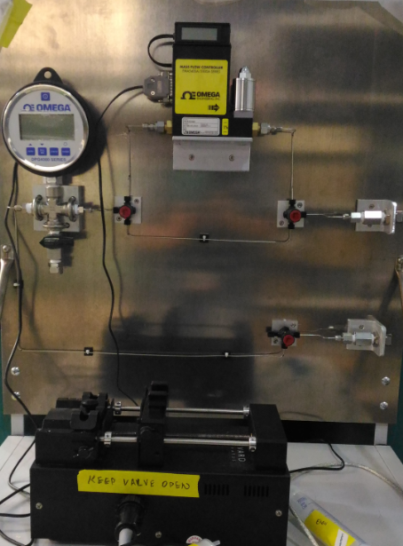
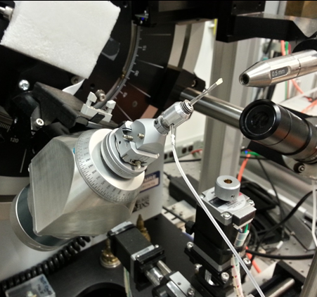
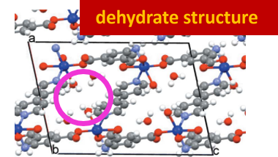
Structural Dynamics
  In-situ crystal diffraction
  Environmental Control Cell (ECC)
    Vacuum, gas, solution and humidity
water
Benedict’s Group
J. Appl. Cryst.(2015), 48, 578-581
15min
Dry N₂
5min
Wet N₂
Environmental control cells (ECCs)
Study crystalline nanoporous materials under ‘real world’ conditions
water disappears
Notes:
Time-resolved Photo-Crystallography
X-ray Chopper
Secondary Focusing K-B Mirrors
Small beam
Small crystal
Huber 3 circles diffractometer
Nanosecond pulsed laser
Timing FPGA (field-programmable gate array )
3D Diffuse Diffraction
Study order-disorder and dynamic in single crystal
Single crystal diffuse scattering is a powerful tool, which provides vital information on complex disorder, and can make important contributions to a large number of scientific fields
Here are a couple of slides containing some of our transformed data from Sector 15 that Matt Krogstad prepared. We had hoped to see CDW peaks in the LBCO data, but there was relatively strong diffuse scattering from strain fields around each Bragg peak, which we think obscured the very weak CDW peak. The CDW peaks were clearly visible in the nickelate, although the sample contained two slightly misaligned crystallites. Nevertheless, the data would be good enough to determine the temperature dependence of the CDW order parameter

Slide 28
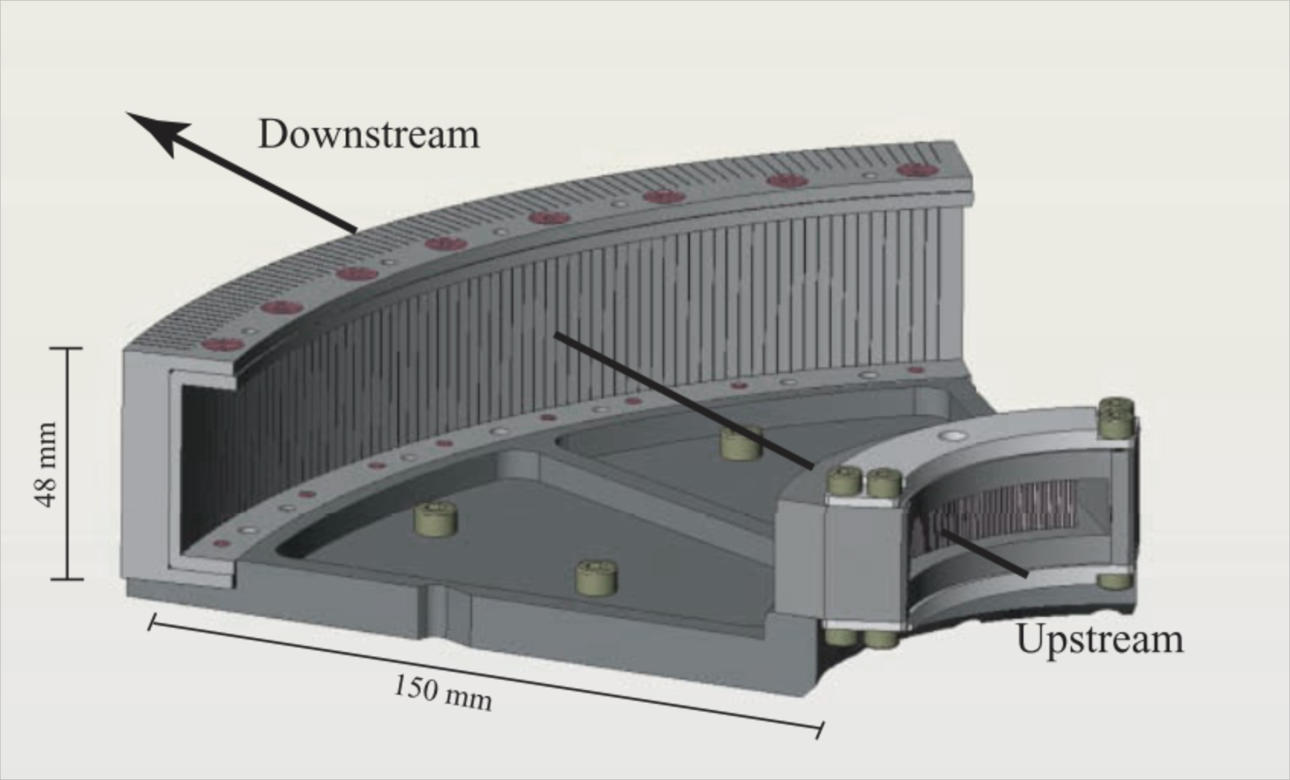
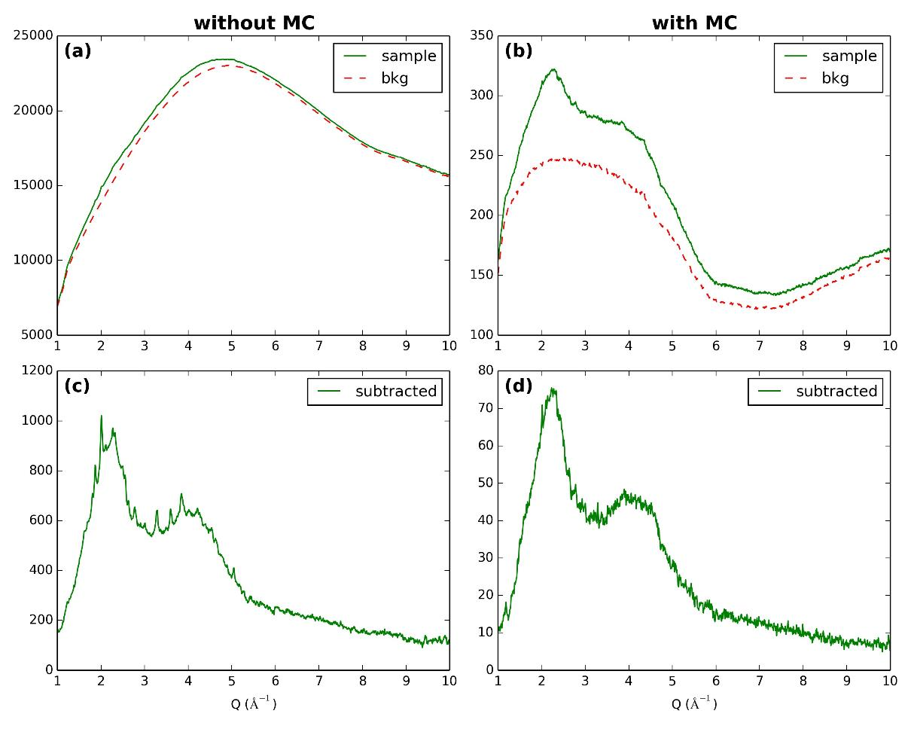
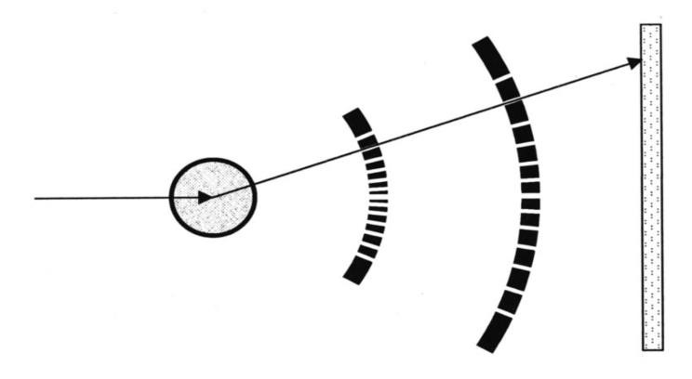
New Pilatus 300KW CdTe Detector and
Multichannel Collimator
Comparison between measurements of Mg₂SiO₄ sample in a Diamond Anvil Cell with and without Multichannel Collimator (MCS).
Detector
Sample
X-ray beam
MC
The upstream block is composed of 75 slits of 50 µm positioned at a distance of 50 mm from the sample. The downstream block is composed of 75 slits of 200 µm positioned at 200 mm
Notes:
One of the central aspects for obtaining high quality structural information of disordered materials by X-ray diffraction is perfect background subtraction. This is particularly difficult when employing high-pressure vessels, such as diamond anvil cells (DAC) and Paris-Edinburgh large volume presses (PEP). Their background contribution is very high compared to the low diffuse scattering signal of the sample, especially at high diffraction angles, and furthermore the background is changing during compression and decompression.
In order to overcome this challenge we have successfully installed a multichannel collimator (MCC) for the DAC setup at the GSECARS 13-IDD beamline, APS

Slide 29
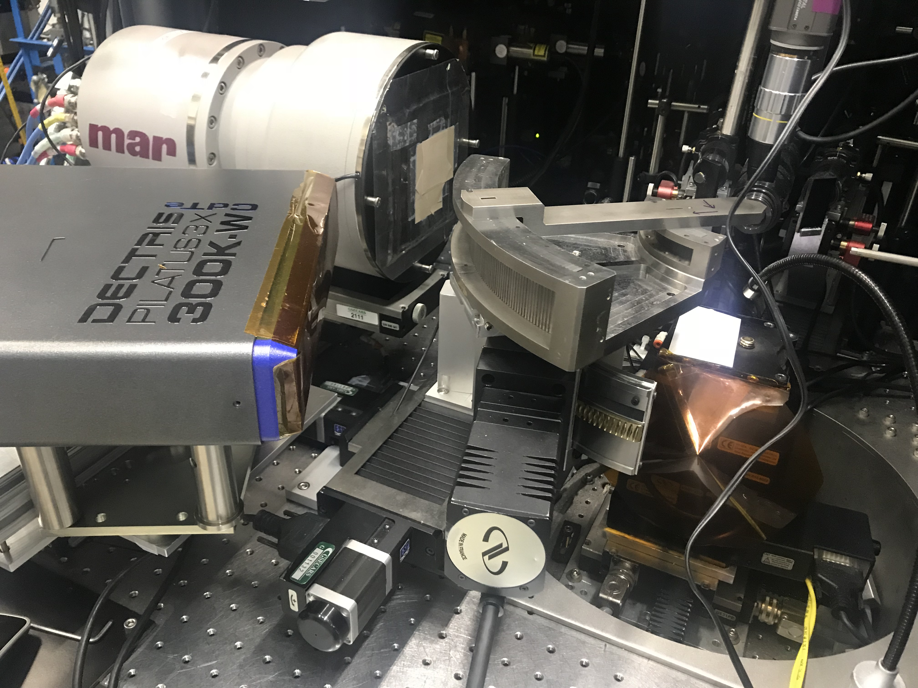
New Pilatus 300KW CdTe Detector and
Multichannel Collimator
Set up for measurements in diamond anvil cell in 13-ID-D
Notes:
One of the central aspects for obtaining high quality structural information of disordered materials by X-ray diffraction is perfect background subtraction. This is particularly difficult when employing high-pressure vessels, such as diamond anvil cells (DAC) and Paris-Edinburgh large volume presses (PEP). Their background contribution is very high compared to the low diffuse scattering signal of the sample, especially at high diffraction angles, and furthermore the background is changing during compression and decompression.
In order to overcome this challenge we have successfully installed a multichannel collimator (MCC) for the DAC setup at the GSECARS 13-IDD beamline, APS

