Slide 1

areaDetector: A module for EPICS area detector support
Mark Rivers
GeoSoilEnviroCARS, Advanced Photon Source
University of Chicago

Slide 2
areaDetector Outline
Motivation & goals for areaDetector module
Overview of architecture
Drivers for detectors & cameras
Plugins for real-time processing
Viewers and other clients

Slide 3
areaDetector - Goals
Drivers for many detectors popular at synchrotron beamlines
  Visible, IR, and x-ray wavelengths
  Handle detectors ranging from >500 frames/second to <1 frame/second
Basic parameters for all detectors
  E.g. exposure time, start acquisition, etc.
  Allows generic clients to be used for many applications
Easy to implement new detector
  Single device-driver C++ file to write. EPICS independent.
Easy to implement detector-specific features
  Driver understands additional parameters beyond those in the basic set
EPICS-independent at lower layers.
Middle-level plug-ins to add capability like regions-of-interest calculation, image transformations, file saving, etc.
  Device independent, work with all drivers
  Below the EPICS layer for highest performance

Slide 4
areaDetector – Data structures
NDArray
  N-Dimensional array.
    Everything is done in N-dimensions (up to 10), rather than 2. This is needed even for 2-D detectors to support color.
    Other types of devices (Dante, Xspress3, xMAP x-ray spectrometers, quad electrometers also use NDArrays and areaDetector plugins.
  This is what plugin callbacks receive from device drivers.
NDAttribute
  Each NDArray has a list of associated attributes (metadata) that travel with the array through the processing pileline. Attributes can come from driver parameters, any EPICS PV, or any user-written function.
    Can store motor positions, temperature, ring current, amplifier gains, etc. with each frame.
    Written to disk files for TIFF, netCDF, and HDF5 file formats.
NDArrayPool
  Allocates NDArray objects from a freelist
  Plugins access in readonly mode, increment reference count
  Eliminates need to copy data when sending it to callbacks.

Slide 5
EPICS areaDetector Architecture
Layer 6
EPICS CA clients
Channel Access Clients (CSS, medm, Python, ImageJ, SPEC, etc.)
Layer 5 Standard EPICS records
ADBase
.template
xxxDriver
.template
NDPluginBase
.template
NDPluginXXX.
template
C++ Base classes (NDArray, asynPortDriver, asynNDArrayDriver, ADDriver, NDPluginDriver)
Layer 4
EPICS device support
Standard asyn device support
(device-independent)
Layer 3 Plug-ins
File
(HDF5, netCDF, TIFF, JPEG)
StdArrays
Process
ROI
Layer 2
Device drivers
Driver
Channel access
Record/device support
Layer 1
Hardware API
Vendor API
asynInt32, Float64, Octet
asynXXXArray
Hardware
asynGenericPointer (NDArray)
C library calls

Slide 6
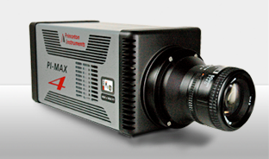
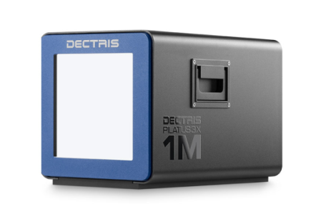
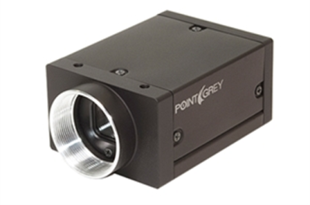
Detector Drivers
Currently 41 detector drivers covering a wide variety of detectors.
Simulation driver
GigE cameras (Prosilica/AVT, Point Grey/FLIR, any GigEVision camera via aravis library)
Point Grey/FLIR USB-3.x cameras
Dectris Pilatus and Eiger pixel array detectors
Princeton Instruments and Photometrics detectors and spectrometers
Andor CCD and CMOS cameras
Perkin Elmer and Dexela flat panel detectors
Web cameras and Axis video servers
Many more (Bruker, Pixirad, Photonic Sciences, etc.)

Slide 7
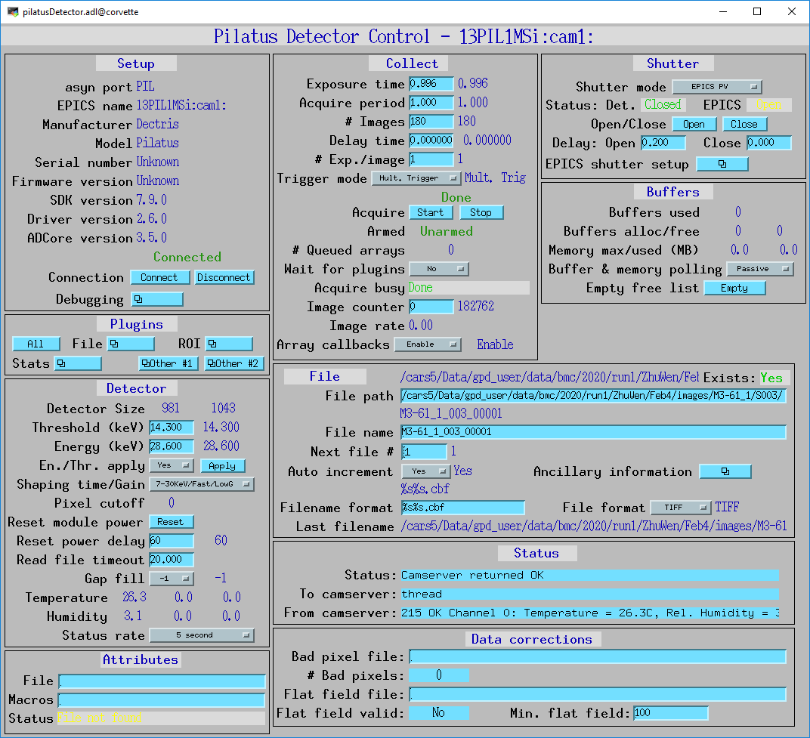
Detector control screens
Screens specific for each detector provided for medm, edm, caQtDM, CSS/Boy, and CSS/Phoebus display managers
Common screen elements are in separated files, included in top-level screen (eg. Setup, Attributes, Shutter, Buffers)

Slide 8
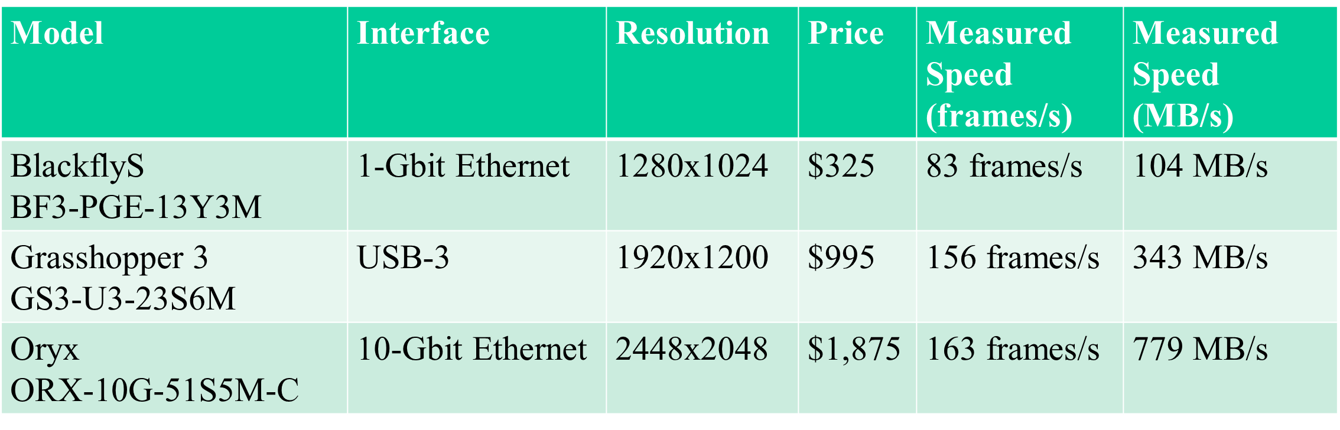
Point Grey/FLIR drivers
GigE, USB 3.0, and 10 GigE camera
High performance, low cost

Slide 9
GenICam Overview
Generic Interface for Cameras standard is the base for plug & play handling of cameras and devices.
From European Machine Vision Association (EMVA)
Generic programming interface for all kinds of devices (mainly cameras)
  Independent of interface technology (GigE Vision, USB3 Vision, CoaXPress, Camera Link HS, Camera Link etc.)
Every GenICam camera has an XML file inside it that can be accessed to determine the cameras available “features”.
By reading and parsing this XML file one can automatically generate the EPICS database and OPI screens based on the specific features available in that camera.
Not open source, open only to consortium members, cannot be disclosed

Slide 10
ADGenICam
ADGenICam is a base class common to all GenICam cameras
Derived classes for real drivers
  Implement the code to read and write features to the device
  Implement the code to stream the images from the device
ADAravis
  Uses aravis library (reversed engineering GenICam library)
  Linux only (most versions, e.g. RHEL 7)
ADSpinnaker
  Driver for FLIR/Point Grey cameras using their Spinnaker SDK
  Windows and recent Linux versions(e.g. Ubuntu 18, RHEL8, not RHEL 7)
ADVimba
  Driver for AVT/Prosilica cameras using their Vimba SDK
  Windows and Linux (most versions, e.g. RHEL 7)

Slide 11
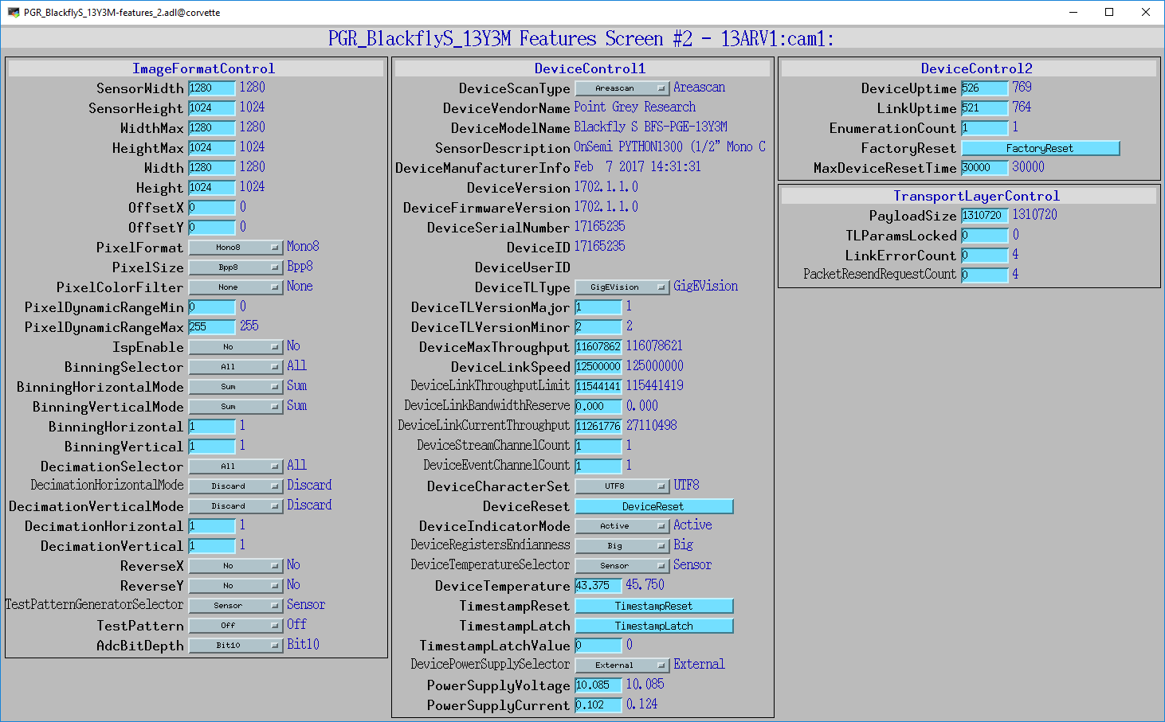
Auto-generated medm screens for PGR BlackflyS 13Y3M
Screen #2

Slide 12
Plugins
Designed to perform real-time processing of data, running in the EPICS IOC (not over EPICS Channel Access)
Receive NDArray data over callbacks from drivers or other plugins
Plugins can execute in their own threads (non-blocking) or in callback thread (blocking)
  If non-blocking then NDArray data is queued
  If executing in callback thread, no queuing, but slows driver
Allows
  Enabling/disabling
  Throttling rate (e.g. ≤ 2Hz) or bandwidth (e.g. ≤ 20 MB/s)
  Changing data source for NDArray callbacks to another driver or plugin
Plugins can be sources of NDArray callbacks, as well as consumers
  Allows creating a data processing pipeline running at very high speed, each in a different thread, and hence in multiple cores on modern CPUs.
  ADCore R3-0 allows each plugin itself to run in multiple threads. More later.

Slide 13
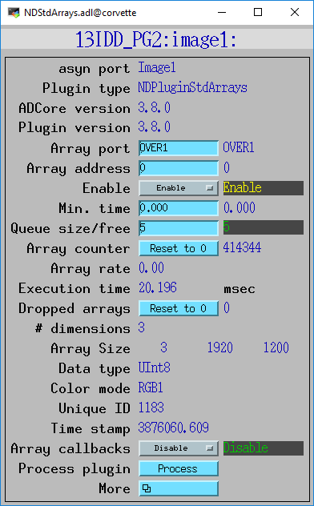
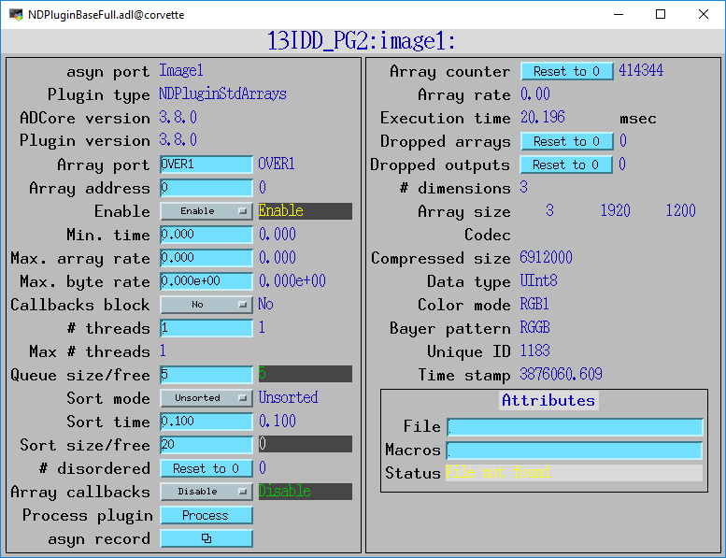
NDPluginDriver medm Screens

Slide 14
Plugins (continued)
Currently 28 plugins that perform wide variety of operations
NDPluginStdArrays
  Receives arrays (images) from device drivers, converts to standard arrays, e.g. waveform records.
  This plugin is what EPICS Channel Access viewers normally talk to.
NDPluginPVA
  Converts NDArrays to EPICS V4 NTNDArrays
  Exports the NTNDArrays over PVAccess with internal V4 server
  Can be used to send structured data to EPICS V4 clients
  When used with the PVAccess driver then areaDetector plugins can be run on different machine from the detector driver
NDPluginROI
  Performs region-of-interest calculations
  Select a subregion. Optionally bin, reverse in either direction, convert data type.
  Divide the array by a scale factor, which is useful for avoiding overflow when binning.
NDPluginTransform
  Performs geometric operations (rotate, mirror in X or Y, etc.)
NDPluginCodec
  Performs compression/decompression
  Codecs include JPEG, Blosc, LZ4, Bitshuffle/LZ4

Slide 15
Plugins (continued)
NDPluginStats
  Calculates basic statistics on an array (min, max, sigma)
  Optionally computes centroid centroid position, width and tilt.
  Optionally Computes X and Y profiles, including average profiles, profiles at the centroid position, and profiles at a user-defined cursor position.
  Optionally computes the image histogram and entropy
NDPluginProcess
  Does arithmetic processing on arrays
  Background subtraction.
  Flat field normalization.
  Offset and scale.
  Low and high clipping.
  Recursive filtering in the time domain.
  Conversion to a different output data type.
NDPluginOverlay
  Adds graphic overlays to an image.
  Can be used to display ROIs, multiple cursors, user-defined boxes, text, etc.
NDPluginFFT
  Computes FFT of 1-D or 2-D NDArrays
  Exports NDArrays containing the absolute value (power spectrum) of the FFT
  Exports 1-D arrays of the FFT real, imaginary, absolute values, and time and frequency data.

Slide 16
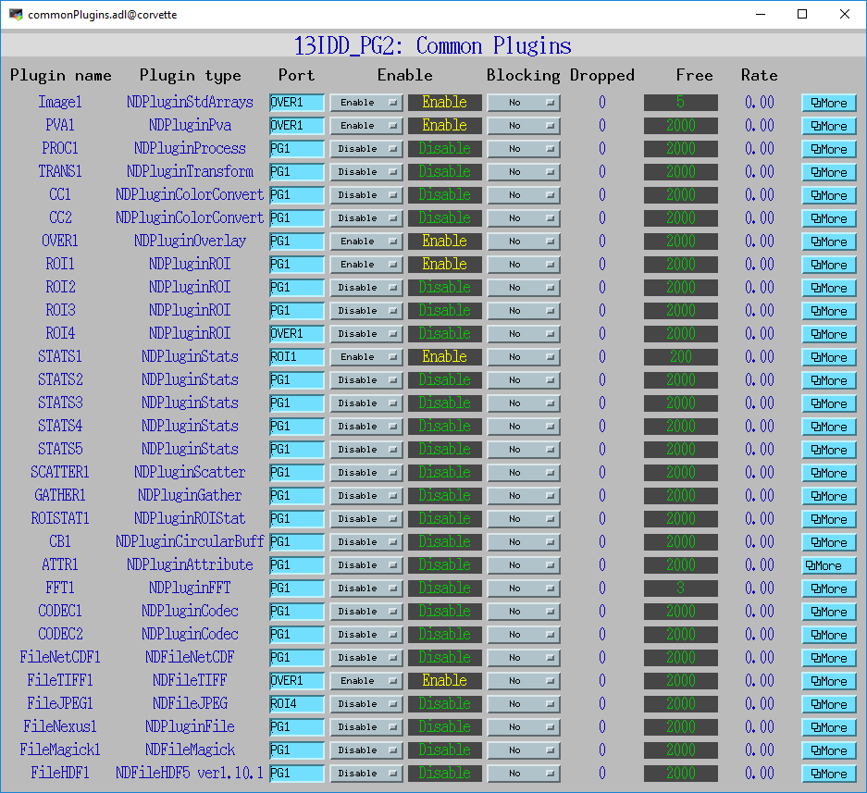
commonPlugins.adl All plugins at a glance

Slide 17
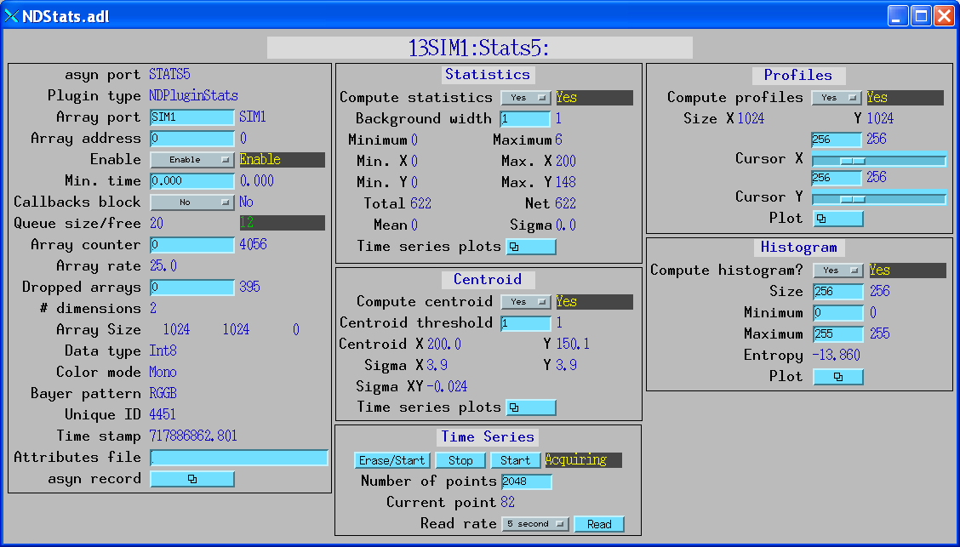
Statistics plugin

Slide 18
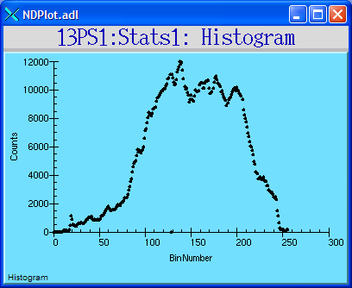
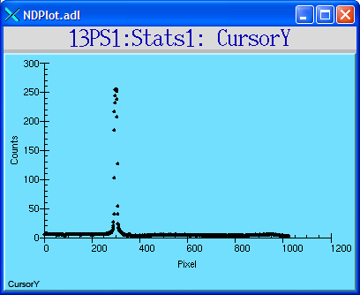
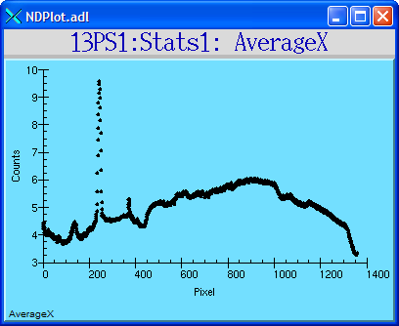
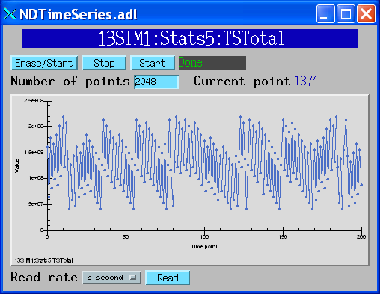
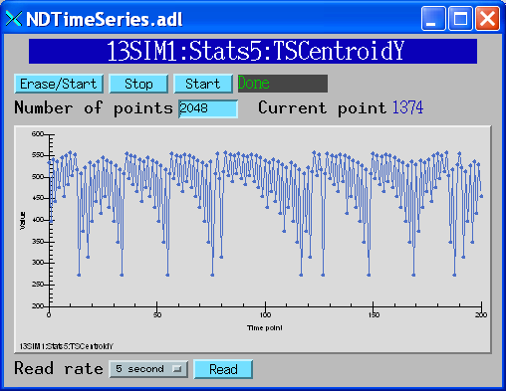
Statistics plugin (continued)

Slide 19
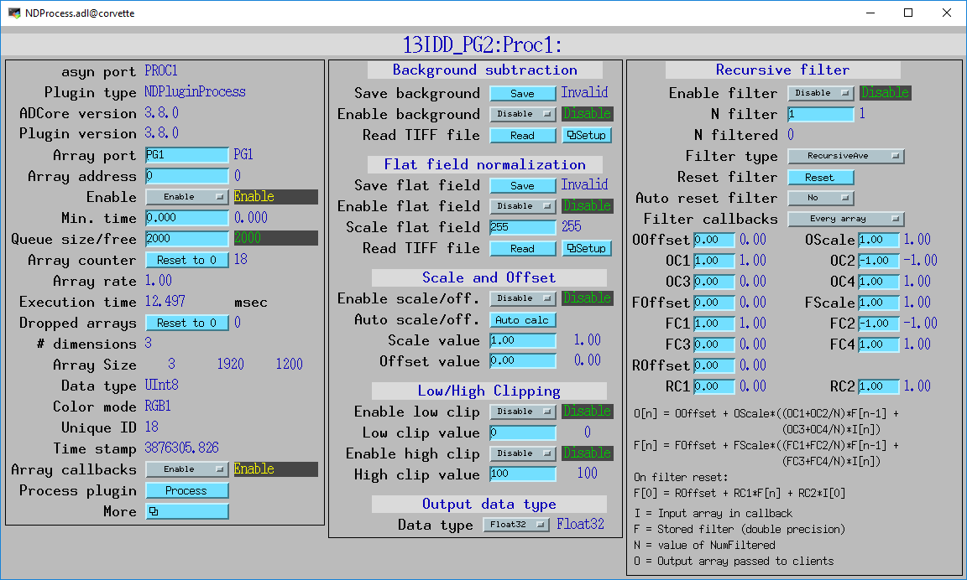
Processing plugin

Slide 20
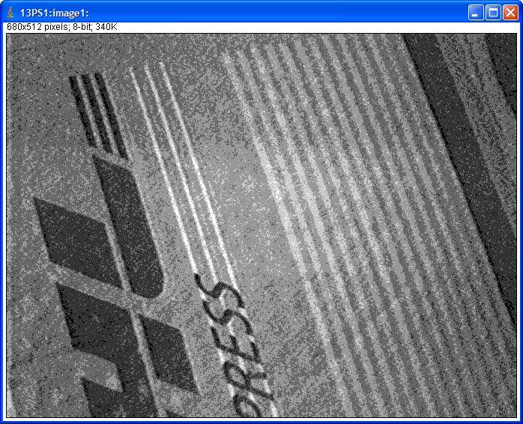
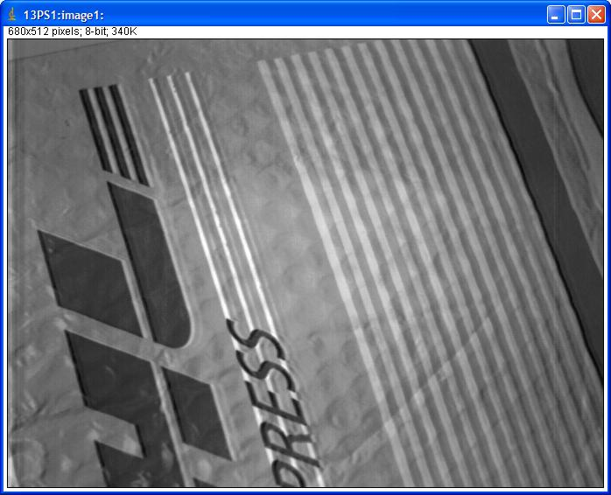
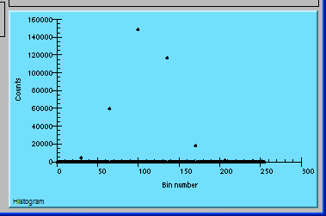
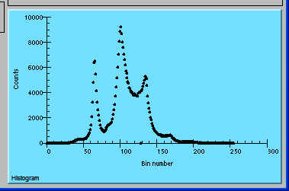
Processing plugin
30 microsec exposure time
No filtering
N=100 recursive average filter

Slide 21
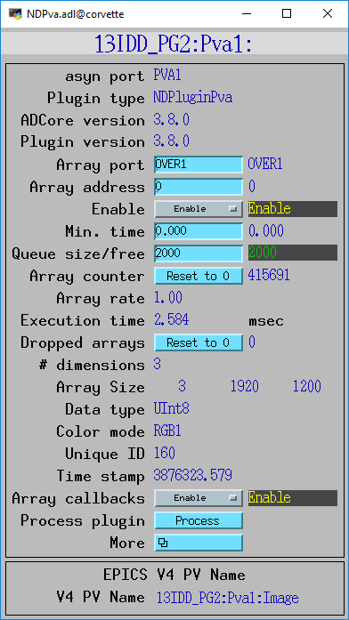
NDPluginPva (EPICS V4/7)
Plugin that converts NDArrays into the EPICS v4 normative type NTNDArray
Embedded EPICSv4 server serves the NTNDArray structure as an EPICSv4 PV
High performance, ~3.2GB/s shown here
Can be received by any EPICS v4 client
  Java, Python, C++ versions of pvAccess
  CSS has a widget that can display NTNDArrays
  ImageJ EPICS_NTNDA_Viewer plugin
  Python PY_NTNDA_Viewer program
  Can include an NTNDArray receiver in another IOC

Slide 22
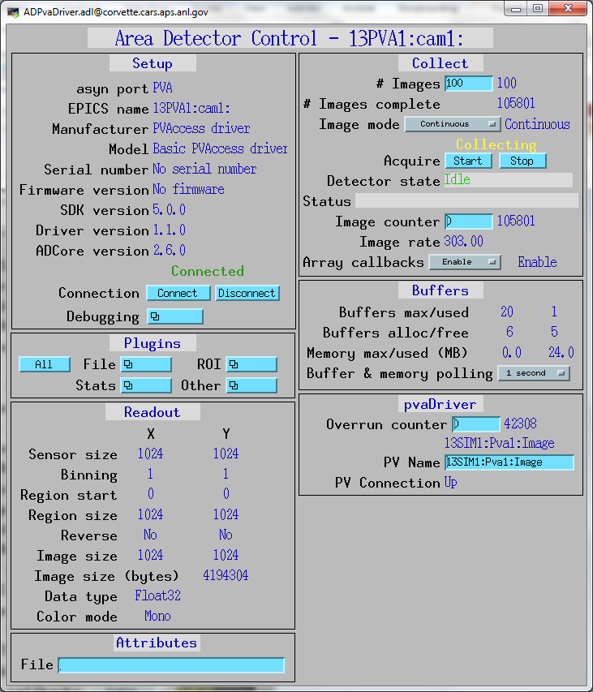
pvAccess Driver (EPICS V4)
Logical inverse of NDPluginPva
Receives NTNDArrays over the network, converts to NDArrays and calls plugins
Can be used to run areaDetector IOC and plugins on another machine or in another process
High performance:
  ~1.2 GB/s shown here with interprocess communication
  Saturating 10 Gb Ethernet links has been demonstrated

Slide 23
Plugins: NDPluginFile
6 File formats currently supported including
  NDFileTIFF
    Supports any NDArray data type
    Stores NDAttributes as ASCII user tags
  NDFileJPEG
    With compression control
  NDFileNetCDF
    Popular self-describing binary format, supported by Unidata at UCAR
  NDFileHDF5
    Writes HDF5 files with the native HDF5 API, unlike the NeXus plugin which uses the NeXus API. Supports 7 types of data compression.
    Supports using an XML file to define the layout and placement of NDArrays and NDAttributes in the HDF5 file
    Supports Single Writer Multiple Reader (SWMR). Only supported on local file systems, GPFS, and Lustre (not NFS or SMB)
    Supports Direct Chunk Write to write pre-compressed NDArrays, very fast.

Slide 24
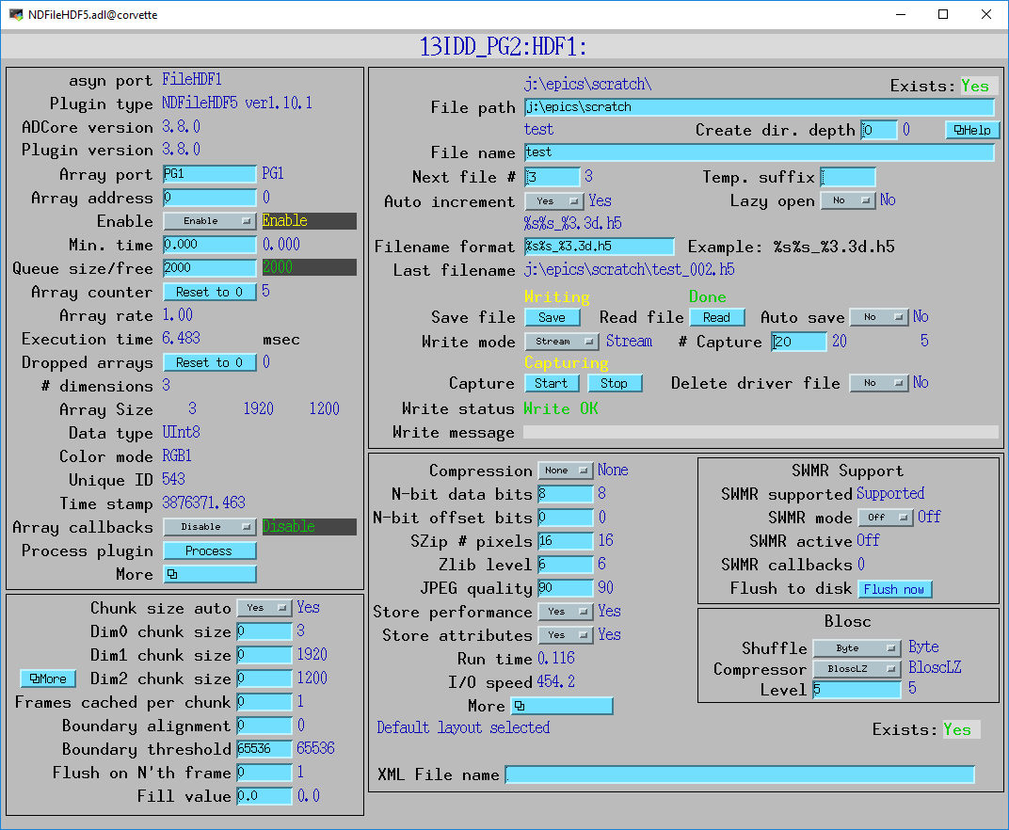
NDFileHDF5

Slide 25
Multiple Threads per Plugin
Support for multiple threads running the processCallbacks() function in a single plugin.
Can improve the performance of the plugin by a large factor.
  Linear scaling with up to 5 threads (the largest value tested) observed for most of the plugins that now support multiple threads.
Maximum number of threads that can be used for the plugin is set in constructor and in IOC startup script.
Actual number of threads to use controlled via an EPICS PV at run time, up to the maximum value.
Optional sorting of NDArrays by uniqueId to attempt to output them in the correct order.
  Several parameters to control this option

Slide 26
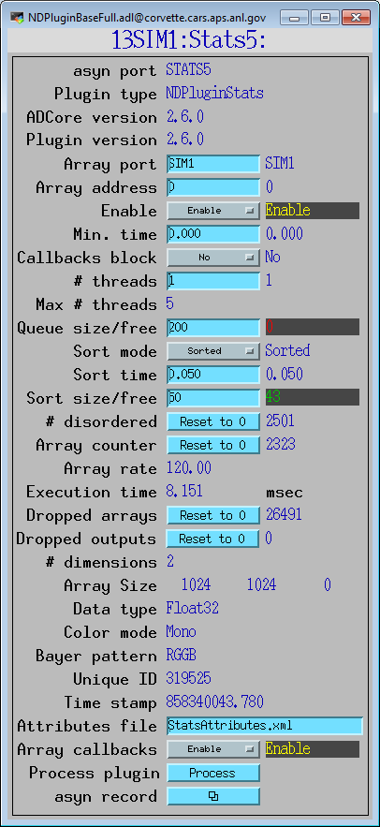
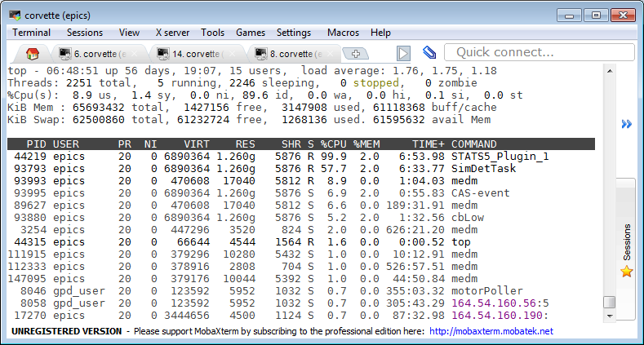
Multiple Threads per Plugin
1 Thread

Slide 27
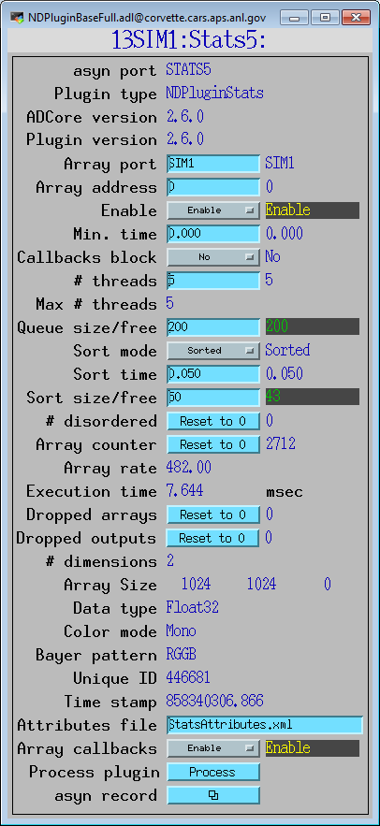
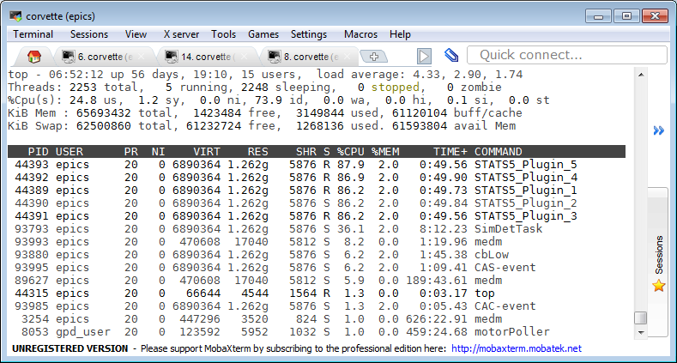
Multiple Threads per Plugin
5 Threads

Slide 28
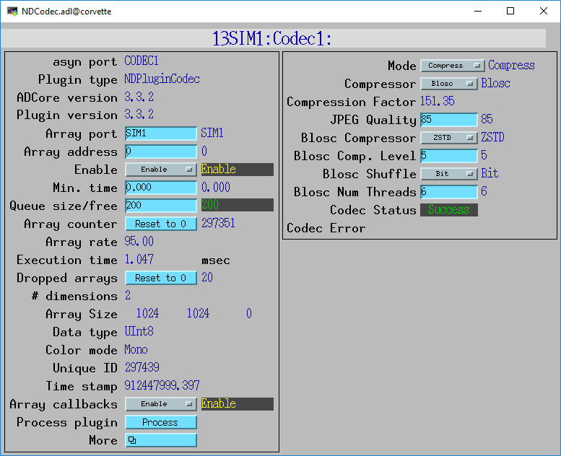
NDPluginCodec
Plugin for data compression and decompression
Mode:
  Compress or Decompress
Compressor:
  None
  JPEG (JPEGQuality selection)
  Blosc (many options, next slide)
  LZ4
  BSLZ4 (Bitshuffle/lz4)
CompFactor_RBV:
  Actual compression ratio
CodecStatus, CodecError
JPEG is lossy, all others lossless
All codecs are built in ADSupport as shareable libraries that can be called from Python, Java or HDF5
Easy to add additional codecs

Slide 29
HDF5 Compression
NDFileHDF5 file writing plugin has always supported the “built-in” compression filters from HDF5:
  N-bit
  SZIP
  ZLIB
  Blosc (6 codecs)
  LZ4
  Bitshuffle/LZ4
  JPEG filters
All of these compressors are called from the HDF5 library.
  Limits performance because of the overhead of the library.
  All compression runs in a single thread with the rest of the library.

Slide 30
HDF5 Compression
Support for HDF5 Direct Chunk Write added in R3-5
  Much faster, much of the code in the HDF5 library is skipped.
  The NDArrays can be pre-compressed
  Compression can be done either in NDPluginCodec, or directly by the driver (e.g. ADEiger)
    NDPluginCodec can be using multiple-threads
  Also works with uncompressed NDArrays

Slide 31
Viewers
areaDetector allows generic viewers to be written that receive images as EPICS waveform records over Channel Access
Current viewers include:
  ImageJ plugin EPICS_AD_Display. ImageJ is a very popular image analysis program, written in Java, derived from NIH Image.
  ImageJ EPICS_NTNDA_Viewer. Same as above but uses pvAccess rather than Channel Access. Supports compressed NTNDArrays.
  Python NTNDA_Viewer. Uses QT and pvAccess, supports compressed NTNDArrays.
  ffmpegServer allows image display in any Web browser
  ffmpegViewer high-performance Qt-based viewer for MJPEG stream

Slide 32
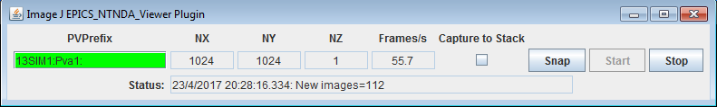
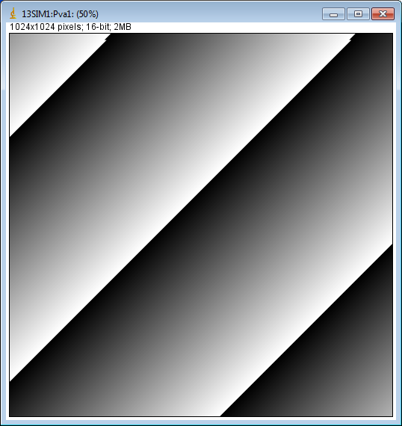
EPICS_NTNDA_Viewer ImageJ plugin
Essentially identical to EPICS_AD_Viewer.java except that it displays NTNDArrays from the NDPluginPva plugin, i.e. using pvAccess to transport the images rather than NDPluginStdArrays which uses Channel Access.

Slide 33
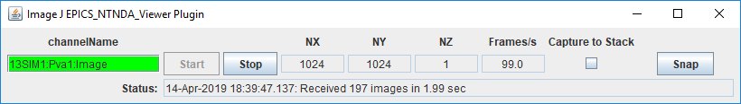
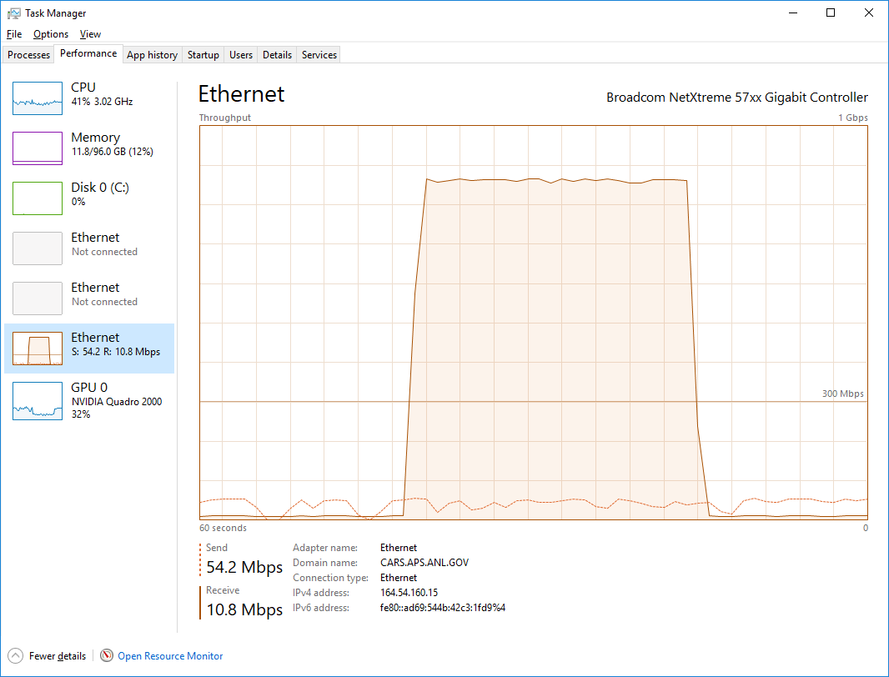
ImageJ pvAccess Viewer
Now supports displaying compressed NTNDArrays
Supports all compressions (JPEG, Blosc, LZ4, BSLZ4)
Can greatly reduce network bandwidth when the IOC and viewer are running on different machines
No compression
Blosc compression

Slide 34
Other Drivers that use ADCore
NDArrays are not limited to 2-D detectors
  File, ROI, and statistics plugins are useful for other types of detectors
Used for spectra arrays [NumMCAChannels, NumDetectors, NumPixels] for:
  Xspress3 from Quantum Detectors
  xMAP, Mercury and new FalconX from XIA
  Dante detector from XGLab
Used for time-series data [NumTimePoints, NumInputs] for the quadEM quad electrometer software
  AH401, AH501, TetrAMM from CaenEls
  Two types of electrometers from BNL Instrumentation group (Peter Siddons)

Slide 35
Conclusions
Architecture works well, easily extended to new detector drivers, new plugins and new clients
Base classes, asynPortDriver, asynNDArrayDriver, asynPluginDriver actually are generic, nothing “areaDetector” specific about them.
Documentation in ReST on github.io:
  https://areaDetector.github.io
Can get code from github
  https://github.com/areaDetector

