Slide 1


Slide 2
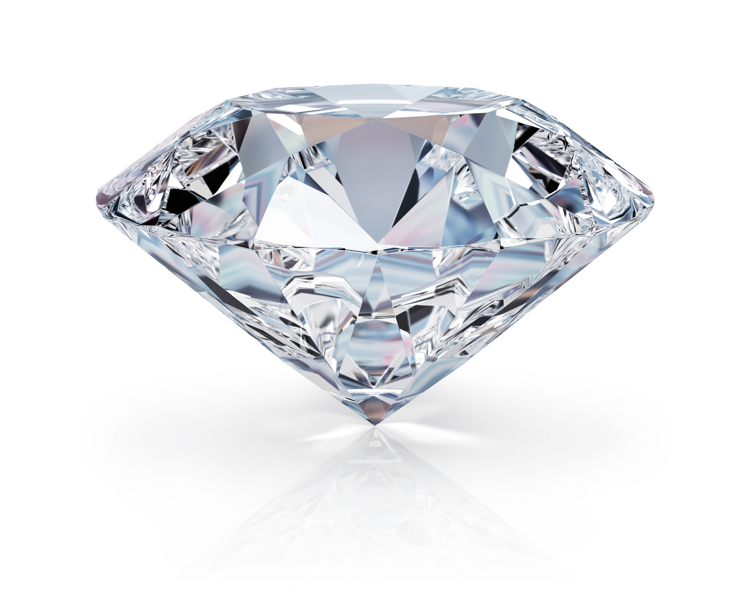
Diamond Anvil Cell Program at GSECARS
Vitali Prakapenka, Sergey Tkachev, Dongzhou Zhang & Eran Greenberg
Notes:
We are using hardest known materials, gem quality diamonds, to generate pressures relevant to the deep planetary interior, squeezing tiny samples between two anvils

Slide 3
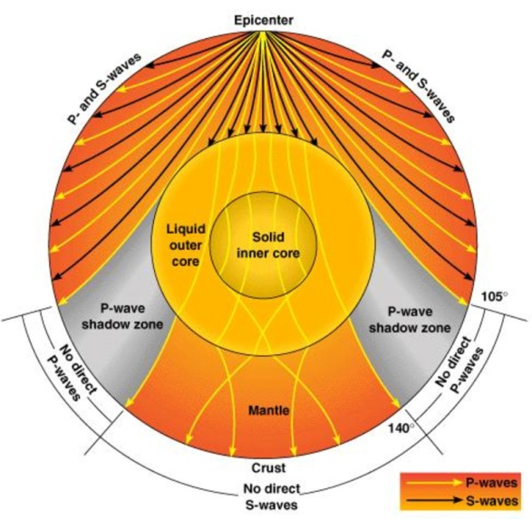
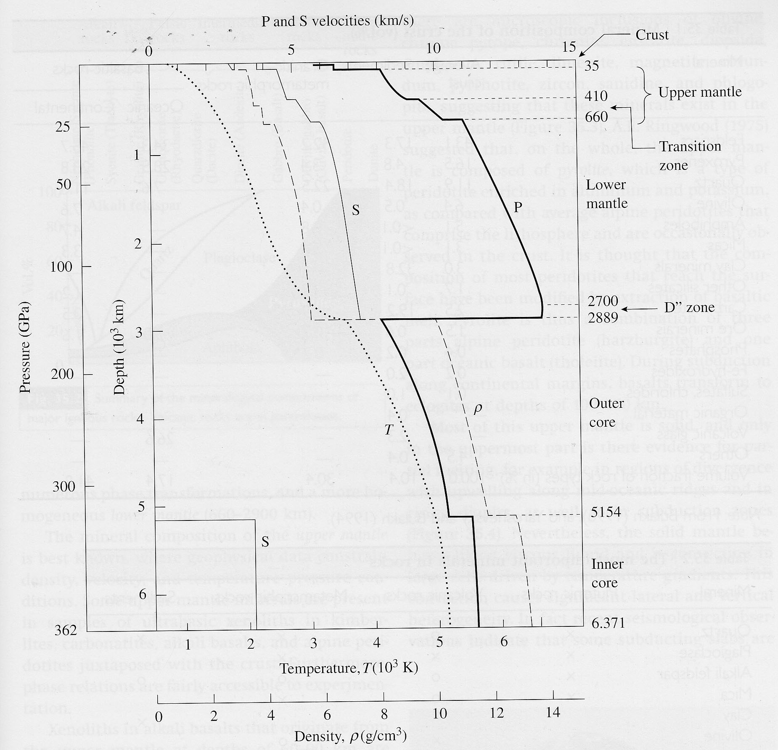
The interior structure of the Earth
The world’s deepest borehole in Sakhalin is 12,345 m (40,502 ft)
DAC
Most of what we know about the structure of the Earth's deep interior comes from the study of seismic wave velocities
In order to interpret such measurements in terms of mineralogical/compositional models of the Earth's interior, data on the physical and chemical properties of minerals at high pressures and temperatures are essential
Knowledge of thermodynamics, phase equilibria, crystal chemistry, crystallography, rheology, diffusion and heat transport are required to characterize the structure and dynamics of the Earth's deep interior
R.Wenk, 2005

Slide 4
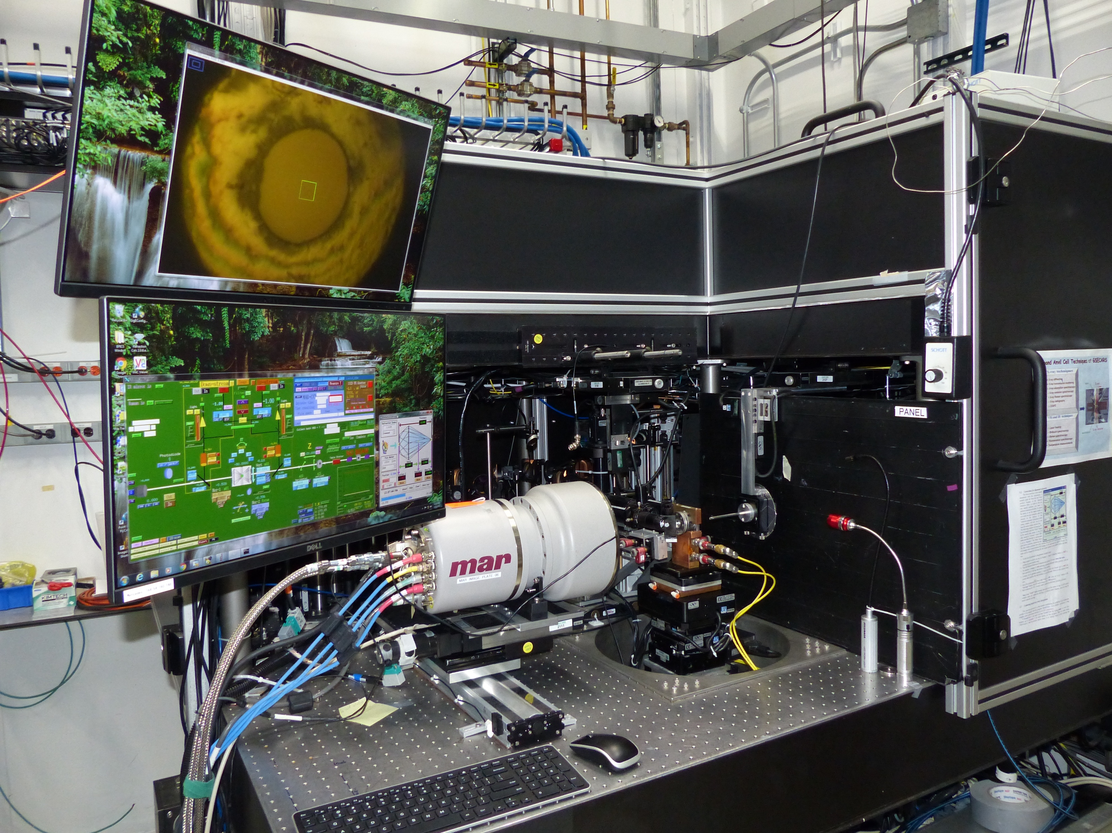
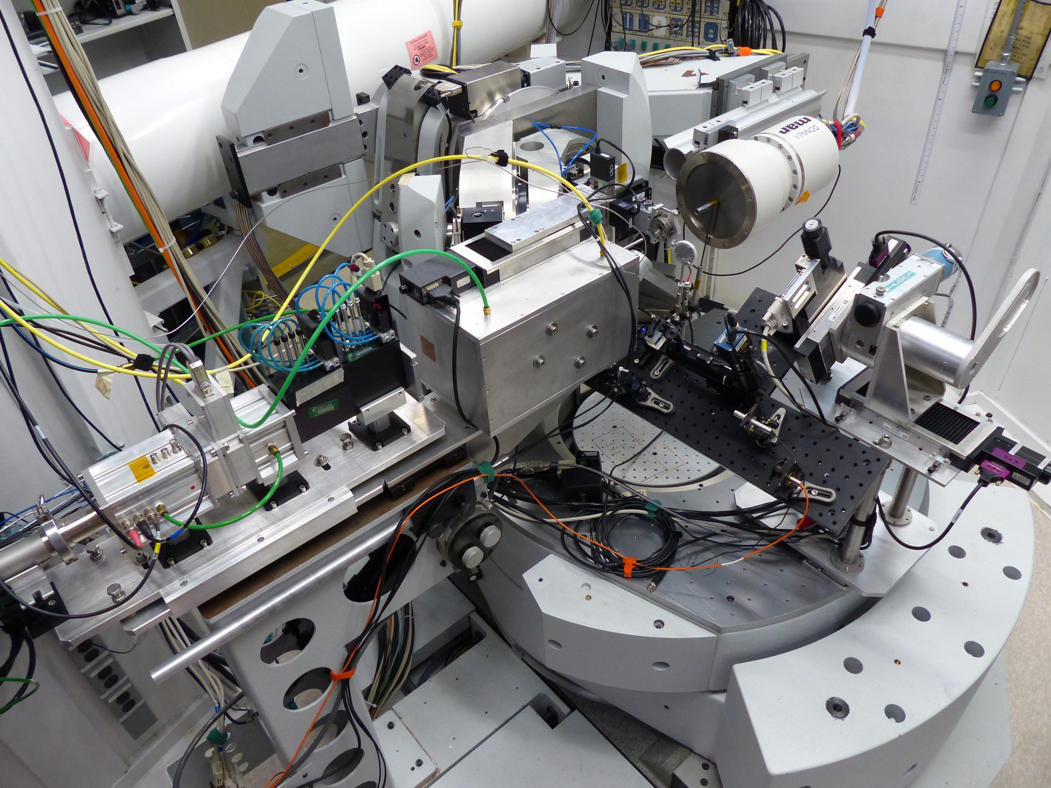
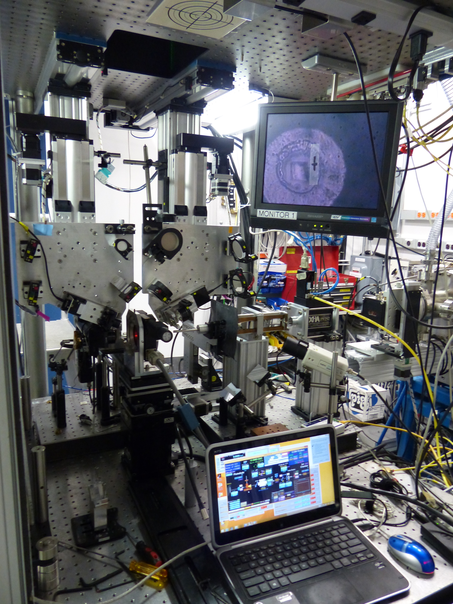
Five optical focal points (x-ray, lasers, spectroscopy)
are aligned with precision better than 1 µm in the DAC
13-BMD
13-IDD
13-BMC
X-ray energy 5-80 keV
beam size ~3 µm
XRD, sXRD, XES
on-line laser heating,
Raman and
VIS-IR spectroscopy
X-ray energy 15, 28.6 keV
beam size ~ 15 µm
sXRD
on-line laser heating, Raman and
VIS spectroscopy
X-ray energy 5-80 keV
beam size ~6 x 12 µm
XRD, sXRD
on-line Brillouin, Raman
VIS-IR spectroscopy
Notes:
To utilize different approaches for sample characterization we have built three dedicated stations: main IDD combined with LH and on-line advanced spectroscopy, BMD coupled with BS, and BMC for sXRD where 6-axis diffractometer is combined with LH , details during the tour.

Slide 5
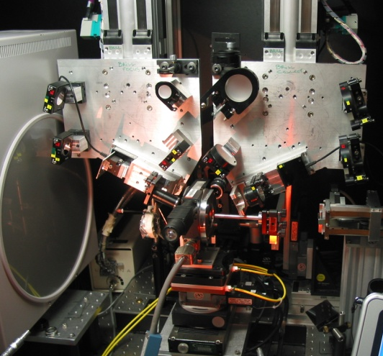
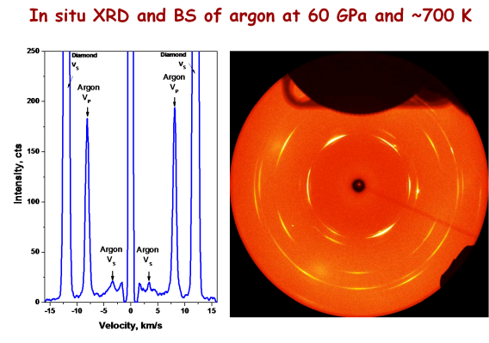

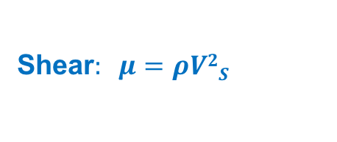
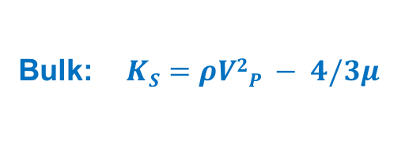
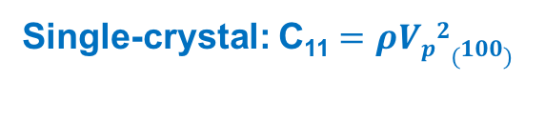
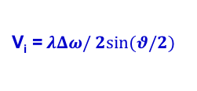
Elastic properties
Brillouin spectroscopy
V_{i} =$ λΔω/ 2sin⁡(θ/2)$
M
Knowledge of elastic properties of minerals are essential for seismic data interpretation, BS is one of the techniques that allows direct measurements of sound velocities
Acoustic waves present in a solid due to thermal motion of atoms
Laser light interacts with phonons (or density / refractive index fluctuations) and is scattered with Doppler shifted frequency $∆ω$
Interferometer
L
M
M
Laser
M
F
P
Scattered
light
M
Laser
M
M
Synchrotron
APS, ANL
L
L
X-ray detector
B
S
X-ray
Scattered x-ray
elastic moduli only for known density
Shear$: μ=ρV2S$
Bulk: $KS=ρV2P − 4/3μ $
Single-crystal: C₁₁ $=ρVp2(100)$
Notes:
As I have mentioned elastic properties of minerals are essential for seismic data interpretation, BS is one of the techniques that allows direct measurements of sound velocities

Slide 6
Elasticity of single-crystal olivine
Natural single-crystal San Carlos olivine [(Mg_{0.9},Fe_{0.1})₂SiO₄], Arizona
full set of nine elastic constants of orthorhombic single-crystal olivine has been measured for the first time using combined Brillouin spectroscopy and X-ray diffraction at high P–T conditions
Considering the combined high P–T effects on the elasticity of olivine along an expected mantle geotherm, the velocity jumps at the 410-km depth are 6.4% for V_{P} and 6% for V_{S}, which are more consistent with seismic observations
Mao Z. et al, EPSL, 426, 204-215 (2015)
Notes:
These results provide tight experimental constraints on the combined P–T effects on the sound velocity profiles and seismic anisotropies of olivine in the upper mantle. Although most of the elastic moduli increase with increasing pressure at given high temperatures, three moduli, C₁₁, C₁₂ and C₁₃ exhibit stronger temperature-induced reduction at greater pressures, showing the importance of the combined effects of high P–T on the elasticity of mantle minerals. The elasticity of single-crystal olivine at high P–T is modeled and applied to decipher the seismic discontinuity at the 410-km depth in a pyrolitic mantle composition as well as the velocity profiles of the metastable olivine wedge in the subduction slabs. Considering the combined high P–T effects on the elasticity of olivine along an expected mantle geotherm, the velocity jumps at the 410-km depth are 6.4% for V_{P} and 6% for V_{S}, which are more consistent with seismic observations, although other factors such as the addition of water or compositional effects may still be needed to reconcile the difference between current mineral physics results and seismic observations. We also found that the presence of the metastable olivine in the slabs can exhibit both low velocities and strong seismic anisotropies that are consistent with seismic observations of the region and will help to locate the potential metastable olivine wedge in the slabs. Our in situ high P–T results, together with thermoelastic modeling, provide new insights on the composition and seismic structures of the Earth's mantle.

Slide 7
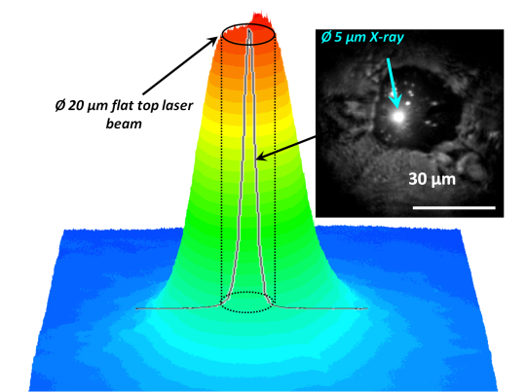
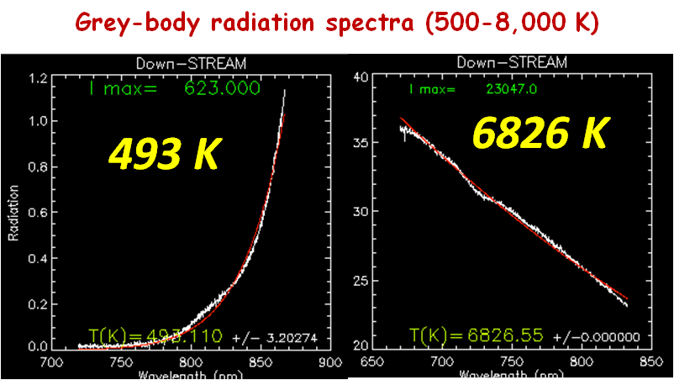
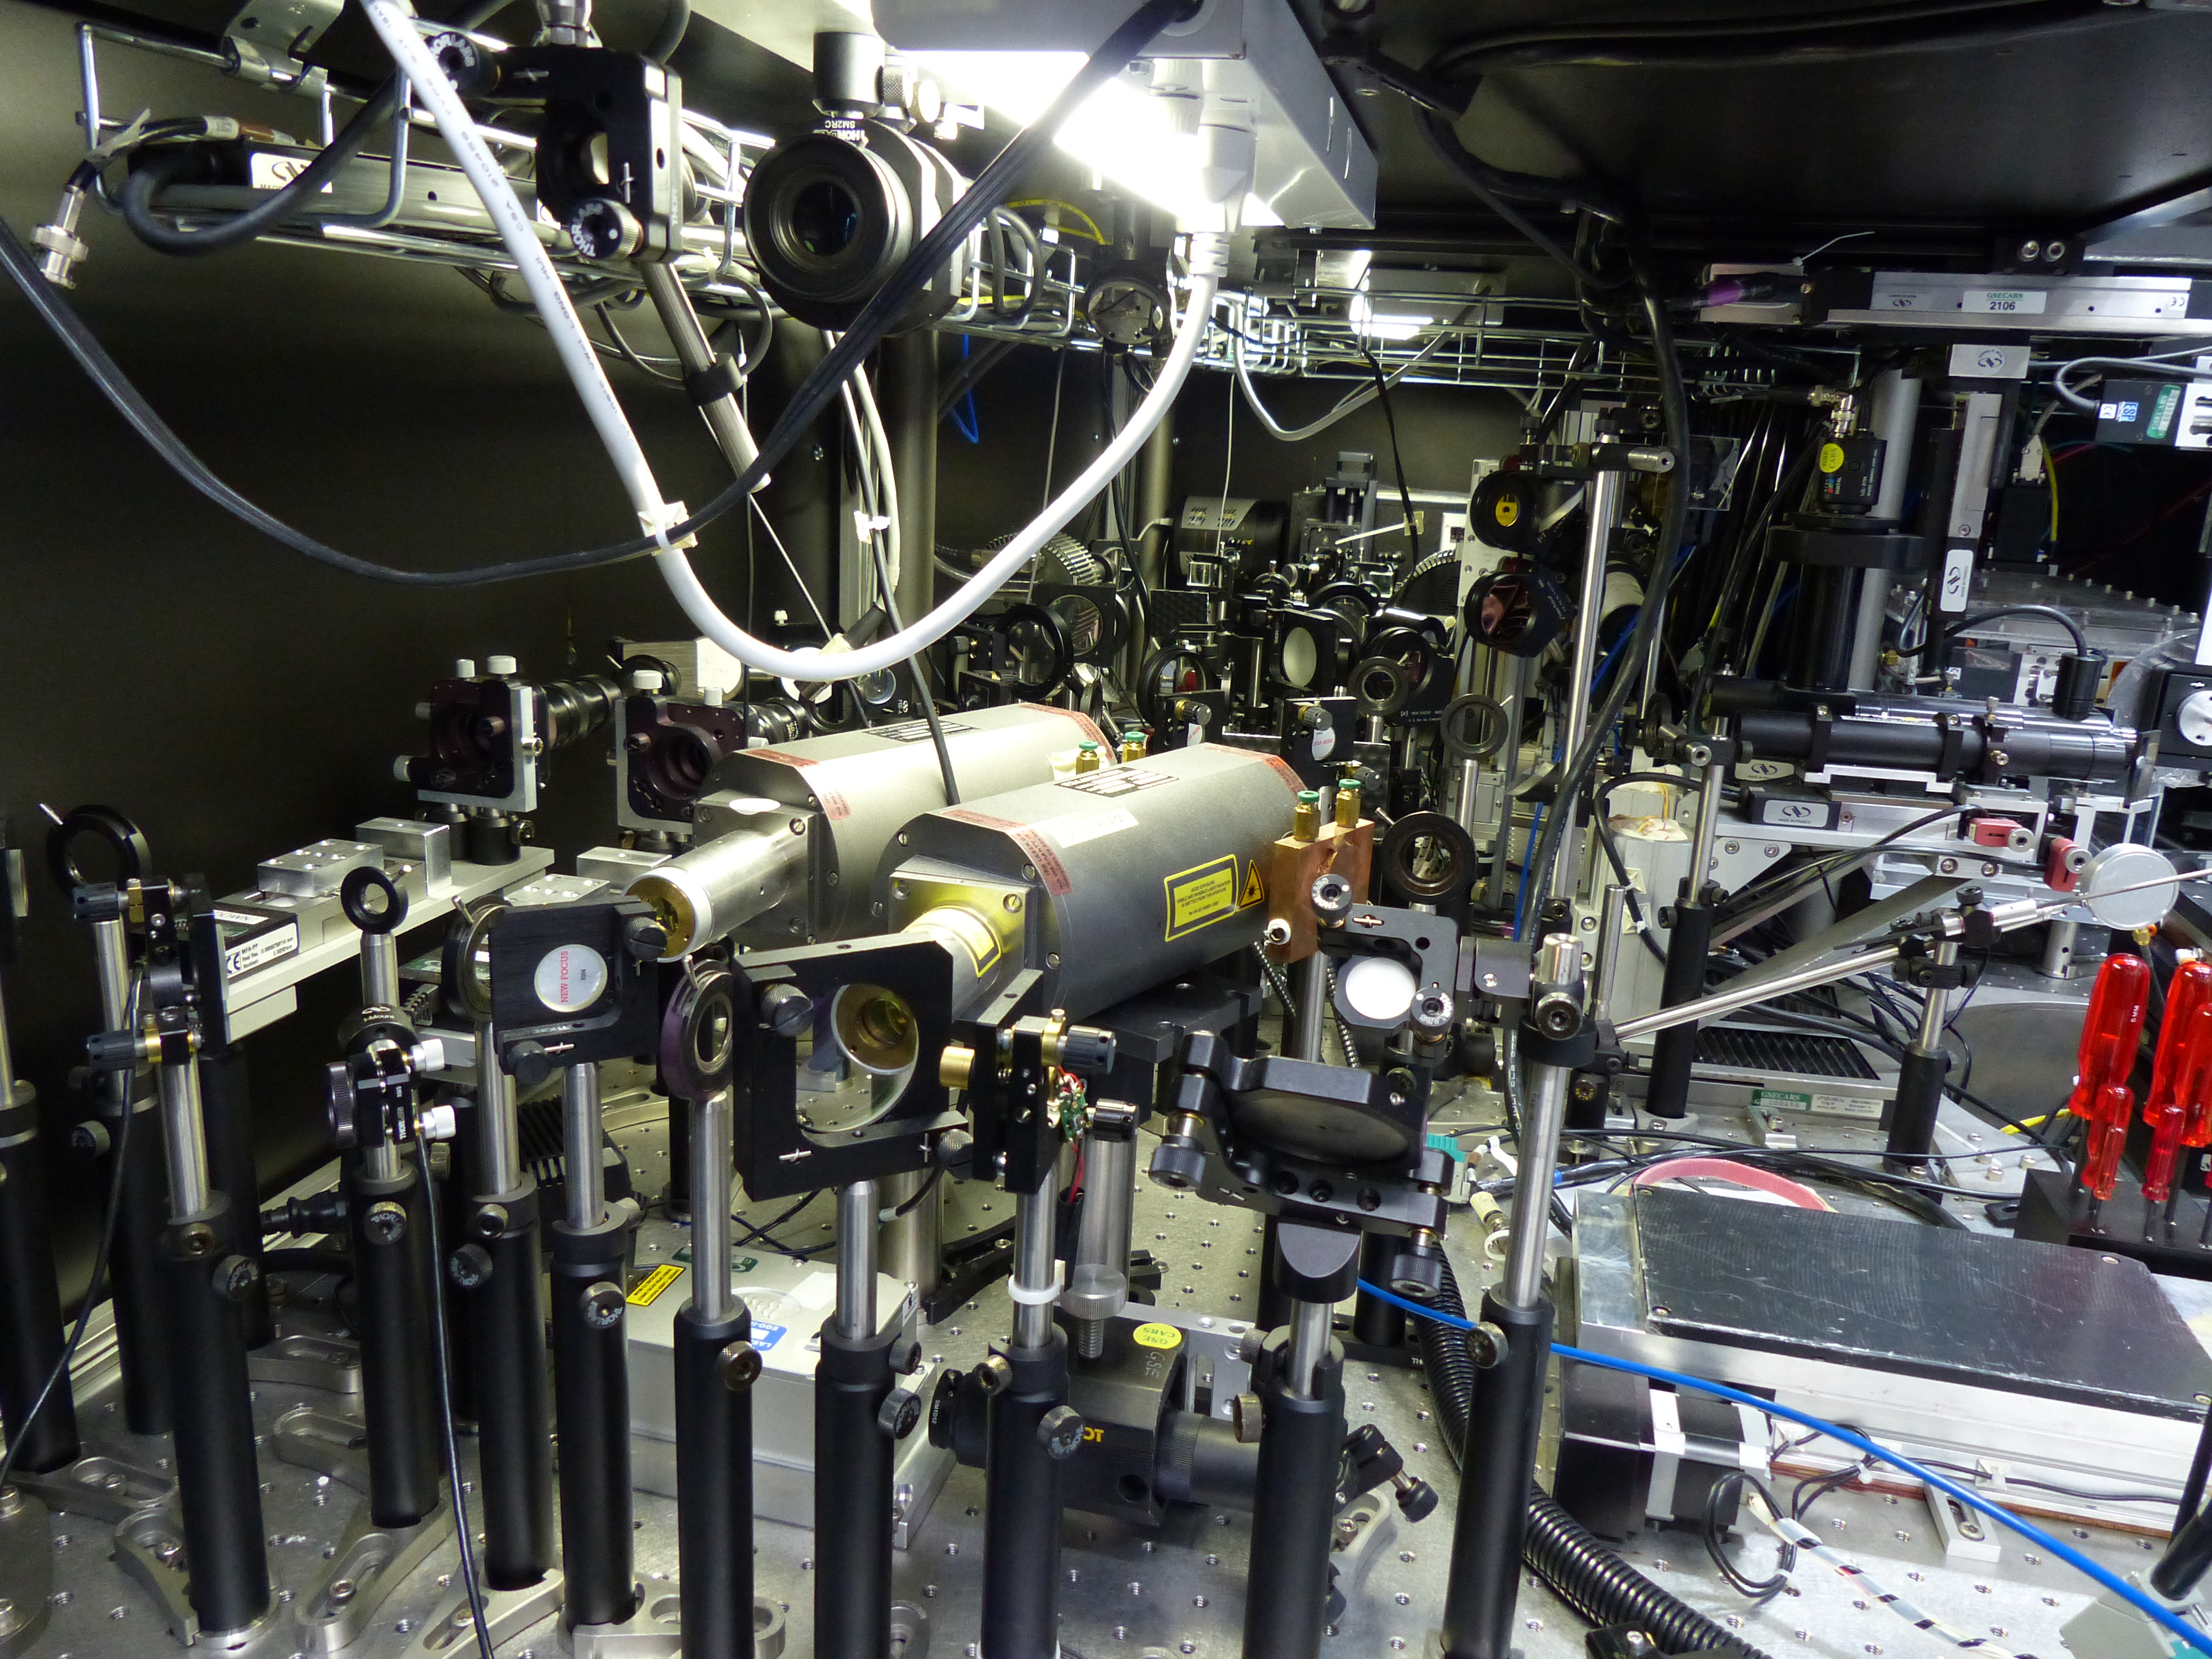
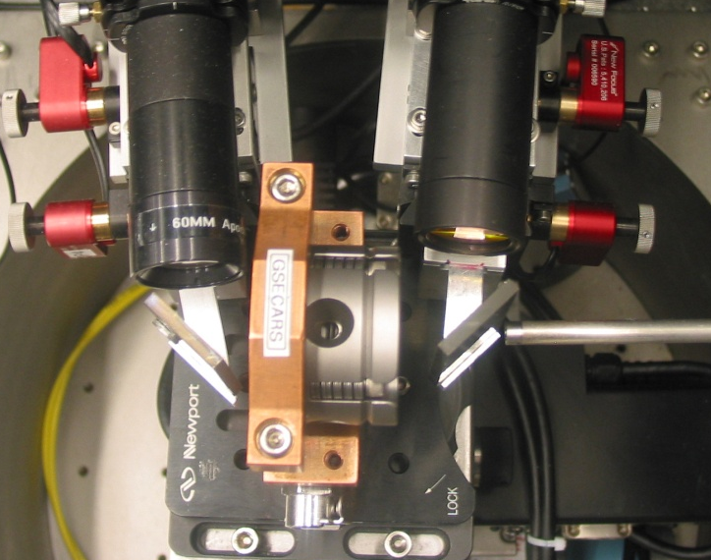
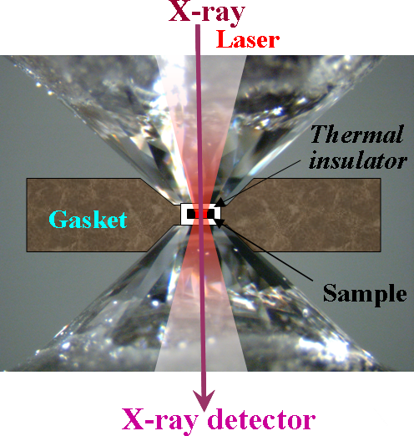
Optical schema of the on-line, flat top,
double-sided laser heating system at GSECARS
900 – 10,000 K
50 kHz, 100ns
500 – 1,000 K
Pilatus
CdTe
~ 3 μm
Prakapenka et al., High Pressure Research, 2008 , 28:3,225
Notes:
To probe samples at much higher T and P we have build very complex but reliable advanced optical system combined with high energy focused x-ray beam.

Slide 8

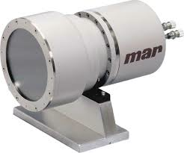
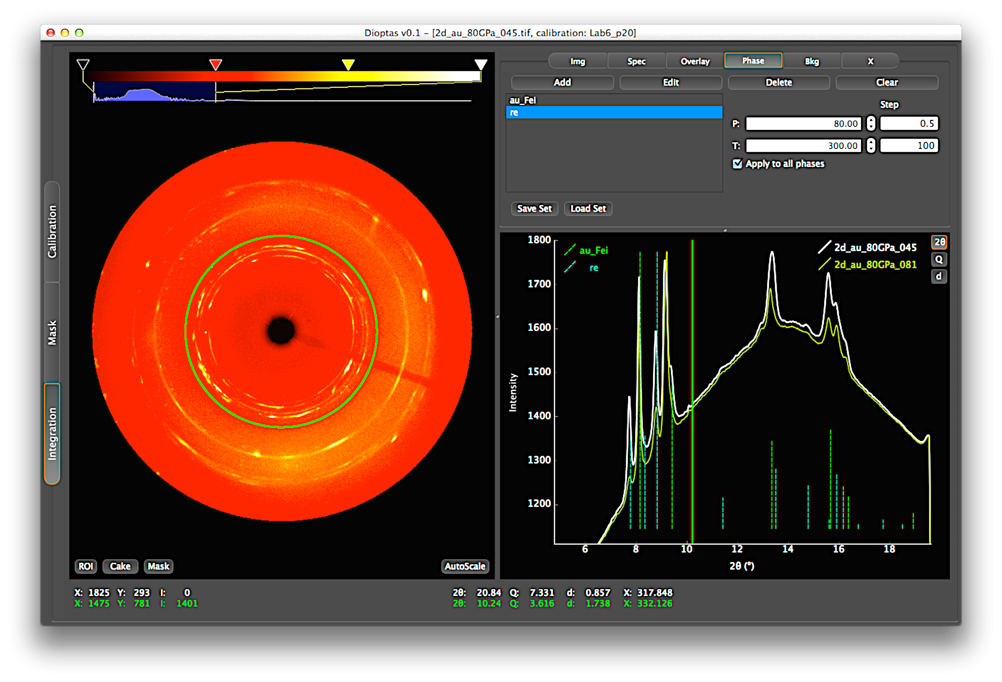

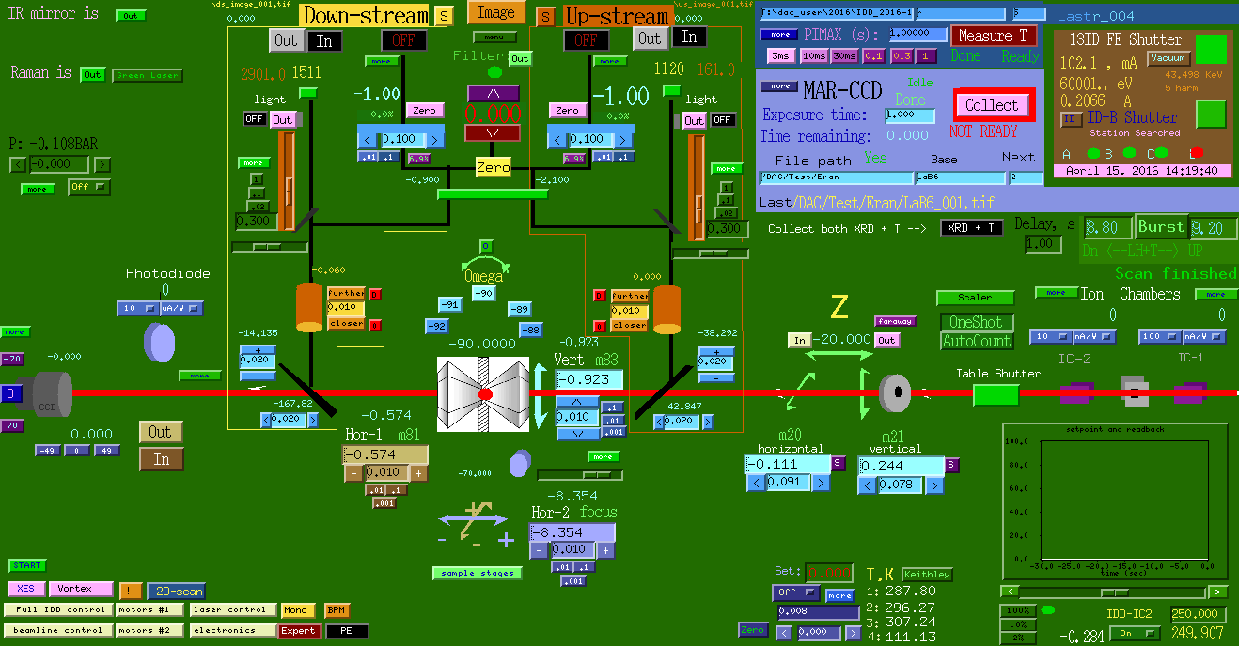
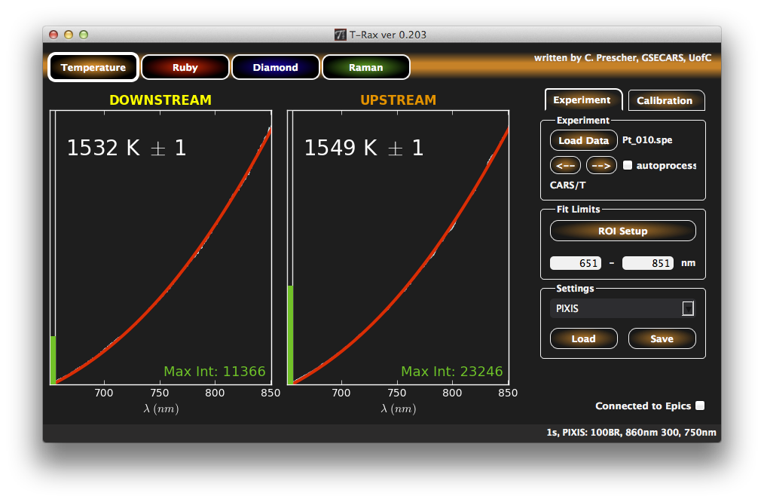

Burst laser heating & XRD
Precise alignment of sample image with 5 optical axes:
x-ray(1), lasers(2) and spectroscopy(2)
start
Laser ON (0.2s – 10s)
stop
calculate T
→ integrate XRD
→ update log-file
→ RT XRD
Laser
X-ray detector ON
no user interaction
Detector
T measurements ON
Temerature
EPICS control
Notes:
To encourage young scientist to do challenging experiments, very efficient

Slide 9
DAC science program
A major portion of the GSECARS research activity with the DAC involved studies of physical and chemical properties of minerals at pressures and temperatures relevant to the Earth’s lower mantle – core conditions.
More than 100 publications (2011-2015) in peer review journals including number of high profile journals:
        Nature series 7
        Science series 2
        Physical review 7
        PNAS 2
        GRL 7
        EPSL 16
Notes:
As result we have for 5 years period more than 100 publications including

Slide 10
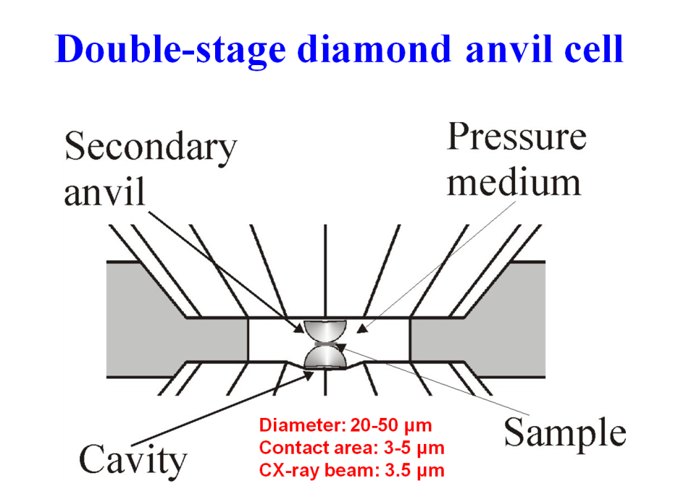
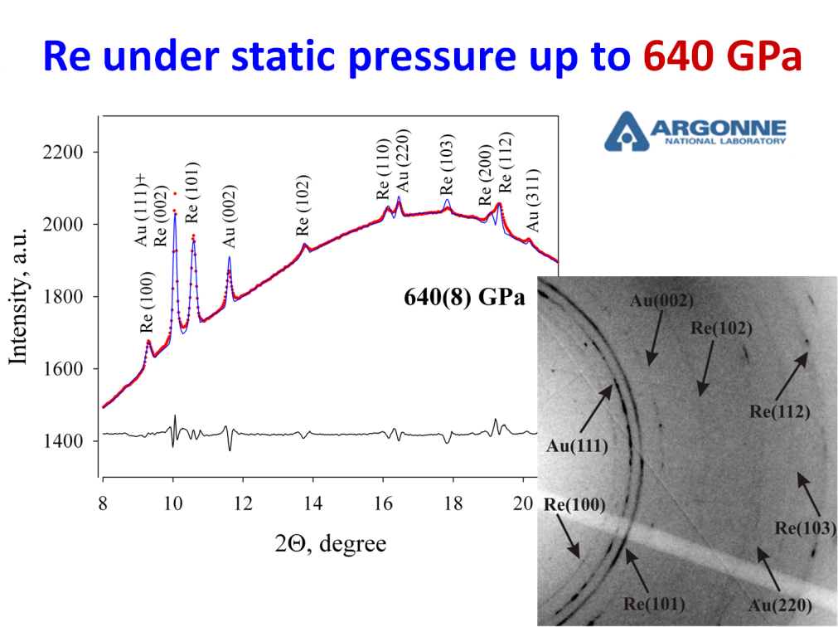
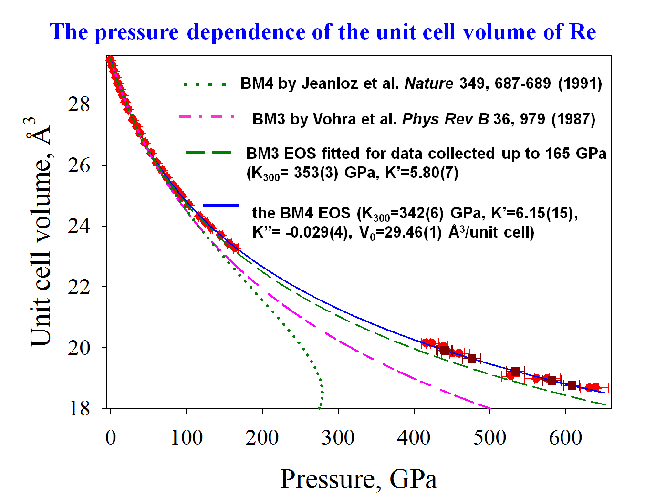

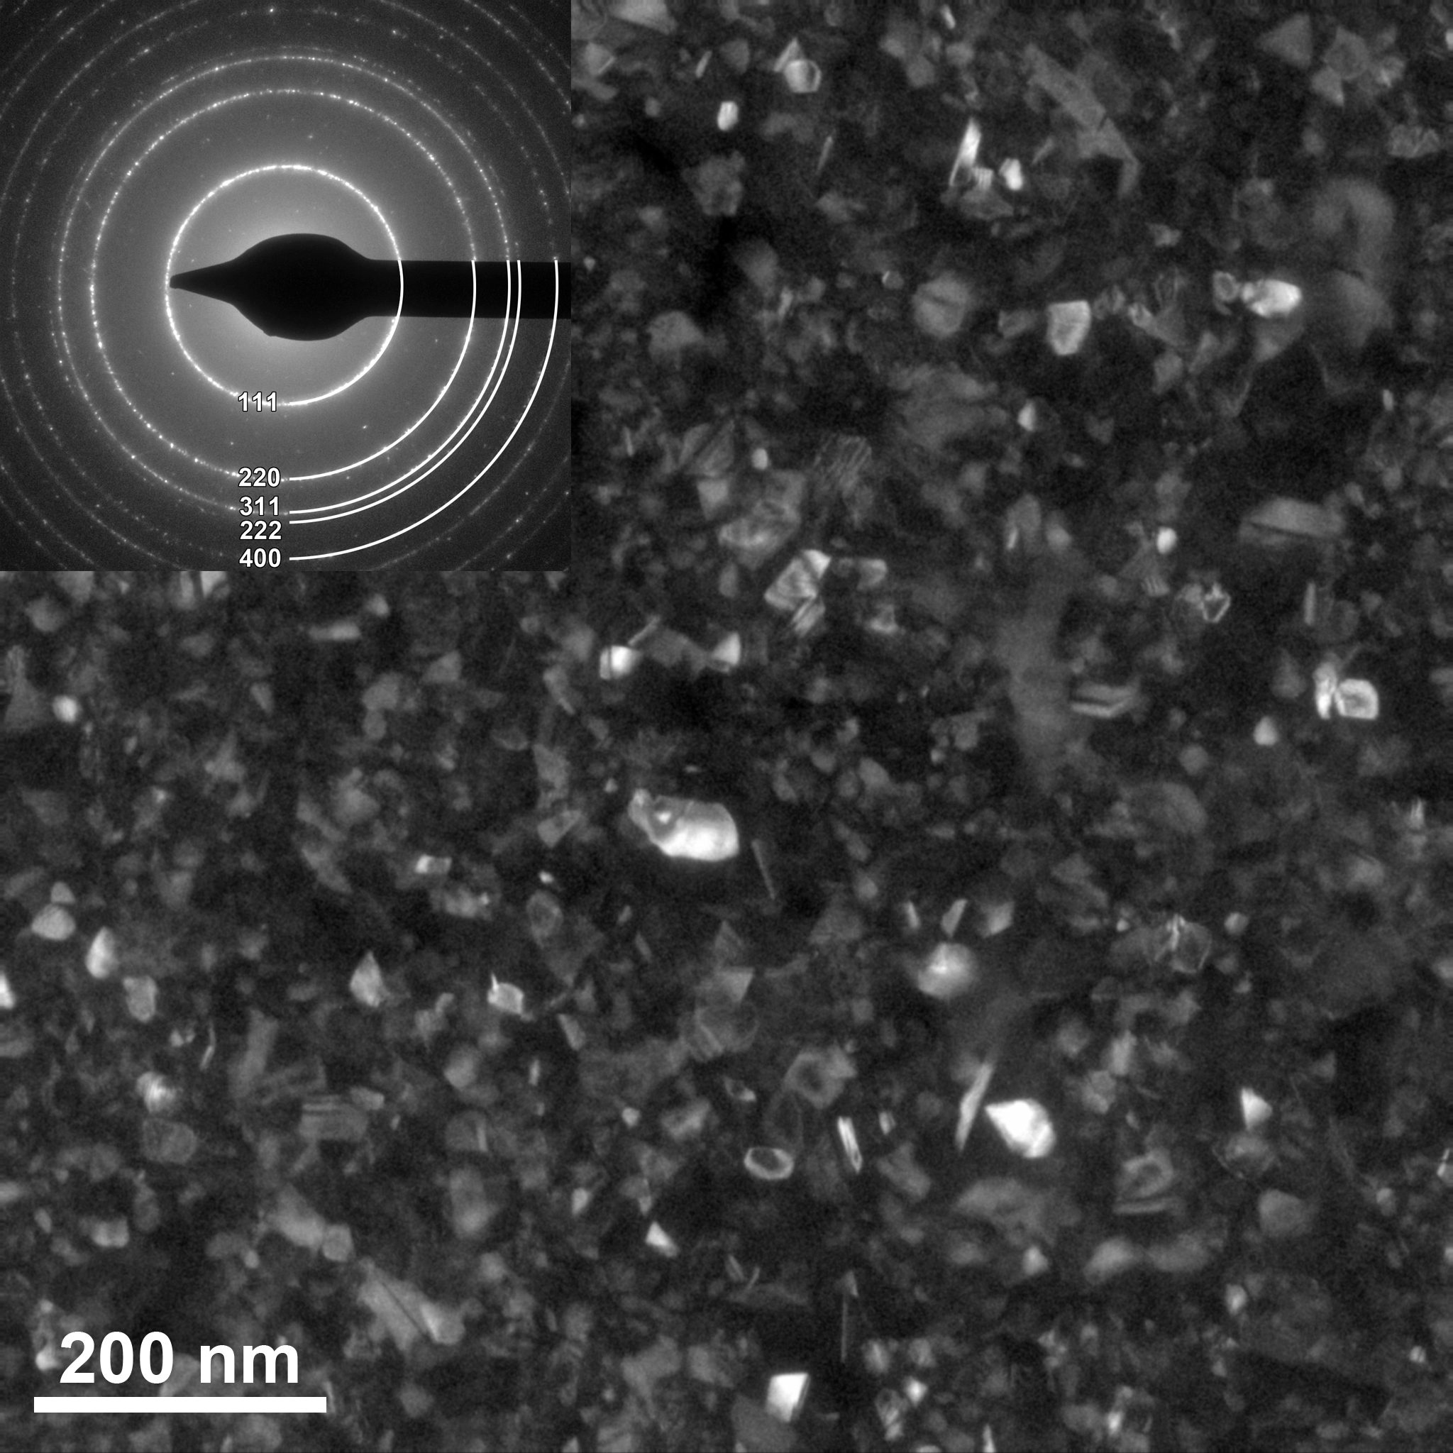
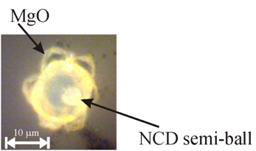
Static pressure above 6 Mbar
GSECARS
NCD micro-balls produced from glassy carbon
Dubrovinsky et al, Nature communication, December 2012
Notes:
One of the break through research

Slide 11
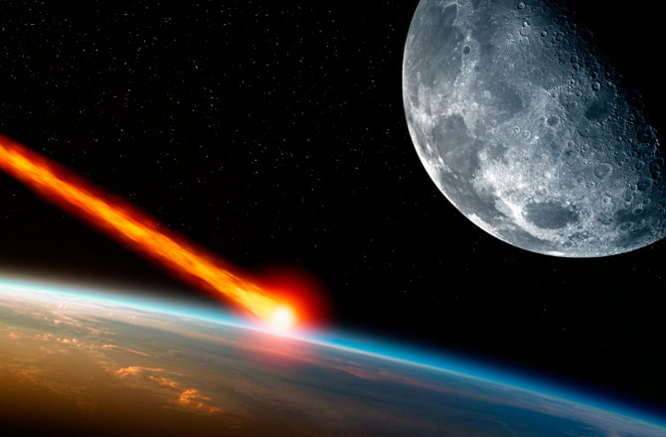
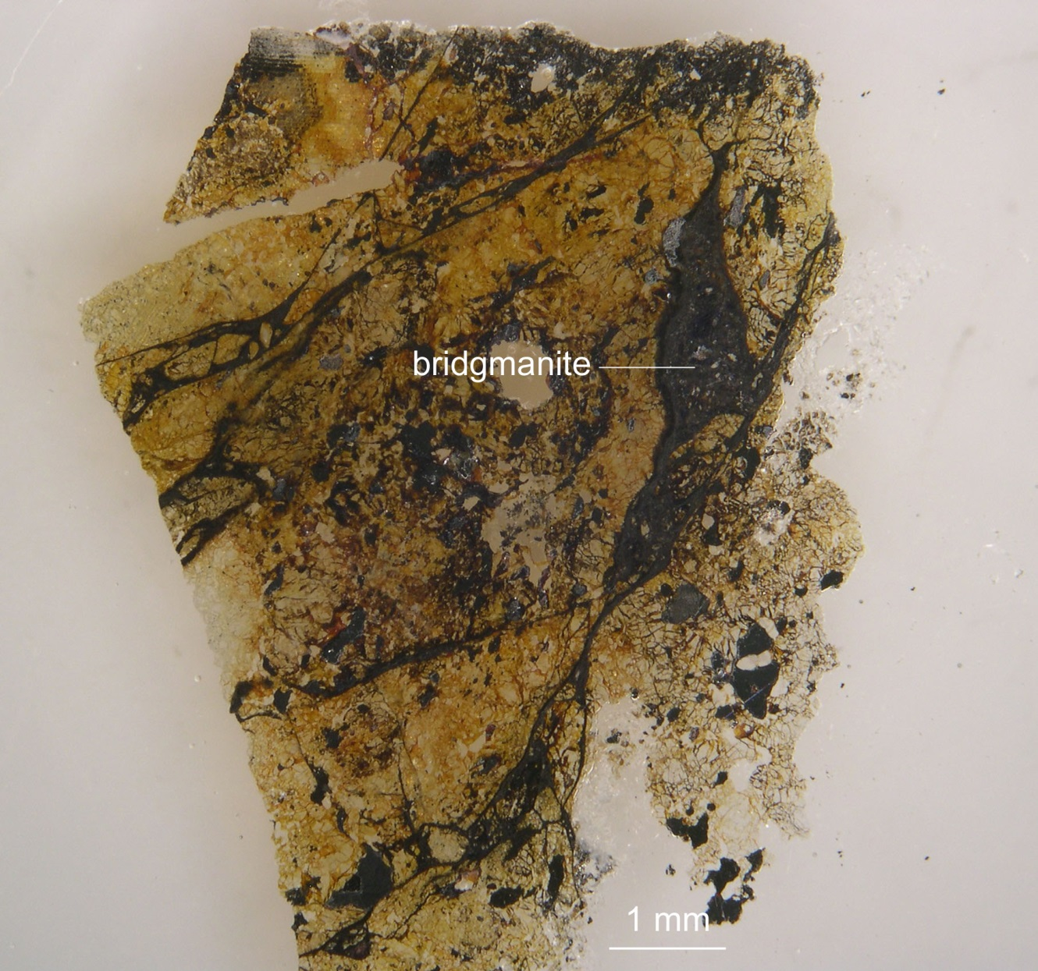
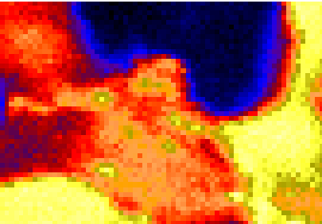

Discovery of bridgmanite
the most abundant mineral in Earth, in a shocked meteorite
half century of efforts to find, identify, and characterize a natural specimen of this important mineral
38% of the Earth’s mantle is (Mg,Fe)SiO3 in a dense perovskite structure, stable below 660 km depth at pressures of above 23 GPa, it has never been found in a terrestrial rock
Combination of XRD and microprobe
The shock melt veins
This first natural specimen of bridgmanite contains an unexpected high amount of ferric iron and much more sodium than most synthetic samples.
Vortex-ME4
The examined portion of the Tenham meteorite revealed diffraction by bridgmanite, akimotoite, and ringwoodite in relative volume proportions of 11%, 16%, and 74%.
Scanning electron microscope image of a bridgmanite-akimotoite aggregate
O. Tschauner et al. Science, 2014; 346 (6213)
Notes:
Meteorites exposed to high pressures and temperatures during impact-induced shock often contain minerals whose occurrence and stability normally confine them to the deeper portions of Earth’s mantle. One exception has been MgSiO₃ in the perovskite structure, which is the most abundant solid phase in Earth. Here we report the discovery of this important phase as a mineral in the Tenham L6 chondrite and approved by the International Mineralogical Association (specimen IMA 2014-017). MgSiO₃-perovskite is now called bridgmanite. The associated phase assemblage constrains peak shock conditions to ~ 24 gigapascals and 2300 kelvin. The discovery concludes a half century of efforts to find, identify, and characterize a natural specimen of this important mineral.
A mineral name for mantle perovskite
A rock from outer space finally puts a name to Earth's most abundant mineral, frequently referred to as perovskite. Mineral names are only bestowed on specimens that are found in nature and characterized. Tschauner et al. isolate a magnesium silicate in the perovskite structure, now called bridgmanite, in the Tenham L6 chondrite meteorite (see the Perspective by Sharp). Bridgmanite formed in this meteorite during a high-pressure and -temperature shock event. Other minerals associated with bridgmanite allow the pressure-temperature conditions to be narrowly bound, giving insight into the shock process. The long-sought-after specimen finally puts to rest a confusing nomenclature of this dense deep mantle silicate.

Slide 12
Magnesium peroxide
Tetragonal MgO₂ (SG: I4/mcm) may be present together or instead of MgO in rocky mantles and rocky planetary cores under highly oxidized conditions.
Lobanov S. et al, Scientific Reports 5, 13582 (2015)
Notes:
Rocky planets are thought to comprise compounds of Mg and O as these are among the most abundant elements, but knowledge of their stable phases may be incomplete. MgO is known to be remarkably stable to very high pressure and chemically inert under reduced condition of the Earth’s lower mantle. However, in exoplanets oxygen may be a more abundant constituent. Here, using synchrotron x-ray diffraction in laser-heated diamond anvil cells, we show that MgO and oxygen react at pressures above 96 GPa and T = 2150 K with the formation of I4/mcm MgO₂. Raman spectroscopy detects the presence of a peroxide ion (O₂²⁻) in the synthesized material as well as in the recovered specimen. Likewise, energy-dispersive x-ray spectroscopy confirms that the recovered sample has higher oxygen content than pure MgO. Our finding suggests that MgO₂ may be present together or instead of MgO in rocky mantles and rocky planetary cores under highly oxidized conditions.

Slide 13
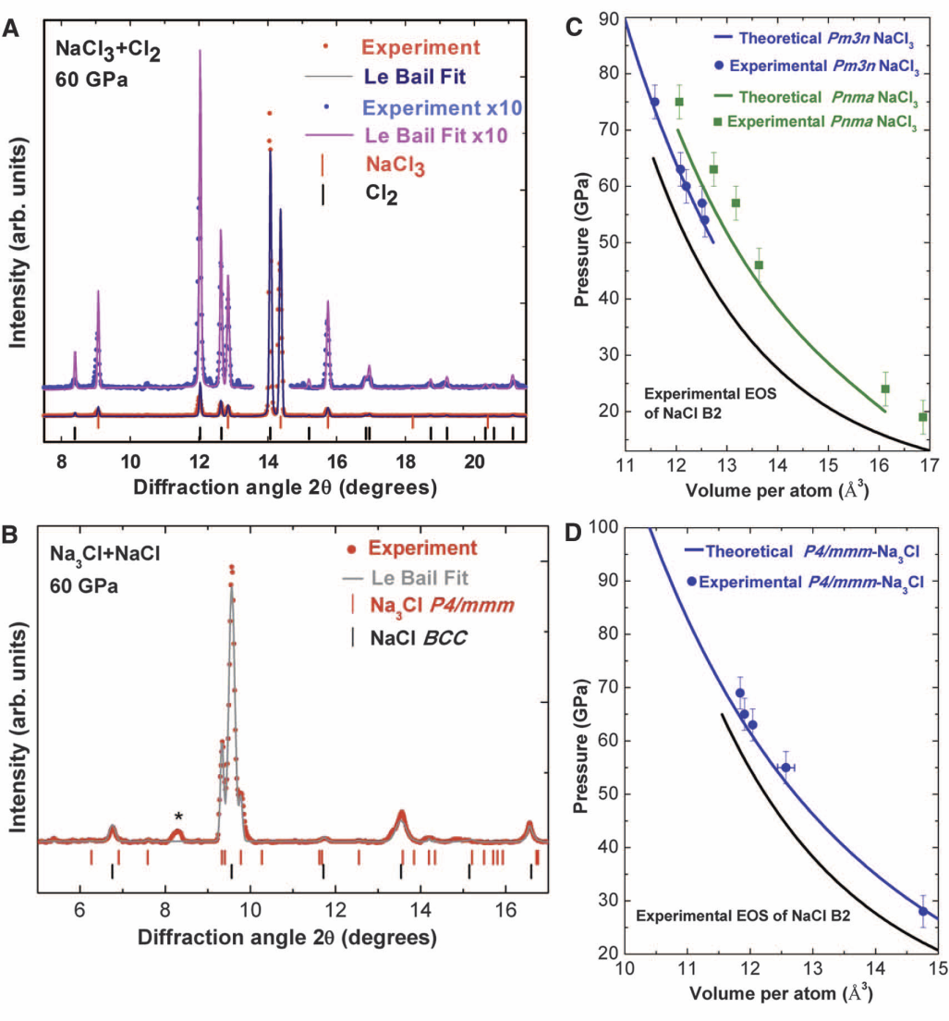
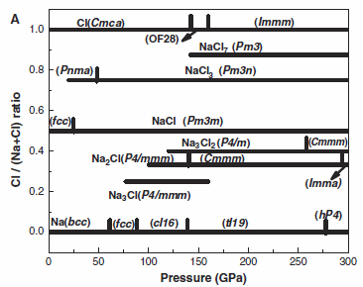
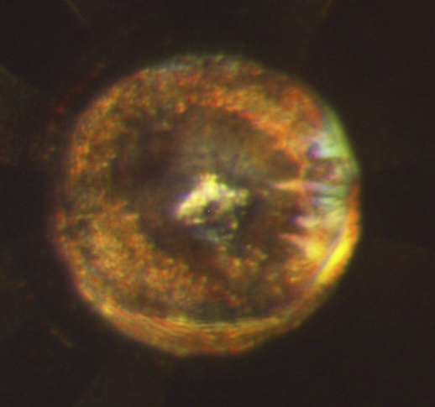
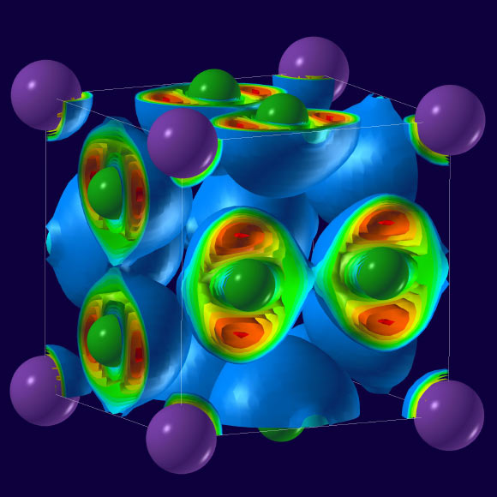
Unexpected Stoichiometry of Sodium Chloride
Semiconducting Na₃Cl and metallic NaCl₃
The calculated phase diagram features unexpected compounds:
NaCl₃, stable above 20 GPa;
NaCl₇, stable above 142 GPa;
Na₃Cl₂, Na₂Cl, and Na₃Cl,
stable above 120 GPa, 100 GPa, and 77 GPa
NaCl3. Image credit: A. Oganov.
Na₃Cl is comprised of layers of NaCl and layers of pure sodium. The NaCl layers act as insulators; the pure sodium layers conduct electricity forming a system with two-dimensional electrical conductivity.
Weiwei Zhang et al, Science, vol. 342, pp. 1502-1505, 2013
Notes:
We know from school chemistry that for many classes of compounds a simple charge balance rule applies to all stable compounds. In ionic compounds Cl atoms have formal charge of -1, and sodium has +1, hence the only possible compound is NaCl. This rules out, for example, NaCl₂. And NaCl₅ and Na₂Cl₃ should be impossible, too.

Slide 14
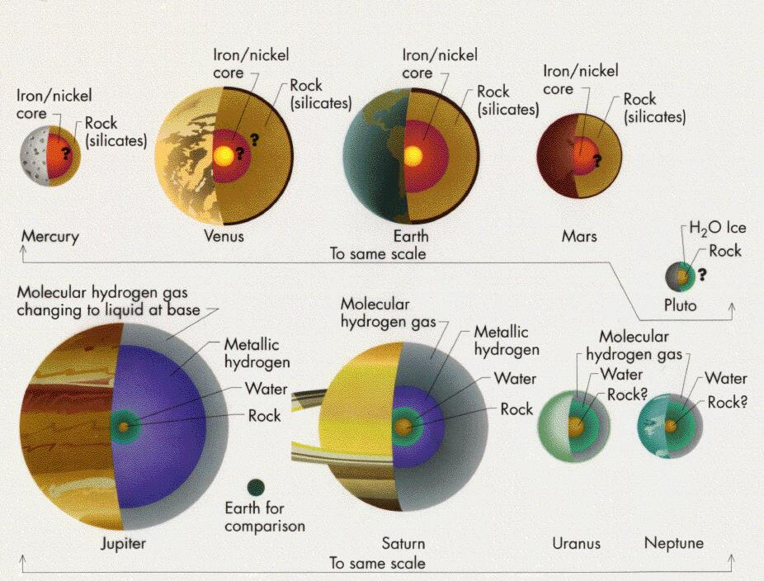
Nature of the Deep Earth and Giant Planets
360 GPa
5,500 K
580 GPa
6,500 K
800 GPa
7,400 K
2,250 GPa
15,500 K
4,500 GPa
36,000 K
Knowledge of material properties (EOS, phase equilibria, etc) probed in-situ at P-T conditions relevant to planetary interiors are required to understand Earth and giant planet formation, evolution and structure.
Modified after http://www2.astro.psu.edu/users/niel/astro1/slideshows/class39/slides-39.html
Notes:
Taking into account very rich high P-T phase diagram and … To understand nature… we have to study in-situ..

Slide 15
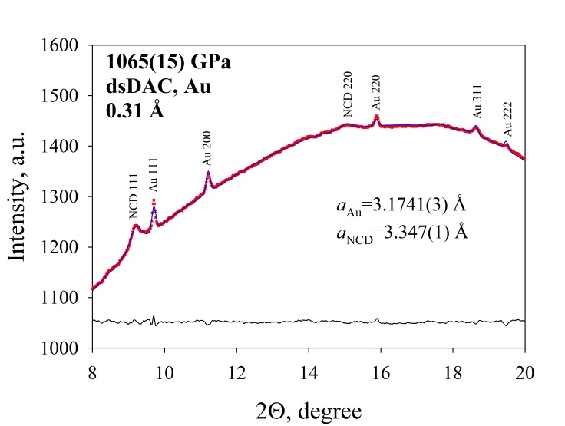
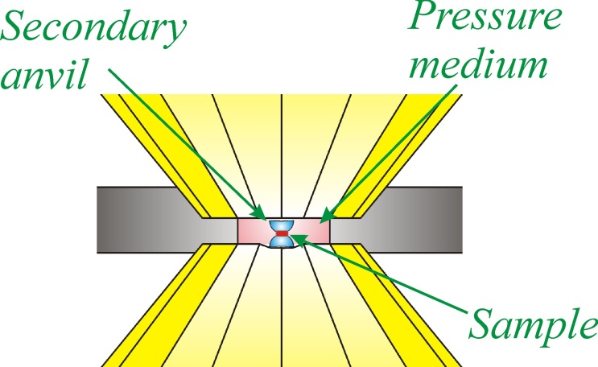
DAC Future Science Program and MBA upgrade
Pushing the limits of ultra-high pressure and temperature experiments to beyond 1 TPa
Ultra-high temperature with pulse laser heating, static and dynamic experiments
1.594 µs
High P-T
T=3.672 µs
Synchrotron
hybrid fill
CdTe
500 ns, 86 mA
Laser pulse
KB mirror upgrade (µfocus) + Laue monochromator (high energy)
Complexity of high pressure melting covering the TPa range
Light element partitioning between molten iron alloys and silicates
Phase diagram of hydrogen compounds
Water in the deep mantle
Synthesis of novel deep Earth materials
Density and structure of silicate liquids and glass
MBA: tightly focused (100-200nm), high brilliance, high energy x-ray beam – natural requirements for sophisticated DAC experiments
Notes:
We anticipate that one of the future directions will be most challenging but exciting studies related to the ultra high P-T, as I have mentioned at GSECARS we have established new double stage anvils techniques that allows us generate several Mbar pressure, just recently we was be able to ..

Slide 16

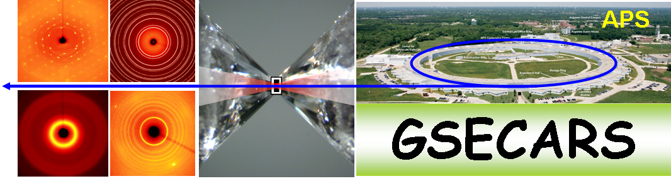

Complex Characterization of Materials at Extreme Conditions with Advanced Combination of Synchrotron and Optical Techniques
>600 GPa
>6,000K
3-4 µm
Laser
heating
4.8 – 80 keV
X-ray diffraction
X-ray total scattering
X-ray absorption spectroscopy
X-ray emission spectroscopy
X-ray inelastic scattering
X-ray radiography
X-ray microprobe
High pressure/temperature experiment
Conditions?
Optical spectroscopy → temperature, pressure
High pressure chemistry
Hydrogen, oxygen, dissociation?
Raman spectroscopy → low Z element
High pressures physics
Dielectric, metal?
Optical absorption → band gap
Equation of state and phase transition
Elastic properties, pressure scale?
Brillouin spectroscopy → self consistent EOS
Optics

Slide 17
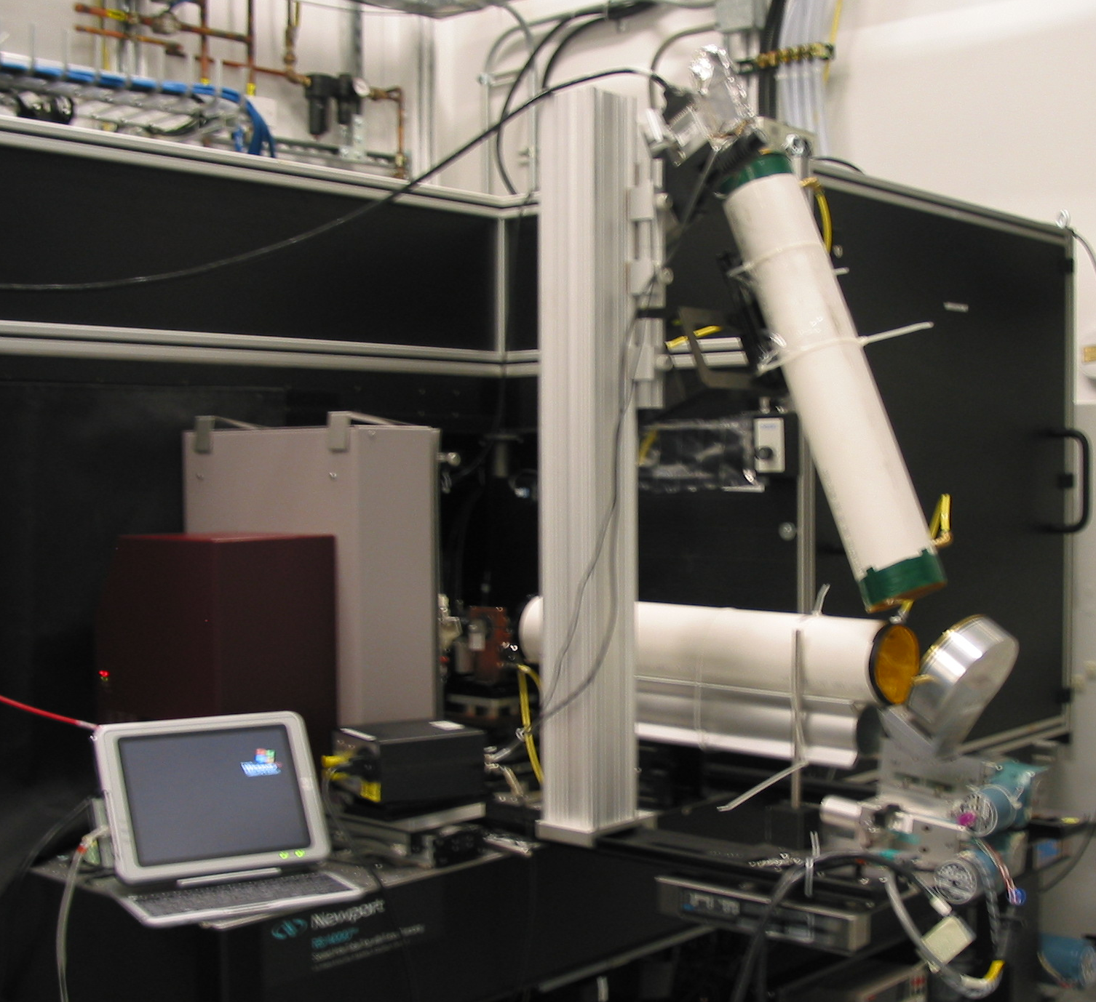
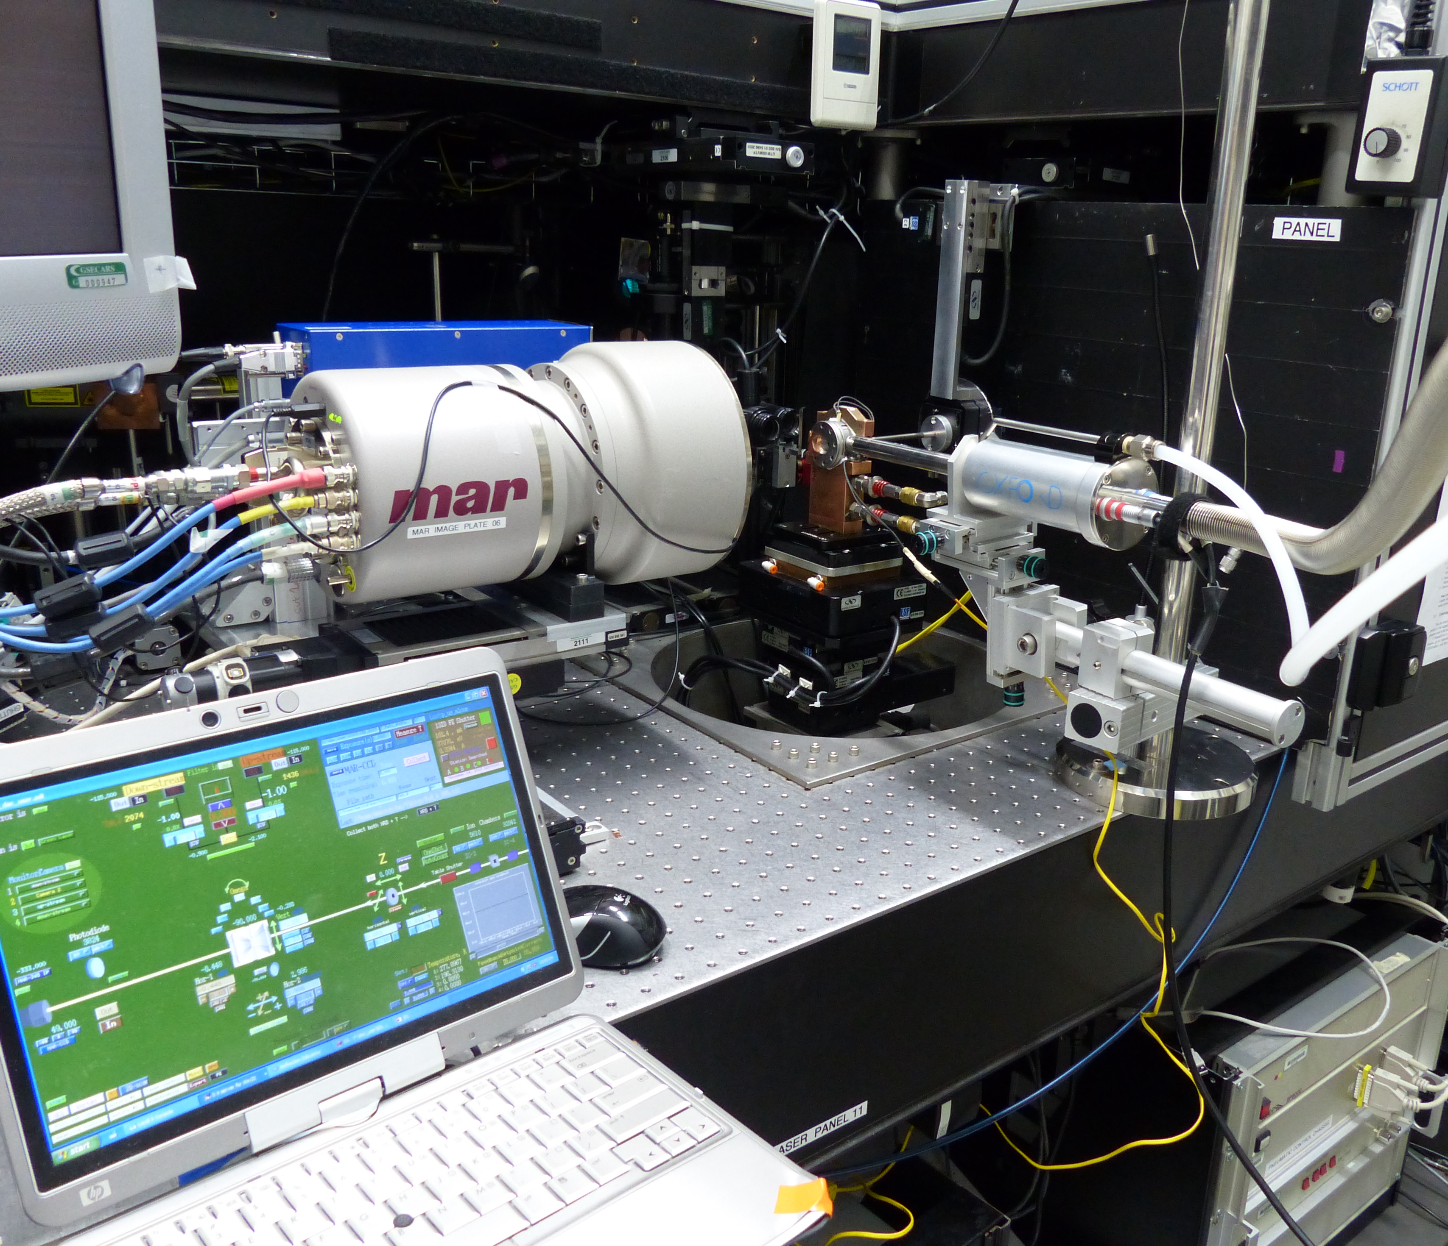
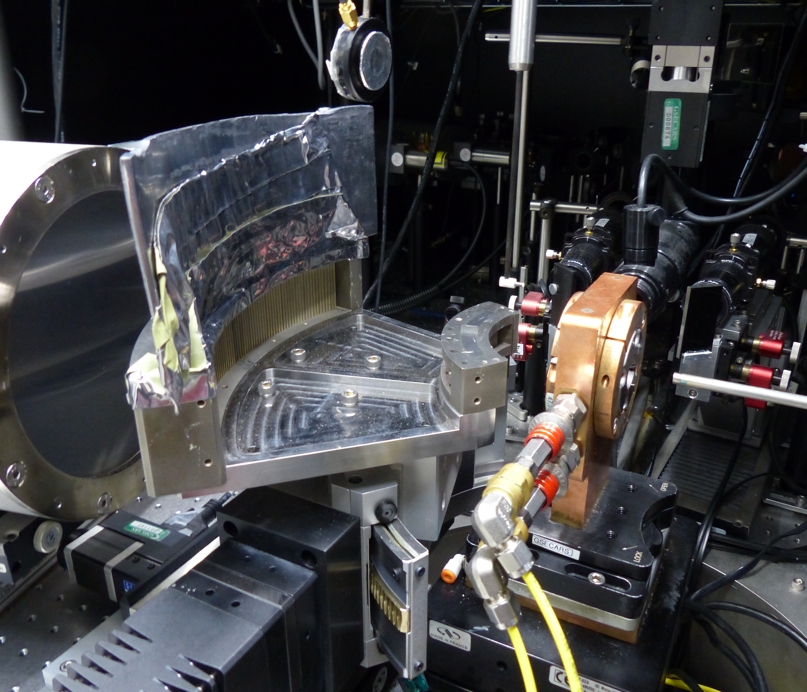
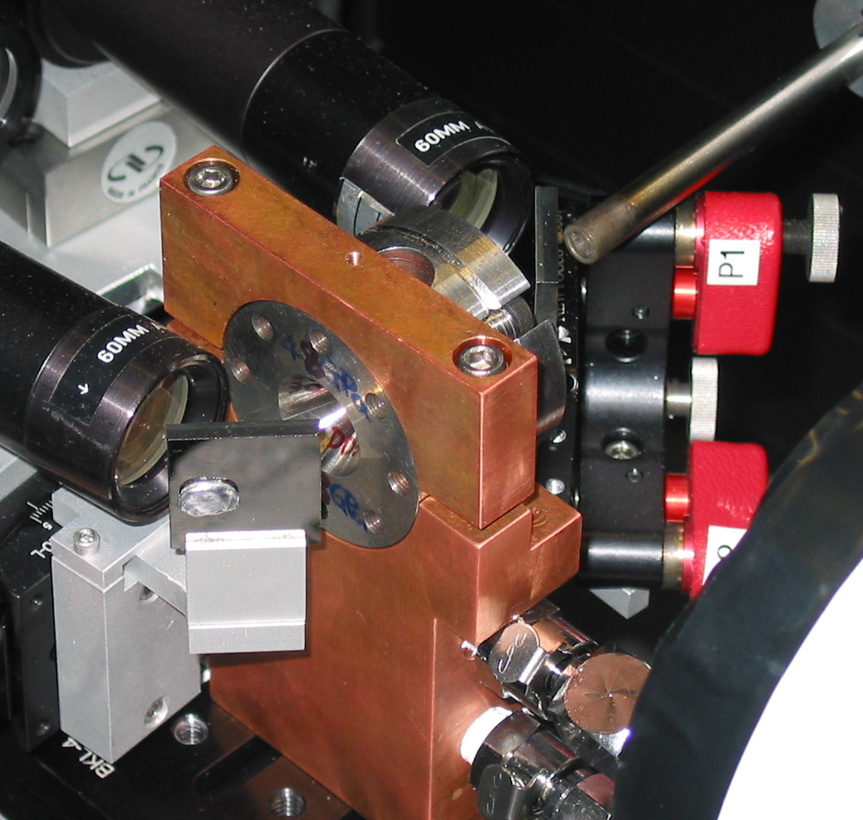
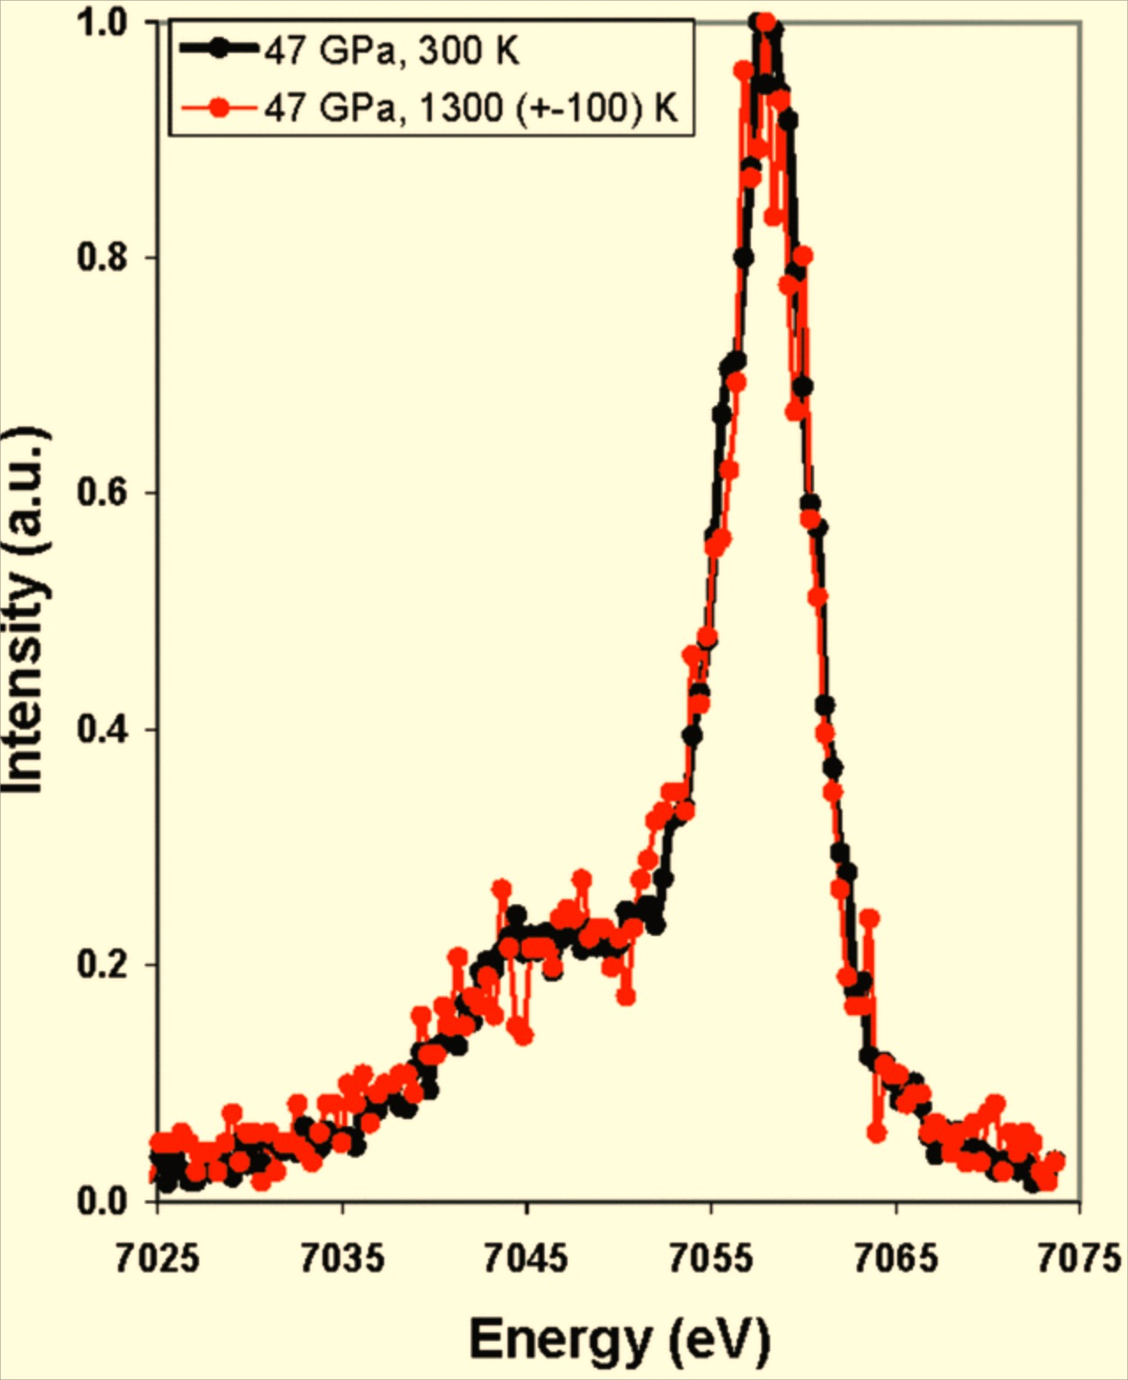
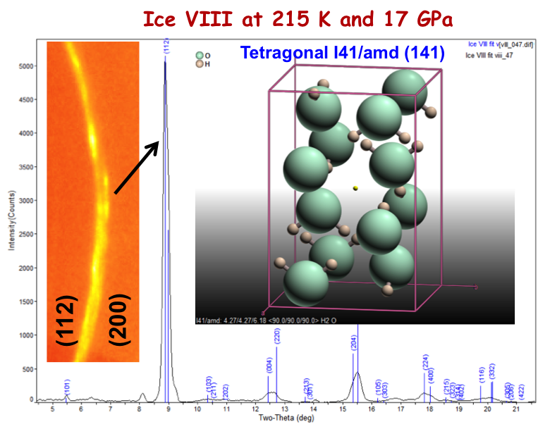
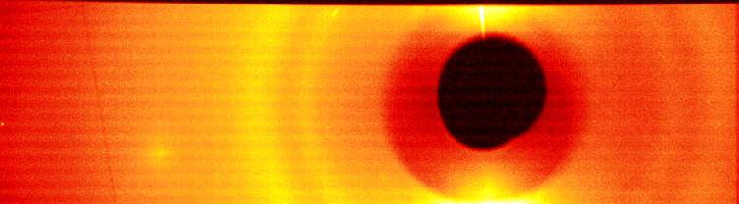
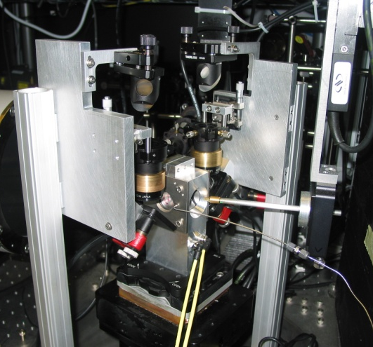
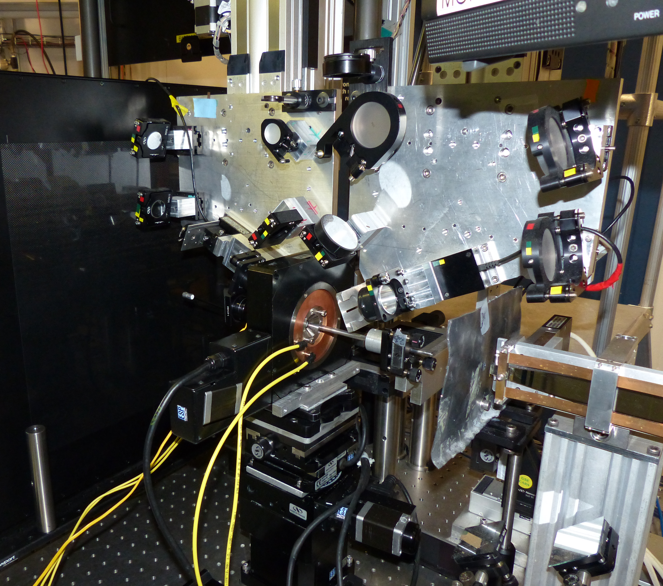
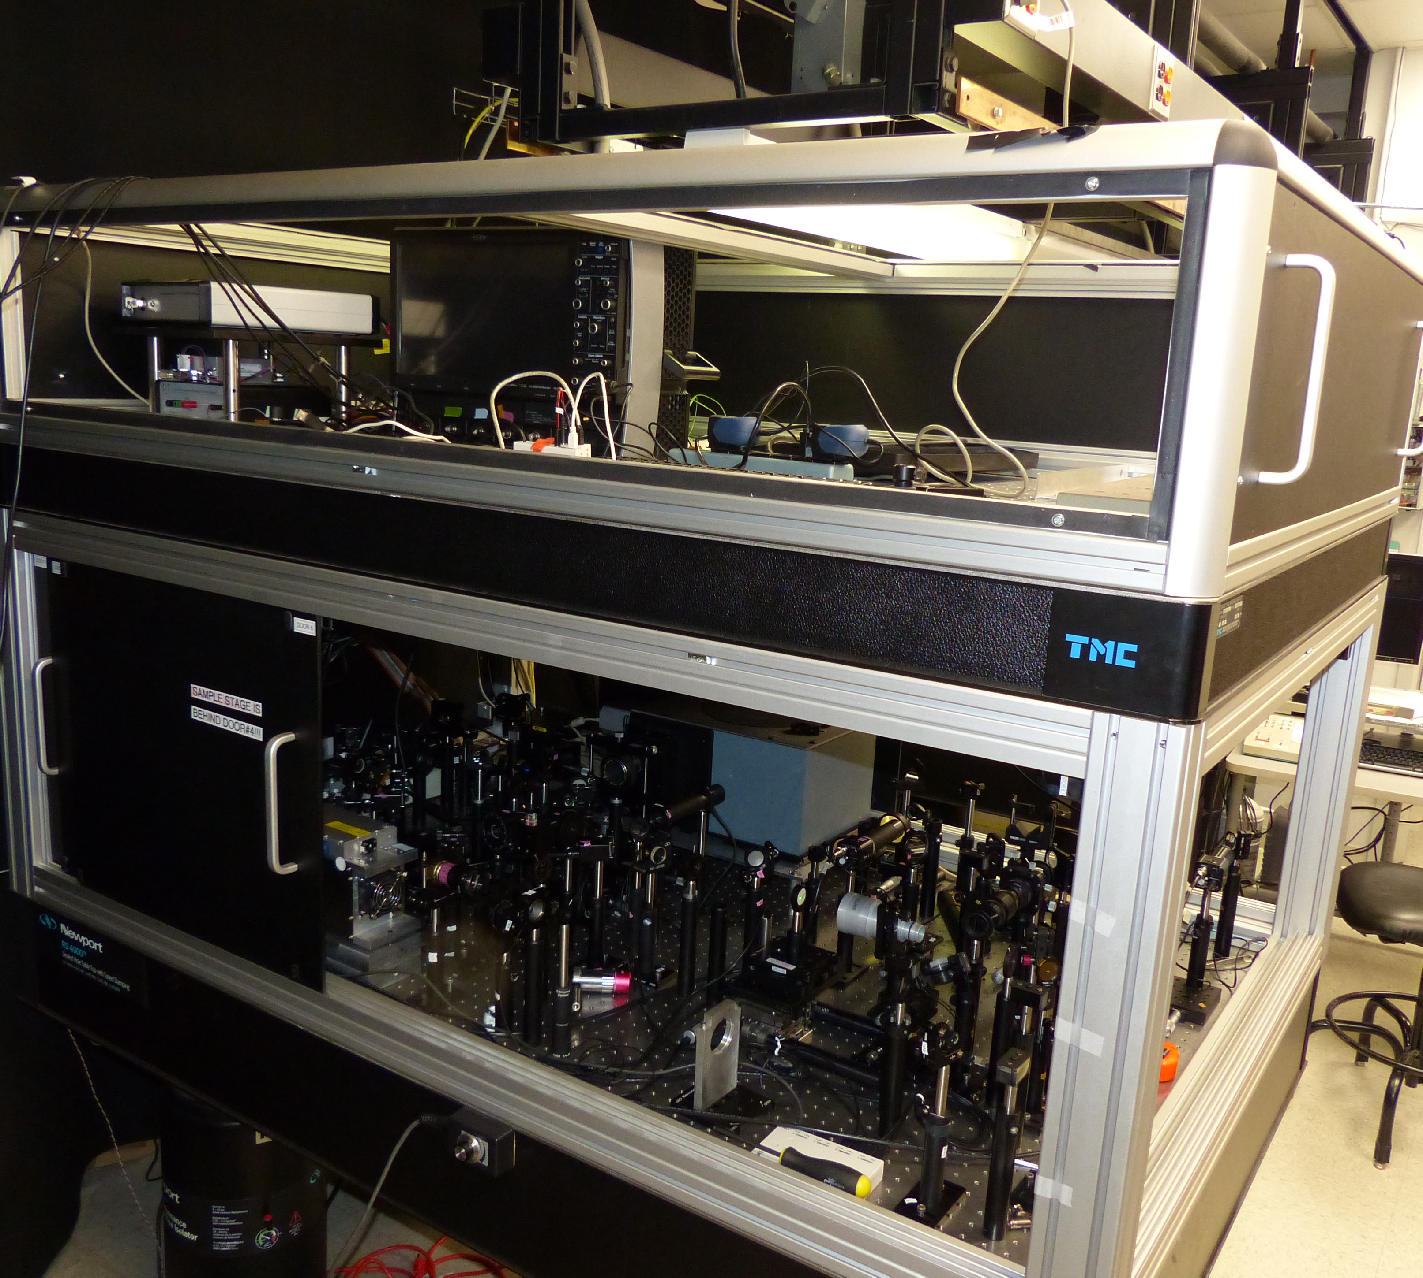
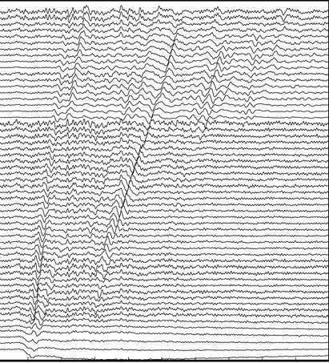
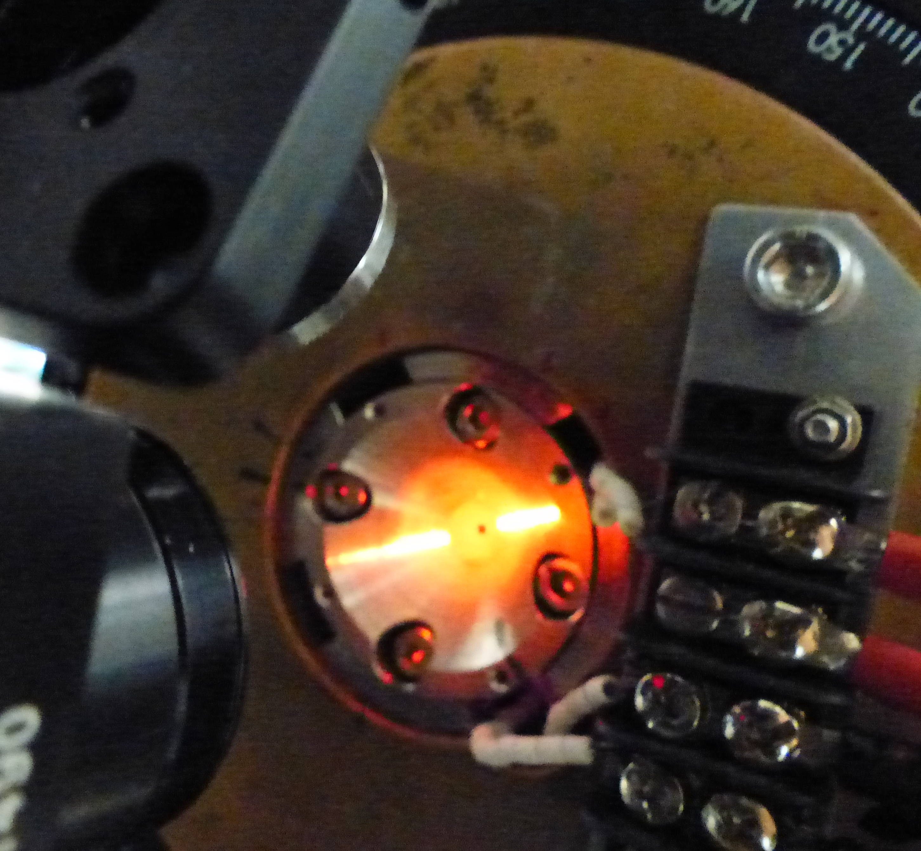



Unique techniques available only at GSECARS
High T XES & XRD
Low T (115 K) XRD
Multichannel Collimator
150 GPa
Radial XRD & LH
Brillouin spectroscopy
Laser ultrasonic with LH
Notes:
There are a number of advanced techniques for sample analysis and some of the them available only at GSCEARS. In situ radial X-ray diffraction combined with LH to study of pressure induced texture and stress vs T

Slide 18








Supporting equipment
Gas-loading system
Cryogenic loading
Raman system
Preparation lab
Laser heating/cutting
Micro-manipulator
Notes:
Significant infrastructure development is required to maintain DAC program

